Slide 1
Training Module 9
The role of the teacher

Slide 2
Introduction to the CEYS project
(use dependent on context)
European Erasmus+ project
Partners in Belgium, Greece, Romania, UK
Continuation of the Creative Little Scientists project http://www.creative-little-scientists.eu
Aims
  Development of a teacher development course and accompanying materials
  Promotion of the use of creative approaches in teaching science in preschool and early primary education (up to age of eight)
Notes:
The Creativity in Early Years Science project is a European Erasmus+ project with partner countries Greece, Romania, Belgium and the UK
As indicated – it aims to develop a European teacher professional development course and accompanying materials to promote the use of creative approaches in teaching science in preschool and early primary education (up to age of eight).
It is a continuation of the project Creative Little Scientists, an FP7 EU project, where curriculum design principles to foster inquiry and creativity in science education were designed.

Slide 3
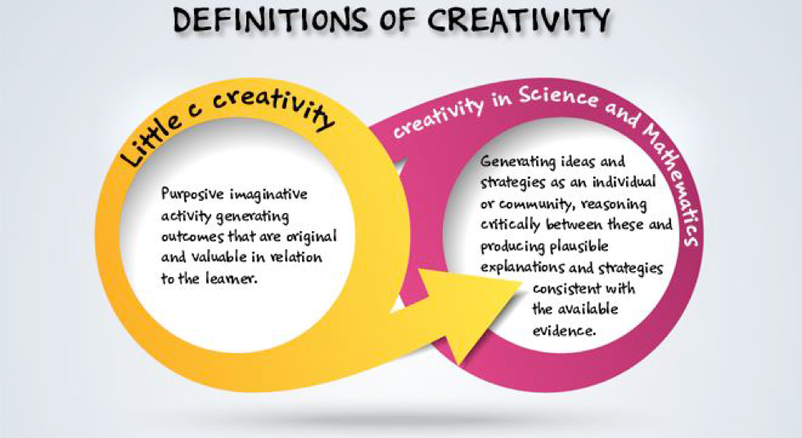
Definition of creativity in early science
Creative Little Scientists (2014)

Slide 4
Features of inquiry and creative dispositions
FEATURES OF INQUIRY | CREATIVE DISPOSITIONS
Questioning Designing or planning investigations Gathering evidence Making connections Explaining evidence Communicating explanations | Sense of initiative Motivation Ability to come up with something new Ability to make connections Imagination Curiosity Ability to work together Thinking skills

Slide 5
Synergies between inquiry-based and creative approaches
SYNERGIES
Play and exploration
Motivation and affect
Dialogue and collaboration
Problem solving and agency
Questioning and curiosity
Reflection and reasoning
Teacher scaffolding and involvement
Assessment for learning

Slide 6
Aims of the module
Introduce participants to sensitive and responsive scaffolding techniques to support independence and extend inquiry as well as foster creativity in science.
Share and discuss the variety of different roles that the teachers can assume during their interactions with children and the extent of fostering children’s agency for each of these roles.
Identify and discuss challenges involved in balancing intervention and collaboration with children.
Share strategies on creating and maintaining a learning environment that increases opportunities to foster children’s agency.

Slide 7
Links to Content Design
Principles and Outcomes 1
1. Teacher education should provide content knowledge about science and mathematics, including interesting and current topics, to be used in activities linked with everyday life.
  1.2 Teachers should be able to make children aware of connections between science and mathematics learning and their everyday lives, in order to engage their motivation, interest and enjoyment in science and mathematics and foster curiosity and creativity.
Notes:
These are for information for the facilitator to be shared with participants as appropriate.

Slide 8
Links to Content Design Principles and Outcomes 2
7. Teacher education should familiarise teachers with a range of formal and informal inquiry- and creativity-based learning, teaching and assessment approaches and strategies and their use in relation to authentic problems within the areas of science and mathematics.
  7.7 Teachers should be able to assume a variety of roles in their interactions with the children e.g. allower, leader, afforder, coordinator, supporter, tutor, motivator and facilitator, to support children’s creativity and inquiry in science and mathematics.
  7.8 Teacher should be able to use a variety of scaffolding techniques to promote creativity in science and mathematics, from standing back in order to observe, listen and build from the children’s interests, to intervening with appropriate questioning to support and extend inquiries.

Slide 9
Links to Content Design Principles and Outcomes 3
11. Teacher education should enable teachers to use questioning effectively and encourage children’s questions in order to foster creativity and inquiry.
  11.1 Teacher should be able to use different forms of questioning at appropriate points to scaffold creative learning outcomes in science and mathematics, and in particular to encourage children’s reflections and explanations, foster their independence and extend their inquiry.
  11.2 Teachers should value and be able to build on the potential of children’s own questions to foster their curiosity in science and mathematics, and support their generation and follow up, including those that are investigable.

Slide 10
Rationale for the module
Why is teacher scaffolding important?
Fosters children’s independence as inquirers and problem-solvers, their creativity as possibility thinkers, as well as their conceptual knowledge and meta-cognitive strategies.
Provides children with shared, meaningful, physical experiences and opportunities to develop their own questions and ideas about scientifically relevant concepts.
Reflects the importance of teachers mediating learning to meet children’s diverse needs.
Plays a fundamental role in making links between everyday concepts gained through playful interaction and more formal scientific concepts.
Teachers, who prioritise stopping, observing, listening and noticing the nature of children’s engagement, support children’s agency and decision-making – utilising time and space available to explore and experiment.

Slide 11
Module outline
Sharing your experiences of roles you take on as teachers (successful instances and challenges).
Discussion of classroom examples – the level of children’s agency in their learning and the role of the teacher.
Implications for planning learning activities in terms of learning environment and varied roles of the teacher.
Reflections on the module.

Slide 12
Sharing experiences of different roles (as teachers)
Work in groups of 4/5
What are the different roles you take in the science classroom to foster inquiry and creativity? Provide some examples.
Have there been instances when your choice of role was unsuccessful? What were those? Provide some examples.
As an individual - Write down answers to these questions on separate post its and place on the sheet on the table.
As a group – See if you can sort these – Any common themes or differences?
Feedback to the whole group.
In what ways did your different roles support features of inquiry and creative dispositions?

Slide 13
Sharing experiences of different roles (as teachers) - SUMMARY
DIFFERENT ROLES I take in the science classroom | INSTANCES | SUCCESSFUL OR UNSUCCESSFUL?

Slide 14
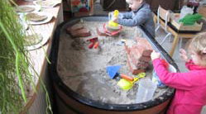
Discussion of classroom examples
SandBox:
Children age 3
Materials in the sand corner, including real bricks, tools

Slide 15
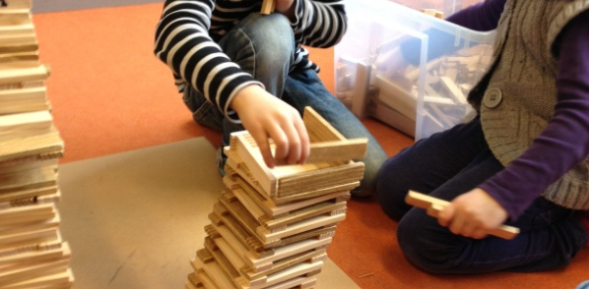
Discussion of classroom examples
Building blocks: Children age 5
Building the Tower of Pisa
Notes:
Inspired by photographs of real buildings on the wall, the children decided to build the “Leaning Tower of Pisa” using wooden building blocks. The teacher stood back and let the children take the lead. She encouraged the children to express themselves clearly and she valued their ideas.

Slide 16
Discussion of classroom examples
Habitat:
Children ages 6-7
Exploring how the colour of some animals enables them to be camouflaged in their habitat

Slide 17
Discussion of classroom examples
Gloop:
Children ages 4-5
Getting an awareness of texture, motor skills necessary for writing, pattern making…

Slide 18
Discussion of classroom examples 1
Work in groups of 4
4 classroom examples each group
Divide into 2 sub groups - A and B
(2 people in Group A and 2 people in group B)
Focus on:
Group A : agency and children’s learning
Group B : the role of the teacher
After 10 minutes groups A & B swap examples!

Slide 19
Discussion of classroom examples 2
Group A:
To what extent is the agency of the children fostered in the examples given?
Try to give a number from 0 to 5, where 5 = ‘agency is highly fostered’, 0 = ‘agency is not fostered’.
Please explain the basis for your evaluation.
Group B:
Describe in detail the role of the teacher in the different examples.
Focus on interactions with the children; questions used; explanations given; different materials used, etc.

Slide 20
Discussion of classroom examples SUMMARY
NAME of the classroom example | Degree of agency in children’s learning (0-5) | Description of the role of the teacher
GLOOP
SANDBOX
HABITAT
BUILDING BLOCKS

Slide 21
Reflection on classroom examples
Whole group
What is the role of the teacher when the degree of child agency = 5?
What are children learning and to what extent are they learning when the degree of child agency = 5?
In the example in which the degree of children’s agency is lowest, what is the role of the teacher in this example, and what are children learning?
Is it possible to increase opportunities for children’s agency in this example? What could be changed?
What about the learning environment in the different examples?
Is there any link between high agency and the learning environment?

Slide 22
How might different roles foster creativity in learning?
FEATURES OF INQUIRY | CREATIVE DISPOSITIONS
Questioning Designing or planning investigations Gathering evidence Making connections Explaining evidence Communicating explanations | Sense of initiative Motivation Ability to come up with something new Ability to make connections Imagination Curiosity Ability to work together Thinking skills

Slide 23
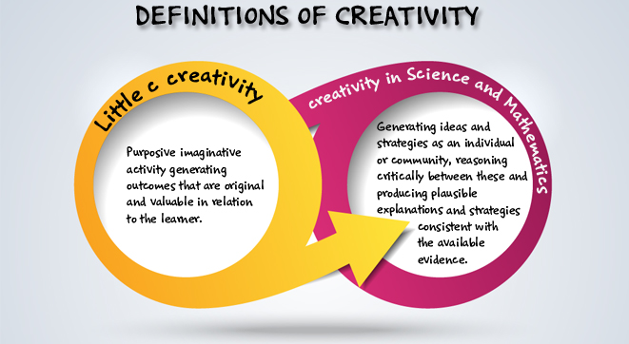
Creativity in early science and mathematics
Creative Little Scientists (2014)

Slide 24
Varied roles over time
Essential features of classroom inquiry and their variations (Barrow, 2010, p. 3)
Essential features | Variations
Learner engages in scientifically orientated questions | Learner poses a question | Learner selects among questions, poses new questions | Learner sharpens or clarifies question provided by teacher, materials or source | Learner engages in question provided by teacher, materials and source
Learner gives priority to evidence in responding to questions | Learner determines what constitutes evidence and collects it | Learner directed to collect certain data | Learner given data and asked to analyse | Learner given data and told how to analyse
Learner formulates explanations from evidence | Learner formulates explanations after summarising evidence | Learner guided in process of formulating explanations from evidence | Learner given possible ways to use evidence to formulate explanation | Learner provided with evidence
Learner connects explanations to scientific knowledge | Learner independently examines other resources and forms links to explanations | Learner directed toward areas and sources of scientific knowledge | Learner given possible connections
Learner communicates and justifies explanations | Learner forms reasonable and logical argument to communicate explanations | Learner coached in development of communication | Learner provided broad guidelines to sharpen communication | Learner gives steps and procedures to communication
More…….................................................................Amount of Learner Self-Direction…….......................................................................Less
Less……...........................................................Amount of Direction from Teacher Material…….............................................................More

Slide 25
Different roles of the teacher
Allower
Leader
Afforder
Coordinator
Supporter
Tutor
Motivator
Facilitator
(Hyvönen, 2008)
Learner
Follower
Observer
Listener
Co-player
‘Meddler in the middle’
(McWilliam, 2008)
Provocateur
(Bancroft et al.,2008 and Craft et al.,2012)

Slide 26
Scaffolding techniques
Delaying instruction until the learner has had a chance to investigate and inquire on their own or with others to promote innovation and discovery.
Stopping and closely observing children, enabling them to make decisions, utilising the time and space available to explore and experiment.
Varied levels of intervention and collaboration - professional restraint, stepping back, ‘Meddling in the middle’.
Modelling through talk and actions for example, attitudes such as curiosity, willingness to make mistakes or inquiry processes such as questioning, reflecting on observations and ideas.
Questioning – encouraging children to make explicit and reflect on their ideas and strategies.
Structuring learning environment – range of resources, space and time for play and exploration, supporting collaboration.

Slide 27
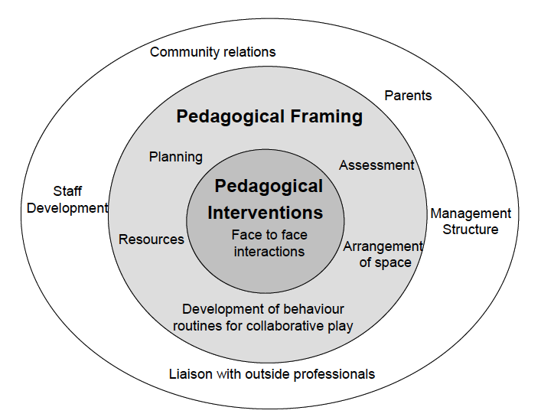
Sharing responses
Implications for planning?
(linked to Pedagogical Model from Siraj-Blatchford et al. 2002)

Slide 28
Take-Home Messages
Different roles of the teacher influence children’s agency and learning differently.
Balancing intervention and collaboration with children can lead to fostering creativity.
Creating and maintaining a learning environment that increases opportunities to foster children’s agency is crucial.
Varied scaffolding techniques provide greater opportunities for children’s agency, creativity and inquiry-based learning.

Slide 29
Reflections
Look back at your original post its as a group – anything you might add? Add in any additional comments or issues in another colour (pen/post it).
In what ways did the different activities in this module help you rethink your role as teacher in the early years science classroom?
In what ways did they help you to reflect on ways of promoting creativity in early years science education?
What impact do you expect this module to have on your future activities?
How far have the aims of the module been met?

Slide 30
Further information
Creative Little Scientists
(FP7 EU project 2011 – 2014)
Design principles and exemplar materials based on fieldwork www.creative-little-scientists.eu
Creativity in Early Years Science Education
(Erasmus+ EU project 2014 – 2017)
Curriculum Materials and Training Materials for teacher CPD to promote creative approaches to early years science www.ceys‐project.eu

Slide 31

THANK YOU!

Slide 32
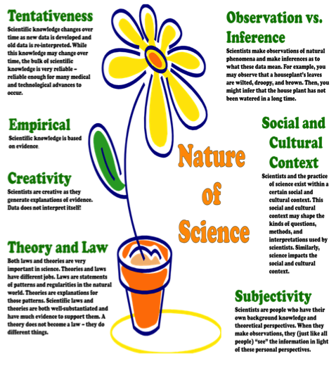
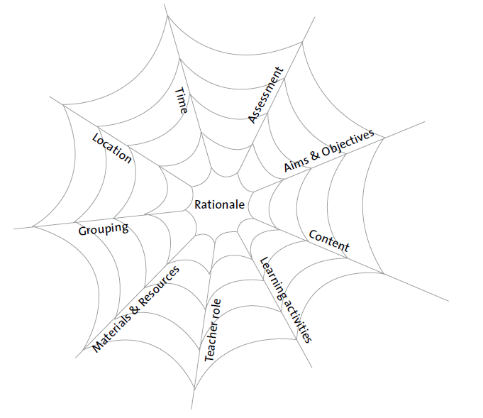
Assessment
Strategy
Formative
Self assessment
Peer assessment
Ongoing
Summative
Focus on product or process
CLS conceptual framework
Adopted by the CEYS project
Synergies
Play and exploration
Motivation and affect
Dialogue and collaboration
Problem solving and agency
Questioning and curiosity
Reflection and reasoning
Teacher scaffolding and involvement
Assessment for learning
Creative Dispositions
Sense of initiative
Motivation
Ability to come up with something new
Ability to make connections
Imagination
Curiosity
Ability to work together
Thinking skills
Learning activities/Features of inquiry
questioning
designing or planning investigations
gathering evidence
making connections
explaining evidence
communicating explanations
Notes:
This sets out key features of the CLS conceptual framework adopted by the CEYS project – it provides a useful reference point.
Facilitators will need to decide when best to use this dependent on audience.
It can be useful, particularly on a longer course for participants to have this as a handout for reference during a session.

Slide 33

Acknowledgements
Creativity in Early Years Science EDUCATION (2014-2017) www.ceys-project.eu
© 2017 CREATIVITY IN EARLY YEARS SCIENCE EDUCATION Consortium
This work is licensed under the Creative Commons Attribution-NonCommercial-NoDerivatives 4.0 International License. To view a copy of this license, visit http://creativecommons.org/licenses/by-nc-nd/4.0/.

