Slide 1
Training Module 8
Varied modes of expression
and representation

Slide 2
Introduction to the CEYS project
(use dependent on context)
European Erasmus+ project
Partners in Belgium, Greece, Romania, UK
Continuation of the Creative Little Scientists project http://www.creative-little-scientists.eu
Aims
  Development of a teacher development course and accompanying materials
  Promotion of the use of creative approaches in teaching science in preschool and early primary education (up to age of eight)
Notes:
The Creativity in Early Years Science project is a European Erasmus+ project with partner countries Greece, Romania, Belgium and the UK
As indicated – it aims to develop a European teacher professional development course and accompanying materials to promote the use of creative approaches in teaching science in preschool and early primary education (up to age of eight).
It is a continuation of the project Creative Little Scientists, an FP7 EU project, where curriculum design principles to foster inquiry and creativity in science education were designed.

Slide 3
Aims of the module
Increase awareness of the key roles of expression and representation of ideas in inquiry-based approaches to learning.
Highlight the need for practitioners to introduce and value varied modes of expression and representation in fostering children’s articulation and reflection on their developing ideas and strategies.
Enhance recognition of the importance of children’s expression and representation of ideas as starting points for questioning, discussion and further investigation.
Illustrate ways in which children’s expression and representation in varied ways can provide the basis for assessment (both by children and teachers) to inform future planning.
Consider ways in which the teacher provide varied opportunities to share and represent their ideas at different phases in an investigation and encourage a classroom climate in which children are willing to offer and reflect on ideas.
Highlight ways in which sharing and discussion of ideas can foster creative dispositions in science .

Slide 4
Links to Content Design Principles and Outcomes
9. Teacher education should enable teachers to make best use of and assess the various modes of expression and representation of science learning to support inquiry and the development of creativity.
  9.1 Teachers should be able to recognize and value children’s various forms of expression and representation of their ideas and learning in science and mathematics.
  9.2 Teachers should be able to make best use of children’s preferred forms of expression and representation of their science and mathematics ideas to support inquiry and their creativity development.
  9.3 Teachers should be able to select and use different approaches for and forms of recording children’s ideas and learning in science and mathematics at different stages of the learning process and for various purposes, including to support children’s reflection and reasoning processes.
  9.4 Teachers should be able to use the various modes of children’s expression and representation of science and mathematics ideas (e.g. pictures, graphs, gestures, physical activities) for assessment purposes.

Slide 5
Rationale for the module
Support reflection and reasoning that play key roles in science learning and teaching
Central in scientific inquiry processes – observing, comparing, evaluating evidence, explaining
Offer opportunities for children’s creativity in developing and evaluating their ideas and strategies
Provide a context for peer and self assessment
To do justice to their capabilities - children need opportunities to represent their ideas in different ways

Slide 6
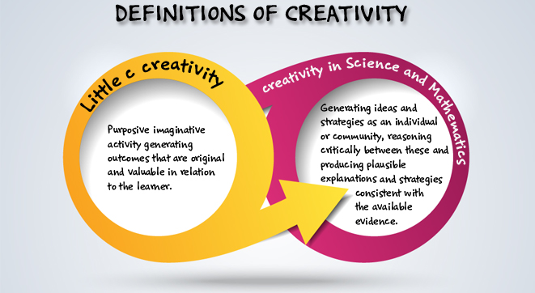
Creativity in early science
Creative Little Scientists (2014)
Notes:
Role of creativity in reflection and reasoning – central in scientific inquiry

Slide 7
Synergies between creative and inquiry based approaches to learning
Play and exploration
Motivation and affect
Dialogue and collaboration
Problem solving and agency
Questioning and curiosity
Reflection and reasoning
Teacher scaffolding and involvement
Assessment for learning
Notes:
Encouraging reflection and reasoning is also one of the key teaching approaches that the project identified as important in fostering children’s creativity and inquiry.
Focusing today on how reflection and reasoning can be supported through young children’s expression in varied ways.

Slide 8
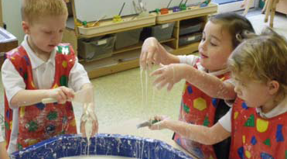
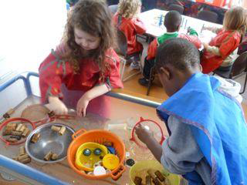
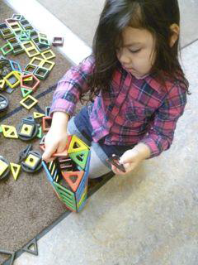
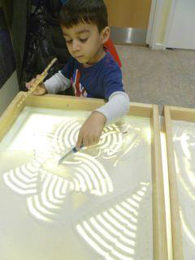
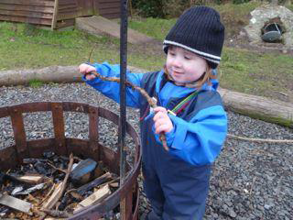
Motivating contexts
fostering children’s play and exploration
Notes:
These images from the ‘Creative Little Scientists’ project provide examples of opportunities for play and exploration – fostered by a rich and varied physical environment.
They also illustrate children’s capacities for sustained engagement and interest in the world around them.
These these photographs were taken in the context of free flow play in an early years setting – children’s interactions with general provision both indoors and out.
Indications of children’s responses and their emerging questions and reasoning were often evident from their actions, gestures as well as comments.
Children playing with gloop (mixture of cornflour and water), sand and water, construction materials, exploration outdoors ‘trying to find little beasties’ and making shapes with different objects in sand (on top of a light box).
Sensitive observation important in noticing the focus and direction of these explorations - give glimpses of children’s ideas and strategies .
Watching carefully the direction of their activities may suggest ways in which we can build on this and help children to make these more explicit.

Slide 9
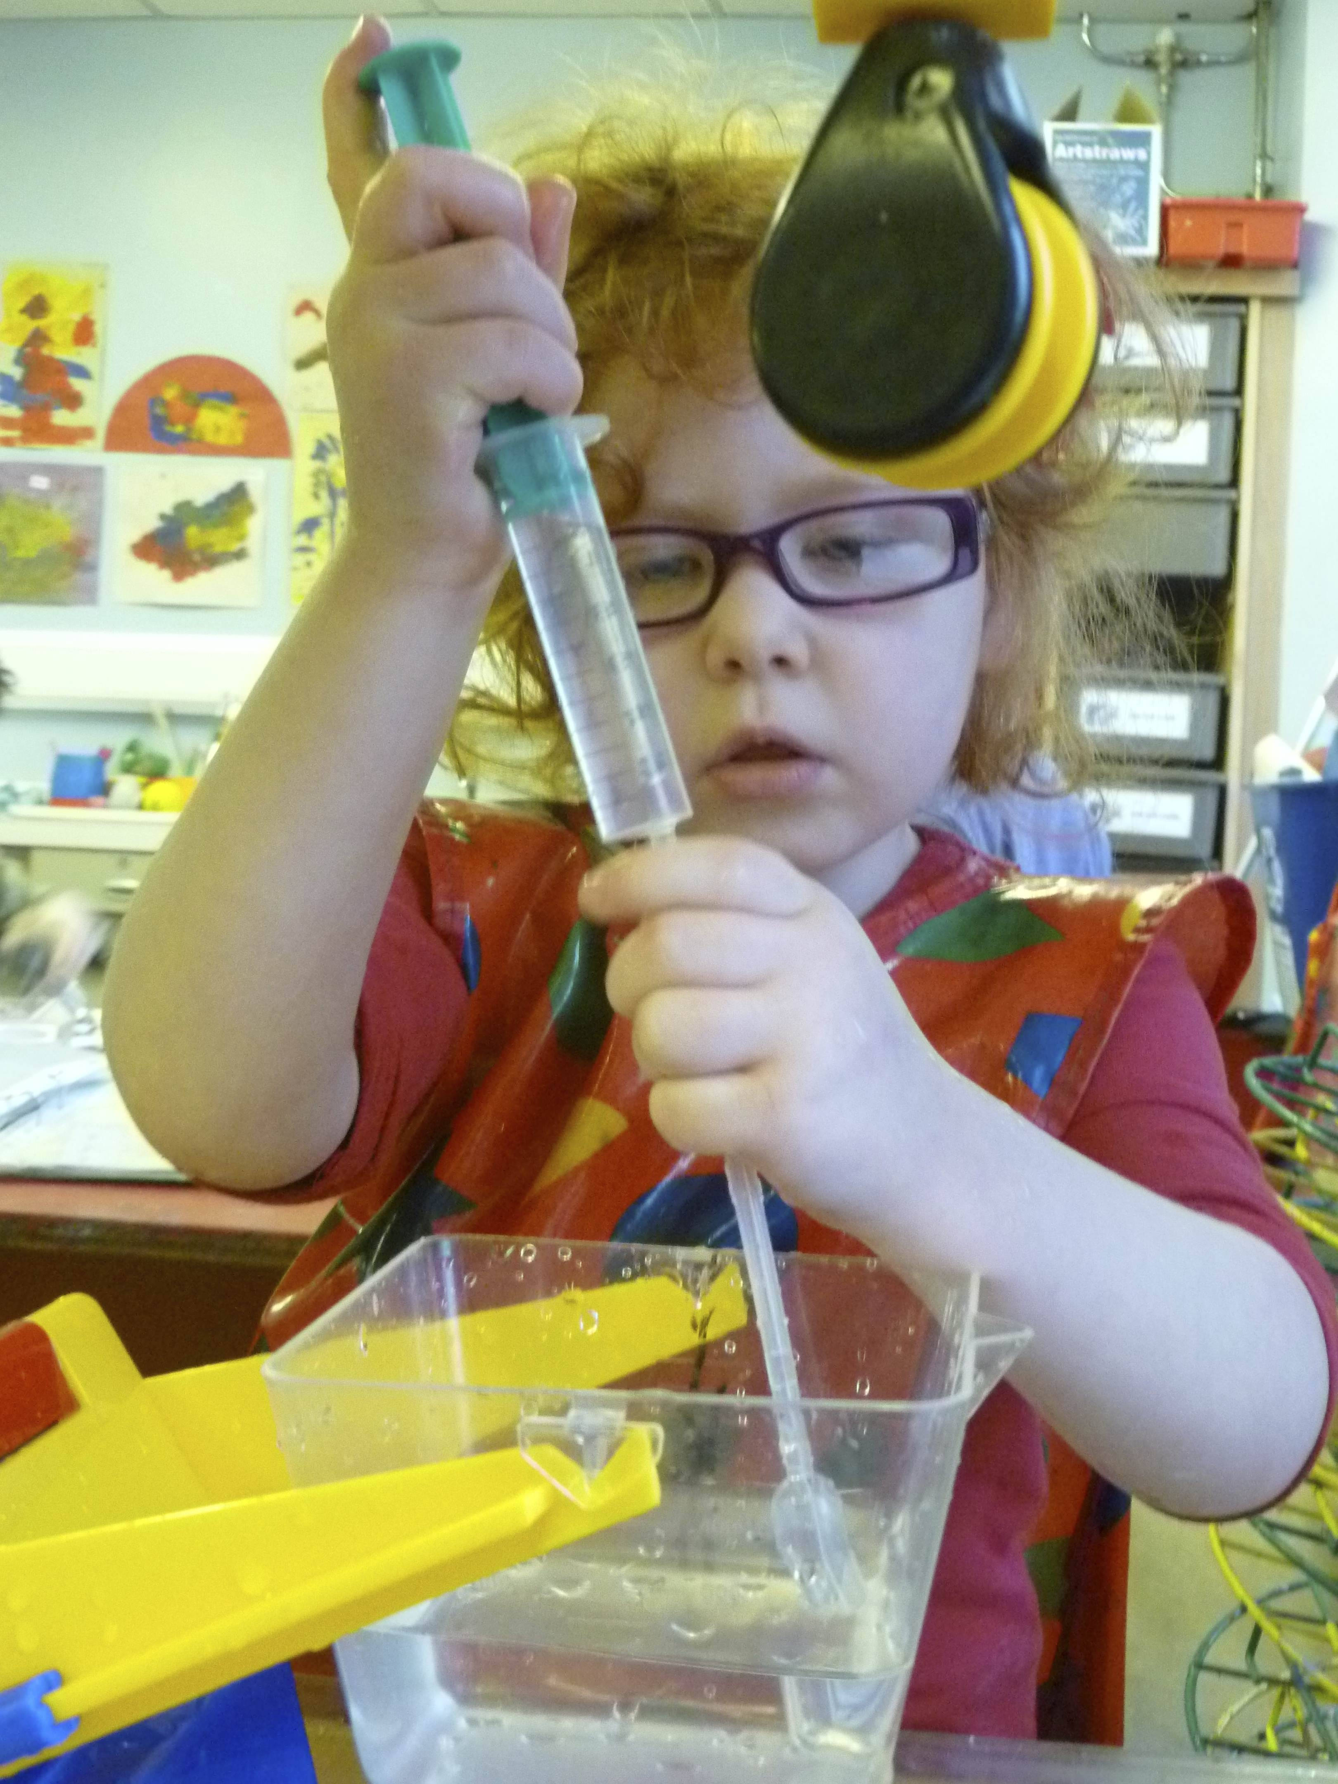
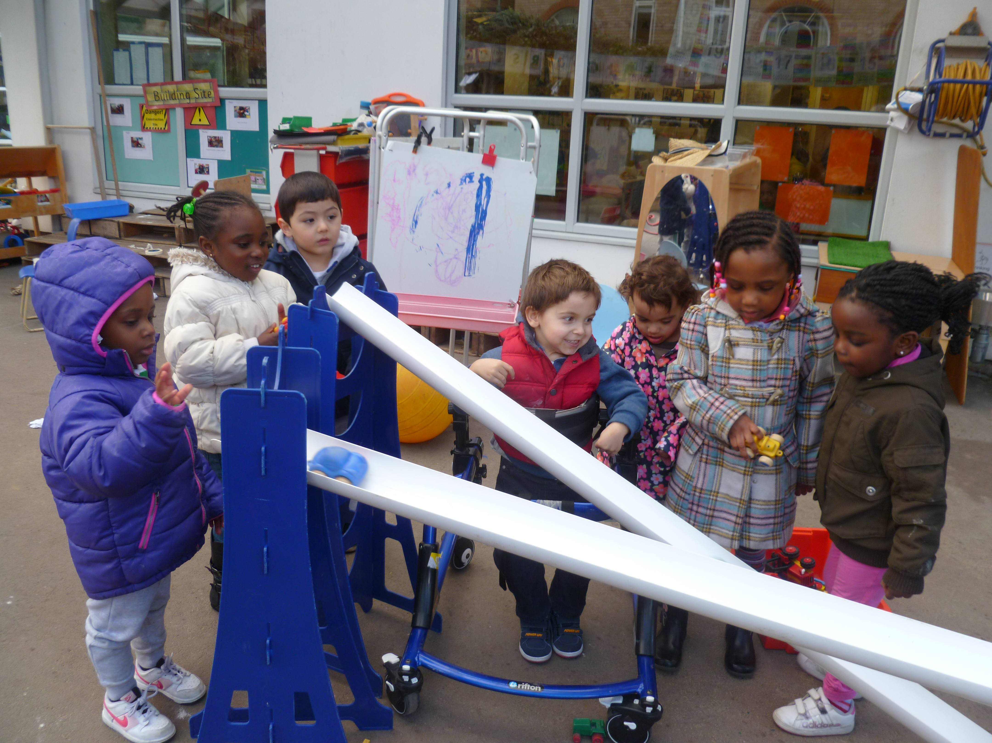
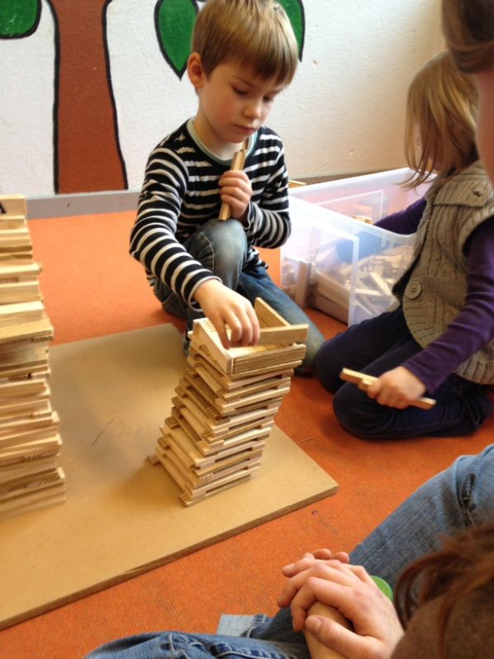
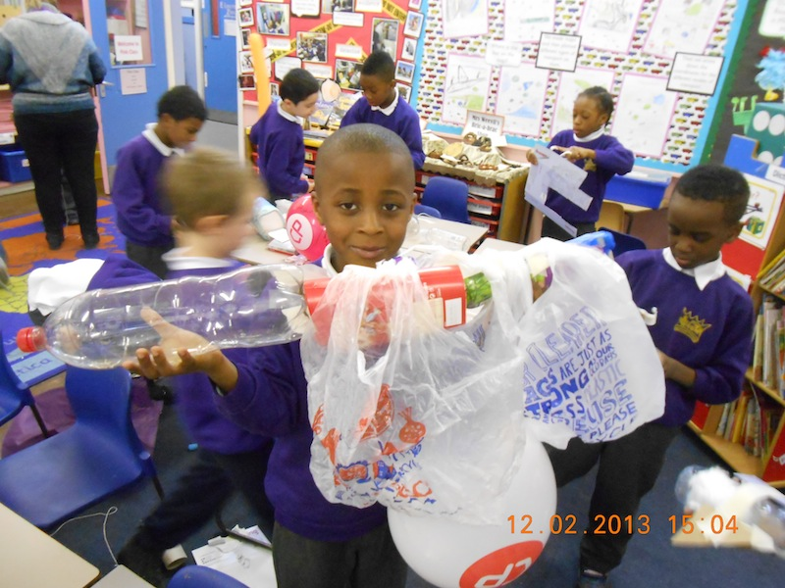
Opportunities for working as individuals and in groups
Notes:
The project also recorded opportunities for children to work both as individuals and in groups – fostering talk and discussion with peers and adults.
From child-initiated play and exploration – trying to fill a pipette with a syringe.
With follow up discussion with the teacher.
Adult initiated activities extended by children through collaborative engagement with exploration and investigation.
Building the Tower of Pisa and Cars and Ramps – discussion with adults and other children.
Collaborative engagement in exploration and investigation – cars and ramps.
Problem solving and reflection – making an egg carrier to carry an egg to the ground safely.

Slide 10
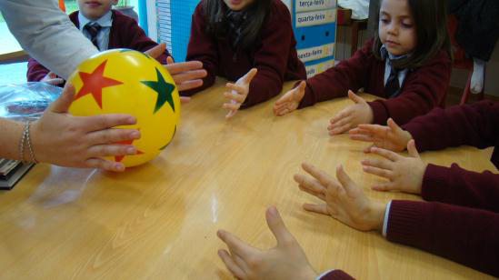
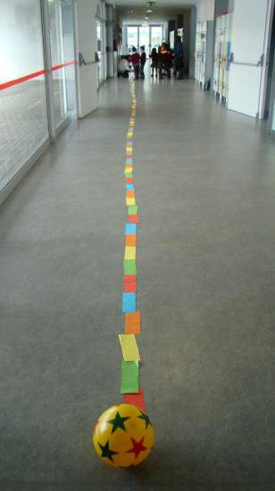
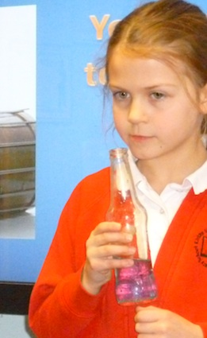
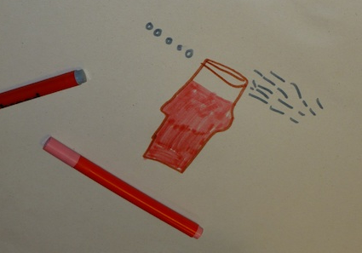
Representing ideas in different ways
Notes:
Representing ideas more explicitly in a variety of ways in the context of their inquiries to support their developing thinking.
How sounds are made.
Relationships between the sizes of the planets and the distances between them.

Slide 11
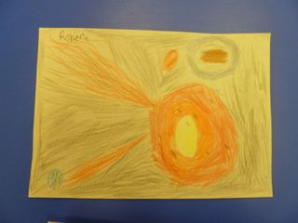
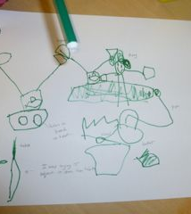
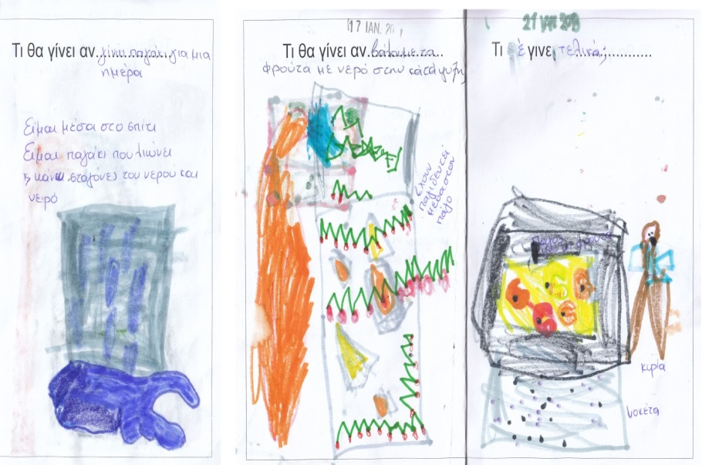
Notes:
Varied opportunities for reflection on learning shown here.
Through drawings, model making, and class discussion.
Interesting insights also offered in through the interviews researchers conducted with children – see some of these later.
These illustrate children’s capacities for self assessment and reflection on learning processes that could also provide the basis for discussion of the nature of science.

Slide 12
Module outline
Introduction to the session
Sharing classroom approaches
Practical activity - role of expression and recording in scientific inquiry
Break
Discussion of classroom examples – roles of expression and recording in fostering inquiry and creativity
Links to creative dispositions
Implications for planning
Review and evaluation
End

Slide 13
How do you encourage children to express and represent their ideas?
As an individual
Brainstorm as many ideas as you can in 2 minutes .
Record each idea on a separate post it (one for each idea).
As a group 3/4
See if you can sort these – any common themes or differences?
In what ways might they support learning?
How do they support your planning, teaching and assessment?
Identify any issues raised in your discussion.
Whole group - feedback of key issues

Slide 14
Role of expression and recording in scientific inquiry
Working in 3s/4s undertake an investigation and keep records of your progress.
How can you change the size and shape of shadows? What factors make a difference?
How is your rate of blinking affected by the activity you do?
Draw what happens to food in your body?
Can you make a spinner that falls really slowly?
Improvise on equipment!
Notes:
Resources for 3 groups of each
Shadows
Shadow box with white paper at the back, paper, pritstick, scissors, plastic straws, paper of various kinds, range of objects of different materials (transparent, translucent and opaque) and shapes (regular/irregular) – glass, plastic, fabrics, helpful if some include materials of different transparency, torches, ruler, pens and pencils, scissors.
Spinners
Card and paper of various thiicknesses, paper clips – varied materials and sizes, rules, tape measures, timers and batteries, scissors.

Slide 15
Features of scientific inquiry involved in your activity.
In your 3s/4s - What did you discuss?
Review your recording. What evidence does this provide of inquiry processes?
In what ways did discussion/recording support inquiry processes – in particular reflection and reasoning?
Review the features of inquiry on the Barrow chart. Are there further features that could have been included? What are the implications for planning?
Notes:
Need recording sheet and copies of Barrow Chart.

Slide 16
Essential features of classroom inquiry and their variations
(Barrow, 2010, p. 3)
Essential features | Variations
Learner engages in scientifically orientated questions | Learner poses a question | Learner selects among questions, poses new questions | Learner sharpens or clarifies question provided by teacher, materials or source | Learner engages in question provided by teacher, materials and source
Learner gives priority to evidence in responding to questions | Learner determines what constitutes evidence and collects it | Learner directed to collect certain data | Learner given data and asked to analyse | Learner given data and told how to analyse
Learner formulates explanations from evidence | Learner formulates explanations after summarising evidence | Learner guided in process of formulating explanations from evidence | Learner given possible ways to use evidence to formulate explanation | Learner provided with evidence
Learner connects explanations to scientific knowledge | Learner independently examines other resources and forms links to explanations | Learner directed toward areas and sources of scientific knowledge | Learner given possible connections
Learner communicates and justifies explanations | Learner forms reasonable and logical argument to communicate explanations | Learner coached in development of communication | Learner provided broad guidelines to sharpen communication | Learner gives steps and procedures to communication
More……...................................................................Amount of Learner Self-Direction…….................................................................Less
Less……..............................................................Amount of Direction from Teacher Material……......................................................More

Slide 17
Discussion of classroom examples
Work in groups of 4
2 classroom examples each group – Focus on
What approaches did children use to express/represent ideas?
In what ways might the approaches identified support learning?
What evidence of learning is provided – how might you build on this?
How does the teacher support reflection and reasoning?
What questions would you like to ask?
Note down key points on the sheet provided.
Notes:
Work in groups of 4/5 and you will have two examples to work with – to make this practical I suggest you divide further into groups of 2/3 to share the materials.
You have a sheet in front of you that sets out the key questions to be addressed – I suggest you work with one example first – and then half way across the time swap and your colleagues can add their comments. (Between 5-10 minutes each example – will see how you get on)
At the end we will share perspectives.
Go briefly through the examples to explain what you have – two different types of materials – in both cases there is some background information – and then some examples of the data – photographs, dialogue.
Selected episodes GE Building Blocks, PT Sun Distance
Templates UK EN Egg Carrier UK EN Sound

Slide 18
Building blocks: Children age 5
Building the Tower of Pisa
Notes:
Inspired by photographs of real buildings on the wall, the children decided to build the “Leaning Tower of Pisa” using wooden building blocks. The teacher stood back and let the children take the lead. She encouraged the children to express themselves clearly and she valued their ideas.

Slide 19
Sun distance: Children age 5
Notes:
First, in their classroom, they had a conversation with questions and hypotheses about the Sun’s size, the Earth’s size and the distance between them. Through dialogue between the teacher and the children, they gathered many facts about the Sun and its importance for life.
Then using a ball and a little piece of plasticine they began to explore the relative sizes and distances.

Slide 20
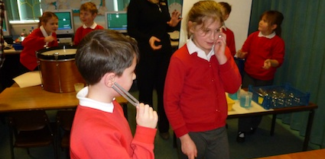
Sound: Children ages 7-9
Exploring ways to make sounds
Notes:
The tables are set up with equipment for exploration: bass drum, snare drum and steel pan, each with a cup of rice; bottles and coloured water in a jug; trays, jugs, water and tuning forks; wind instruments; hollow tubes of different lengths; frog guiro; all tables have large paper and felt tip marker pens. The children had about 30 minutes to explore the resources on two tables and then had to find a way to represent on paper how sound is made.

Slide 21
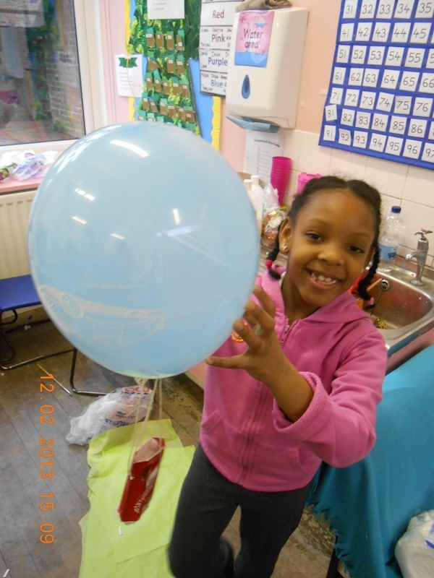
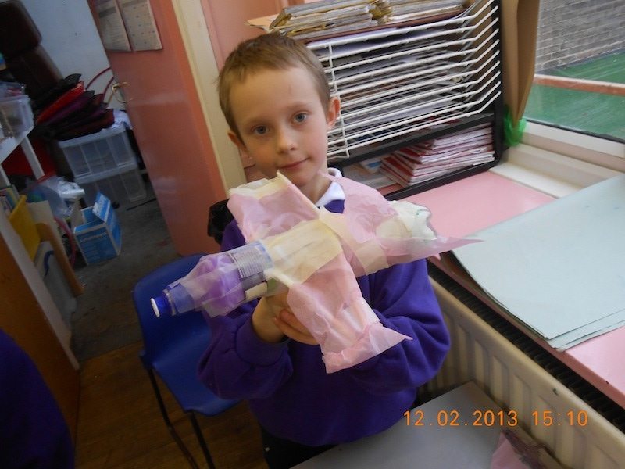
Egg Carrier: Children ages 6-7
Design and make an egg carrier
Notes:
Children had to design and make an egg carrier to transport a fresh egg safely when dropped from a height.
They had a wide range of resources to draw on.
The children were expected to draw on their observations of modern modes of transport as well as studying the structure of the Wright brothers’ first aeroplane.

Slide 22
How might such approaches foster creativity in learning?
Sense of initiative
Motivation
Ability to come up with something new
Ability to connect what they have learnt during lessons with topics in other subjects
Imagination
Curiosity
Ability to work together
Thinking skills
(Factors from the CLS Conceptual Framework)
Notes:
Can you offer any suggestions?
Pair and share – ideas until we run out.
Provide a sheet to annotate

Slide 23
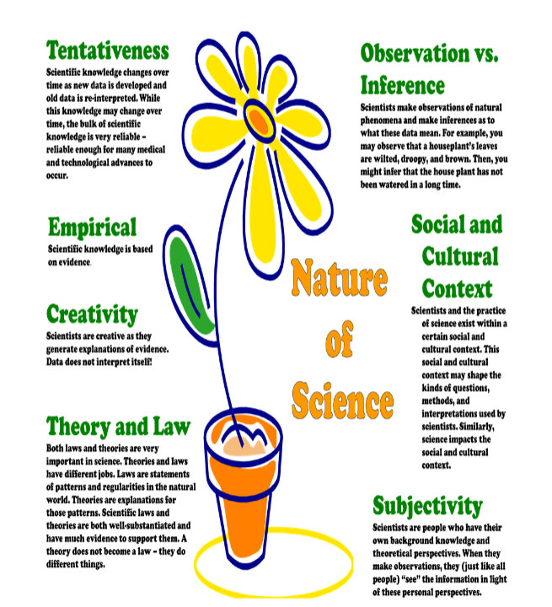
Poster that can be used to introduce or reinforce aspects of Nature of Science
(Akerson et al., 2011, p69)
Notes:
Finally another productive focus of discussion has been the potential for a more explicit focus on the nature of science
Encounters in the classroom suggested there are opportunities in particular related to reflection and reasoning often associated with self assessment for building the foundations for early understanding.
Provide a sheet to annotate
Here found the work of Valarie Akerson and colleagues and the associated poster useful in talking with teachers.

Slide 24
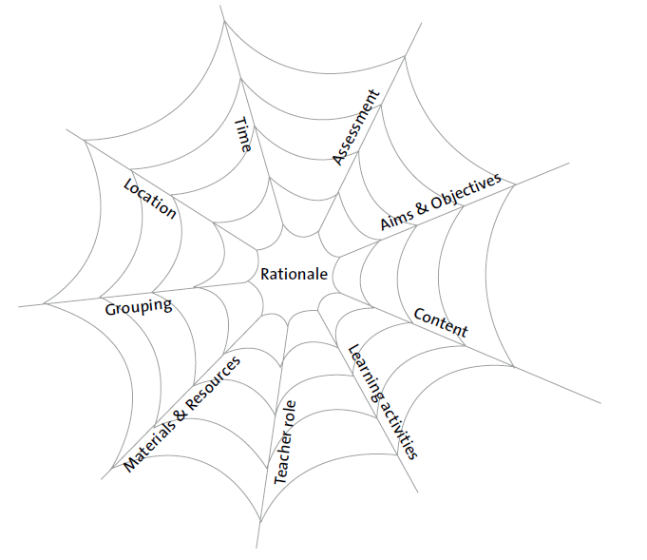
Implications for planning
Vulnerable spider web Van den Akker (2007 p39)
Notes:
How might this affect planning for a science activity – what might you do to establish an environment that fosters sharing and evaluating ideas – children willing and able to do this – all ideas valuable.

Slide 25
Reflections
Look back at your original post its as a group – anything you might add? Add in any additional comments or issues in another colour (pen/post it).
In what ways did the different activities support your developing thinking?
In what ways did they help you to reflect on ways in which children can represent and express their ideas?
Note and record 2 actions you will take building on module content.
How far have the aims of the module been met?

Slide 26
Further information
Creative Little Scientists
(FP7 EU project 2011 – 2014)
Design principles and exemplar materials based on fieldwork www.creative-little-scientists.eu
Creativity in Early Years Science Education
(Erasmus+ EU project 2014 – 2017)
Curriculum Materials and Training Materials for teacher CPD to promote creative approaches to early years science www.ceys‐project.eu

Slide 27


Slide 28

Acknowledgements
Creativity in Early Years Science EDUCATION (2014-2017) www.ceys-project.eu
© 2017 CREATIVITY IN EARLY YEARS SCIENCE EDUCATION Consortium
This work is licensed under the Creative Commons Attribution-NonCommercial-NoDerivatives 4.0 International License. To view a copy of this license, visit http://creativecommons.org/licenses/by-nc-nd/4.0/.

