Slide 1
Training Module 7
Role of play and exploration in inquiry and creativity

Slide 2
Introduction to the CEYS project
(use dependent on context)
European Erasmus+ project
Partners in Belgium, Greece, Romania, UK
Continuation of the Creative Little Scientists project http://www.creative-little-scientists.eu
Aims
  Development of a teacher development course and accompanying materials
  Promotion of the use of creative approaches in teaching science in preschool and early primary education (up to age of eight)
Notes:
The Creativity in Early Years Science project is a European Erasmus+ project with partner countries Greece, Romania, Belgium and the UK
As indicated – it aims to develop a European teacher professional development course and accompanying materials to promote the use of creative approaches in teaching science in preschool and early primary education (up to age of eight).
It is a continuation of the project Creative Little Scientists, an FP7 EU project, where curriculum design principles to foster inquiry and creativity in science education were designed.

Slide 3
Aims of this module
Introduce participants to the importance of play and exploration in inquiry-based and creative approaches to early years science education.
Explore the role of the teacher in supporting and extending play and exploration, in order to stimulate creative thinking.
Engage participants in sharing ideas of how to use this approach in own scientific activities.

Slide 4
Content of the Module
An introduction to the role of play and exploration within inquiry-based and creative approaches to early years science learning
Exploration of materials
Discussion of possibilities for play and exploration
Reflection on the use of the materials
Analysis and discussion of the role of the teacher
Analysis of classroom examples
Focus on creativity: reflection on how approaches might foster creativity.
Discussion of possibilities to apply insights to own classroom practice: implications for planning and the teacher’s role.
Resume on what has been gained from the module – both content and process, in relation to the aims of the module.

Slide 5
Links to Content Design Principles and Outcomes 1
7. Teacher education should familiarise teachers with a range of formal and informal inquiry- and creativity-based learning, teaching and assessment approaches and strategies and their use in relation to authentic problems within the areas of science and mathematics.
  7.3 Teachers should be able to recognize and exploit the value of play and exploration in science and mathematics for fostering and extending inquiry and creativity, by for example prompting questions, eliciting ideas, providing opportunities for consideration of alternative strategies during children’s familiarisation with phenomena and events.
  7.4 Teacher should be able both to build in new and to make the most of existing opportunities for child-initiated play, recognising and capitalising on the potential of children’s explorations beyond the teacher’s original intentions.
.

Slide 6
Links to Content Design Principles and Outcomes 2
8. Teacher education should enable teachers to design and assess creativity-enabling inquiry-based activities which are child-friendly and include both guided and open inquiries.
  8.1 Teachers should be able to design and assess open-ended learning activities.
17. Teacher education should address with teachers issues in ensuring rich provision, planning and use of resources (including digital resources) in and out of the classroom to support children’s inquiry and creativity.
  17.2 Teachers should be able to recognize the nature and potential of different materials and resources both to constrain and extend children’s explorations.
  17.4 Teachers should be able to evaluate provision for free flow play in their school settings.
  17.6 Teachers should be able to gain insights into children’s developing explorations and creativity based on their use of resources.

Slide 7
Introduction to the role of play and exploration within inquiry and creativity
Importance of play and exploration in early years science
  Central to inquiry based science education and creative approaches
  Supports development of creative skills and dispositions
  Nurtures children’s motivation
  Increases children’s creativity
  Develops inquiry skills such as observing, raising questions, classifying, hypothesising, communicating, thinking, reasoning
Notes:
Clarifying that the focus of this module is the role of the teacher in creating opportunities for play and exploration.

Slide 8
Connecting Inquiry Based Science Education and Creative Approaches
Inquiry-based Science Education
Creative Dispositions
Sense of initiative
Motivation
Ability to come up with something new
Making connections
Imagination
Curiosity
Ability to work together
Thinking skills
(for example Chappell et al 2008)
Questioning
Designing and planning investigations
Gathering evidence
Making connections
Explaining evidence
Communicating explanations
(for example Minner et al 2010)
From Creative Little Scientists, 2012
Notes:
I have added this as I think it might be useful in alerting participants to characteristics of creativity and inquiry in the activities that follow.

Slide 9
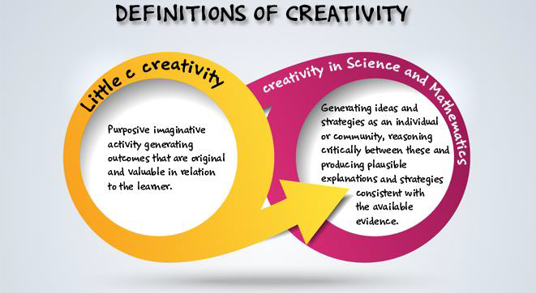
Definition of creativity adopted by the CEYS project
(from Creative Little Scientists, 2014)

Slide 10

Needs & expectations?
What do you hope to be answered?
Key problems?
What do you want to learn?
Notes:
Teachers individually write down what they want to learn during this session and what their questions are. Use of method ‘5 finger fix’.
Participants briefly tell their partner what they wrote down.
Facilitator makes a quick list of the little finger digit (= key problems) and questions. This way he gets a clear view on what participants regarding would like to learn and what problems they face.

Slide 11
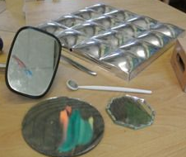
Exploration of materials
Notes:
Participants explore the materials and their possibilities.
Let participants play with the materials.
Possible prompts to make sure participants play and explore:
Can you see your reflection in the different materials? How does it look?
Can you send the light of the flashlight somewhere else?
Can you have the same effect if you use other materials?
…
You can leave some materials behind to add when participants find it difficult to keep playing.

Slide 12
Possibilities for play and exploration?
What did you do with the materials?
What questions arose during play?
Notes:
Participants discuss the previous activity
Participants list what they did with the materials.
Participants write down what questions arose during their play.
They share ideas of possibilities of play and exploration.

Slide 13
Reflection on the use of everyday materials in the classroom
Locally available video of play and exploration
or
photographs of everyday provision for play and exploration
Note down how children play, what they explore and research.
Note down questions children ask or might ask themselves while exploring the materials.
Notes:
After exploring materials themselves, participants are challenged to step into the role of children. This phase starts by showing a locally available video clip of children exploring and playing with a selection of materials or photographs of play and exploration included in the materials for this module. Participants analyse this material by answering the questions shown on the slide.

Slide 14

Possibilities for science learning
As an individual
List key science related learning activities or use of vocabulary – each on a separate post it
Discussion (small groups)
Group activities and vocabulary used on the A3 sheet of paper
Consider the role of the teacher
(linked to the synergies)
  Can you see how this science activity is approached
  in a creative way?
  Which synergies are used to foster scientific
  inquiry skills and concepts?
Whole group discussion
Notes:
Participants individually list science related activities and key scientific vocabulary children might use or develop(min. 5), each idea on another post-it.
Discussion with the small group: group the activities and vocabulary on the A3 sheet of paper.
Consider evidence of the role of the teacher in providing these possibilities
Make links to the synergies: can they see how this science is approached in a creative way? Can they see which synergies are used to foster learning in relation to the scientific topics and vocabulary identified in the video/photographs

Slide 15
Synergies between inquiry-based and creative approaches
From the Conceptual Framework adopted by the CEYS Project (Creative Little Scientists, 2012)
Play and exploration
Motivation and affect
Dialogue and collaboration
Problem solving and agency
Questioning and curiosity
Reflection and reasoning
Teacher scaffolding and involvement
Assessment for learning

Slide 16
Role of the teacher
How can you foster play, exploration and therefore creativity and inquiry in science and extend the learning of children in this example?
Children’s questions (explicit or implicit): how would you act on them to foster creativity?
Use the list of key scientific vocabulary and science related learning experiences.
Notes:
Participants reflect in relation to a particular classroom recording.
Participants use children’s questions listed in the recording sheet to discuss how they would act on them to foster creativity.
Participants use the key scientific vocabulary and science related learning activities listed to explore how a teacher can foster creativity in these areas.

Slide 17
Take Home Messages
Importance of a rich physical environment
Importance of the time and space for children to explore
Importance of making links with children’s everyday lives to engage interest and foster curiosity
Notes:
Short discussion in whole group.
Take home message:
Point out the importance of a rich physical environment, the time and space they get to explore and the importance of making links with children’s everyday lives to engage interest and foster curiosity.

Slide 18
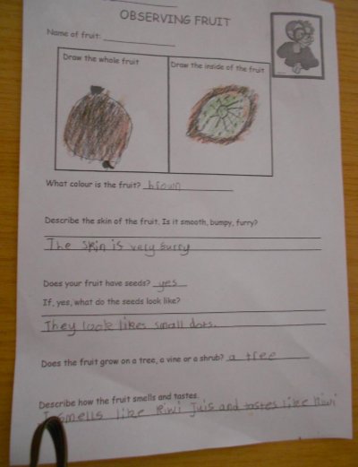
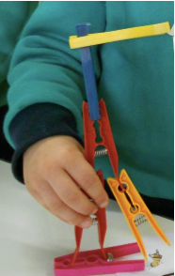
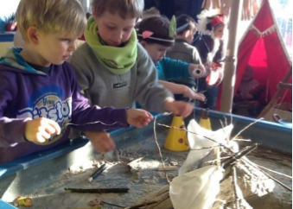

Discussion and reflection on classroom examples
The Tipi
Measuring Robots
Fruit
Notes:
BE_Class_TheTipi
MA_Class_MeasuringRobots
MA_Class_Fruit_Multimodal

Slide 19
Discussion and reflection on classroom examples
How does the teacher scaffold on the play and exploration to develop the science inquiry of the children?
How does the teacher scaffold on the play and exploration to develop the creativity of the children?
Can you provide other possibilities?
Notes:
Note down key points on the recording sheet provided
(eg adding more resources, questioning, playing along, giving examples, modelling questions and curiosity, observation to be able to scaffold,, …)
Bring it together to discuss the answers and overlap (hopefully there is overlap, because a good scientific inquiry is creative). Brief feedback of general comments related to each question.

Slide 20
Apply insights to your own classroom practices
Experiences from the module
Own practice
Enrich your activities with ideas to foster more play and exploration in order to provoke children’s inquiry and creative thinking.
Notes:
First individually write down 3 examples of scientific activities you already use in your own classroom context. Then enrich them with ideas to foster more play and exploration in order to provoke creative thinking.
Note down possible difficulties and questions you have when transferring this approach to your own classroom context.
Exchange ideas, discuss questions and possible difficulties.
Interesting insights are shared with the whole group.

Slide 21
Reflection and implications
How far have the questions at the start of the module been answered?
  Key challenges
Note 2 actions you will take building on module content record.
In what ways did the different activities support your developing thinking?

Slide 22
Further information
Creative Little Scientists
(FP7 EU project 2011 – 2014)
Design principles and exemplar materials based on fieldwork www.creative-little-scientists.eu
Creativity in Early Years Science Education
(Erasmus+ EU project 2014 – 2017)
Curriculum Materials and Training Materials for teacher CPD to promote creative approaches to early years science www.ceys‐project.eu

Slide 23


Slide 24

Acknowledgements
Creativity in Early Years Science EDUCATION (2014-2017) www.ceys-project.eu
© 2017 CREATIVITY IN EARLY YEARS SCIENCE EDUCATION Consortium
This work is licensed under the Creative Commons Attribution-NonCommercial-NoDerivatives 4.0 International License. To view a copy of this license, visit http://creativecommons.org/licenses/by-nc-nd/4.0/.

