Slide 1
Training Module 6
Collaboration and Group Work

Slide 2
Introduction to the CEYS project
(use dependent on context)
European Erasmus+ project
Partners in Belgium, Greece, Romania, UK
Continuation of the Creative Little Scientists project http://www.creative-little-scientists.eu
Aims
  Development of a teacher development course and accompanying materials
  Promotion of the use of creative approaches in teaching science in preschool and early primary education (up to age of eight)
Notes:
The Creativity in Early Years Science project is a European Erasmus+ project with partner countries Greece, Romania, Belgium and the UK
As indicated – it aims to develop a European teacher professional development course and accompanying materials to promote the use of creative approaches in teaching science in preschool and early primary education (up to age of eight).
It is a continuation of the project Creative Little Scientists, an FP7 EU project, where curriculum design principles to foster inquiry and creativity in science education were designed.

Slide 3
Connecting IBSE and CA
(from Creative Little Scientists, 2012)
Features of inquiry
Creative dispositions
Questioning
Designing and planning investigations
Gathering evidence
Making connections
Explaining evidence
Communicating explanations
Sense of initiative
Motivation
Ability to come up with something new
Making connections
Imagination
Curiosity
Ability to work together
Thinking skills

Slide 4
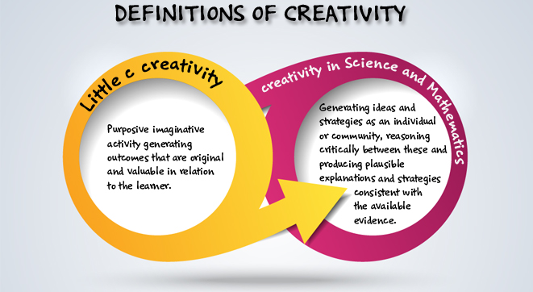
Definitions of creativity adopted by the CEYS project
(from Creative Little Scientists, 2014)

Slide 5
Aims of the module
Explore benefits of collaboration and group work in early years science education.
Enable participants to plan activities involving group work and collaboration to enhance creativity in science education.
Introduce features of dialogue, collaboration and group work important in promoting inquiry and creativity.
Share strategies for stimulating and fostering children’s creativity through collaboration in groups.
Increase awareness of different ways of providing opportunities for children’s creativity through collaboration and group work.

Slide 6
Links to Content Design Principles and Outcomes 1
(For use as appropriate)
15. Teacher education should promote teachers’ use of group work to support children’s inquiry processes and creative learning.
  15.1 Teachers should have knowledge of the value of collaboration for inquiry and creative thinking and learning.
  15.2 Teachers should be able to use purposefully a variety of patterns of collaboration, shifting between individual and collaborative activity over time, to support children’s inquiry processes and creative learning.

Slide 7
Links to Content Design Principles and Outcomes 2
(For use as appropriate)
15.3 Teachers should be able to organize group work, aligning ways of grouping children, task design, teaching and assessment strategies in different ways to promote collaboration amongst children in science and mathematics.
15.4 Teachers should be able to use resources and teacher intervention appropriately to foster collaboration in science and mathematics.
15.5 Teachers should be able to assess group work.
15.6 Teachers should be able to use effective strategies for sharing ideas and discussions from different groups.

Slide 8
Rationale for the module
Collaboration is viewed as a key aspect of inquiry-based learning
Growing recognition of the social, collective and collaborative nature of creative processes
Collaboration offers opportunities for dialogue – a critical feature of both creative and inquiry-based education
Dialogic talk enables children externalise their thinking, explore, share and evaluate alternative ideas and strategies

Slide 9
Issues for teachers
Supporting children’s collaborative reasoning and creative engagement
Using questioning and encouraging exploratory talk without dominating dialogic exchanges
Designing tasks to promote equality of involvement and quality of engagement
Developing a supportive classroom environment that encourages discussion of alternative ideas
Adopting grouping strategies to maximise children’s engagement, participation and progress

Slide 10
Module outline
Introduction, aims and rationale for the module
Problem solving task - opportunities for collaboration and dialogue – their roles in fostering creativity and inquiry
Sharing experiences of group work – effective approaches, challenges
Analysis of classroom examples - evidence of group work, role of the teacher in supporting collaboration
Implications for planning
Reflection on what has been gained from the module.

Slide 11
Problem solving task
Build the tallest, strongest structure you can to support an egg using spaghetti and marshmallows!
Work in groups of 4/6
20 mins
Divide into 2 groups of 2/3
Problem solvers do the task
Observers take notes of the talk and actions of the problem solvers

Slide 12
Time for analysis
Sharing experiences and observations
Where are the elements of inquiry & creativity in the activity?
In what ways did the problem-solvers work together?
What did they talk about?
10mins
In what ways did dialogue and collaboration support inquiry and creativity?

Slide 13
Collaboration
Working collaboratively goes beyond what is often seen in classrooms, where children in groups work on related but individual tasks in a supportive way (cooperation).
Collaboration entails ‘participating in joint activity that is mutually supportive, working towards a common goal and developing shared understanding’ (McGregor 2012:78)
A key notion here is that collaboration enables the group to achieve more than could be achieved were they to work individually.

Slide 14
Features of dialogue fostering inquiry and creativity
Posing questions
Constructing shared interpretations and new knowledge
Articulating and justifying own points of view
Actively commenting and building on each other’s ideas
Agreeing and disagreeing politely
Changing our mind based on further evidence/input
Can you identify links to the definitions of creativity?

Slide 15
Sharing experiences
In pairs record on post its
Positive strategies and challenges in fostering collaboration and dialogue in the classroom
Benefits for inquiry and creativity
10 mins
Share with the group on your table
Reflect on common themes and issues
nature of task
group composition teacher role ?

Slide 16
Collaboration and Group Work
Analysis of classroom examples
Framework for the Classroom Examples
Setting the scene – focus, rationale, background
Starting points
Developing the learning journey – activities and their rationale, examples of children’s responses, teacher reflections and implications for the next session.
Reflections – children’s progress, teacher role, classroom environment, next steps
Materials
Bath Bombs
Notes:
Now moving on
Share some examples from the classroom to to explore nature of group work – opportunities for collaboration and dialogue and their role in fostering inquiry and creativity.
Also ways in which teacher built on children’s responses over time and sought to foster children’s skills and understandings associated with inquiry.

Slide 17

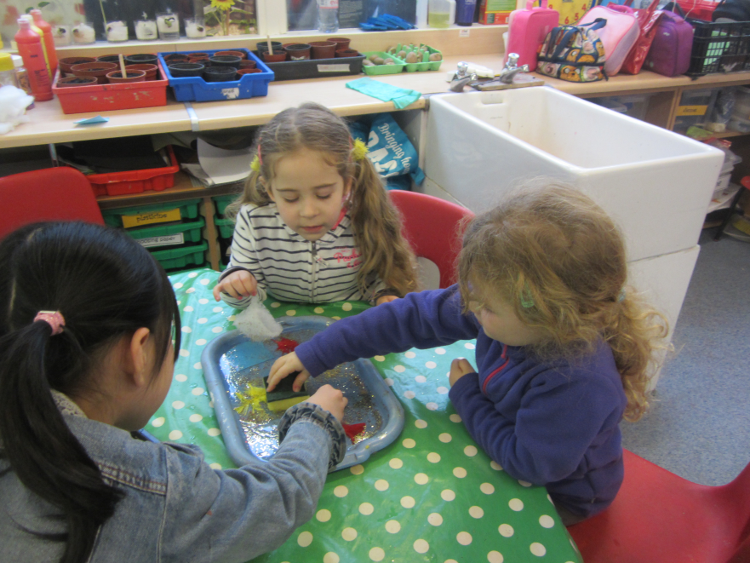
Materials
Children age 5-6

Slide 18
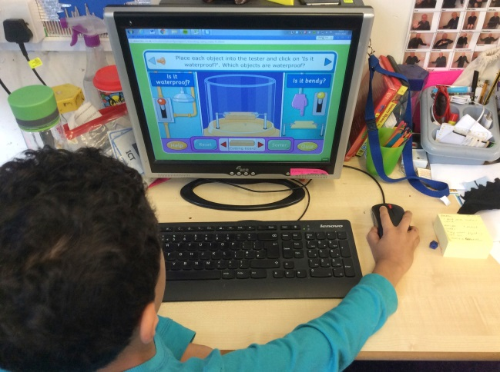
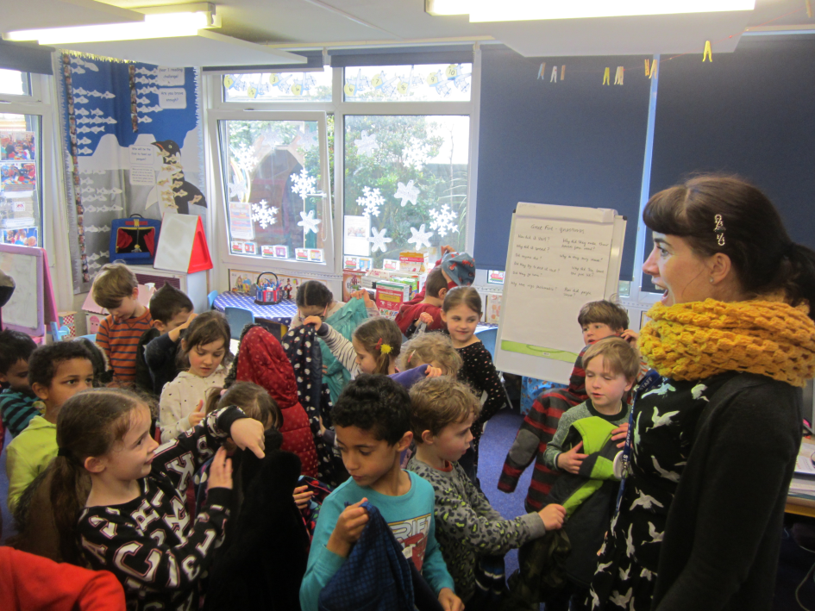
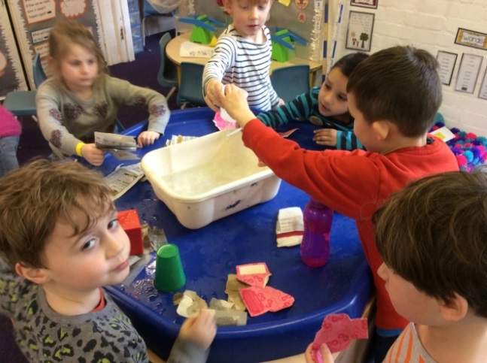
Materials

Slide 19
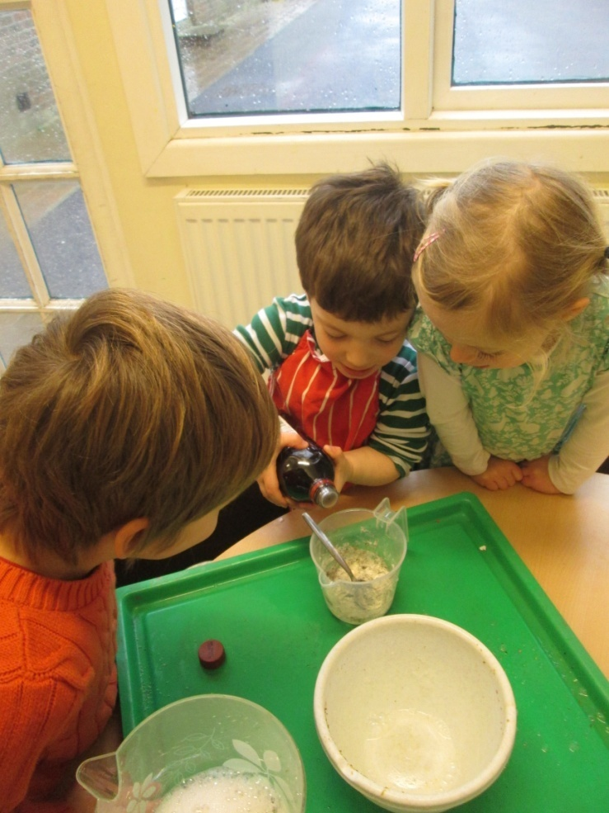
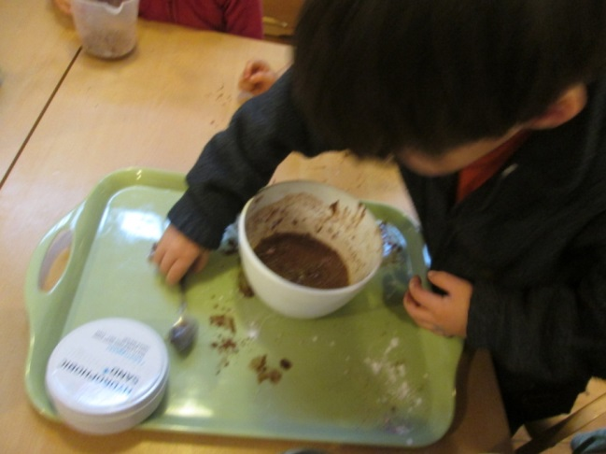
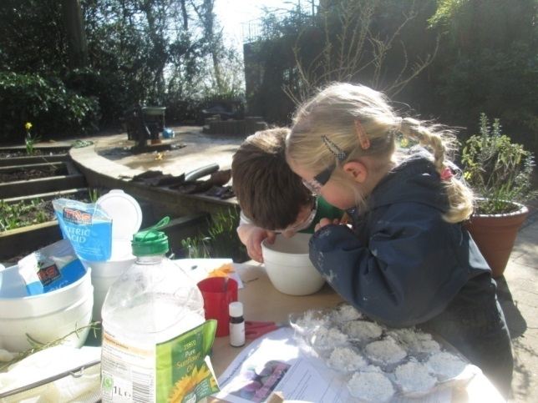
Bath bombs
Children age 3-5

Slide 20
Analysis of classroom examples
What promoted collaboration and dialogue in the classroom examples?
How did this promote inquiry and creativity?
Identify opportunities for assessment.
10 min
Discuss and note responses to the reflection questions on the recording sheet provided.
Notes:
Work in groups of 4 – 1/2 examples for each group
Start in pairs with different examples, then swap
1. Read through first to gain an overview of the learning journey.
2. Then consider the following questions:

Slide 21
Action planning
In pairs, identify two things to take forward when planning investigations to foster collaboration and dialogue.
Identify an investigation you might carry out:
When will it take place?
How will the children be grouped?
How will you structure the activity to promote children’s collaboration and dialogue?
What approaches might you use for assessment?
Consider - nature of the task, grouping, your role

Slide 22
Reflection on the module
In what ways did the different activities support your developing thinking?
2. How far have the aims of the module been met?
Notes:
How to record? List ideas on flip chart.
Back to the aims?

Slide 23
Further information
Creative Little Scientists
(FP7 EU project 2011 – 2014)
Design principles and exemplar materials based on fieldwork www.creative-little-scientists.eu
Creativity in Early Years Science Education
(Erasmus+ EU project 2014 – 2017)
Curriculum Materials and Training Materials for teacher CPD to promote creative approaches to early years science www.ceys‐project.eu

Slide 24

THANK YOU!

Slide 25

Acknowledgements
Creativity in Early Years Science EDUCATION (2014-2017) www.ceys-project.eu
© 2017 CREATIVITY IN EARLY YEARS SCIENCE EDUCATION Consortium
This work is licensed under the Creative Commons Attribution-NonCommercial-NoDerivatives 4.0 International License. To view a copy of this license, visit http://creativecommons.org/licenses/by-nc-nd/4.0/.

