Slide 1
Training Module 5 Practical Investigation which fosters Creativity

Slide 2
Aims of the module
This module will:
Explore the role of practical investigations in fostering creativity in early years science
Highlight the nature of creativity and a range of creative dispositions
Prompt participation in investigations and reflection upon them
Widen awareness of structured and unstructured explorations
Provide space to plan investigations that foster children’s creativity

Slide 3
Links to Content Design Principles and Outcomes
2. Teacher education should provide teachers with skills and competences to carry out practical investigations of science and mathematics in the classroom.
2.1 Teachers should be able to instigate and involve children in the design and conduct of practical investigations of science and mathematics in the classroom, as such activities can contribute to the development of children’s creativity.
17. Teacher education should address with teachers issues in ensuring rich provision, planning and use of resources (including digital resources) in and out of the classroom to support children’s inquiry and creativity.
17.1 Teachers should be able to organise and use materials (including everyday materials), resources (including ICT and natural resources) and equipment (including digital equipment and simple laboratory instruments) in the classroom, school and wider environment, both indoors and out, to support independent inquiry and creativity.
Notes:
Information for facilitators for sharing with participants as appropriate

Slide 4
Outline of the module
Introduction
Problem finding and problem solving tasks
Analysis of classroom examples
Reflection on the teaching approaches adopted in classroom examples
Consequences for participants’ own planning
Reflection on what has been gained from the workshop

Slide 5
Introduction to the CEYS project (use dependent on context)
European Erasmus+ project
Partners in Belgium, Greece, Romania, UK
Continuation of the Creative Little Scientists project http://www.creative-little-scientists.eu
Aims
Development of a teacher development course and accompanying materials
Promotion of the use of creative approaches in teaching science in preschool and early primary education (up to age of eight)
Notes:
The Creativity in Early Years Science project is a European Erasmus+ project with partner countries Greece, Romania, Belgium and the UK
As indicated – it aims to develop a European teacher professional development course and accompanying materials to promote the use of creative approaches in teaching science in preschool and early primary education (up to age of eight).
It is a continuation of the project Creative Little Scientists, an FP7 EU project, where curriculum design principles to foster inquiry and creativity in science education were designed.

Slide 6
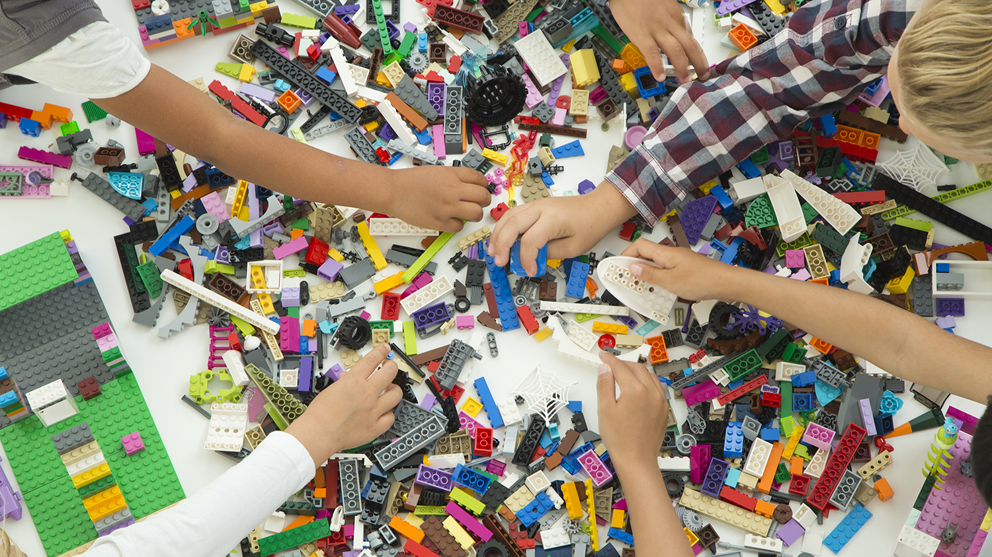
Engagement task
You have been provided with some bricks.
You have 10 minutes to make something from the resources, individually or in pairs.

Slide 7
Discussion
• What happened?
• What issues arose?
• What questions emerge?

Slide 8
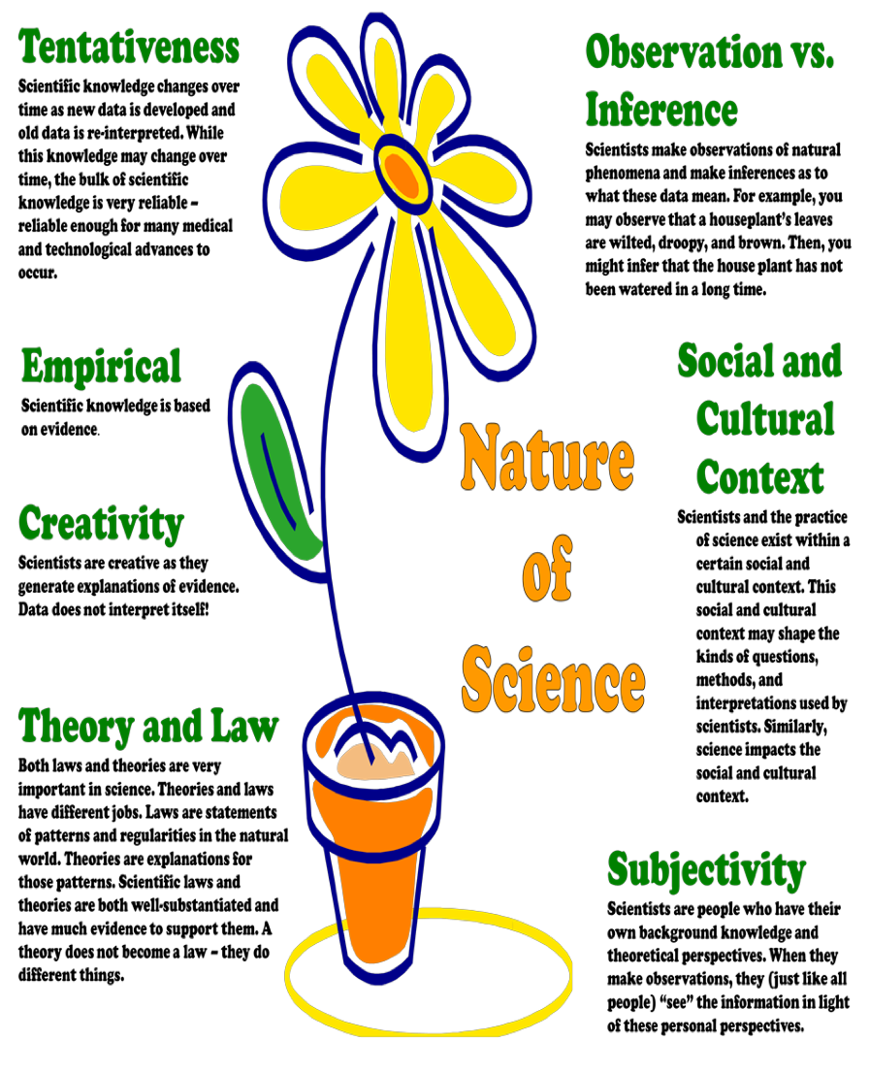
Links between creativity and the nature of science
Akerson, V.L., Weiland, I. S., Pongsanon, K., & Nargund, V. (2010). Evidence-based Strategies for Teaching Nature of Science to Young Children. Journal of Kirsehir Education, 11 (4), 61-78.
Notes:
About 30 minutes of presentation + discussion, asking for concrete examples per item.

Slide 9
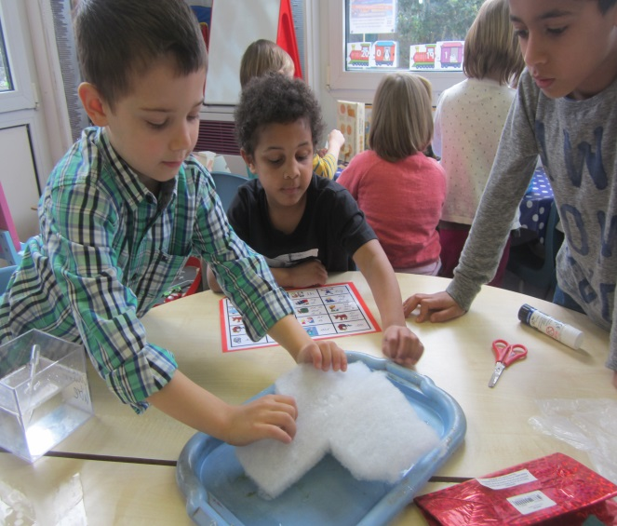
Creativity
From what is to what might be…
(Craft, 2001)
What if…

Slide 10
Big-C and little-c creativity
Everyday creativity /“little-c” ➔
can be found in nearly all people, personal creativity
(e.g. Kaufman and Beghetto , 2009; Boden, 2001;Craft, 2003)
Eminent creativity/ “Big-C” ➔
can be found in ‘artists’, historical paradigm-shifting creativity
(e.g. Gardner, 1993; Csikszentmihalyi, 1997)

Slide 11
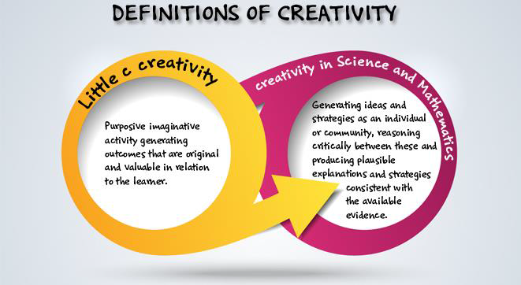
Definition of creativity adopted by the CEYS project (from Creative Little Scientists, 2014)

Slide 12
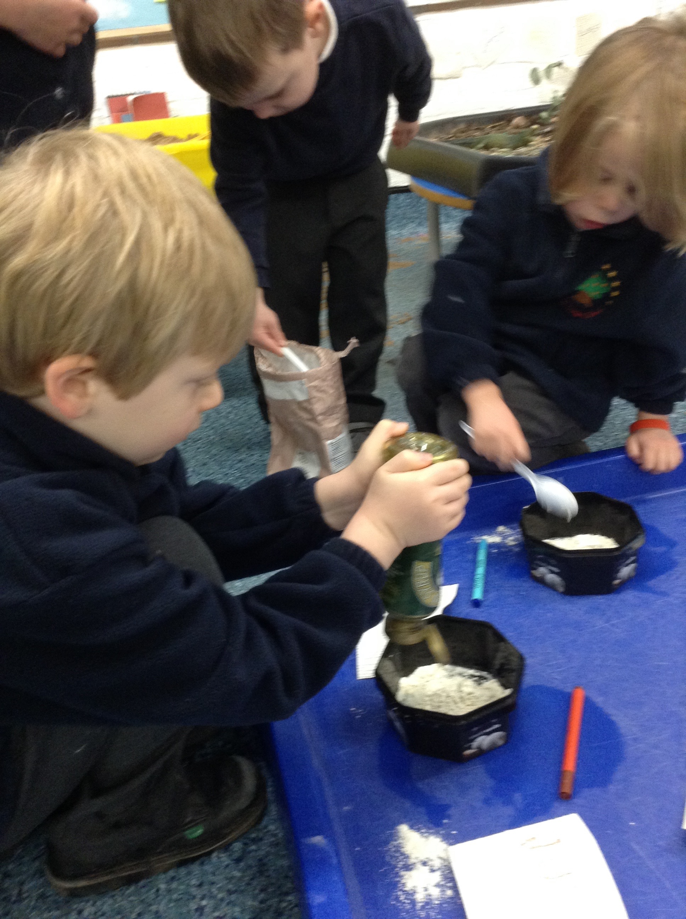
Creative dispositions
Sense of initiative
Motivation
Ability to come up with something new
Ability to make connections
Imagination
Curiosity
Ability to work together
Thinking skills

Slide 13
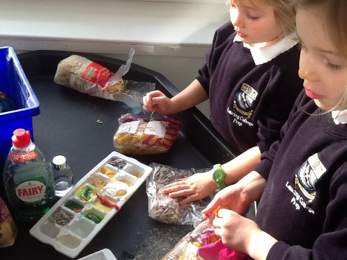
Synergies between inquiry-based and creative approaches From the Conceptual Framework adopted by the CEYS Project (Creative Little Scientists, 2012)
Play and exploration
Motivation and affect
Dialogue and collaboration
Questioning and curiosity
Problem-solving and agency
Reflection and reasoning
Teacher scaffolding and involvement
Assessment for learning

Slide 14
Problem finding and problem solving tasks How to foster creativity?
GROUP A | GROUP B | GROUP C
Do something with the resources provided… | Make an animal! | Make a spider whose body does not touch the floor!
2 people from each group observe and note evidence of creative dispositions and feed back

Slide 15
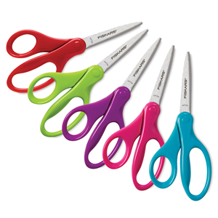
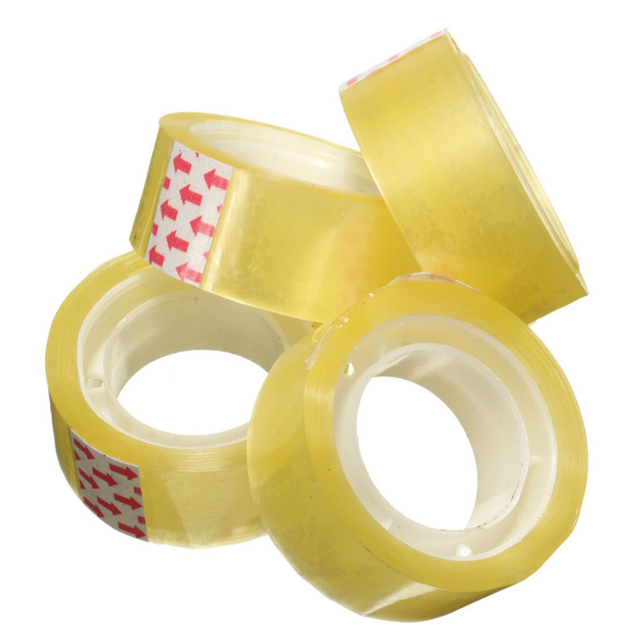
Resources

Slide 16
Discussion
What was the influence of the task on the creative dispositions?
To what extent did the investigation’s design influence the creativity shown?

Slide 17
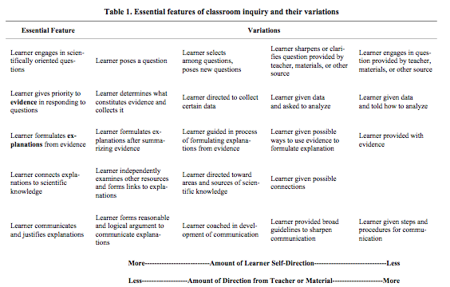
Problem solving and agency (Barrow, 2010, p3)

Slide 18
Analysis of classroom examples
Colouring cotton
Observation corner ‘autumn’
The pizza
Carpenter corner

Slide 19
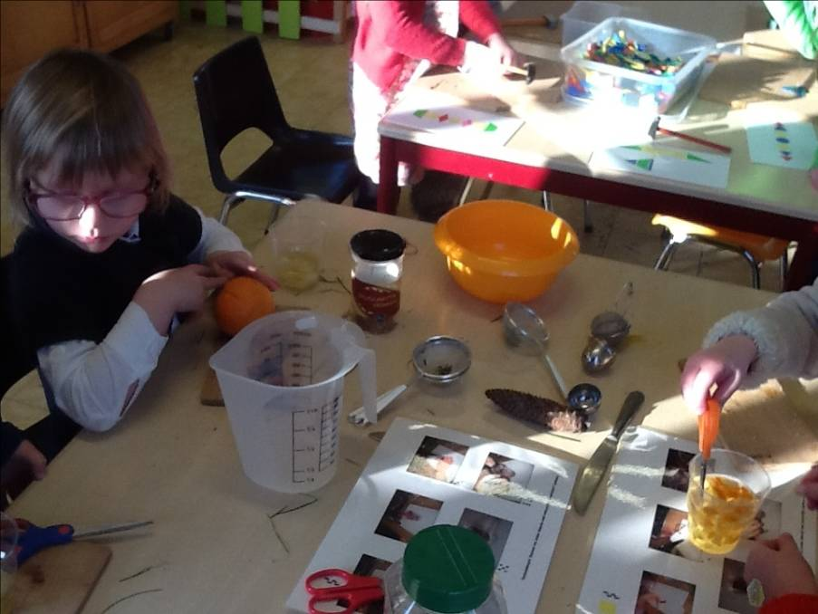
Colouring cotton

Slide 20
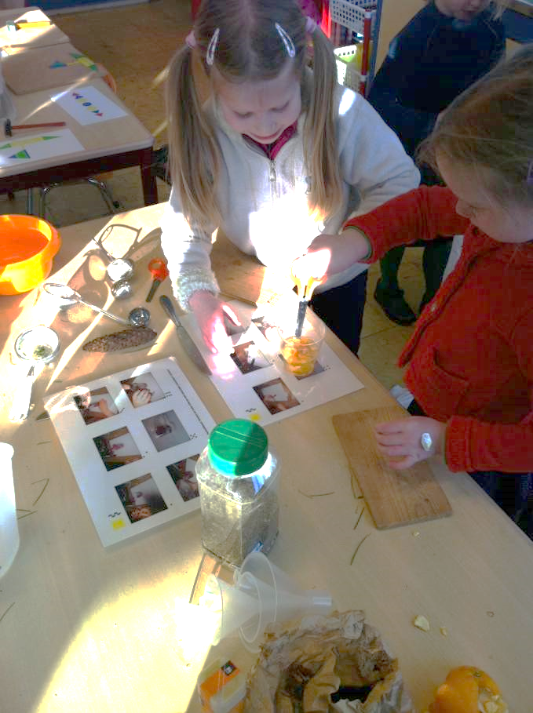
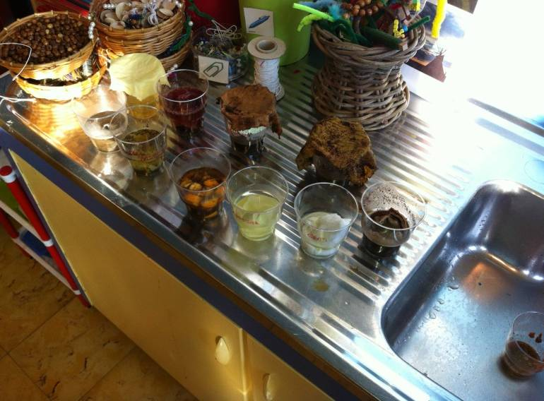
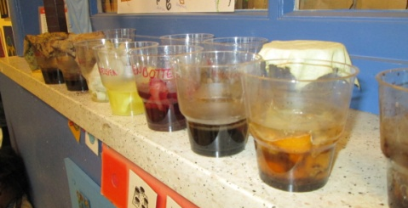
Colouring cotton

Slide 21
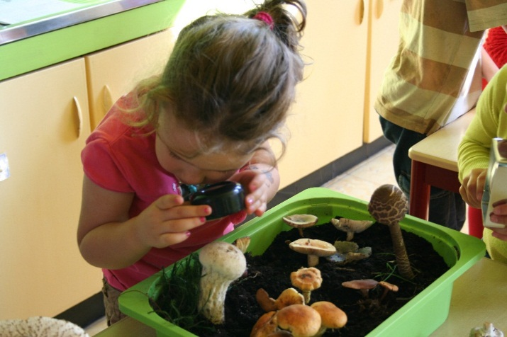
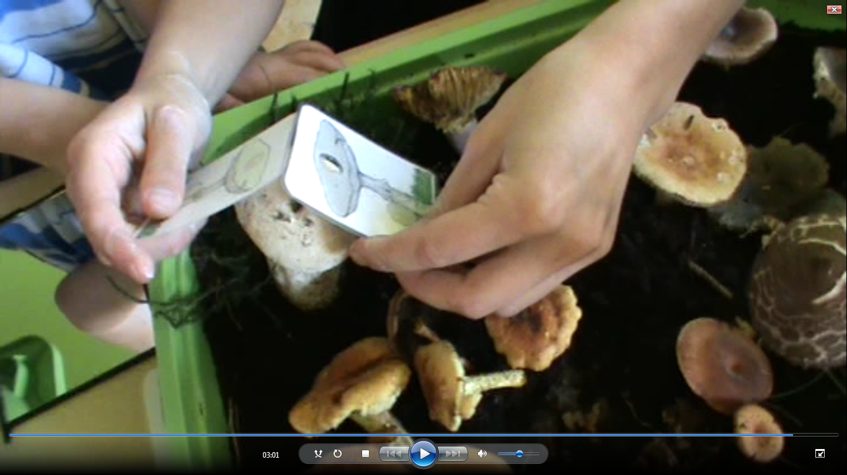
Observation corner ‘autumn’

Slide 22
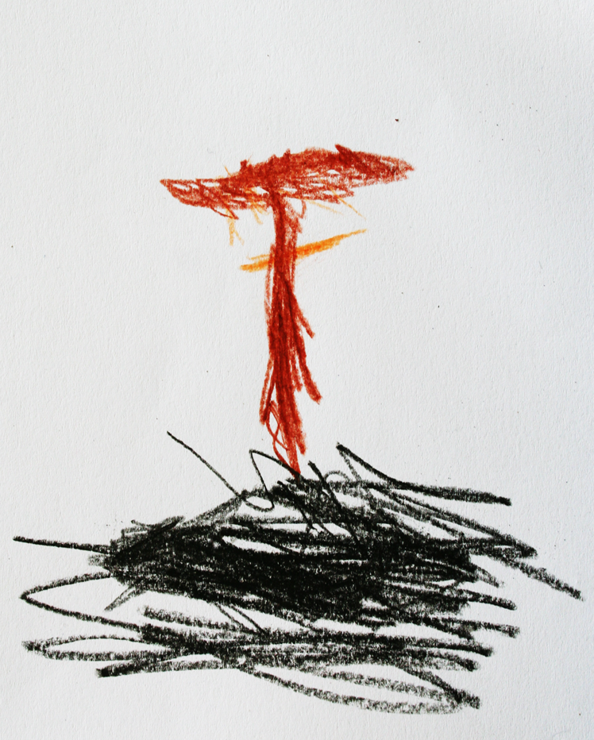
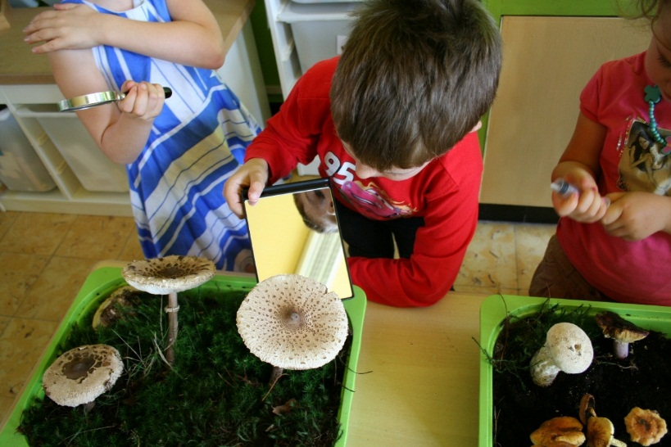
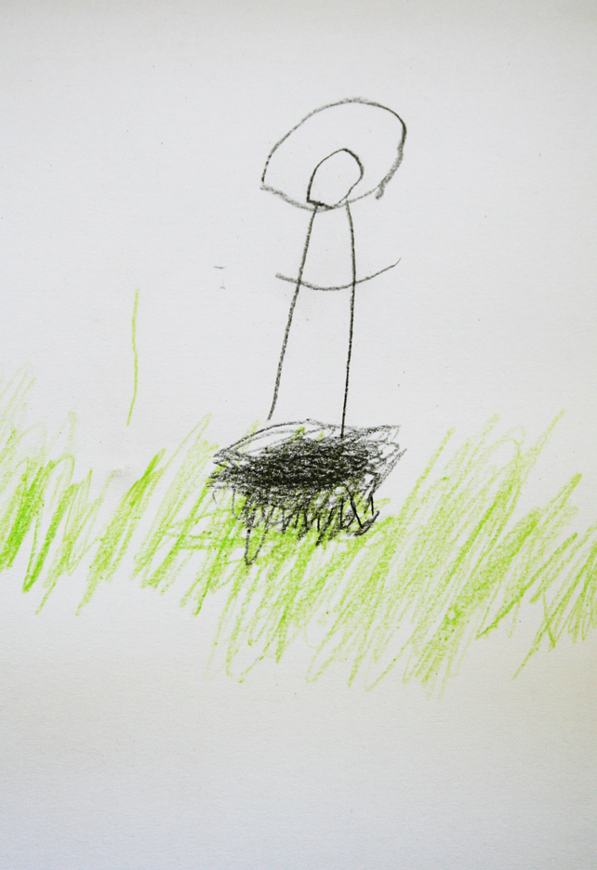
Observation corner ‘autumn’

Slide 23
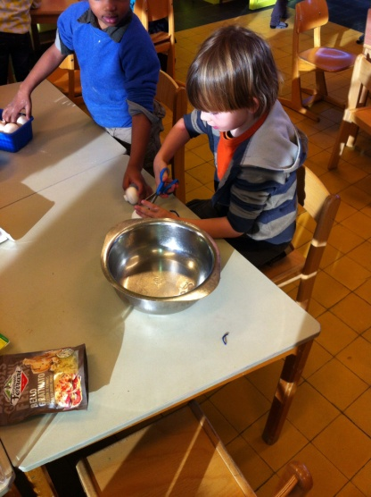
The pizza

Slide 24
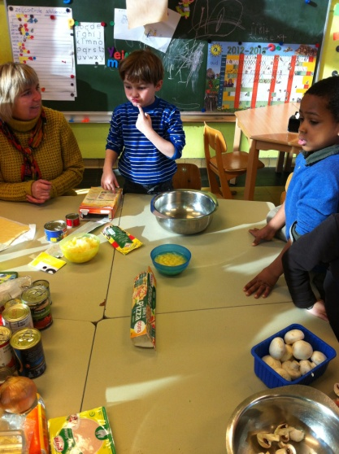
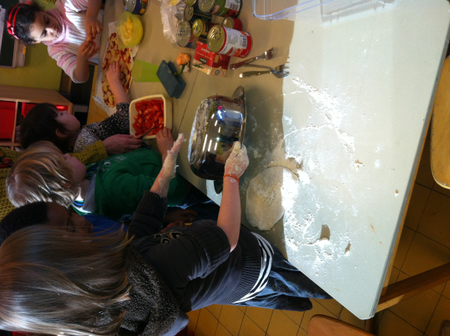
The pizza

Slide 25
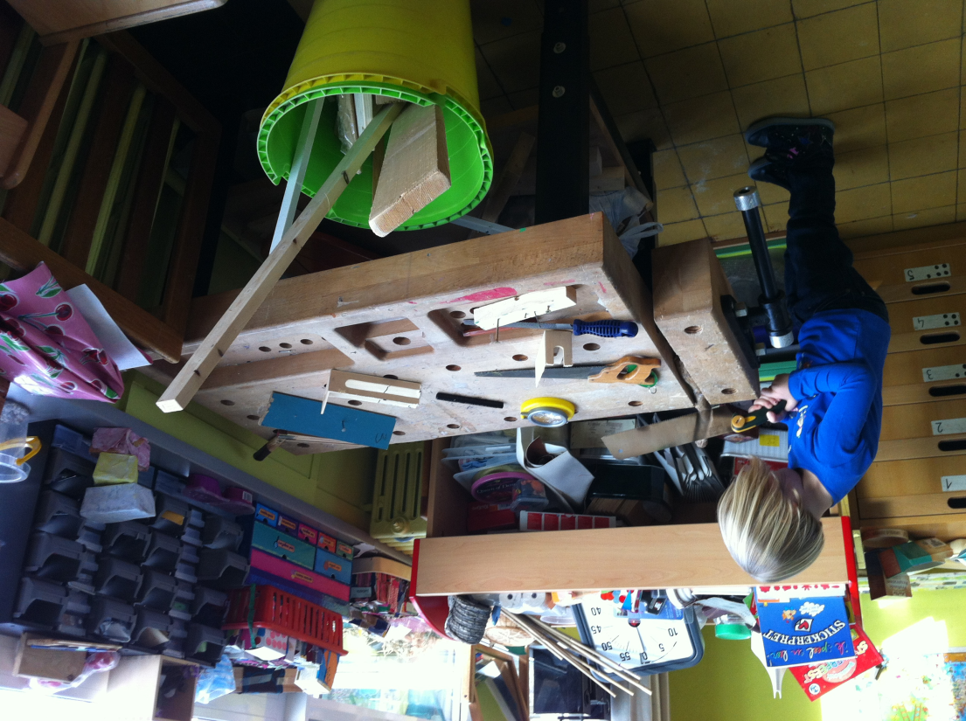
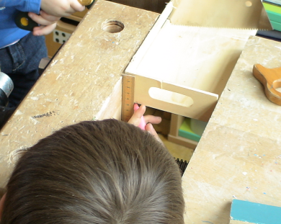
Carpenter corner

Slide 26
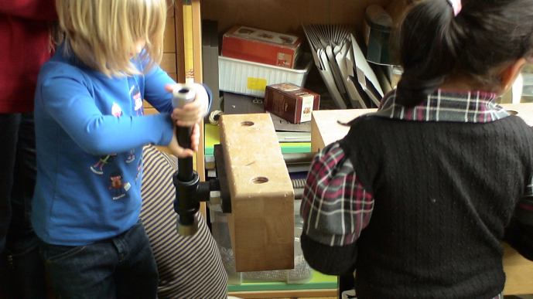
Carpenter corner

Slide 27
Classroom examples: Activity
GROUP 1 | GROUP 2 | GROUP 3 | GROUP 4
Example 1 (colouring cotton) + 2 (observation corner ‘autumn’) | Example 2 (observation corner ‘autumn’) + 3 (the pizza) | Example 3 (the pizza) + 4 (the carpenter corner) | Example 4 (the carpenter corner) + 1 (colouring cotton)
Annotate the copies of the examples with regard to creativity and creative dispositions.
Feedback to the whole group particular strengths within the example and aspects of creativity which need further encouragement.

Slide 28
Whole group discussion
A) Setting and space, number of children, organisation of materials and resources
B) Agency of the children
C) Role of the teacher
D) Nature of the learning activity
E) Opportunities for creativity
F) Opportunities for assessment

Slide 29
Implications for Planning
In pairs discuss one practical investigation you have undertaken in your own classroom and be prepared to share with whole group.
What are the implications for planning to foster creativity in terms of:
arrangement of space (map of the space)
materials and resources
questions which could be used to initiate, support or evaluate children’s investigations and foster their creativity
ways in which children can share, discuss and evaluate results and explanations, how this is encouraged
time

Slide 30
Conclusion
Different elements, including:
setting and space
number of children
organisation of materials and resources
questions which could be used to foster children’s creativity
role of the teacher
nature of the learning activity
… can provide opportunities for fostering children’s creativity in early years science education.

Slide 31
Action planning
In pairs, identify two things to take forward when planning investigations to foster creativity.
Identify an investigation you might carry out:
When will it take place?
How will you structure the activity and assess children’s learning and creativity?

Slide 32
Reflections
In what ways did the different activities support your developing thinking?
2. How far have the aims of the module been met?
Notes:
How to record? List ideas on flip chart.
Back to the aims?

Slide 33
THANK YOU!
What if…

Slide 34
Further information
Creative Little Scientists
(FP7 EU project 2011 – 2014)
Design principles and exemplar materials based on fieldwork www.creative-little-scientists.eu
Creativity in Early Years Science Education
(Erasmus+ EU project 2014 – 2017)
Curriculum Materials and Training Materials for teacher CPD to promote creative approaches to early years science www.ceys‐project.eu

