Slide 1
Training Module 4
Focus on Inquiry-based Science-
Link with Creativity

Slide 2
Introduction to the CEYS project
(use dependent on context)
European Erasmus+ project
Partners in Belgium, Greece, Romania, UK
Continuation of the Creative Little Scientists project http://www.creative-little-scientists.eu
Aims
  Development of a teacher development course and accompanying materials
  Promotion of the use of creative approaches in teaching science in preschool and early primary education (up to age of eight)
Notes:
The Creativity in Early Years Science project is a European Erasmus+ project with partner countries Greece, Romania, Belgium and the UK
As indicated – it aims to develop a European teacher professional development course and accompanying materials to promote the use of creative approaches in teaching science in preschool and early primary education (up to age of eight).
It is a continuation of the project Creative Little Scientists, an FP7 EU project, where curriculum design principles to foster inquiry and creativity in science education were designed.

Slide 3
Aims of the module
Introduce participants to characteristics of inquiry-based approaches to science education
Explore opportunities for creativity within scientific inquiry
Examine connections between inquiry-based and creative approaches to learning and teaching
Consider ways in which practitioners can promote children’s decision making and creativity in science, building on their own ideas and questions
Enable participants to reflect on opportunities for fostering inquiry-based and creative approaches to science, within both policy and practice, in their own educational settings.

Slide 4
Links to Content Design Principles and Outcomes
6. Teacher education should provide pedagogical content knowledge to stimulate inquiry and problem solving in science and mathematics education.
  6.2 Teachers should be able to open up everyday learning activities to allow greater opportunities for inquiry, problem solving and scope for creativity.
  6.3 Teachers should be able to recognise the key roles of children’s questioning and existing ideas (both implicit and explicit) of science and mathematics.
  6.4 Teachers should be able to use a variety of strategies for eliciting and building on children’s questions and ideas during inquiry processes (before, during and after explorations and investigations).
  6.5 Teachers should be able to foster opportunities for children’s agency and creativity in learning in inquiry and problem solving – in particular the importance of children making their own decisions during inquiry processes, making their own connections between questions, planning and evaluating evidence, and reflecting on outcomes.

Slide 5
Rationale for the module
Growing emphasis in policy on scientific literacy
Common inclusion of scientific inquiry skills and ways of working in curriculum requirements
Recognition of the central role of inquiry processes in young children’s science learning
Role of practical inquiry in fostering positive attitudes to science and scientific attitudes – such as curiosity, respect for evidence
Increasing attention to the role of creativity in the development of science ideas and strategies - both in science and in science education.

Slide 6
Key issues for practitioners
What do we mean by inquiry-based science education?
What are the connections with creativity? What might this look like in the classroom?
How might children’s inquiry and creativity be recognised and fostered in everyday classroom activities?
What factors are important in opening up opportunities for children to build on their own ideas and questions, and make decisions during inquiry processes?

Slide 7
Outline of the module
What do we mean by inquiry and creativity in early years science? Introduction to the definition of creativity in science adopted by the CEYS Project
What is meant by scientific inquiry? Practical activities to illustrate key features.
What are the roles of the teacher in supporting inquiry processes? Advantages and disadvantages of open, guided and structured approaches to investigation.
BREAK
What is the potential for inquiry and creativity within everyday classroom activities?
What are the roles of the teacher in fostering inquiry and creativity in children’s learning?
What are the implications for planning?
Reflection on what has been gained from the workshop.

Slide 8

What characteristics do you associate with creativity, science and early learning?
Science
Creativity
?
How might they be related?
Early Years Education

Slide 9
How would you recognise creativity in early years science?
What does creativity look like in science and mathematics in preschool and first years of primary school?
The examples you have been given are lessons that were taught by undergraduate teacher training students, which they believed were creative.
Do you think they are creative? In what ways?
How might opportunities for creativity be extended?
Notes:
Making distinctions between creative teaching and teaching for creativity

Slide 10
Which examples do you think show greatest potential for creativity, and why?
1. Making moving vehicles. The children designed their own cars with no set format or guidance. The children had individual and fantastic ideas. They then made the vehicles from a cardboard box and decorated them. The children were extremely passionate and were more talkative as it was their own ideas and their personal work. (4 & 5-year olds)
3. I taught push and pull through hands-on tasks outdoors. The children were enthusiastic. (5 & 6-year olds)
5. The children had to do an experiment individually where they had to test what material soaked up the most water. They had to make it a fair test by using the same amount of water each time and same amount of material. They measured the water then tested cotton wool, paper towels, kitchen roll, plastic bags and sponge. Giving each a mark out of 3 on effectiveness. They were all involved and it helped to get them interested in science. (6 & 7-year olds)
4. Went on a ‘habitats walk’ outside. Saw the effect of changing the learning environment on motivating learning. The children were allowed to ask any questions they wanted to find out about. They tried to answer these through observation and investigation. (5 & 6-year olds)
2. Exploring what light travels through. They were able to explore their own choices of items and make their own decisions. They were excited and motivated to find out more. They were also eager to create their own investigations. (6 & 7-year olds)

Slide 11
Connecting Inquiry Based Science Education and Creative Approaches
Inquiry-based Science Education
Creative Dispositions
Sense of initiative
Motivation
Ability to come up with something new
Making connections
Imagination
Curiosity
Ability to work together
Thinking skills
(for example Chappell et al 2008)
Questioning
Designing and planning investigations
Gathering evidence
Making connections
Explaining evidence
Communicating explanations
(for example Minner et al 2010)
From Creative Little Scientists, 2012

Slide 12
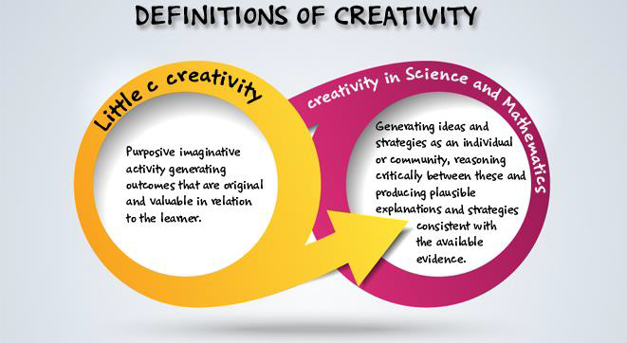
Definitions of creativity adopted by the CEYS project
(from Creative Little Scientists, 2014)

Slide 13
Synergies between inquiry-based and creative approaches
From the Conceptual Framework adopted by the CEYS Project (Creative Little Scientists, 2012)
Play and exploration
Motivation and affect
Dialogue and collaboration
Problem solving and agency
Questioning and curiosity
Reflection and reasoning
Teacher scaffolding and involvement
Assessment for learning

Slide 14

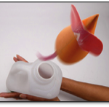
Opportunities for developing inquiry skills?
Ear Gongs
Rocket Mice
http://www.sciencemuseum.org.uk/educators/classroom_and_homework_resources.aspx

Slide 15
What is meant by scientific inquiry?
In groups of 2/3 – Try out one of the practical activities
1. List inquiry skills and processes you used.
Which did you engage in spontaneously?
Which might need further support/encouragement?
What is the scope for creativity?
2. What opportunities did you have for decision making?
Locate yourself on the Barrow Chart. Did this change over time?
3. What ideas and questions did you generate?
How might your inquiry be extended?
What are the implications?
As a whole group share experiences
What aspects of inquiry might need particular support?

Slide 16
Varied roles over time
Essential features of classroom inquiry and their variations (Barrow, 2010, p. 3)
Learner poses a question
Question provided by teacher
Essential features | Variations
Learner engages in scientifically orientated questions | Learner poses a question | Learner selects among questions, poses new questions | Learner sharpens or clarifies question provided by teacher, materials or source | Learner engages in question provided by teacher, materials and source
Learner gives priority to evidence in responding to questions | Learner determines what constitutes evidence and collects it | Learner directed to collect certain data | Learner given data and asked to analyse | Learner given data and told how to analyse
Learner formulates explanations from evidence | Learner formulates explanations after summarising evidence | Learner guided in process of formulating explanations from evidence | Learner given possible ways to use evidence to formulate explanation | Learner provided with evidence
Learner connects explanations to scientific knowledge | Learner independently examines other resources and forms links to explanations | Learner directed toward areas and sources of scientific knowledge | Learner given possible connections
Learner communicates and justifies explanations | Learner forms reasonable and logical argument to communicate explanations | Learner coached in development of communication | Learner provided broad guidelines to sharpen communication | Learner gives steps and procedures to communication
More…….................................................................Amount of Learner Self-Direction…….......................................................................Less
Less……...........................................................Amount of Direction from Teacher Material…….............................................................More

Slide 17
Open, guided, structured inquiry:
Advantages and disadvantages?
In pairs discuss the 3 different approaches to the fliers activity shown on the sheet provided (or another common classroom investigation).
List the advantages and disadvantages of each approach.
As a whole group record advantages and disadvantages of each approach on a flip chart.
Consider links to your previous activity.
How might different types of inquiry have an impact on opportunities for creativity?

Slide 18
Potential for inquiry and creativity in everyday classroom activities?
In 4s consider opportunities for children’s inquiry and creativity in one example (review others briefly).
Which features of the inquiry process can you see in each example?
What are the opportunities for children’s decision-making linked to the Barrow chart?
Do you think this is an example of an open, guided or structured inquiry? Why?
What evidence can you identify of children’s creativity?
How could the activity be extended?
As a whole group share key features of the 4 different examples.

Slide 19
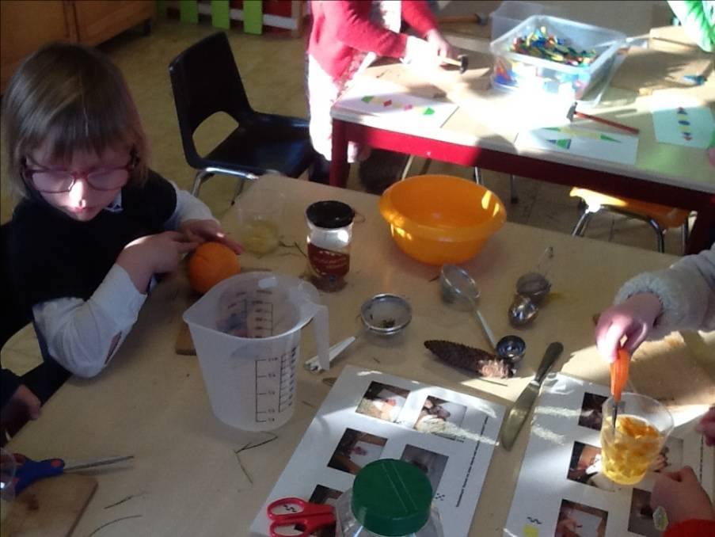
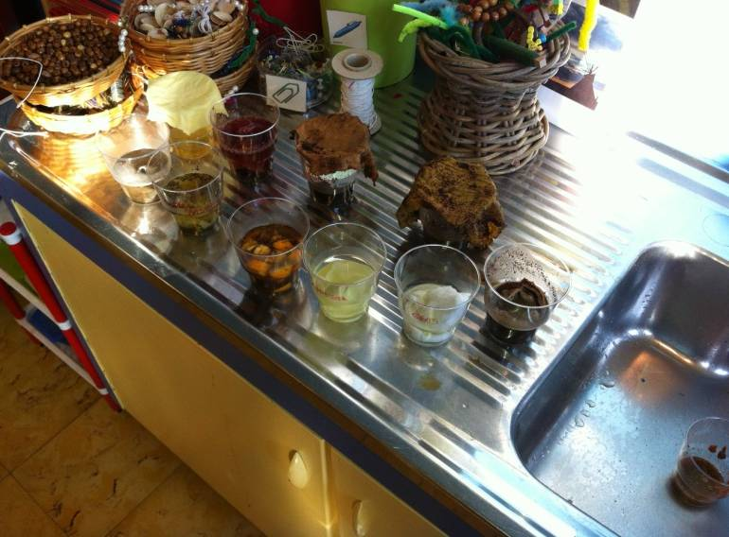
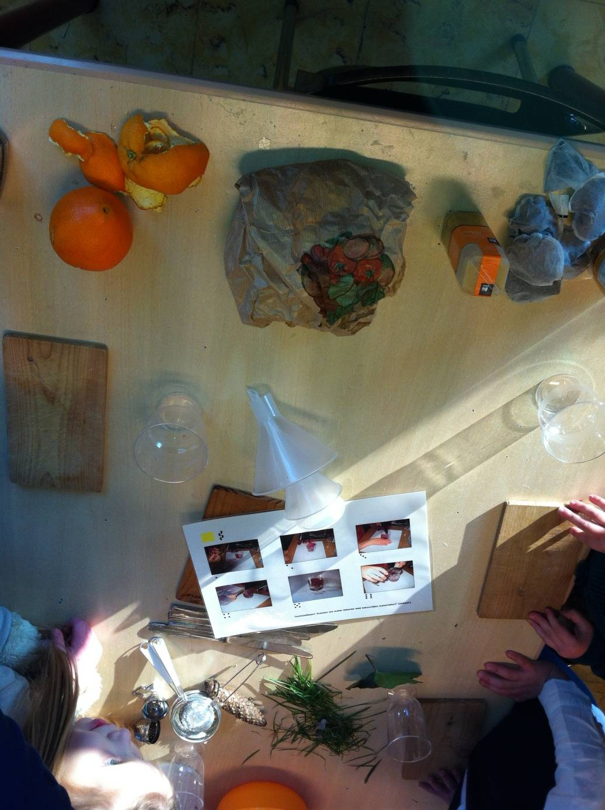
Colouring – extracting dyes from natural materials
Children selecting their own materials and equipment

Slide 20
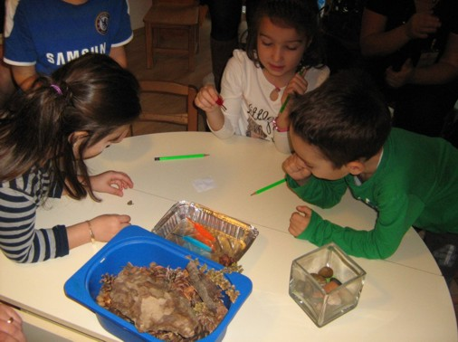
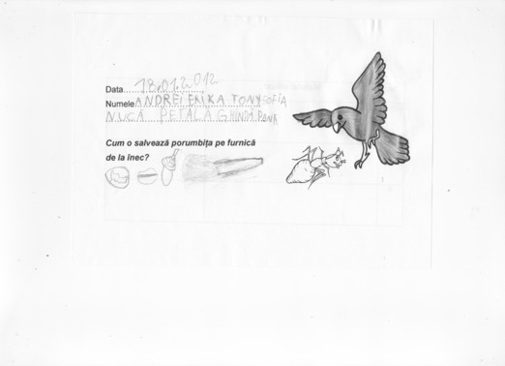
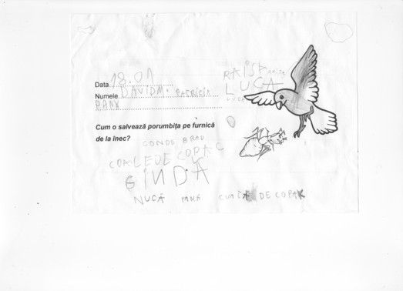
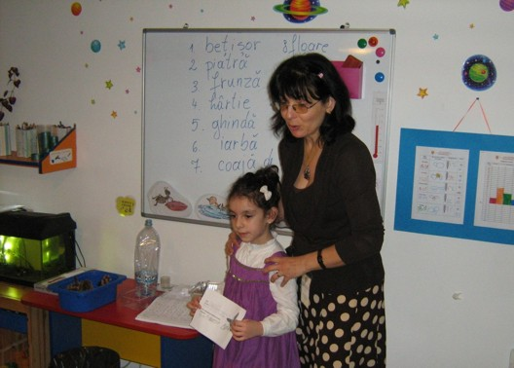
Float or Sink?
How can you rescue the little ant that fell in the river?
Notes:
Then one day, the little ant fell into a river. A dove flying by saw what happened and wanted to help the ant.
Later, Maria suggested that the children run an investigation to identify the best idea to solve the problem. The children were given small containers with water in order to verify what materials existing in the forest could be used as little ‘boats’ for the ant. A variety of materials were made available including nuts, feathers, wooden sticks, leaves, little stones, acorns, pieces of bark, fir cones, etc. Maria asked every group to come to the front table and to take the materials they thought were the most suitable for the task to save the ant, items they intended to test. Children had to predict which objects would float.

Slide 21
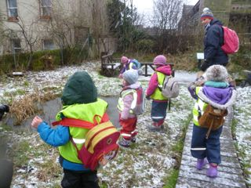
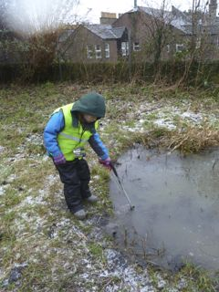
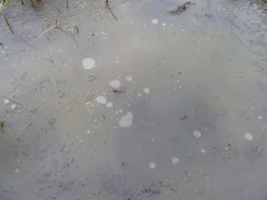
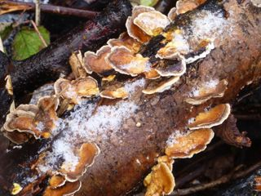
Forest School
Opportunities to observe change in the natural environment over time.

Slide 22
What are the roles of the teacher?
In groups of 4 examine the role of the teacher
In what ways do you think the teacher fostered children’s creativity and inquiry?
How was support provided for children’s decision making in each case?

Slide 23
Synergies between inquiry-based and creative approaches
From the Conceptual Framework adopted by the CEYS Project (Creative Little Scientists, 2012)
Play and exploration
Motivation and affect
Dialogue and collaboration
Problem solving and agency
Questioning and curiosity
Reflection and reasoning
Teacher scaffolding and involvement
Assessment for learning

Slide 24
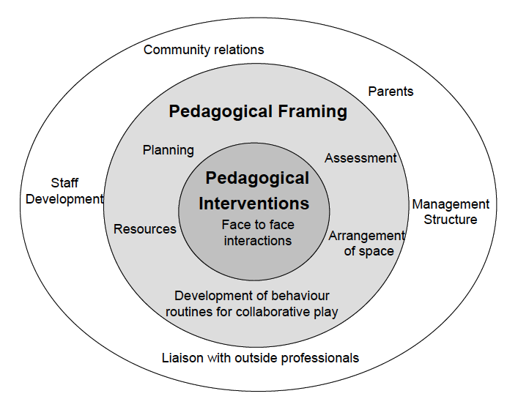
Pedagogical interventions in context
(Siraj Blatchford et al., 2002)

Slide 25
Implications for planning?
Take a favourite science activity you carry out in your setting. How could opportunities for creativity be extended?
What could you feed back to colleagues: What does it mean to teach science creatively? Why does it matter?
What are the implications for addressing curriculum requirements in your setting?
Key issues and questions raised?

Slide 26
Reflections
In groups 2/3s
Look back at your original ideas about connections between science/creativity/early years education. Anything you might add or change? Add in any additional comments or issues in another colour (pen/post it).
Note and record 2 actions you will take building on module content.
In what ways did the different activities support your developing thinking?
How far have the aims of the module been met?
Complete the module evaluation form.

Slide 27
Further information
Creative Little Scientists
(FP7 EU project 2011 – 2014)
Design principles and exemplar materials based on fieldwork www.creative-little-scientists.eu
Creativity in Early Years Science Education
(Erasmus+ EU project 2014 – 2017)
Curriculum Materials and Training Materials for teacher CPD to promote creative approaches to early years science www.ceys‐project.eu

Slide 28

THANK YOU!

Slide 29

Acknowledgements
Creativity in Early Years Science EDUCATION (2014-2017) www.ceys-project.eu
© 2017 CREATIVITY IN EARLY YEARS SCIENCE EDUCATION Consortium
This work is licensed under the Creative Commons Attribution-NonCommercial-NoDerivatives 4.0 International License. To view a copy of this license, visit http://creativecommons.org/licenses/by-nc-nd/4.0/.

