Slide 1
Training Module 3
Focus on the nature of science

Slide 2
Introduction to the CEYS project
(use dependent on context)
European Erasmus+ project
Partners in Belgium, Greece, Romania, UK
Continuation of the Creative Little Scientists project http://www.creative-little-scientists.eu
Aims
  Development of a teacher development course and accompanying materials
  Promotion of the use of creative approaches in teaching science in preschool and early primary education (up to age of eight)
Notes:
The Creativity in Early Years Science project is a European Erasmus+ project with partner countries Greece, Romania, Belgium and the UK
As indicated – it aims to develop a European teacher professional development course and accompanying materials to promote the use of creative approaches in teaching science in preschool and early primary education (up to age of eight).
It is a continuation of the project Creative Little Scientists, an FP7 EU project, where curriculum design principles to foster inquiry and creativity in science education were designed.

Slide 3
Questions for the module
What is the relevance of nature of science to early years science education?
What kinds of teaching and learning approaches might be appropriate to support children’s developing understanding of the nature of science?
Why is it important for teachers to reflect on their views of the nature of science?
Notes:
This session seeks to explore the relevance of the nature of science to early years science
In what ways can ideas about the nature of science be nurtured in the early years
In what ways might teachers’ views of the nature of science impact on their work in classrooms?

Slide 4
Rationale and aims for science education
Economic imperatives
Scientific literacy for citizens
Technological developments
Implications for aims of science education
  Focus on nature of science
  Community
  Positive attitudes
  Inquiry Based Learning
Growing evidence of the influence of teacher attitudes to science
Notes:
Considerable debate in recent years about the importance and purposes science education, reflected in documentation at EU level and in discussions in science education community UK in recent years that has contributed to growing emphasis on the nature of science. Common themes include:
Economic imperatives- both supply of future scientists and technically skilled workforce, and to complete globally the need for individuals who have the skills and competencies to apply knowledge in innovative ways, concerns about lack of take up of science and declining attitudes to science across the primary school.
Growing emphasis on scientific literacy for citizens – importance of science and mathematics education not just for future jobs and the needs of the economy – but for all as an individual and as part of a community - to participate in democratic processes - to make decisions in the context of access to vast quantities of information and in using new technologies, need to develop skills and dispositions for 21st century when futures are uncertain and knowledge changing rapidly.
Technological developments – offer new opportunities not just for assessing learning but shaping learning processes – how to take advantage of these new opportunities (especially in relation to capturing sharing and discussing ideas), as well as considering their limitations
Changes in society’s perception of science have led to changing perceptions of how it should be taught in schools. This includes emphasis on children understanding the nature of science, social and cultural aspects, notion of science as a human construction building on evidence and involving argumentation within a community.
There is greater acknowledgement of the need to foster positive attitudes to science and involve children in debate around contemporary issues.
Science should not be presented to children as something divorced from their everyday lives, rather the importance of helping children draw personal meaning, promoting the role of inquiry and creativity in questioning and interpreting the world around them.

Slide 5
Growing attention to the nature of science
“The ‘nature of science’ has become an important concern in the curriculum. This often means the rejection of the stereotypical and false image of science as a simple search for objective and final truths based on unproblematic observations.
The recent emphasis on understanding the nature of science is related to the attempt to give more attention to its social, cultural and human aspects. Science is now to be presented as knowledge that is built on evidence as well as upon arguments deployed in a creative search for meaning and explanation”
(Gago et al., 2004: 138).
Notes:
This increased attention in general terms is expressed by this comment.
As suggested this session provides an opportunity to consider the relevance of this to teachers and early years science.

Slide 6
Aims of the module
Introduce participants to current perspectives on the nature of science
Examine arguments for the relevance of the nature of science in early years science education
Explore ways in which teachers can support children's developing understanding of the nature of science and challenge stereotypical images of science and scientists
Discuss the importance of teachers' views of the nature of science and ways in which they can influence opportunities for children's creativity and inquiry in their science learning

Slide 7
Links to Content Design Principles and Outcomes
3. Teacher education should advance teachers’ understandings about the nature of science and how scientists work, confronting stereotypical images of science and scientists.
  3.1 Teachers should be able to advance children’s understanding about the nature of science and how scientists work, confronting stereotypical images of science and scientists.
  3.2 Teachers should be able to recognize young children’s capabilities to engage with processes associated with the evaluation as well as generation of ideas in science and mathematics, since these processes are also important for the development of learner creativity.
  3.3 Teachers should be able to foster the processes of imagination, reflection and consideration of alternative ideas in supporting children’s understanding of scientific ideas and procedures and development of creativity.
Notes:
This workshop is connected to some of the key Curriculum Design Principles and Outcomes developed in the Creative Little Scientists project
And as yesterday uses classroom examples from the project to address the following aims and objectives

Slide 8
Mystery Boxes
This is a resource developed by the London Science Museum available at http://www.sciencemuseum.org.uk/educators
Activity 1
Work in groups to try and discover what is inside each of the boxes without opening them.
Record your observations.
Come up with your best idea based on your evidence.
Notes:
Hand out a mystery box and observation sheet to each group of 4/5
3- 4 minutes to work out what’s in the box.

Slide 9
What is inside the box?
Prompt Questions
What material do you think the item is made from?
How much space does the item take up inside the box?
How does the item move inside the box?
What shape do you think it is?
Can you draw what you think it looks like?
Notes:
Encourage groups to make notes on their observation sheet justifying their ideas.
Come up with the best idea and record on a post it note.

Slide 10
Activity 2
In your groups think about and write a list of all the different skills and approaches you used to work out what was inside each box.
Notes:
2- 3 minutes

Slide 11
What skills and approaches did you use?
Prompt Questions
How did you know it was made of this material?
Did anyone work in silence?
Did you investigate all the boxes in the same way?
How did you decide on your group’s idea?
Did anyone suggest an idea that you tested?
Did you try and picture in your head or draw what was inside the box?
Notes:
Prior knowledge
Discussion
Systematic approach
Negotiation / reasoning / discussion
Hypothesis / testing / drawing conclusion
Imagination / visualisation / creativity

Slide 12
Mystery Boxes
Skills used: discussion, developing an argument, observation, negotiation and teamwork.
Scientists generate scientific theories based on evidence, but they do not find definitive answers.
Scientific knowledge and ideas change over time and are open to further revision as our understanding of the world around us evolves.
Science is a social and creative activity.
Notes:
Scientists propose ideas and test them.
Discussion is a vital part of science.
Science is both social and creative.

Slide 13
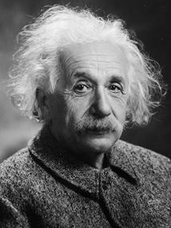
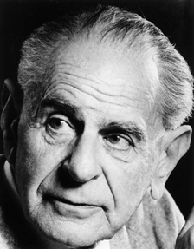
“Science is a history of
corrected mistakes.”
Karl Popper (1902-94)
“The important thing is
not to stop questioning.”
Albert Einstein (1879-1955)

Slide 14
“Most scientists will concede that, although they seek truth, they don’t know or generate truth. They propose and test theories, knowing that future evidence may cause refinement, revision, or even rejection of today’s theories...
However, we can reach the best possible conclusion based on the most complete and modern evidence available.”
Dr Bruce Railsback, University of Georgia

Slide 15
Scientists and Mystery Boxes
Watch:
https://www.youtube.com/watch?v=iH7SaE8-qEo
Mystery Boxes is a resource developed by the London Science Museum available at http://www.sciencemuseum.org.uk/educators

Slide 16
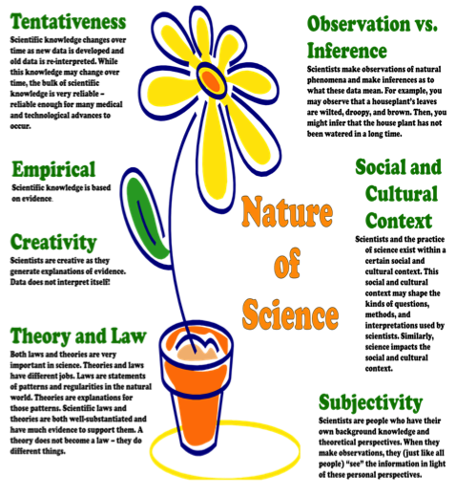
Features of the Nature of Science
(Akerson et al, 2011, p64)
Notes:
Empirical – based on evidence
Tentative – changes in light of new data/ interpretations of data
Creative – involves imagination and creativity
Subjective – influenced by knowledge and perspectives
Social and cultural context – influences both practices of science and impact
Law (pattern/regularity) and Theory (explanation)

Slide 17
Reflections on experience: Links to the nature of science
On your own:
Can you think of any examples to illustrate the nature of science from your
everyday life
experiences at the workshop
experiences in the classroom?
Record your ideas on post-its - to share with the group.
Notes:
Individually write a post it - one on each category –- don’t worry if you do not have an example in a particular category
We will then share ideas and collate

Slide 18
In your groups:
Pool your ideas.
Place them into groups on the sheet
provided.
Annotate to illustrate specific links
to the Akerson flower poster.
Are there any common themes?
Are there any characteristics of the NoS that are easier/harder to illustrate?
What images of science were presented in your own school experience of science?

Slide 19
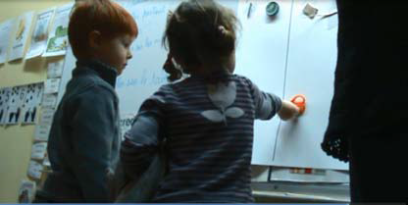
Magnetic attraction or not: Children age 3-6
Notes:
This classroom example involved the children exploring whether some given objects are
attracted to a magnet or not. Included in the objects were pairs of scissors
which were made out of iron and plastic, so part of the scissors were
magnetic and part of them were not magnetic.
The activity was initiated by the teacher and involved children working in small groups (n=5-6) testing the objects and then as a whole group (n=13) for the discussion of their findings and the formation of a collective statement about the magnetic properties of materials.
In the small group activities the teacher discussed the children’s discoveries with them and helped them sort out their categories - ‘Magnetic’ and ‘Non-magnetic’.
The teacher emphasised the importance of children testing their objects during
the first phase in order to have evidence to be able to justify their own
decisions about the magnetic properties of the objects.
In the next phase of this episode the children worked together as a whole

Slide 20
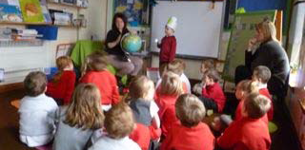
Day and night:
Children age 5-6
Notes:
Based on children’s questions
Variety of activities – role play, links to prior experience
Varied modes of recording
Teacher sharing her enthusiasm with her new app on the ipad – learning together and wondering at the images with the children

Slide 21
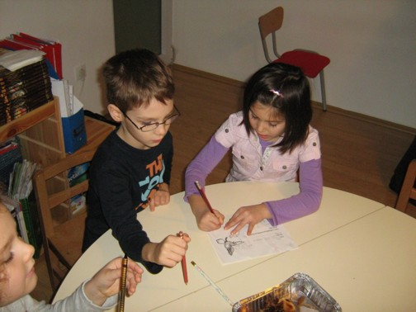
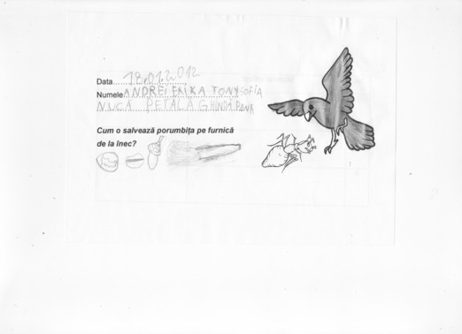
Float and sink:
Children age 5-6
Notes:
Story as a starting point
Encouraging children’s suggestions for what they might test
Deliberate planning of sharing of findings – teacher questioning to focus on evidence to support children’s views

Slide 22
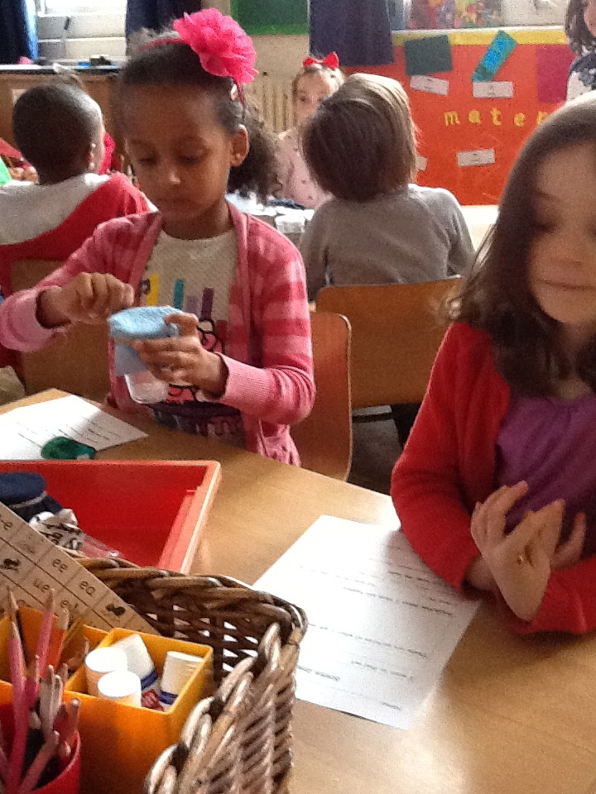
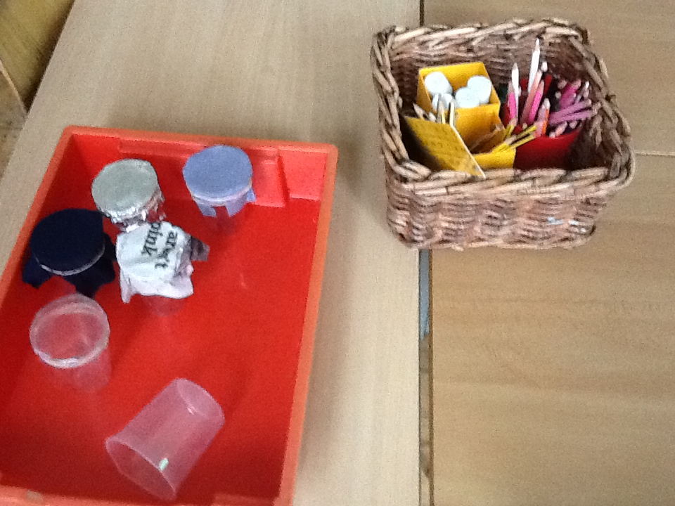
Waterproofing: Children age 5-6
Notes:
The session on Waterproof Materials was part of a half term science-based project on materials. The context for the session was the need to select the best material to make an umbrella. Emily began the lesson by talking about the class puppet MAX who needed a new umbrella because he had left his on the bus. Emily then explained that MAX wanted to see them as real scientists who can record. She showed the sheet for recording and emphasised the task was collaborative. They needed to work out how to carry out their investigations, share tasks between them and agree on the findings in order to give advice to MAX.

Slide 23
Discussion of classroom examples
Work in groups of 4/5 – 1 example each group.
Which aspects of Nature of Science are evident in the examples offered ?
What makes you think this?
Which aspects are discussed with the children and made explicit by the teacher and how?
Annotate your copy of the Ackerson poster to indicate links with your example
Discuss with the other group on your table
Brief feedback altogether

Slide 24
How might teachers draw attention to the nature of science?
What are the implications for the curriculum: Aims, teaching, learning, assessment and contextual factors?
Read through the Learning Journey of ‘Plants’.
How does the teacher build the nature of science into her planning in relation to:
  Learning objectives
  Contexts for science
  Ways of organizing class
  The nature of activities
  Questions she asks
  Children's reporting and recording
  Assessment
  Any other considerations?
Notes:
Powerpoint slides of creative dispositions, CEYS definition of creativity in science and scientific attitudes. Note connections to conceptual framework for the CEYS project in particular creative dispositions and the definition of creativity in science.

Slide 25
Implications for the curriculum
Assessment
Aims
Children’s reporting and recording
Contexts
Class organisation
Questions
she asks
Nature of activities

Slide 26
Whole group feedback
What have you found?
How might these approaches impact on children's attitudes to science or scientific attitudes such as curiosity or critical reflection?

Slide 27
Questioning to support reflection
What do we already know?
How might we find out? Are there any other suggestions?
What have you observed?
Have you noticed any patterns ?
How could you explain this? Are there any alternatives?
How have your ideas changed? Why?
In what ways are we acting like scientists?
Use of evidence, creativity in design and interpretation, influence of background knowledge, tentative – change in ideas.
Supported by working in teams, reflective notebooks, peer assessment

Slide 28
Application to classroom planning
Work in groups of 2/3
Select a recent science topic you have explored in your classroom
How might the activities be extended to enhance understanding of the nature of science?
Whole group
What would you say to convince a colleague of the relevance of the nature of science in primary science?
How might this link to your curriculum content?

Slide 29
Summary issues
Children’s different strategies and ideas offer important starting points for inquiry in science
Creativity central in science – in coming up with different ideas or interpretations
Role of debate, reasoning and discussion to generate and evaluate ideas
Importance of explicit discussion of aspects of NoS with young children.

Slide 30
Further information
Creative Little Scientists
(FP7 EU project 2011 – 2014)
Design principles and exemplar materials based on fieldwork www.creative-little-scientists.eu
Creativity in Early Years Science Education
(Erasmus+ EU project 2014 – 2017)
Curriculum Materials and Training Materials for teacher CPD to promote creative approaches to early years science www.ceys‐project.eu

Slide 31

THANK YOU!

Slide 32

Acknowledgements
Creativity in Early Years Science EDUCATION (2014-2017) www.ceys-project.eu
© 2017 CREATIVITY IN EARLY YEARS SCIENCE EDUCATION Consortium
This work is licensed under the Creative Commons Attribution-NonCommercial-NoDerivatives 4.0 International License. To view a copy of this license, visit http://creativecommons.org/licenses/by-nc-nd/4.0/.

