Slide 1
Training Module 2
Resources and learning environment as essential context factors for Creativity and Inquiry

Slide 2
Aims of the module
Introduce the role of resources and the learning environment in inquiry-based and creative approaches to early years science education.
Share strategies and experiences for recognizing and building on available resources and the learning environment.
Increase awareness of the different opportunities that everyday resources and learning environments offer.

Slide 3
Links to Content Design Principles and Outcomes 1
7. Teacher education should familiarise teachers with a range of formal and informal inquiry- and creativity-based learning, teaching and assessment approaches and strategies and their use in relation to authentic problems within the areas of science and mathematics.
  7.5 Teachers should be able to use a range of creative contexts and approaches for provoking children’s interest, motivation and enjoyment in science and mathematics, such as stories, poems, songs, drama, puppets, and games.
14. Teacher education should equip teachers with knowledge and skills to use a range of formal, non-formal and informal learning environments, including the outdoor environment, both the school grounds and the wider environment beyond the school, in their teaching of science and mathematics.
  14.1 Teachers should be able to make use of varied settings for science and mathematics learning, including flexible use of the environment both indoors and out.
  14.4 Teachers should be able to manage visits with children to the outdoor and wider environment beyond the school, addressing issues of health and safety, liaison with parents, building progression in experience inside the classroom.

Slide 4
Links to Content Design Principles and Outcomes 2
17. Teacher education should address with teachers issues in ensuring rich provision, planning and use of resources (including digital resources) in and out of the classroom to support children’s inquiry and creativity.
  17.1 Teachers should be able to organise and use materials (including everyday materials), resources (including ICT and natural resources) and equipment (including digital equipment and simple laboratory instruments) in the classroom, school and wider environment, both indoors and out, to support independent inquiry and creativity.
  17.2 Teachers should be able to recognize the nature and potential of different materials and resources both to constrain and extend children’s explorations.
  17.3 Teachers should be able to evaluate and select creativity enabling ICT resources for children to use in their inquiry.

Slide 5
Module outline
Introduction to the CEYS project
Creativity and inquiry in in the early years science
Sharing current practices, questions and issues
Exploring opportunities
  Outdoor environment
  Indoor environment
Resources
Discussion & reflection on classroom examples
Implications and reflections on the module

Slide 6
Introduction to the CEYS project
(use dependent on context)
European Erasmus+ project
Partners in Belgium, Greece, Romania, UK
Continuation of the Creative Little Scientists project http://www.creative-little-scientists.eu
Aims
  Development of a teacher development course and accompanying materials
  Promotion of the use of creative approaches in teaching science in preschool and early primary education (up to age of eight)
Notes:
The Creativity in Early Years Science project is a European Erasmus+ project with partner countries Greece, Romania, Belgium and the UK
As indicated – it aims to develop a European teacher professional development course and accompanying materials to promote the use of creative approaches in teaching science in preschool and early primary education (up to age of eight).
It is a continuation of the project Creative Little Scientists, an FP7 EU project, where curriculum design principles to foster inquiry and creativity in science education were designed.

Slide 7
Connecting Inquiry Based Science Education and Creative Approaches
Inquiry-based Science Education
Creative Dispositions
Sense of initiative
Motivation
Ability to come up with something new
Making connections
Imagination
Curiosity
Ability to work together
Thinking skills
(for example Chappell et al 2008)
Questioning
Designing and planning investigations
Gathering evidence
Making connections
Explaining evidence
Communicating explanations
(for example Minner et al 2010)
From Creative Little Scientists, 2012
Notes:
A key challenge for the Creative Little Scientists project was to define what we mean by creativity in science and mathematics. We often use the term ‘creativity’ in rather general terms – and it appears also in policy documents – but what exactly does that mean.
Drawing on a wide range of sources and discussions with stakeholders from the early years and science education communities we developed the following definitions that are a central feature of the project.

Slide 8
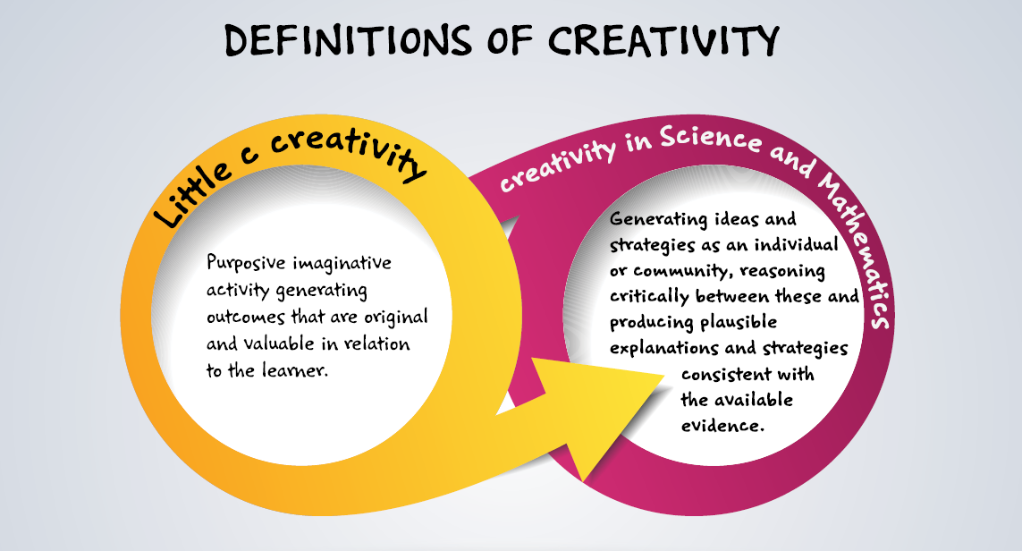
Conceptual Framework

Slide 9
Why are resources and the learning environment important?
A rich learning environment may
stimulate curiosity and trigger children to question the world around them;
help develop insights about scientifically relevant concepts;
foster children’s agency in problem finding and solving.
Outdoor environment
Indoor environment
Resources

Slide 10
Starting points
Write down what you would like to learn during the session and any questions.
Record your existing practices
  Outdoor environment
  Indoor environment
  Use of resources

Slide 11

Explore the outdoor environment
30 minutes exploration of the outdoor environment
Take pictures of situations/objects that raise questions
Question to think about:
  What aspects are important to trigger your curiosity?
This raises questions - I want to know more about this!

Slide 12
What triggered your curiosity?
Email pictures to
..@..

Slide 13
What triggered your curiosity?
What aspects were important to trigger your curiosity?
Are there common elements? Are there differences?
Opportunities in the outdoor environment to identify scientific insights, questions?
Use of tablets/smartphones? Materials?
What would you investigate? What kinds of investigations could you set up?

Slide 14

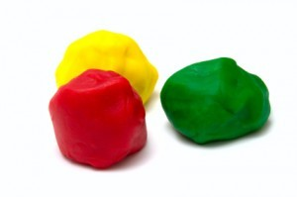
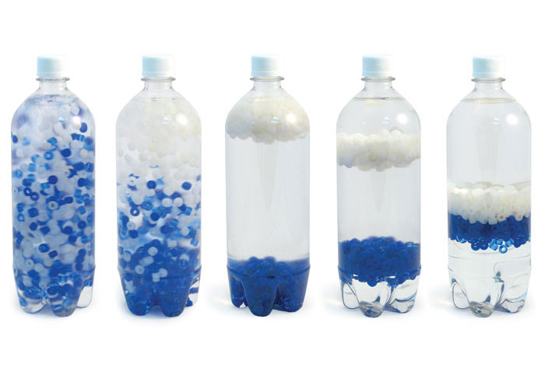
What kinds of resources may stimulate creativity?

Slide 15
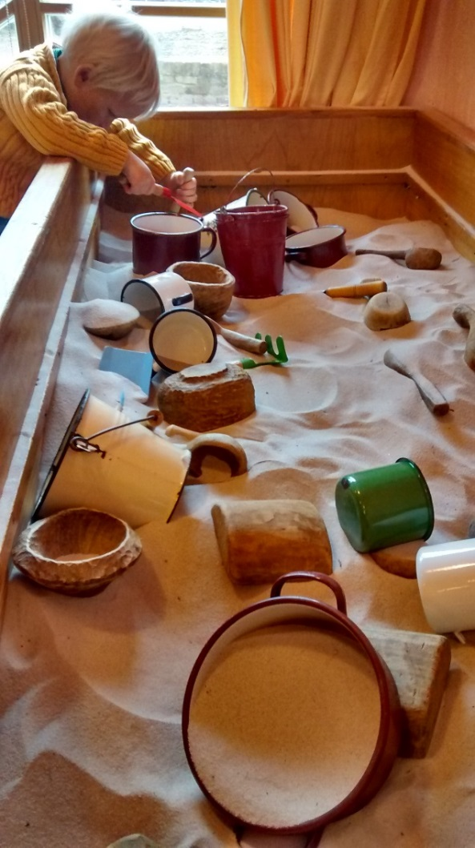
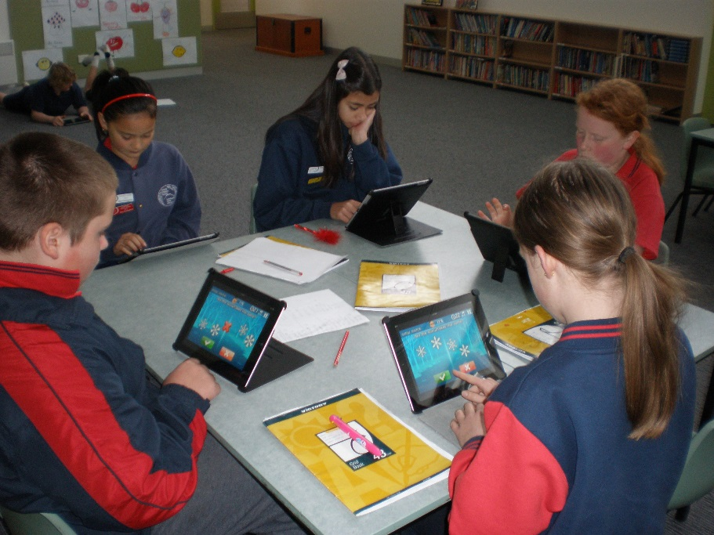
Analysing pictures of the indoor environment

Slide 16
Resources and learning environment:
Essential context factors for Creativity and Inquiry?
Learning environment:
  Flexible use
  A general sense of openness and spaciousness
  Display of work in progress
  …
Wide range of materials, tools and other resources
Outdoor environment:
  More use of outdoor environment
  A rich context for discovering children’s interests
  Ownership and collaboration

Slide 17
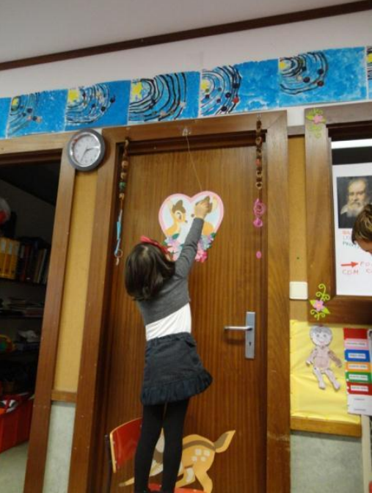
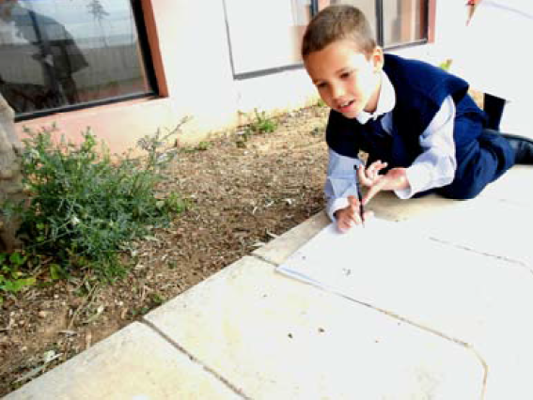
Classroom examples: Discussion and reflection
Forest School
Minibeasts
Swing game rope

Slide 18
Discussion and reflection on classroom examples
How can the indoor and outdoor environment, and resources influence and enhance the science learning of the children?
What is the role of the teacher in the examples?
How do they stimulate children to use the resources and to explore the environment?
What would you do (differently) in your classroom?

Slide 19
Apply insights to your own classroom
Experiences from the workshop
Own practice
What approaches do you find useful in stimulating children to explore the learning environment and resources?
What challenges have you faced?

Slide 20
Implications
Enriching current practices (adding to your examples at the start of the module)?
Implications for planning?
Approaches to stimulating children’s exploration of the learning environment and resources?
Common challenges and possible solutions?
Notes:
Common challenges:
The teachers must connect the early scientific concepts of the children with more formal scientific concepts.
By providing a rich physical environment teachers may engage interest and foster curiosity.
Teachers need to see the link between the everyday environment and lives of the children and the physical concepts within it.
Teachers need to see the opportunities that digital technologies may offer.

Slide 21

Notes:
In what ways did the different activities support your developing thinking?
How far have the questions at the start of the session been answered?
Do you still have new questions that need addressing?

Slide 22
Further information
Creative Little Scientists
(FP7 EU project 2011 – 2014)
Design principles and exemplar materials based on fieldwork www.creative-little-scientists.eu
Creativity in Early Years Science Education
(Erasmus+ EU project 2014 – 2017)
Curriculum Materials and Training Materials for teacher CPD to promote creative approaches to early years science www.ceys‐project.eu

Slide 23

THANK YOU!

Slide 24

Acknowledgements
Creativity in Early Years Science EDUCATION (2014-2017) www.ceys-project.eu
© 2017 CREATIVITY IN EARLY YEARS SCIENCE EDUCATION Consortium
This work is licensed under the Creative Commons Attribution-NonCommercial-NoDerivatives 4.0 International License. To view a copy of this license, visit http://creativecommons.org/licenses/by-nc-nd/4.0/.

