Slide 1
Training Module 19
Nature of CreATiViTy

Slide 2
Introduction to the CEYS project
(use dependent on context)
European Erasmus+ project
Partners in Belgium, Greece, Romania, UK
Continuation of the Creative Little Scientists project http://www.creative-little-scientists.eu
Aims
  Development of a teacher development course and accompanying materials
  Promotion of the use of creative approaches in teaching science in preschool and early primary education (up to age of eight)
Notes:
The Creativity in Early Years Science project is a European Erasmus+ project with partner countries Greece, Romania, Belgium and the UK
As indicated – it aims to develop a European teacher professional development course and accompanying materials to promote the use of creative approaches in teaching science in preschool and early primary education (up to age of eight).
It is a continuation of the project Creative Little Scientists, an FP7 EU project, where curriculum design principles to foster inquiry and creativity in science education were designed.

Slide 3
Links to Content Design Principles and Outcomes 1
4. Teacher education should promote understandings about the nature and framings of creativity, characteristics of creative teaching and learning, and how creativity is manifest in early years science.
  4.1 Teachers should be able to recognize how creativity is manifest in early years science and have knowledge of distinctions between features of creative teaching and creative learning.
5.Teacher education should provide knowledge about how children’s creativity development could be enhanced and assessed within science education.
  5.1 Teachers should have detailed knowledge about the synergies between inquiry and creativity, such as play and exploration, motivation and affect, dialogue and collaboration, problem solving and agency, questioning and curiosity, reflection and reasoning; and teacher scaffolding and involvement, to support children’s creative learning and advance their creativity within science education

Slide 4
Links to Content Design Principles and Outcomes 2
6. Teacher education should provide knowledge about early child development, the purposes and aims of science education, and their place in the early years curriculum.
  6.5 Teachers should be able to foster opportunities for children’s agency and creativity in learning in inquiry and problem solving – in particular the importance of children making their own decisions during inquiry processes, making their own connections between questions, planning and evaluating evidence, and reflecting on outcomes.
12. Teachers should have knowledge of the role of creativity in child development and in the field of science.
  12.3 Teachers should have knowledge of the role of creativity in child development and in the field of science.
  12.6 Teachers should be able to support the diverse interests and needs of young children in engaging creatively within the field of science.

Slide 5
Aims of the module
Introduce the concept, nature and role of creativity in (early years science) education
Offer guidance on the pedagogical similarities between creative development approaches and inquiry based science teaching in the early years
Explore the role of the teacher in supporting and fostering creativity in the classroom (teaching creatively and teaching for creativity)
Provide time for planning to foster creativity in early years science education

Slide 6
Module Outline
Introduction
Problem solving task
Analysis of classroom examples
Reflection on the teaching approaches and teacher role adopted in classroom examples
Consequences for your own planning
Reflection on what has been gained from the module

Slide 7
Introductions
Introduce yourself to your neighbour
What are you hoping to gain from the session?
Write down any questions you may have.

Slide 8
Creativity and science education
Creativity is seen as important for the development of the child and citizen
strengthening of creativity and innovation through education
empowering today’s students to become tomorrow’s creative citizens
(European Commission, Education & Training 2020)
Science education has the potential to promote creativity
It is widely acknowledged that inquiry based science education promotes innovation and curiosity (Osborne and Dillon, 2008).

Slide 9
Problem solving task
➣ Highly creative, unique and intelligent beings from a different planet are coming to visit the Earth, among other planets, to choose where to settle and share their creativity, intelligence and overall ‘know-how’ of how to live a happy, fulfilled life.

Slide 10
Problem solving task
➣ For 20 minutes examine the materials and make a novel response - designing something that you can present to the visitors as ‘a welcome to Earth symbol’ of our human species that would help these creative, unique and intelligent beings choose Earth.

Slide 11
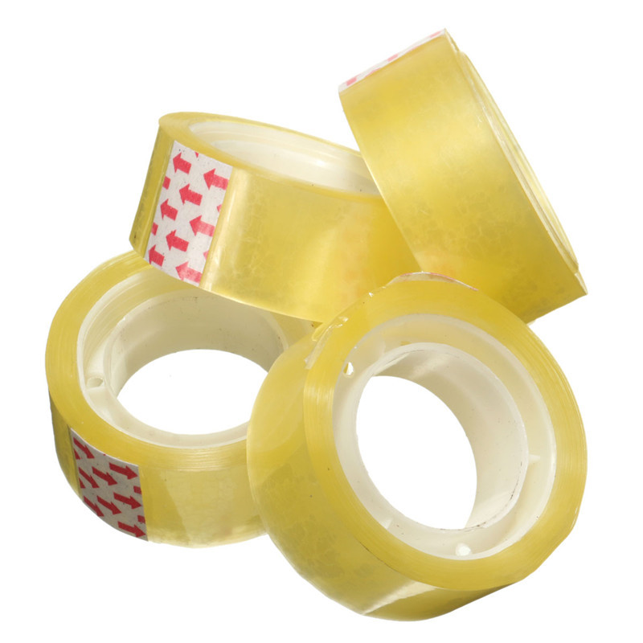
Resources

Slide 12
Resources: properties
Bendy Shiny
Flexible
Sticky
Rigid
Shiny
Strong
Fragile
Rigid
Hard
Elastic

Slide 13
Time for more creativity
Designing something as ‘a welcome to Earth symbol’ of our human species
20 min

Slide 14
Problem solving task
Important announcement!
After 5-6 minutes we get information that the intelligent beings are allergic to certain materials and they need to be taken away:
GROUPS | TAKE AWAY
GROUP A | pipe cleaners and paper cups
GROUP B | straws and pieces of cloth
GROUP C | sticky tape and paper plates
GROUP D | everything but paper
GROUP E | paper

Slide 15
Time for more creativity
Design something as ‘a welcome to Earth symbol’ of our human species
(with limited resources)
13 min

Slide 16
Problem solving task
Once 20 minutes are over, for 10 minutes:
look at one another’s creations (rotation);
present your creation/explain your choice (to the visitors from a different planet) in a creative and convincing way.

Slide 17
Time for more creativity
Two people from each group visit (rotate) other groups (2.5 minutes per group) to hear their creative and convincing argument
(2.5 minutes per group, altogether 10 minutes)

Slide 18
Creativity
Being creative is at the heart of being human and of all cultural progress … (Robinson, 2015).
Creativity is recognised as both a process and state of mind involving the serious play of ideas and possibilities.
Creativity is the generation of novel ideas.

Slide 19
Big-C and little-c creativity
everyday creativity /“little-c” ➔
can be found in nearly all people, personal creativity
(Beghetto and Plucker, 2006; Craft, 2003; Runco, 2003)
eminent creativity/ “Big-C” ➔
can be found in ‘artists’, historical paradigm-shifting creativity
(e.g. Gardner, 1993; Csikszentmihalyi, 1996; Simonton, 1994)

Slide 20
Creativity
From what is to what might be…
(Craft, 2001)
What if…

Slide 21
Creativity in education?
To teach creatively
and/or
To teach for creativity

Slide 22
Creativity in education?
To teach creatively:
‘using imaginative approaches to make learning more interesting and effective’ (NACCE, p. 89)
To teach for creativity:
forms of teaching that are intended to develop young people’s/learners’ own creative thinking or behaviour

Slide 23
Creativity in education
‘Young people’s creative abilities are most likely to be developed in an atmosphere in which the teacher’s creative abilities are properly engaged’
(National Advisory Committee on Creative and Cultural Education – NACCCE, 1999, p. 90).

Slide 24
Early Years creativity
Children behave with intentionality, are self-determined and use imagination. They innovate and take risks and are immersed in the creative process.
Teachers provide an enabling environment, valuing children’s agency, standing back and offering children time and space, yet recognising when to engage playfully with children entering their narrative and imaginative worlds (‘meddling in the middle’ – Craft et al., 2012).

Slide 25
Primary school creativity
Children have a sense of relevance in the experience they are engaged in, control over its articulation, a feeling of ownership over their learning, and opportunities to innovate (Jeffrey and Woods, 2003).
Wegerif (2005, 2010), Vass (2007), Rojas-Drummond et al., (2006) argue that dialogic engagement is necessary and inherent in everyday creativity in the classroom.

Slide 26
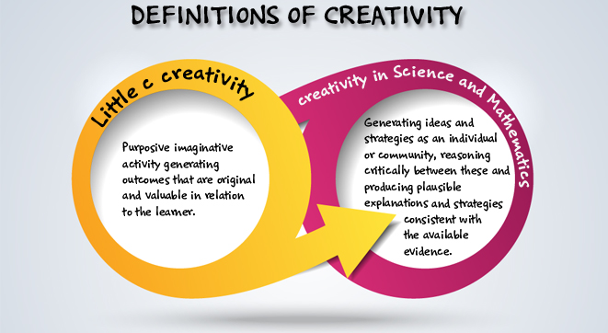
Creativity in early years science education
Creative Little Scientists (2014)

Slide 27
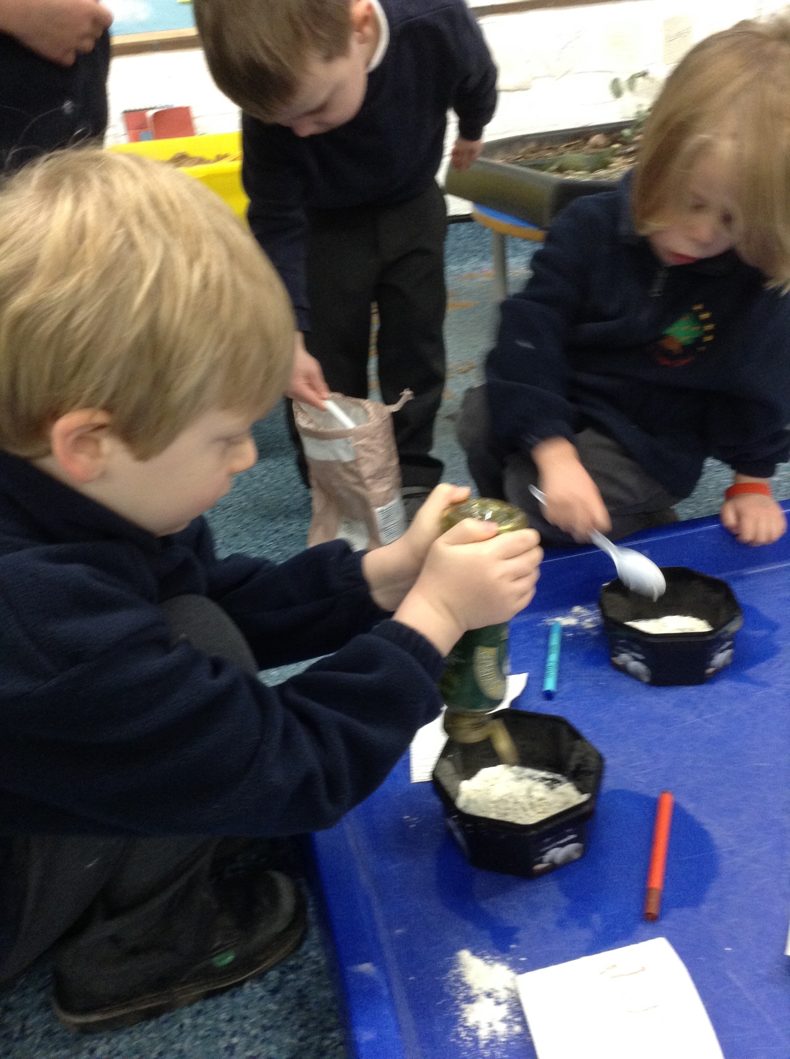
Creative dispositions
Sense of initiative
Motivation
Ability to come up with something new
Ability to make connections
Imagination
Curiosity
Ability to work together
Thinking skills

Slide 28
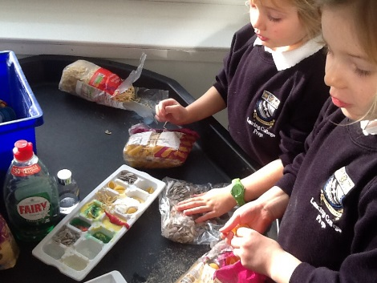
Synergies between IBSE and Creative Approaches
Play and exploration
Motivation and affect
Dialogue and collaboration
Questioning and curiosity
Problem-solving and agency
Reflection and reasoning
Teacher scaffolding and involvement
Assessment for learning

Slide 29
Discussion
• What happened?
• How did you feel?
• What issues arose?
• What questions emerge?

Slide 30
Time for reflection
Where are the elements of creativity in the task?
Where are the elements of science in the task?
10 minutes

Slide 31
Synergies between IBSE and Creative Approaches
Play and exploration
Motivation and affect
Dialogue and collaboration
Questioning and curiosity
Problem-solving and agency
Reflection and reasoning
Teacher scaffolding and involvement
Assessment for learning

Slide 32
Reflect on your practice
When do you feel you foster creativity in your classrooms (in general)?
When do you feel you foster creativity in your science-based lessons?
Any issues/concerns?
15 minutes

Slide 33
Reflect on your practice
Which of the synergies do you feel you practice already?
Which synergies are more challenging ?
10 minutes

Slide 34
Introduction to classroom examples
Framework for the Curriculum Materials
Setting the scene – focus, rationale, background
Starting points
Developing the learning journey – activities and their rationale, examples of children’s responses, teacher reflections and implications for the next session.
Reflections – children’s progress, teacher role, classroom environment, next steps
Materials
Snails
Notes:
Now moving on
Share some examples from the classroom of investigations over time – that illustrate varied approaches to inquiry and ways of recording.
Also ways in which teacher built on children’s responses over time and sought to foster children’s skills and understandings associated with inquiry.
In the time frame can only give you time to gain a sense of what the materials might offer.
Looking at 2 different examples covering different age ranges: 3-4 and 5-6.
Materials
Snails

Slide 35

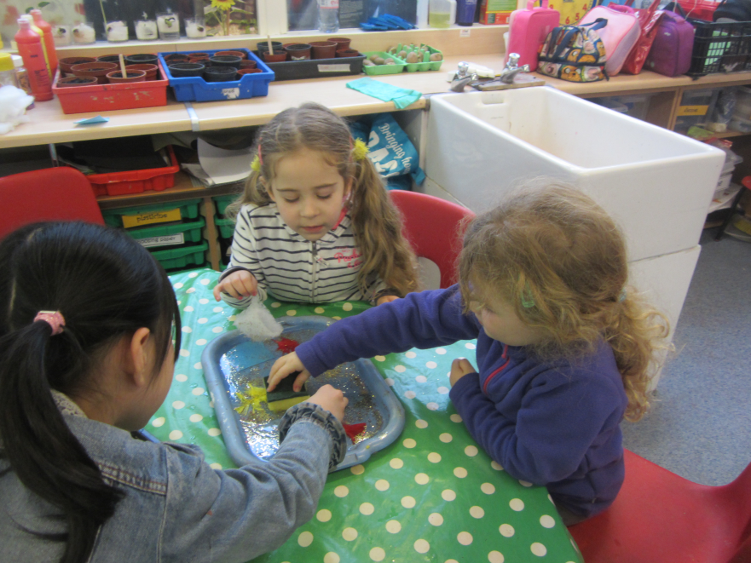
Materials
Children ages 5-6

Slide 36
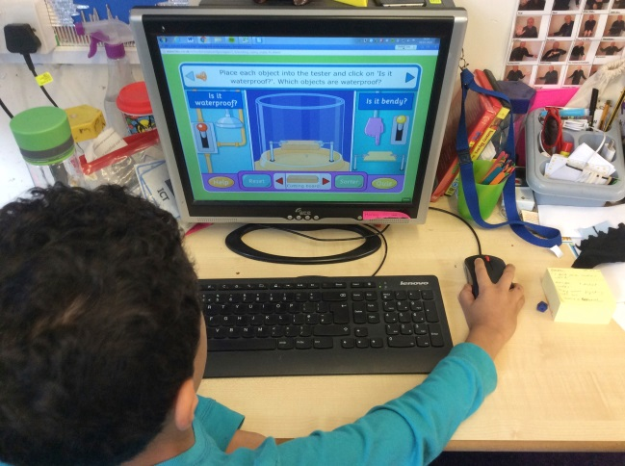
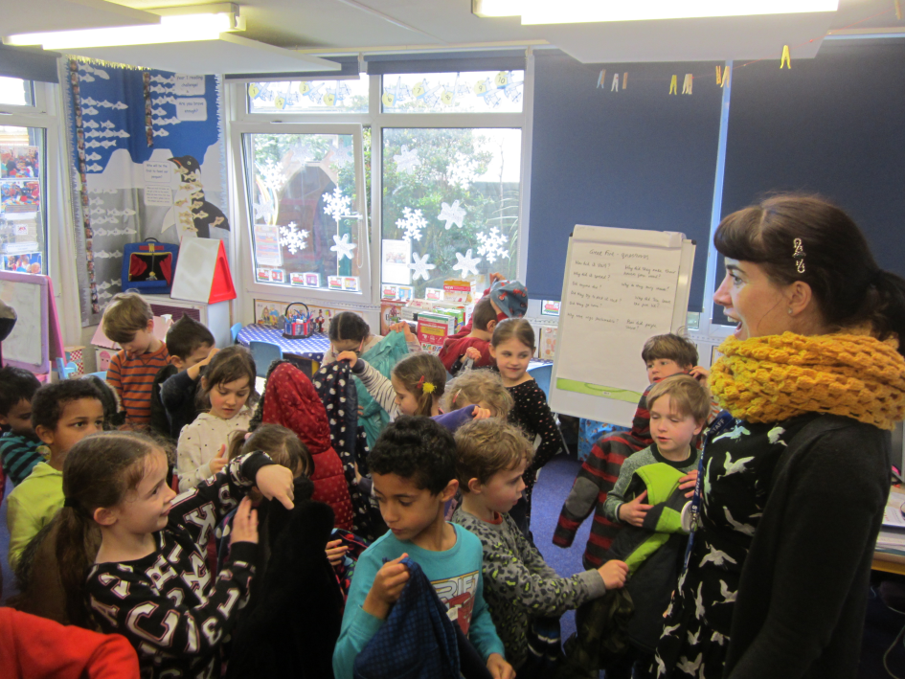
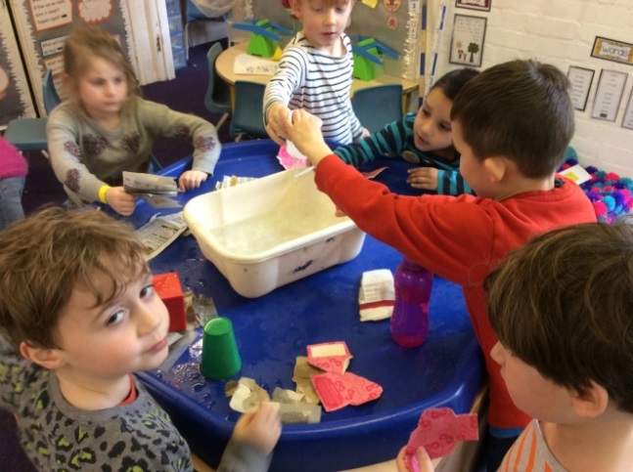
Materials
Children ages 5-6

Slide 37
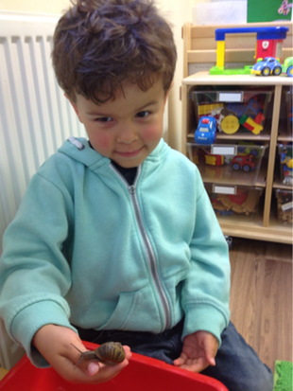
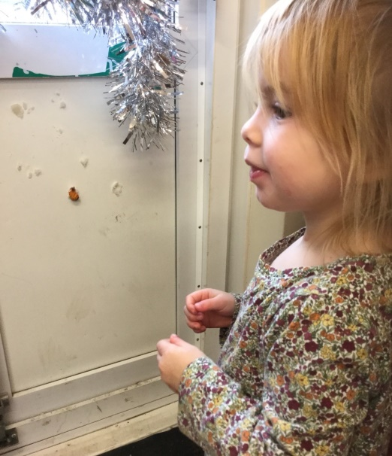
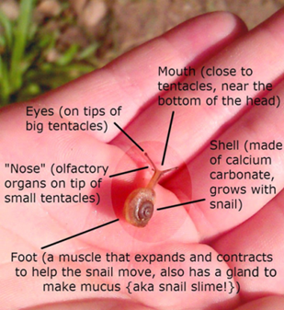
Snails
Children ages 3-4

Slide 38
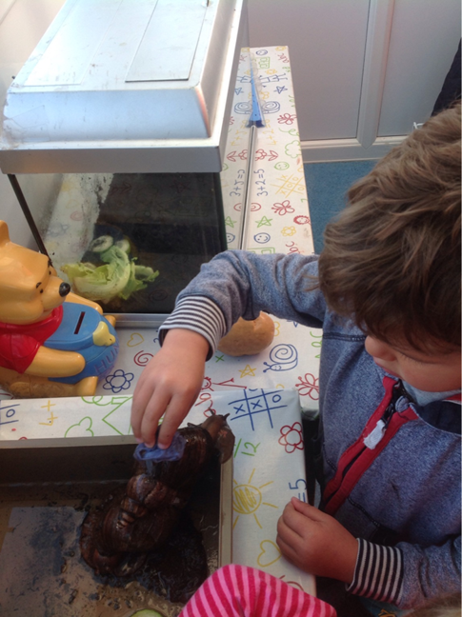
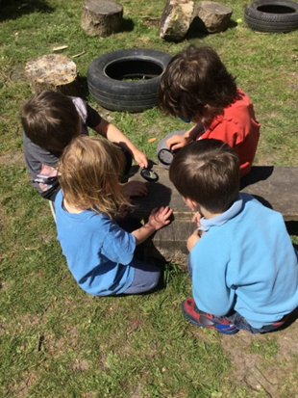
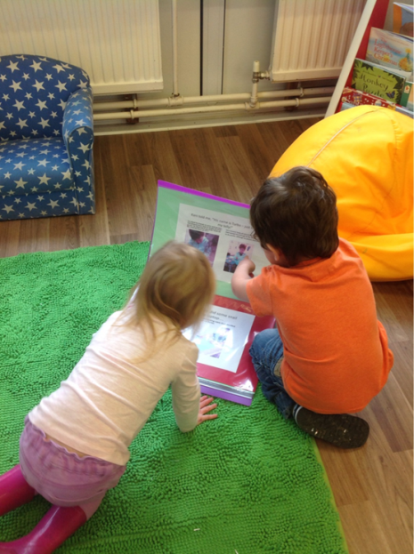
Snails
Children ages 3-4

Slide 39
Analysing classroom examples
Read through your example first to gain an overview of the learning journey
Then consider the following questions:
What synergies were the teachers working on?
12 minutes
Where can you see evidence of opportunities for children’s creativity and impact on learning?

Slide 40
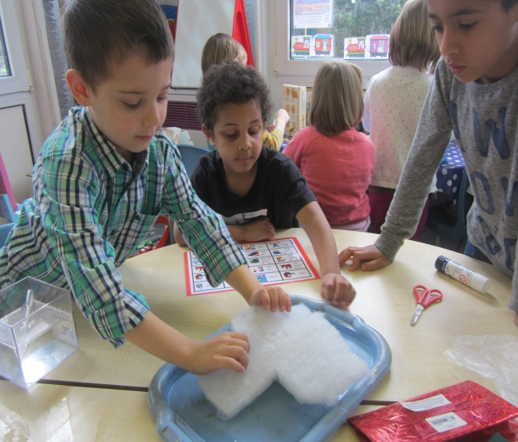
Creativity
From what is to what might be…
(Craft, 2001)
What if…

Slide 41
Summary:
Nature of Creativity
Being creative is at the heart of being human and of all cultural progress … (Robinson, 2015)
Creativity is recognised as both a process and state of mind involving the serious play of ideas and possibilities.
Creativity is the generation of novel ideas.

Slide 42
Summary:
Issues for teachers
Teachers’ beliefs about creativity can help or inhibit children’s creativity.
Teachers’ concerns about time and assessment can prevent both creative teaching and teaching for creativity.
Teachers’ enthusiasm for novelty, risk taking, imagination, curiosity, making connections can promote both creative teaching and teaching for creativity .

Slide 43
Reflection and implications
How far have your questions at the start of the session been answered?
Note 2 actions you will take building on module content.
In what ways did the different activities support your developing thinking?

Slide 44
Further information
Creative Little Scientists
(FP7 EU project 2011 – 2014)
Design principles and exemplar materials based on fieldwork www.creative-little-scientists.eu
Creativity in Early Years Science Education
(Erasmus+ EU project 2014 – 2017)
Curriculum Materials and Training Materials for teacher CPD to promote creative approaches to early years science www.ceys‐project.eu

Slide 45

THANK YOU!
What if…

