Slide 1
Training Module 18
Nature of inquiry:
different types of inquiry

Slide 2
Introduction to the
CEYS project
(use dependent on context)
European Erasmus+ project
Partners in Belgium, Greece, Romania, UK
Continuation of the Creative Little Scientists project http://www.creative-little-scientists.eu
Aims
  Development of a teacher development course and accompanying materials
  Promotion of the use of creative approaches in teaching science in preschool and early primary education (up to age of eight)
Notes:
The Creativity in Early Years Science project is a European Erasmus+ project with partner countries Greece, Romania, Belgium and the UK
As indicated – it aims to develop a European teacher professional development course and accompanying materials to promote the use of creative approaches in teaching science in preschool and early primary education (up to age of eight).
It is a continuation of the project Creative Little Scientists, an FP7 EU project, where curriculum design principles to foster inquiry and creativity in science education were designed.

Slide 3
Rationale for the module
Increasing focus internationally on inquiry-based approaches to science teaching and learning
Recognition of the role of creativity in science and in science learning and teaching
Growing emphasis on the importance of children developing ideas about the nature of science
Ongoing debate concerning
  Different types of inquiry in science
  Strategies for introducing young children to the nature of science and the varied ways scientists work
  Varied purposes of practical work in science
  The role of the adult in supporting children’s decision making and creativity in inquiry.

Slide 4
Aims of the module
Enhance awareness of the varied approaches to inquiry-based science education
Distinguish different purposes of practical work – related to the development of skills, processes, concepts or attitudes in science
Examine the role of the teacher in fostering children’s own decision making in investigations and in making connections between questions, planning, evaluating evidence and reflecting on conclusions.
Consider ways in which classroom investigations can help foster children’s understanding of the nature of science and the varied ways in which scientist work.

Slide 5
Links to Content Design Principles and Outcomes 1
2.Teacher education should provide teachers with skills and competences to carry out practical investigations of science in the classroom.
  2.2 Teachers should have a more detailed knowledge about the nature of inquiry and investigations in early years science in order to be able to recognise the opportunities they offer both for creative learning and developing children’s creativity.
3.Teacher education should advance teachers’ understandings about the nature of science and how scientists work, confronting stereotypical images of science and scientists.
  3.1 Teachers should be able to advance children’s understanding about the nature of science and how scientists work, confronting stereotypical images of science and scientists.

Slide 6
Links to Content Design Principles and Outcomes 2
6.Teacher education should provide pedagogical content knowledge to stimulate inquiry and problem solving in science education.
  6.1 Teachers should have knowledge of all essential features of inquiry and problem solving (questioning, designing or planning investigations, gathering evidence, making connections, explaining evidence, communicating and reflecting on explanations), their different purposes, degrees of structure and guidance (including open, guided and structured inquiries), and varied opportunities they offer for creativity.
  6.5 Teachers should be able to foster opportunities for children’s agency and creativity in learning in inquiry and problem solving – in particular the importance of children making their own decisions during inquiry processes, making their own connections between questions, planning and evaluating evidence, and reflecting on outcomes.

Slide 7
Connecting Inquiry Based Science Education and Creative Approaches
Inquiry-based Science Education
Creative Dispositions
Sense of initiative
Motivation
Ability to come up with something new
Making connections
Imagination
Curiosity
Ability to work together
Thinking skills
(for example Chappell et al 2008)
Questioning
Designing and planning investigations
Gathering evidence
Making connections
Explaining evidence
Communicating explanations
(for example Minner et al 2010)
From Creative Little Scientists, 2012

Slide 8
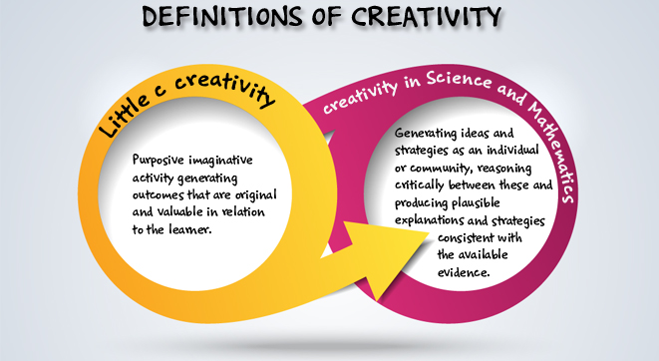
Creativity in early science and mathematics
Creative Little Scientists (2014)
Notes:
And the definitions of creativity

Slide 9
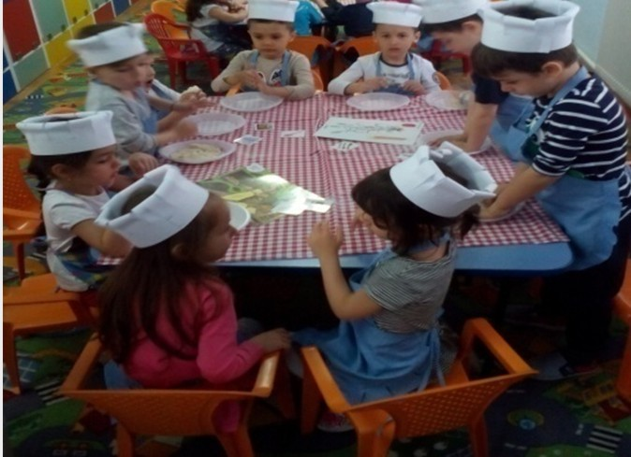
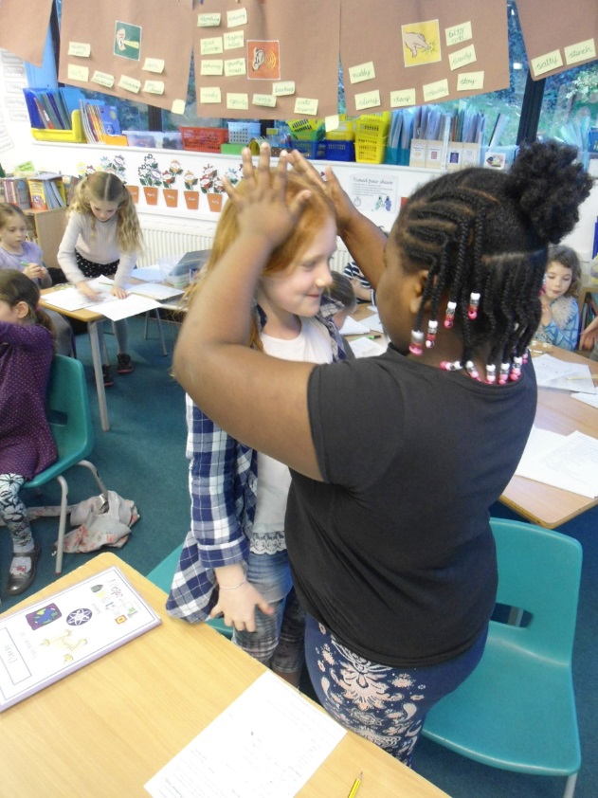
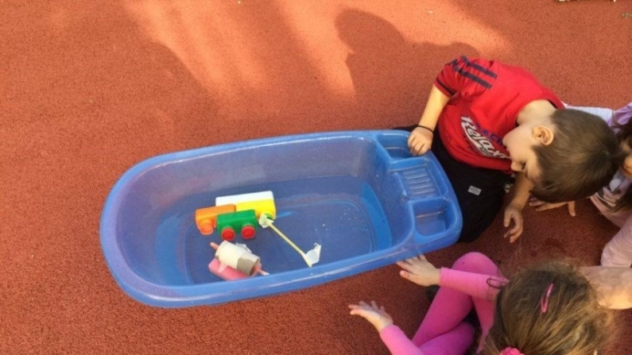
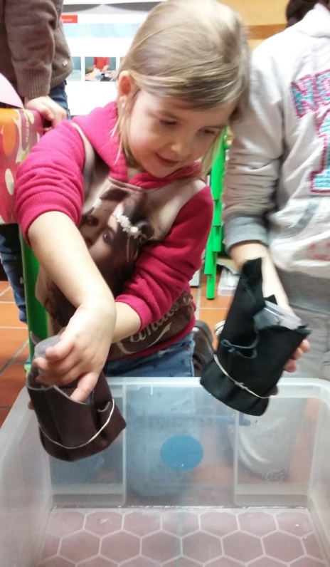
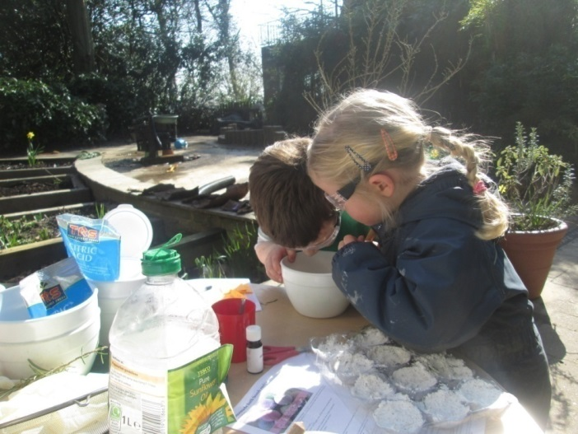
Romania:
Make bread right now!
Greece: Ships
England:
Skeletons
Fostering inquiry
in different contexts
England:
Bath bombs
Belgium: Waterproofing
Notes:
Moderated examples from CEYS partners- opportunities for children’s inquiry and creativity linked to CLS definitions.
Illustrate children’s active engagement and key role of exploration as a starting points for investigations over time.
These are the kinds of experiences common across the partner countries – a key issue has been how to make the most of these.

Slide 10
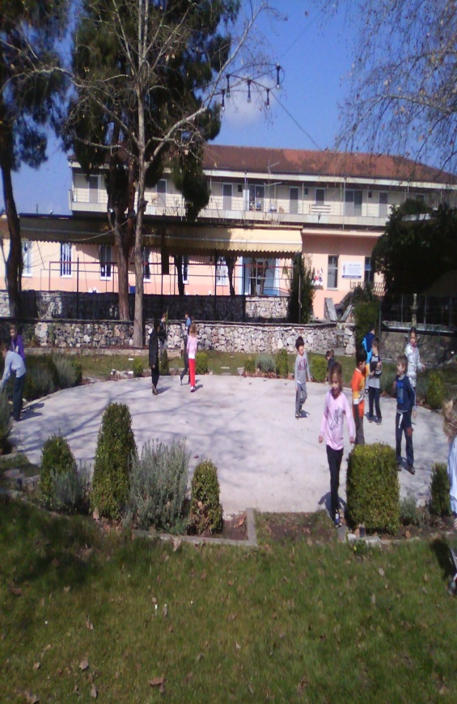
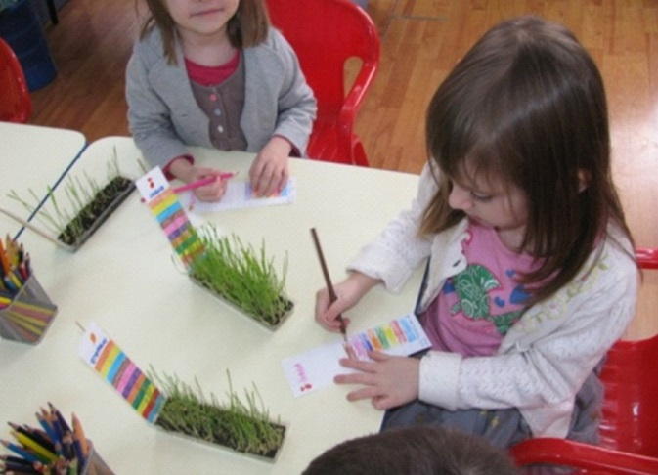
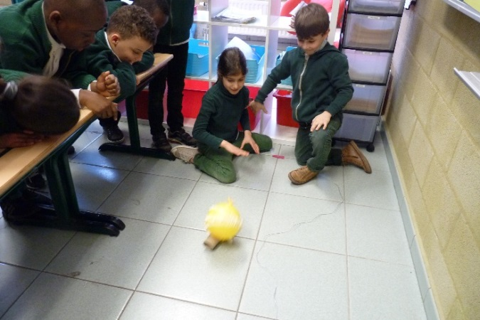
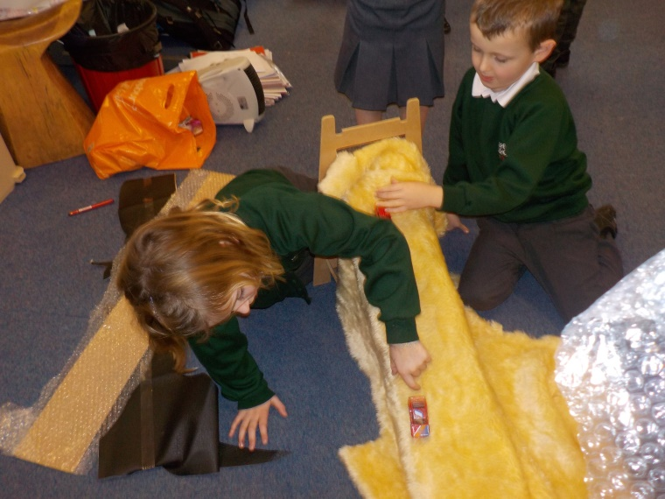
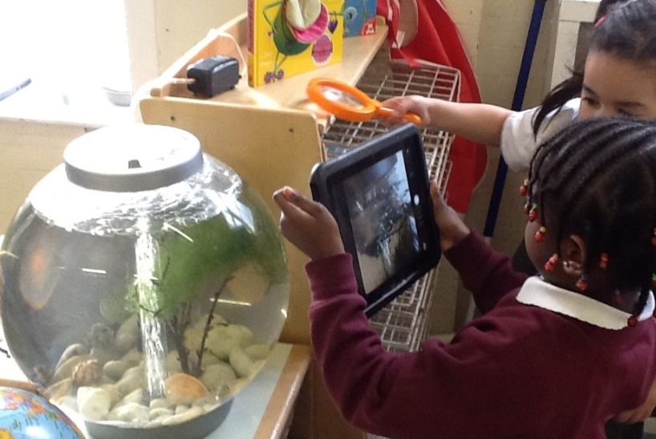
Belgium:
A whisp of air
Romania:
Germination and growth
Greece:
Plants in the environment
England:
Life Cycle of a frog
England:
On the go

Slide 11
Module outline
Sharing your experiences of practical activities in science – highlighting different purposes of practical work
Carrying out investigations – links to different ways in which scientists work and to the nature of science
Discussion of classroom examples – evidence of inquiry skills, children’s decision making, types of inquiry
Opportunities for children’s creativity and links to the nature of science
Implications for future planning – purposes of practical work, types of investigations
Reflections on the module

Slide 12
Sharing examples of practical activities you have carried out/observed in science
Work in groups of 4
As an individual – record examples of practical activities you have carried out/observed on separate post its and place on the A2 sheet on the table.
As a group – See if you can sort these – Any common themes or differences?
  What were the purposes of these activities (skills, processes, attitudes, knowledge and understanding in science )?
  How far were decisions made by the children?
  Note any issues raised.
Feedback to the whole group
Notes:
An important dimension of this module is drawing on your expertise and experience in different contexts and with different age groups as starting points for our discussion.
So we ask you first to record examples of any practical activities in science you have carried out in the classroom as a teacher, or observed, or experienced yourself in school – don’t worry at present about the age group.
As many as you can in 2 minutes.
Then put them together on the sheet in front of you – can you sort them in any way?
Think about the purposes – were they to help you develop scientific skills and attitudes, promote understanding – what do you think?
Were there opportunities for children to make decisions?
Any issues raised?
(5 mins for this)
5 mins feedback.

Slide 13
Different purposes of practical work
Basic skills - developing skills and techniques
Observations – exploration, describing, sorting and classifying
Illustrations – illustrating or demonstrating a concept/procedure
Investigations – arising from play, chance events, statements from other children, children’s questions or new science learning. Children involved in making decisions about how to carry out their investigations.
Notes:
Important point to emerge here is that practical work has varied purposes and the need to distinguish these.
In practice in primary schools there is often limited opportunity for investigation – most practical work in illustration
But if children are to develop skills and understandings related to inquiry and NOS they need to be involved in investigations.
In nursery or preschool the first two often predominate – focus on development of skills, or the children are involved in exploring, but potential of this could be developed further – tendency to focus on observation and communication but children more capable of explaining and testing ideas with support.

Slide 14
Different purposes of practical work: analysing your classroom examples
Initial reflections
Opportunities your activities offered for fostering inquiry skills and creative dispositions.
Which types of practical work were included?
Any implications for practice?
Any issues or questions?
Notes:
So thinking about your examples – any thoughts come to mind?

Slide 15
Carrying out investigations
For example
Do taller people have larger feet?
Which ball is the best bouncer?
Which materials let light through?

Slide 16
Carrying out investigations
Working in groups of 4 (about 15 minutes)
Undertake the investigation provided
Keep notes of your progress and record results and conclusions for sharing with another group
Feedback and discussion with the whole group:
Approaches to data recording and analysis
Conclusions – comparing findings, evaluating evidence
Range of inquiry skills involved
Fostering inter-connections between inquiry skills across the investigation
Notes:
Intention here is to explore the potential of these investigations and their different nature
Also to think about how what you might record and keep track of your results and developing conclusions – you are being scientists and will be expected to share your results with others
Think about the varied ways young children might do this – visually, using the physical materials – keep track of the purpose to help you to think about emerging patterns and share and record results. Think about any of the challenges or issues that arise.

Slide 17
Different types of investigation
Observing over time for example: How do caterpillars develop over time?
Pattern seeking for example: Do people with longer legs jump further?
Identifying, classifying and grouping for example: What is this bird? Which materials are attracted to the magnet?
Comparative and fair testing (controlled investigations) for example: Which is the best material for an umbrella?
Researching using secondary sources for example: What are the different kinds of living things shown in fossils we have found?
Notes:
So an important issue is the need to recognise that scientists work in different ways.
In England there has been a tendency to think that the only kind of science is a fair test. Other approaches also play a key role and not always possible to control variables.
Note the different forms of recording involved.

Slide 18
Introduction to classroom examples
Framework for the Curriculum Materials
Setting the scene – focus, rationale, background
Starting points
Developing the learning journey – activities and their rationale, examples of children’s responses, teacher reflections and implications for the next session.
Reflections – children’s progress, teacher role, classroom environment, next steps
Life Cycle of a Frog
Sounds around us
Skeletons
Notes:
Now moving on
Share some examples from the classroom of investigations over time – that illustrate varied approaches to inquiry and ways of recording.
Also ways in which teacher built on children’s responses over time and sought to foster children’s skills and understandings associated with inquiry.
Again in the time frame can only give you time to gain a sense of what the materials might offer.
Looking at 3 different examples cover a range of ages 4-5, 6-7 and 7-8
Life Cycle of a Frog
Sounds around us
Skeletons

Slide 19
Life cycle of a frog
Children ages 4-5

Slide 20
Sounds around us
Children ages 6-7

Slide 21
Skeletons
Children
ages 7-8

Slide 22
Discussion of classroom examples
Work in groups of 4 - 2 examples for each group
Start in pairs with different examples, then swap
1. Read through first to gain an overview of the learning journey.
2. Then consider the following questions:
How did the investigations develop over time? How did they build on children’s responses?
What opportunities were provided for children’s decision making and creativity?
What forms of recording were involved? How did they support learning?
In what ways did the teacher foster connections between different features of inquiry?
Notes:
You will not have time to read every element – but I suggest you skim through quickly at the start to gain a sense of the nature of the investigations and progress over time.

Slide 23
Types of practical work
Basic skills
Observation
Illustration
Investigation
Types of investigation
Sorting and classifying
Pattern seeking
Observing over time
Comparative and fair testing
Research using secondary sources

Slide 24
Varied roles over time
Essential features of classroom inquiry and their variations (Barrow, 2010, p. 3)
Learner poses a question
Question provided by teacher
Essential features | Variations
Learner engages in scientifically orientated questions | Learner poses a question | Learner selects among questions, poses new questions | Learner sharpens or clarifies question provided by teacher, materials or source | Learner engages in question provided by teacher, materials and source
Learner gives priority to evidence in responding to questions | Learner determines what constitutes evidence and collects it | Learner directed to collect certain data | Learner given data and asked to analyse | Learner given data and told how to analyse
Learner formulates explanations from evidence | Learner formulates explanations after summarising evidence | Learner guided in process of formulating explanations from evidence | Learner given possible ways to use evidence to formulate explanation | Learner provided with evidence
Learner connects explanations to scientific knowledge | Learner independently examines other resources and forms links to explanations | Learner directed toward areas and sources of scientific knowledge | Learner given possible connections
Learner communicates and justifies explanations | Learner forms reasonable and logical argument to communicate explanations | Learner coached in development of communication | Learner provided broad guidelines to sharpen communication | Learner gives steps and procedures to communication
More……...................................................................Amount of Learner Self-Direction…….......................................................................Less
Less……..............................................................Amount of Direction from Teacher Material…….............................................................More

Slide 25
Creativity in early science and mathematics
Creative Little Scientists (2014)

Slide 26
How might such approaches foster creativity in learning?
Sense of initiative
Motivation
Ability to come up with something new
Ability to connect what they have learnt during lessons with topics in other subjects
Imagination
Curiosity
Ability to work together
Thinking skills
(Factors from the Conceptual Framework)

Slide 27
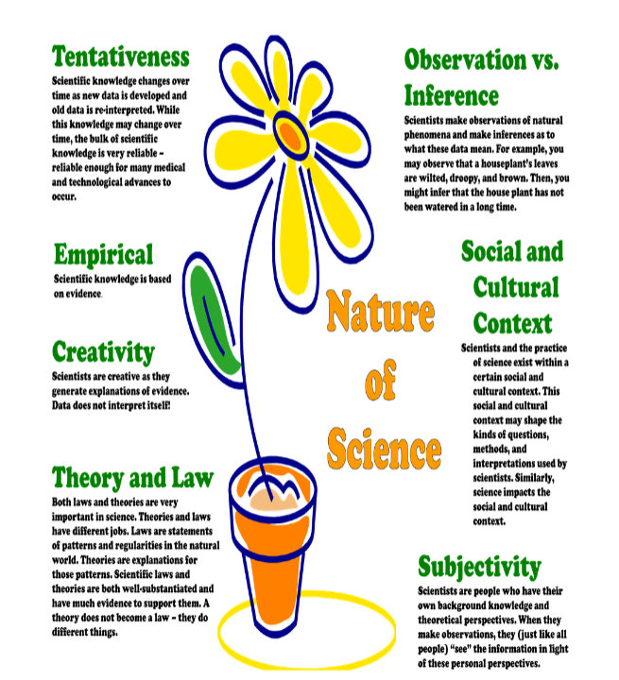
Nature of science
Akerson et al (2011)
Notes:
One of the materials we have used to discuss the potential for illustrating the nature of science through classroom inquiry is this poster developed by Akerson and her team.
Her work shows the potential to begin discuss this explicitly with young children
Go through the elements – any opportunities you might suggest in the examples we have discussed?

Slide 28
Implications for future planning
In pairs reflect on themes discussed across the module:
Clarifying different purposes of practical work
Recognising different ways of conducting investigations appropriate for different science content
Providing opportunities for children’s creativity and decision making
Role of the teacher in supporting inquiry processes and creative dispositions
Identify 2/3 implications for your future practice and any further questions/issues.

Slide 29
Reflection on module content and approaches
Think back to the start of the module and the different activities we have undertaken.
In what ways did the different activities support your developing thinking?
How far have the aims of the module been met?
Complete the evaluation form

Slide 30
Further information
Creative Little Scientists
(FP7 EU project 2011 – 2014)
Design principles and exemplar materials based on fieldwork www.creative-little-scientists.eu
Creativity in Early Years Science Education
(Erasmus+ EU project 2014 – 2017)
Curriculum Materials and Training Materials for teacher CPD to promote creative approaches to early years science www.ceys‐project.eu

Slide 31

Thank you!

Slide 32

Acknowledgements
Creativity in Early Years Science EDUCATION (2014-2017) www.ceys-project.eu
© 2017 CREATIVITY IN EARLY YEARS SCIENCE EDUCATION Consortium
This work is licensed under the Creative Commons Attribution-NonCommercial-NoDerivatives 4.0 International License. To view a copy of this license, visit http://creativecommons.org/licenses/by-nc-nd/4.0/.

