Slide 1
Training Module 17
Involving children in assessment
Supporting creativity and inquiry in science learning and teaching

Slide 2

Introduction to the CEYS project
(use dependent on context)
European Erasmus+ project
Partners in Belgium, Greece, Romania, UK
Continuation of the Creative Little Scientists project http://www.creative-little-scientists.eu
Aims
  Development of a teacher development course and accompanying materials
  Promotion of the use of creative approaches in teaching science in preschool and early primary education (up to age of eight)
Notes:
The Creativity in Early Years Science project is a European Erasmus+ project with partner countries Greece, Romania, Belgium and the UK
As indicated – it aims to develop a European teacher professional development course and accompanying materials to promote the use of creative approaches in teaching science in preschool and early primary education (up to age of eight).
It is a continuation of the project Creative Little Scientists, an FP7 EU project, where curriculum design principles to foster inquiry and creativity in science education were designed.

Slide 3
Connecting Inquiry Based Science Education and Creative Approaches
Inquiry-based Science Education
Creative Dispositions
Sense of initiative
Motivation
Ability to come up with something new
Making connections
Imagination
Curiosity
Ability to work together
Thinking skills
(for example Chappell et al 2008)
Questioning
Designing and planning investigations
Gathering evidence
Making connections
Explaining evidence
Communicating explanations
(for example Minner et al 2010)
From Creative Little Scientists, 2012
Notes:
A key challenge for the Creative Little Scientists project was to define what we mean by creativity in science and mathematics. We often use the term ‘creativity’ in rather general terms – and it appears also in policy documents – but what exactly does that mean.
Drawing on a wide range of sources and discussions with stakeholders from the early years and science education communities we developed the following definitions that are a central feature of the project.

Slide 4
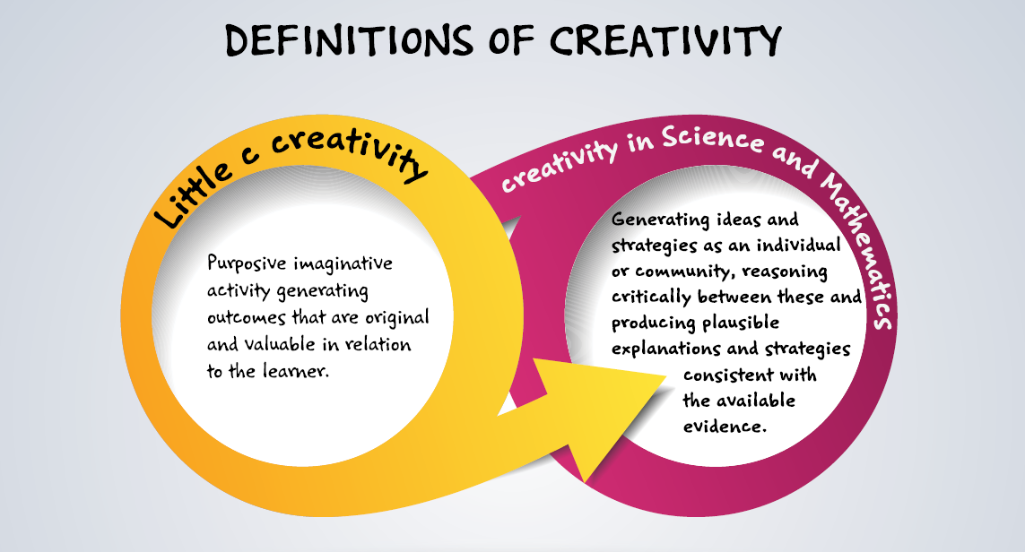
Conceptual Framework

Slide 5
Synergies between inquiry-based and creative approaches
From the Conceptual Framework adopted by the CEYS Project (Creative Little Scientists, 2012)
Play and exploration
Motivation and affect
Dialogue and collaboration
Problem solving and agency
Questioning and curiosity
Reflection and reasoning
Teacher scaffolding and involvement
Assessment for learning

Slide 6
Aims of the module
Introduce participants to different assessment approaches and strategies, in particular the importance of children making their own decisions during inquiry processes, making their own connections between questions, planning and evaluating evidence, and reflecting on outcomes.
Share strategies that allow participants to recognize young children’s capabilities to engage with processes associated with the evaluation as well as generation of ideas in science.
Increase awareness of assessment strategies such as peer and self-assessment, dialogue and feedback on progress, in the early years science classroom with processes associated with the evaluation as well as generation of ideas in science.

Slide 7
Links to Content Design Principles and Outcomes 1
3. Teacher education should advance teachers’ understandings about the nature of science and how scientists work, confronting stereotypical images of science and scientists.
  3.2 Teachers should be able to recognize young children’s capabilities to engage with processes associated with the evaluation as well as generation of ideas in science and mathematics, since these processes are also important for the development of learner creativity.
  3.3 Teachers should be able to foster the processes of imagination, reflection and consideration of alternative ideas in supporting children’s understanding of scientific ideas and procedures and development of creativity..

Slide 8
Links to Content Design Principles and Outcomes 2
6. Teacher education should provide pedagogical content knowledge to stimulate inquiry and problem solving in science and mathematics education.
  6.5 Teachers should be able to foster opportunities for children’s agency and creativity in learning in inquiry and problem solving – in particular the importance of children making their own decisions during inquiry processes, making their own connections between questions, planning and evaluating evidence, and reflecting on outcomes.
7. Teacher education should familiarise teachers with a range of formal and informal inquiry- and creativity-based learning, teaching and assessment approaches and strategies and their use in relation to authentic problems within the areas of science and mathematics.
  7.9 Teachers should be able to use different assessment approaches and strategies and in particular those that involve children in the assessment processes, such as peer and self assessment, dialogue and feedback on progress, in the early years science and mathematics classroom

Slide 9
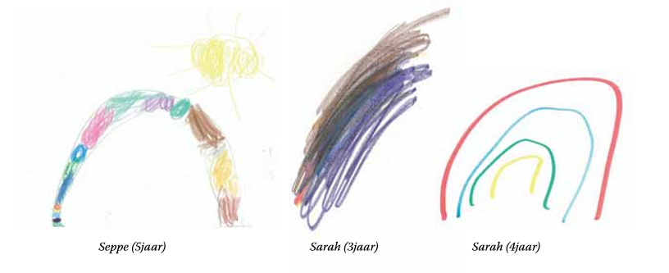
Rationale for the module
Notes:
Children drawing a rainbow: clearly they have some ideas of how a rainbow looks like, but they have different ideas of how it is built. These drawings give the teacher an idea of the prior knowledge of the children. The teacher can use this starting point to explore rainbows together, and focus especially on the colours and how it is built.

Slide 10
Rationale for the module
Reflective attitudes involve the child in developing thinking skills and aid the development of knowledge and understanding
  These attitudes help the child to consider data, interpret evidence and make hypotheses
  These attitudes help the child to remain flexible to change ideas if they are not consistent with the evidence
Assessment for learning supports children’s learning children, but involving them in the assessment has the largest impact on their learning process.
Reflection on learning and evaluation of ideas and strategies central to creative and inquiry based approaches in science

Slide 11
Key issues for practitioners
Young children find it difficult to analyse their ideas critically
Reflection and reasoning in early years is rarely seen through a creativity lens.
Capitalising on children’s emerging interests relies not just on opportunities to observe and recognize the potential, but the need for effective recording and communication systems, and for flexibility so that this can feed into future planning

Slide 12
Outline of the module
Introduction to the role of assessment within inquiry based science education within a creative approach.
Practical activity
Reflection on the the activity: opportunities for assessment
How to involve children in science assessment – focus on clear learning objectives, the use of questioning, feedback, peer- and self-assessment. introduction of the TAPS pyramid model
Analysis of classroom examples: How does the teacher involve children in assessment? Are there other opportunities for assessment involving children?
Discussion of possibilities to apply insights to own classroom practice: implications for planning and the teacher’s role.
Review of what has been gained from the module – both content and process.

Slide 13

What do you hope to learn? What questions do you have?
As an individual write down
  What do you hope to learn?
  What questions do you have concerning this topic?
Exchange with your neighbour

Slide 14
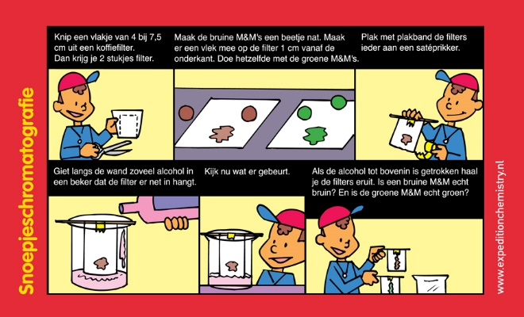
Opportunities for involving children in assessment chromatography investigation
Work in groups of 4
http://www.expeditionchemistry.nl

Slide 15
Opportunities for involving children in assessment reflection
Imagine using this science investigation in your classroom.
What would you want the children to learn?

Slide 16
Opportunities for involving children in assessment reflection
Imagine using this science investigation in your classroom.
What would you want the children to learn?
Can you identify opportunities for fostering inquiry and creativity?

Slide 17
Opportunities for involving children in assessment reflection
How would you find out what children learnt from this investigation?
In what ways would you support children themselves in assessing what they have learnt?
In what ways could you facilitate children assessing each other?”

Slide 18

Opportunities for involving children in assessment reflection
exchange of ideas
-
sharing insights

Slide 19
Involving children in assessment
How?
Clear learning objectives
The use of questioning
Feedback
Peer and self-assessment
TAPS pyramid model
https://pstt.org.uk/resources/curriculum-materials/assessment
Notes:
The TAPS pyramid provides a framework for supporting and evaluating approaches to assessment in schools and classrooms.
In particular it suggests a range of strategies that can be employed to support ongoing formative assessment by teachers and ways of involving children in assessment.
More information on the TAPS pyramid can be found in the module outline or on the webpage https://pstt.org.uk/resources/curriculum-materials/assessment

Slide 20
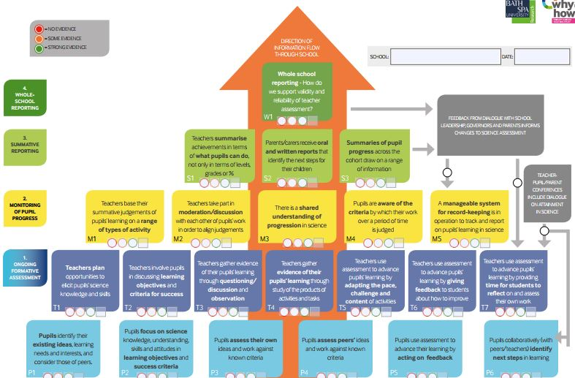
Teacher Assessment in Primary Science (TAPS) school self-evaluation tool

Slide 21
Involving children in assessment
How?
TAPS pyramid model: pupil layer
Pupils identify their existing ideas, learning needs and interests, and consider those of peers.
Group discussions, sorting objects or pictures, collecting individual comments, …

Slide 22
Involving children in assessment
How?
TAPS pyramid model: pupil layer
Pupils focus on science knowledge, understanding, skills and attitudes in learning objectives and criteria.
Focus on science objectives, …

Slide 23
Involving children in assessment
How?
TAPS pyramid model: pupil layer
Pupils assess their own ideas and work against known criteria.
Making self assessment part of the lesson, recording initial ideas and revisiting them, reflection on predictions,…

Slide 24
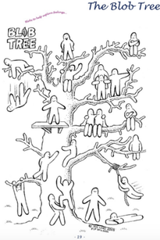
www.blobtree.com
Notes:
More information on the blob tree can be found on the following website: https://www.blobtree.com/pages/frontpage
Children can colour how they think they participated in the activity, or how they felt during the process . For example if they needed help they can colour the blob that gets help from another blob to get higher in the tree.

Slide 25
Involving children in assessment
How?
TAPS pyramid model: pupil layer
Pupils assess peers’ ideas and work against known criteria.
Responding to peer feedback, peer assessment, …

Slide 26
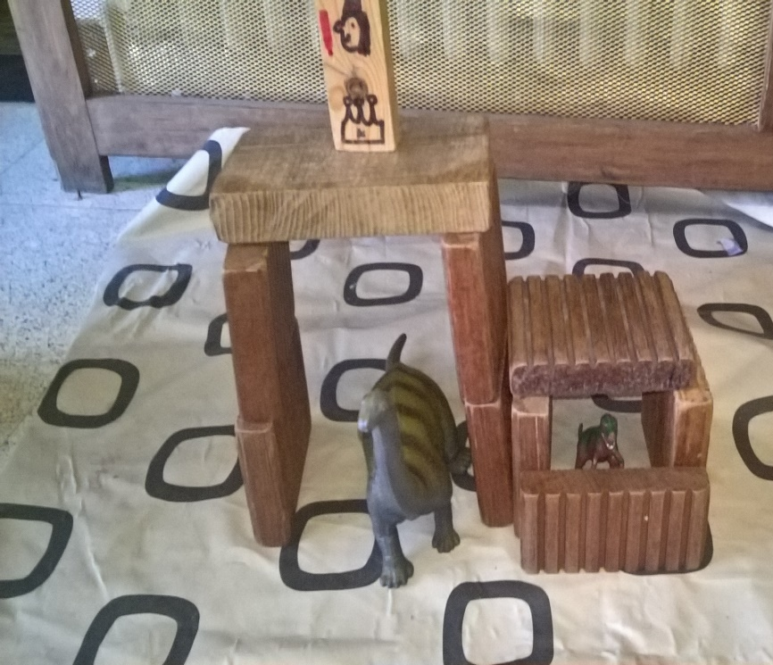
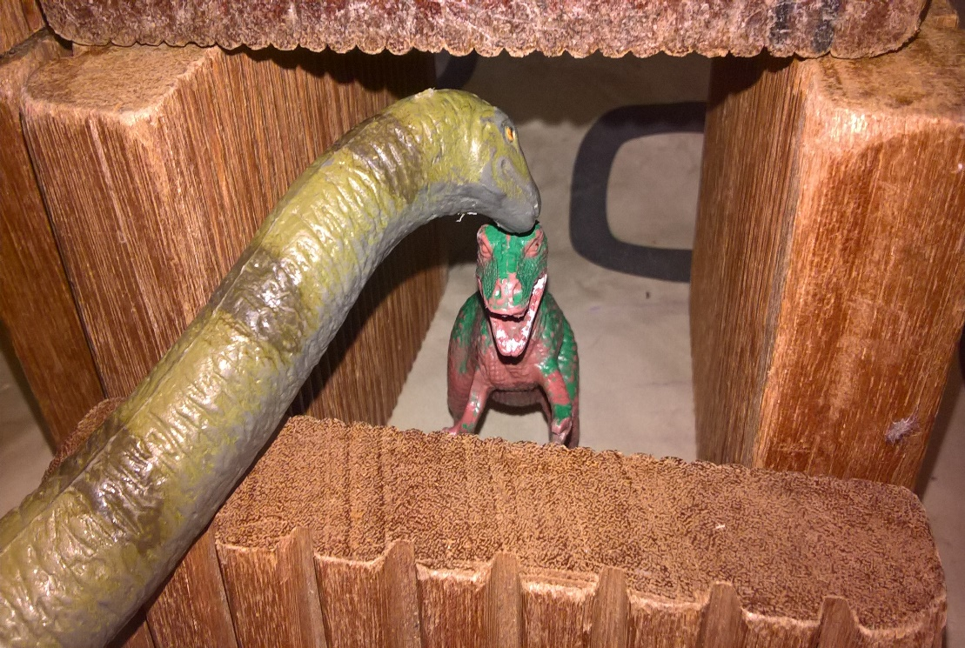
Notes:
Challenge: provide a space for the small dino so the big dino can’t reach him.
The children made a den for the dino. Other children came to watch and gave feedback: the big dino can still reach the other one if he stretches his neck!

Slide 27
Involving children in assessment
How?
TAPS pyramid model: pupil layer
Pupils use assessment to advance their learning by acting on feedback.
Making improvements in respons to suggestions given, …

Slide 28
Involving children in assessment
How?
TAPS pyramid model: pupil layer
Pupils collaboratively (with peers/teachers) identify next steps in learning.
Identifying next steps, …

Slide 29
Involving children in assessment
How?
TAPS pyramid model: teacher layer
Teachers plan opportunities to elicit pupils’ science knowledge and skills.
Finding out what children know at the start and the end of the activity, groups identifying ideas in a brainstorm,…

Slide 30
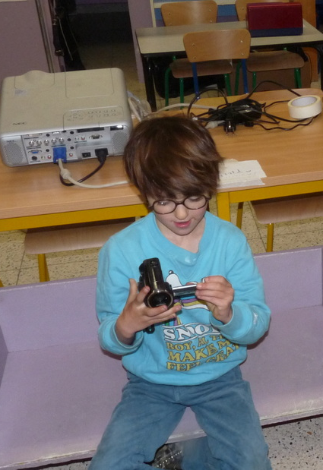
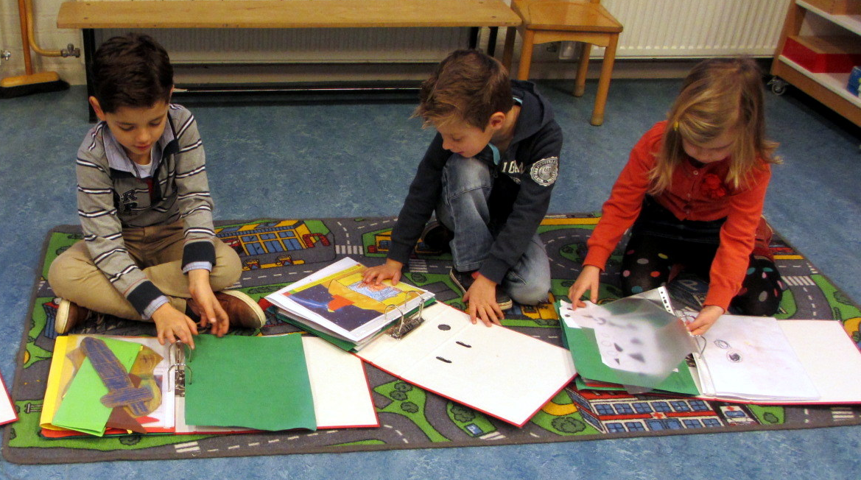
Notes:
Use of Portfolios or floor books, films to record progress in ideas and thinking

Slide 31
Involving children in assessment
How?
TAPS pyramid model: teacher layer
Teachers involve pupils in discussing learning objectives and criteria for success.
Discuss the learning objectives,…

Slide 32
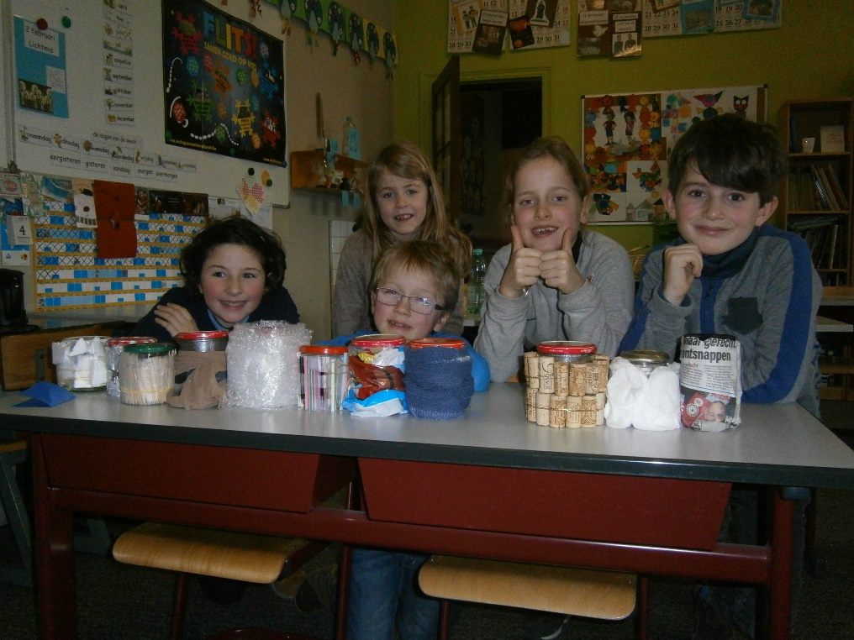
Notes:
Investigate insulation : make something so we can carry our cup of tea without burning our fingers.

Slide 33
Involving children in assessment
How?
TAPS pyramid model: teacher layer
Teachers gather evidence of their pupils’ learning through questioning/discussion and observation.
Concept cartoons, observations, recording discussion in floorbooks, gathering information through class discussion,…

Slide 34
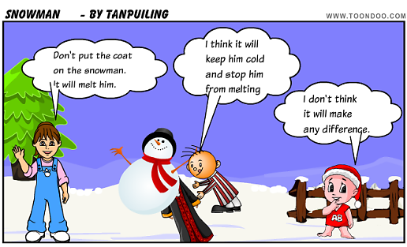
http://www.toondoo.com/public/t/a/n/TanPuiLing/toons/cool-cartoon-2019073.png
Notes:
Concept cartoon

Slide 35
Involving children in assessment
How?
TAPS pyramid model: teacher layer
Teachers use assessment to advance pupils’ learning by giving feedback to students about how to improve.
Oral feedback, ,…

Slide 36
Involving children in assessment
How?
TAPS pyramid model: teacher layer
Teachers use assessment to advance pupils’ learning by providing time for students to reflect on and assess their own work.
Time to reflect in a discussion, in a drawing,…

Slide 37
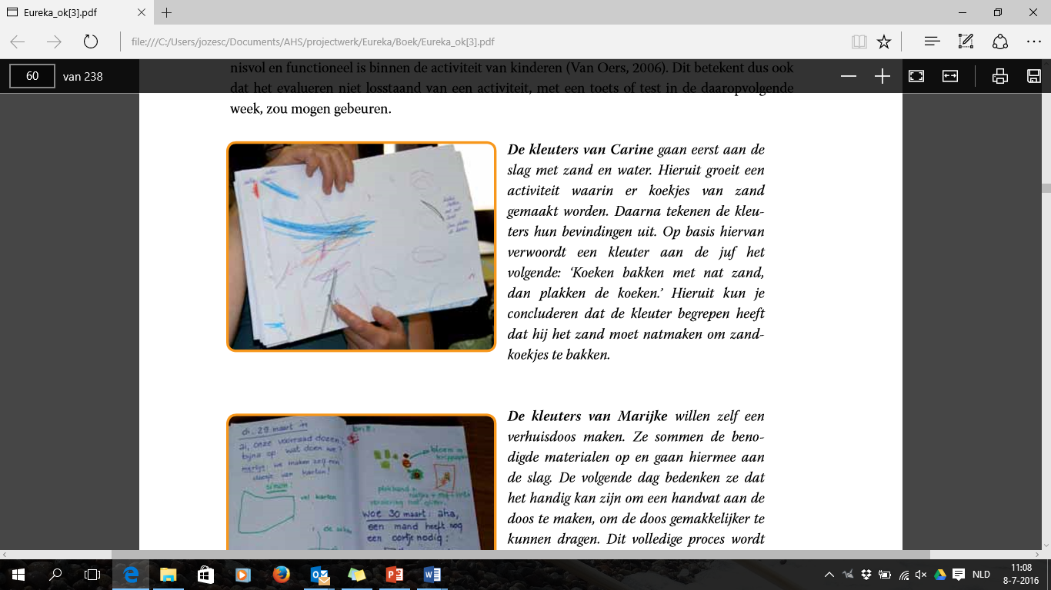
Notes:
A group of toddlers explored sand and water. They experienced that they could make ‘sand cookies’ when the sand was mixed with water. The teacher asked them to draw what they experienced. Children of this age cannot draw figuratively yet, but the teacher lets them explain what they drew, and writes it down on the drawing:
Toddlers: “ making cookies with wet sand, then they stick better” (2,5 year old)

Slide 38
How does this support the children in terms of creativity in learning?
Inquiry-based Science Education | Creative dispositions | Synergies between IBSE & CA
Questioning Designing and planning investigations Gathering evidence Making connections Explaining evidence Communicating explanations | Sense of initiative Motivation Ability to come up with something new Making connections Imagination Curiosity Ability to work together Thinking skills | Play and exploration Motivation and affect Dialogue and collaboration Problem solving and agency Questioning and curiosity Reflection and reasoning Teacher scaffolding and involvement Assessment for learning
Notes:
How does this support the children in terms of creative dispositions and inquiry skills? Can you offer any suggestions?
Take your list of creative dispositions – annotate to indicate opportunities for fostering creativity in your example.
(for example: making connections, communicating explanations, sense of initiative, motivation, thinking skills, problem solving & agency, assessment for learning)
Brief feedback with whole group
Reflective attitudes involve the child in developing thinking skills and aid the development of knowledge and understanding
These attitudes help the child to consider data, interpret evidence and make hypotheses
These attitudes help the child to remain flexible to change ideas if they are not consistent with the evidence
Involving children: when you involve children in assessment, they can be more creative, are able to use their thinking skills, they can make connections, … so this way of assessing has more impact on their learning (=bottom line of TAPS pyramid)

Slide 39
How does this support the children in terms of creativity in learning?
Reflection on learning and evaluation of ideas and strategies: central to creative and inquiry based approaches in science
Role of communication
  Communication of clear learning objectives
  The use of questioning
  Feedback
  Peer and self-assessment
  …
Focus on problem solving and agency: need for varied modes of assessment
Notes:
Communication is an important skill in science learning and assessment. Communicating helps children to sort out what they discovered and what they think. Since formal assessment is difficult in early years education, communicating about their ideas is an important end point in explorations in science. Communication encourages children to clarify and evaluate their ideas in order to communicate them to others.
It also gives them access to the ideas of others. Those ideas may conflict with their own, but by communicating children learn to consider their ideas as tentative and subject to change. This if a form of assessing their own and each other’s ideas in science. (Johnston, 2005)

Slide 40
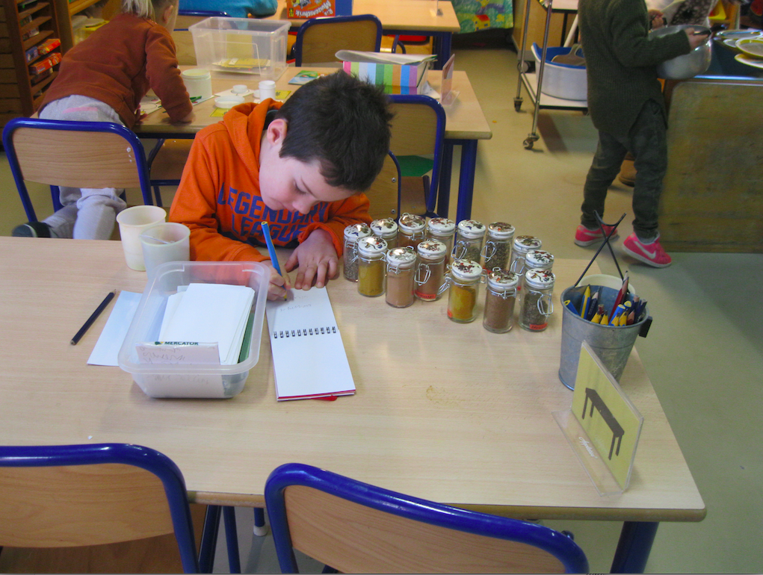
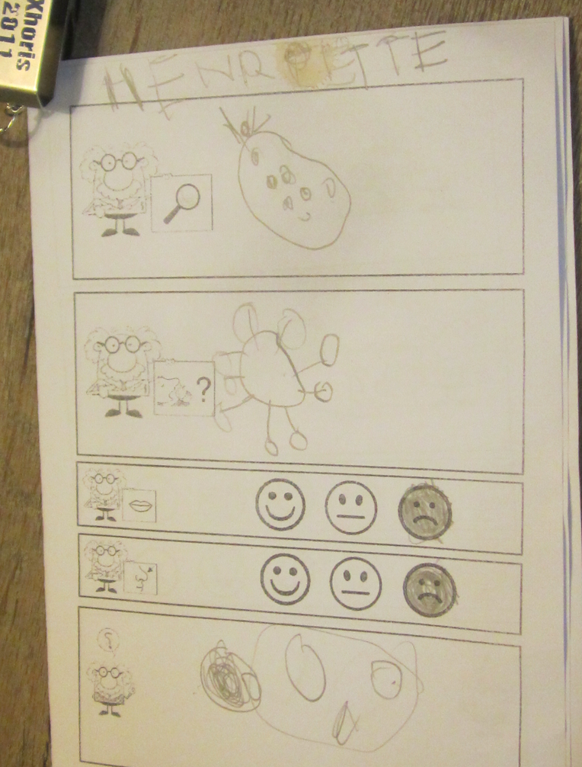
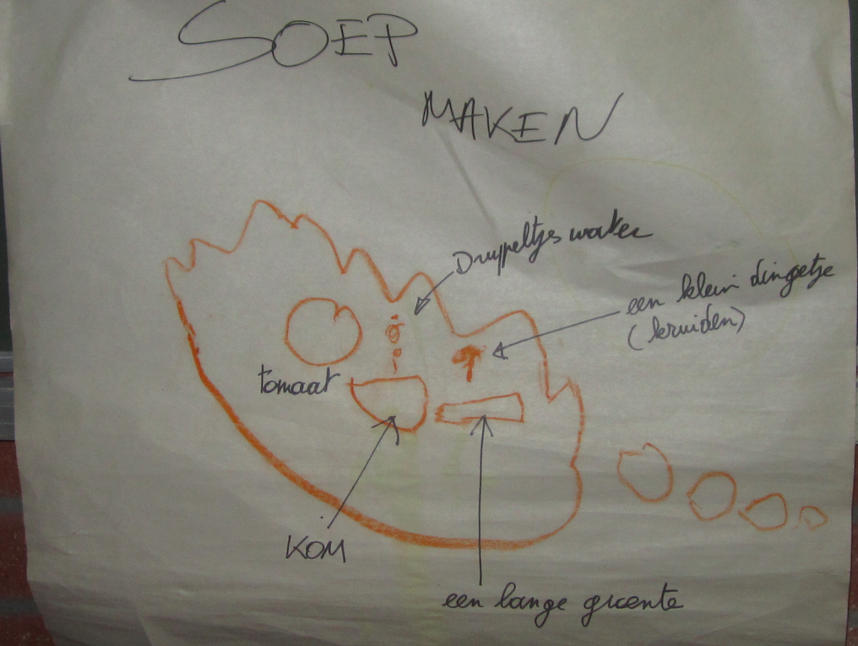
Analysis of classroom example
Super Soup
Children exploring odors to choose possible ingredients for soup.
Notes:
Curriculum material CEYS – Making Soup Veerle Heirbaut

Slide 41
Framework for the Curriculum Materials
Setting the scene – focus, rationale, background
Starting points
Developing the learning journey – activities and their rationale, examples of children’s responses, teacher reflections and implications for the next session.
Reflections – children’s progress, teacher role, classroom environment, next steps
Notes:
This is the framework for the Curriculum Materials that follow the learning journeys of teachers and their children in fostering creative inquiry based approaches to learning.

Slide 42
Analysis of classroom example
Super Soup
1. Read through the example.
2. Then consider the following questions:
What kind(s) of assessment does the teacher use in the activity?
In what way(s) are the children involved in assessment?
Do you see other opportunities for assessment involving children?
In what ways do these approaches foster inquiry and creativity in learning and teaching?
3. Exchange of ideas

Slide 43
Apply insights to own classroom practice
Individually
  list 3 examples of scientific activities you use in your own classroom context
  try to enrich them with ideas about how to involve children in assessment
Possible difficulties and questions?
Exchange ideas, discuss questions and possible difficulties.

Slide 44
What has been gained from the module?
Refer to your original questions.
How far have they been answered?
Identify key challenges.
Consider possible solutions.

Slide 45
What has been gained from the module?
Identify 2 actions you will take building on this module.
Exchange ideas

Slide 46
Further information
Creative Little Scientists
(FP7 EU project 2011 – 2014)
Design principles and exemplar materials based on fieldwork www.creative-little-scientists.eu
Creativity in Early Years Science
(Erasmus+ EU project 2014 - 2017)
Curriculum Materials and Training Materials for teacher CPD to promote creative approaches to early years science www.ceys‐project.eu

Slide 47

Reflection on module content and approaches

Slide 48

Acknowledgements
Creativity in Early Years Science EDUCATION (2014-2017) www.ceys-project.eu
© 2017 CREATIVITY IN EARLY YEARS SCIENCE EDUCATION Consortium
This work is licensed under the Creative Commons Attribution-NonCommercial-NoDerivatives 4.0 International License. To view a copy of this license, visit http://creativecommons.org/licenses/by-nc-nd/4.0/.

