Slide 1
Training Module 16
Assessment for Learning
Variety of strategies supporting creative, inquiry-based approaches to learning

Slide 2
Introduction to the CEYS project
(use dependent on context)
European Erasmus+ project
Partners in Belgium, Greece, Romania, UK
Continuation of the Creative Little Scientists project http://www.creative-little-scientists.eu
Aims
  Development of a teacher development course and accompanying materials
  Promotion of the use of creative approaches in teaching science in preschool and early primary education (up to age of eight)
Notes:
The Creativity in Early Years Science project is a European Erasmus+ project with partner countries Greece, Romania, Belgium and the UK
As indicated – it aims to develop a European teacher professional development course and accompanying materials to promote the use of creative approaches in teaching science in preschool and early primary education (up to age of eight).
It is a continuation of the project Creative Little Scientists, an FP7 EU project, where curriculum design principles to foster inquiry and creativity in science education were designed.

Slide 3
What do you hope to gain from the module?
As an individual
What do you hope to gain from the module?
Do you have any particular questions?
What are the key issues related to assessment in your setting?
Note down 2/3 ideas in relation to each question
Record each idea on a separate post it (one for each idea)
As a group
See if you can sort these into groups – any common themes/differences?
Display as a poster. Keep for later reference.
Notes:
An important dimension of this project is drawing on teacher expertise and experience in different contexts and with different age groups as starting points for our discussion.
Bear these in mind as we undertake the activities across the session.

Slide 4
Module outline
Introduction, aims and rationale for the module
Sharing approaches to assessment approaches to assessment, which are most useful and why?
Assessment of open-ended inquiry-based activities.
What opportunities did the activities provide for assessing creativity?
Analysis of classroom examples: opportunities for assessment and building on assessment information
Implications for planning and assessment.
Reflection on what has been gained from the module

Slide 5
Aims of the module
Introduce participants to a range of assessment approaches and strategies to promote creativity in the early years science classroom
Share strategies that will enable participants to value and be able to make use of varied forms of assessment evidence to inform teaching and longer term planning
Increase awareness of assessment as an opportunity to promote creative learning, through reflection and discussion in science
Explore ways in which teachers can design and assess open-ended learning activities
Enable participants to gain insights into children’s developing explorations and creativity based on their use of resources and varied modes of expression and representation.

Slide 6
Links to Content Design Principles and Outcomes 1
(for use as appropriate)
7. Teacher education should familiarise teachers with a range of formal and informal inquiry-and creativity-based learning, teaching and assessment approaches and strategies and their use in relation to authentic problems within the areas of science and mathematics.
  7.1 Teachers should have knowledge of a range of formal, non-formal and informal learning, teaching and assessment approaches and strategies to promote creativity in their early years science and mathematics classroom.
  7.4 Teachers should be able both to build in new and to make the most of existing opportunities for child-initiated play, recognising and capitalising on the potential of children’s explorations beyond the teacher’s original intentions.
  7.10 Teachers should value and be able to make use of varied forms of assessment evidence (including children’s portfolios, individual or group records of activities), both to promote creative learning, through reflection and discussion in science and mathematics, and explicitly to inform teaching and longer term planning.

Slide 7
Links to Content Design Principles and Outcomes 2
(for use as appropriate)
8. Teacher education should enable teachers to design and assess creativity-enabling inquiry-based activities, which are child-friendly and include both guided and open inquiries.
    8.1 Teachers should be able to design and assess open-ended learning activities.
9. Teacher education should enable teachers to make best use of and assess the various modes of expression and representation of science and mathematics learning to support inquiry and the development of creativity.
    9.4 Teachers should be able to use the various modes of children’s expression and representation of science and mathematics ideas (e.g. pictures, graphs, gestures, physical activities) for assessment purposes.
17. Teacher education should address with teachers issues in ensuring rich provision, planning and use of resources (including digital resources) in and out of the classroom to support children’s inquiry and creativity.
    17.6 Teachers should be able to gain insights into children’s developing explorations and creativity based on their use of resources.

Slide 8
Different purposes of assessment
 | Formative | Summative
What | Assessment FOR learning | Assessment OF learning
Purpose | Improve learning & teaching | Measure of competency
When | On-going | End of course
How it is used | Learn through feedback & practice | Grades

Slide 9
Rationale for the Module
Importance of Assessment for Learning
Vital role in a responsive appoach to teaching and learning:
identifying and building on children’s skills, attitudes, knowledge and understanding
supporting and encouraging children’s active engagement in learning
recognising the key roles of dialogue and feedback
developing a variety of approaches sensitive to young children’s capabilities
Reflection on learning and evaluation of ideas and strategies central to creative and inquiry based approaches in science.

Slide 10
Synergies between creative and inquiry based approaches to learning
(Creative Little Scientists, 2012)
Play and exploration
Motivation and affect
Dialogue and collaboration
Problem solving and agency
Questioning and curiosity
Reflection and reasoning
Teacher scaffolding and involvement
Assessment for learning
Notes:
The key role of assessment for learning reflected in the synergies identified between creative and inquiry based approaches to learning.

Slide 11
What are the issues for teachers? Findings from research, policy and practice
Lack of policy guidance
Mismatch in policy between aims and assessment priorities
Identifying strategies and criteria for assessing inquiry skills and creative dispositions
Developing holistic approaches to assessment sensitive to the capabilities of young children
Capturing learning processes in informal contexts and open-ended inquiry-based activities
Developing a strategic and systematic approach to formative assessment
Notes:
Lack of policy guidance on methods of assessment and criteria for assessing on-going progress
Mismatch between aims of science education and assessment priorities in policy – for example emphasis on science ideas - more limited attention to inquiry processes, creative dispositions in assessment.
Identifying strategies and criteria for assessing inquiry skills and creative dispositions
Developing holistic approaches to assessment sensitive to the capabilities of young children
Capturing learning processes in informal contexts and open-ended inquiry-based activities
Developing a strategic and systematic approach to formative assessment to inform learning and teaching – approaches are often implicit.

Slide 12
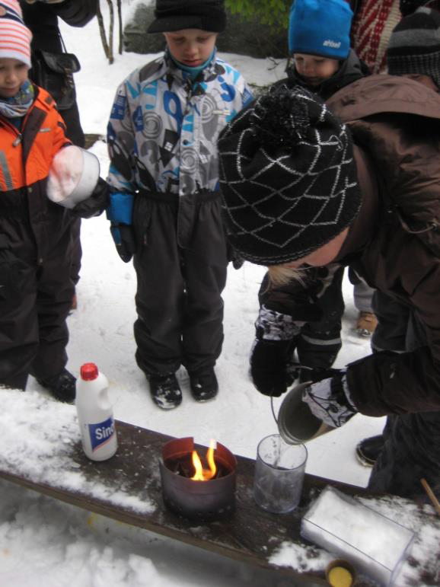
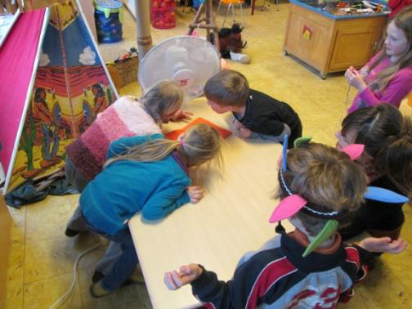
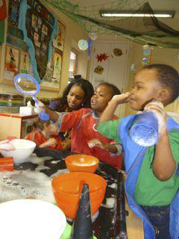
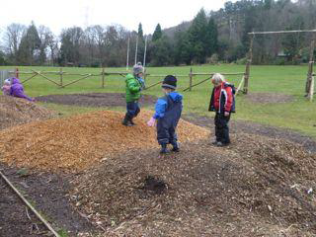
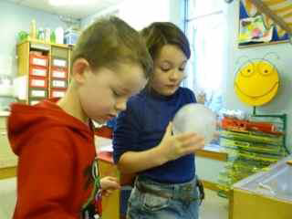
Assessing inquiry and creativity
What are we looking for?
How might we assess?
Notes:
In seeking to foster children’s inquiry and creativity
What might we be looking for? What is there to see?
What evidence might be available?

Slide 13
Connecting IBSE and Creative Approaches
(from Creative Little Scientists, 2012)
Features of inquiry
Creative dispositions
Questioning
Designing and planning investigations
Gathering evidence
Making connections
Explaining evidence
Communicating explanations
Sense of initiative
Motivation
Ability to come up with something new
Making connections
Imagination
Curiosity
Ability to work together
Thinking skills

Slide 14
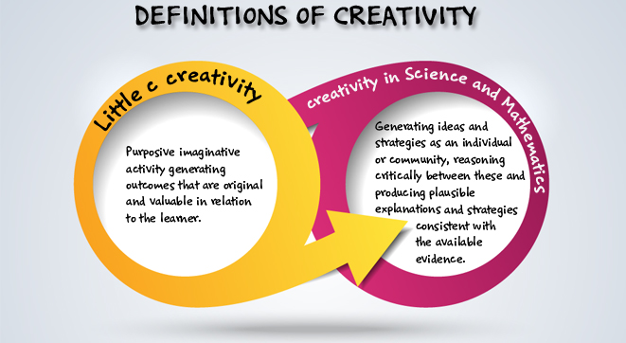
Definitions of creativity adopted by the CEYS project
(from Creative Little Scientists, 2014)

Slide 15

Sharing approaches to assessment
As an individual
What approaches do you use?
Brainstorm as many approaches you can think of in 2 minutes.
Record each approach on a post it.
In groups
Review the range of approaches
Which approaches have you found most helpful in supporting learning and teaching - and why?
In what ways are children involved in assessment processes?
Whole group
Exchange ideas
Consider match to the TAPS pyramid model.

Slide 16
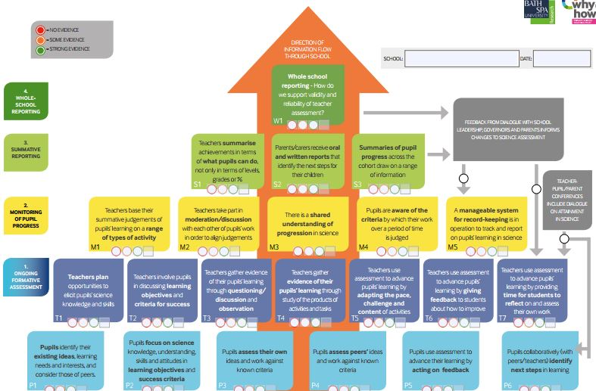
Teacher Assessment in Primary Science (TAPS): School self-evaluation tool
https://pstt.org.uk/resources/curriculum-materials/assessment

Slide 17
Assessment in open-ended inquiry activities
Work in groups of 4
Divide into pairs
One pair does the activity
Other pair observe separately – observers do not communicate with doers or each other
Observers record observations on the recording sheets provided.
At end of the activity
DOERS list what they did and OBSERVERS share observations
Group of 4 share perceptions/feedback
Notes:
Note for the facilitator
Some observers are supplied with a recording sheet with prompts related to inquiry skills and creative dispositions
Others have a blank recording sheet.
This process can be done just once or twice with observers and doers swapping roles.

Slide 18
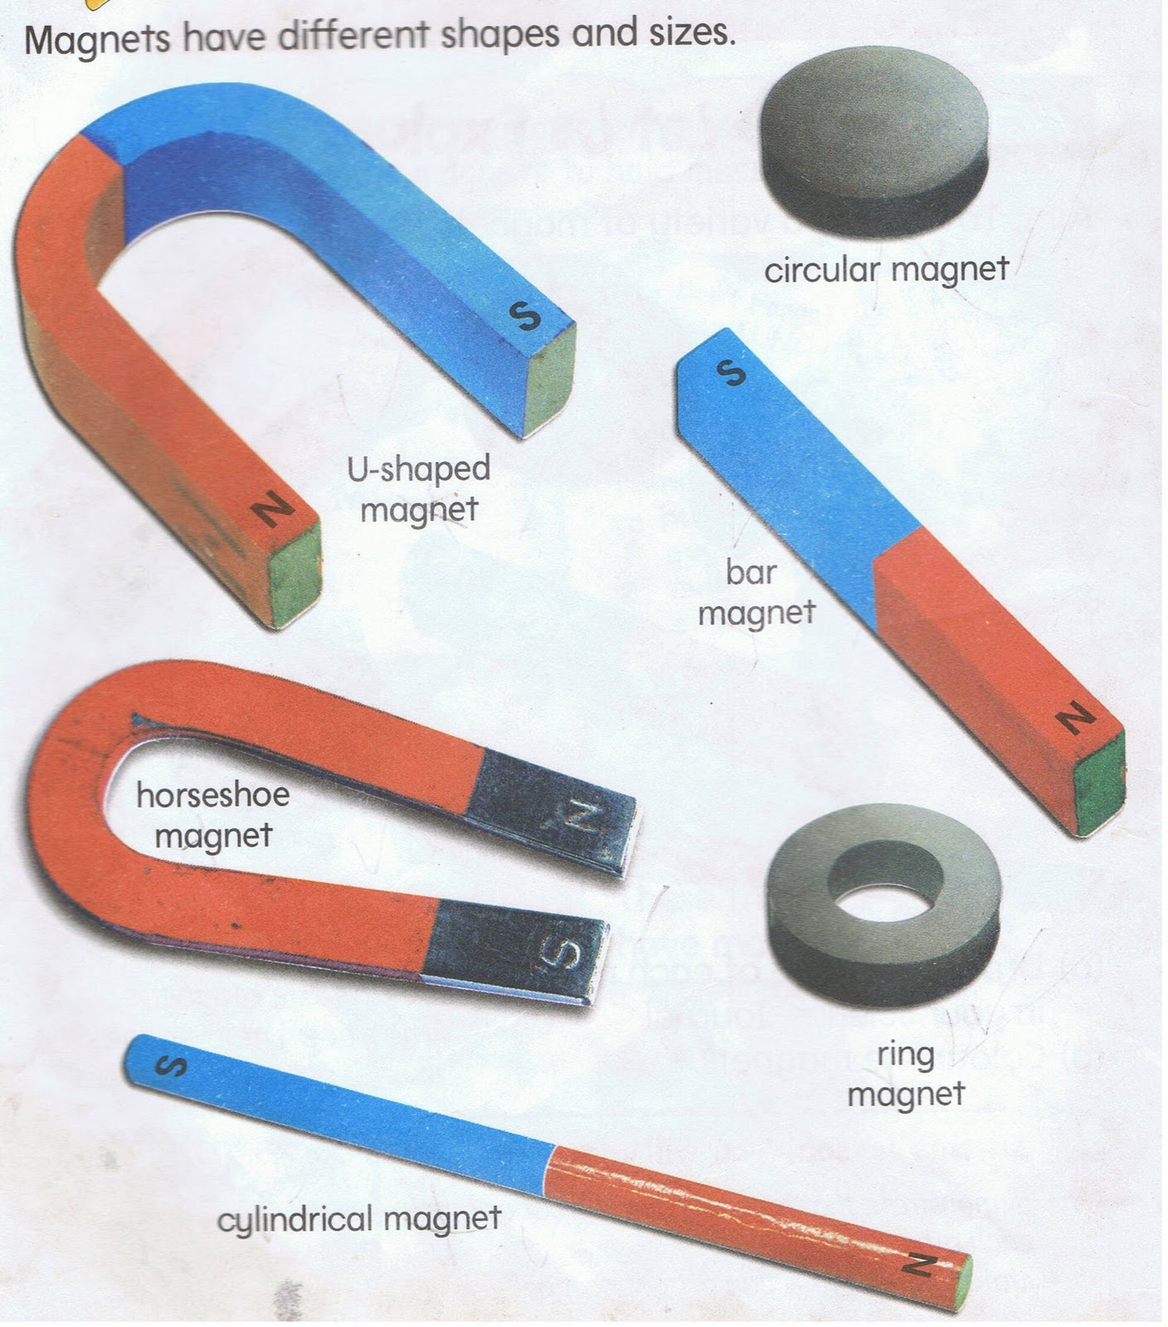
Which is the strongest magnet?
Resources
Variety of magnets
Paper clips – different sizes and colours
Ruler
Squared paper
Swap roles
Doers become observers
observers doers
Either repeat the same activity or do a different activity
Notes:
Further possibilities for activities overleaf

Slide 19
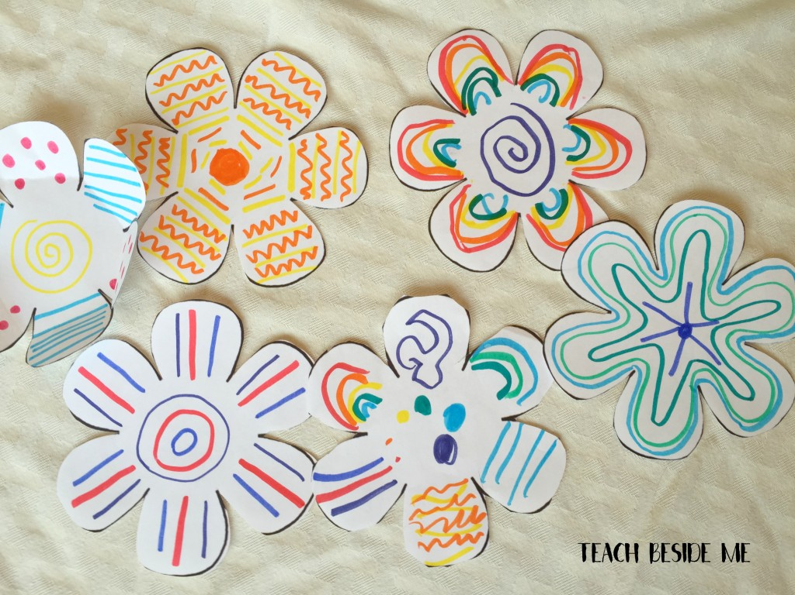
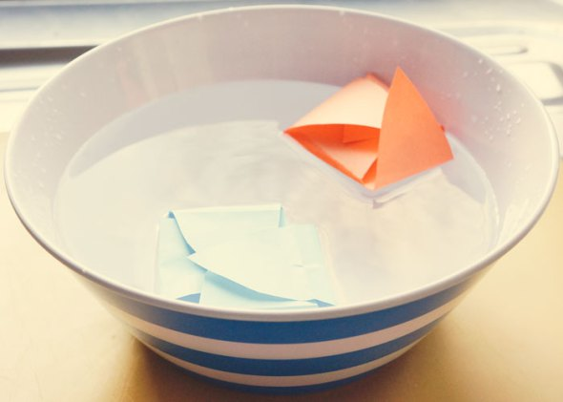
Blossoming Paper Flowers
Make a paper flower. Fold in the petals.
What happens when you put it in water?
What might affect how quickly it opens?
Resources
Paper flower templates, different types of paper
Scissors, pens, pencils
Tray/bowl of water, timer, washing up liquid, salt

Slide 20
Features of scientific inquiry involved in your activity
In your groups
What was difficult/easy to observe?
Note similarities/differences in assessments of investigators/observers
Did it make a difference if you knew/did not know the criteria?
How did it feel?
Any other issues raised?
Sharing across the whole group
What are the implications?
Notes:
Will need to decide whether to employ a chart – but think there is not much time.

Slide 21
What were the opportunities for assessment of creative dispositions?
Sense of initiative
Motivation
Ability to come up with something new
Ability to connect what they have learnt during lessons with topics in other subjects
Imagination
Curiosity
Ability to work together
Thinking skills
(from Conceptual Framework)
What might be the role of the teacher in fostering creativity in this context?
Consider links to the synergies between creative and inquiry based approaches.
Notes:
Can you offer any suggestions?
Pair and share – ideas until we run out.

Slide 22
Synergies between creative and inquiry based approaches to learning
(Creative Little Scientists, 2012)
Play and exploration
Motivation and affect
Dialogue and collaboration
Problem solving and agency
Questioning and curiosity
Reflection and reasoning
Teacher scaffolding and involvement
Assessment for learning
Notes:
The key role of assessment for learning reflected in the synergies identified between creative and inquiry based approaches to learning.

Slide 23
Assessment For Learning
Analysis of Classroom Examples
Framework for Classroom Examples
Setting the scene – focus, rationale, background
Starting points
Developing the learning journey – activities and their rationale, examples of children’s responses, teacher reflections and implications for the next session.
Reflections – children’s progress, teacher role, classroom environment, next steps
An Icy Adventure
On the go
Floating boats
Notes:
Now moving on
Share some examples from the classroom to to illustrate opportunities for assessment for learning
Also ways in which teacher built on children’s responses over time and sought to foster children’s skills and understandings associated with inquiry.

Slide 24
An Icy Adventure
Children age 3-4

Slide 25
On the go
Children age 4-7

Slide 26
Floating Boats
Children age 5-6

Slide 27
Discussion of classroom examples
Work in groups of 4 - 2 examples for each group.
Start in pairs with different examples, then swap.
1. Read through first to gain an overview of the learning journey.
2. Then consider the following questions:
What kinds of evidence does the example provide of children’s inquiry skills and creative dispositions?
What assessment approaches are used by the teacher?
In what ways does the teacher build on assessment information?
How might you gain further insights into children’s learning?
Whole group discussion
Sharing responses
Reflection on implications for planning and assessment
Notes:
You will not have time to read every element – but I suggest you skim through quickly at the start to gain a sense of the nature of the activities and progress over time.

Slide 28
Positive actions to aid the process of assessment
Providing activities in which pupils can apply or display certain ideas, skills, attitudes
Discussing activities with pupils
Asking questions which enable pupils to give their point of view
Listening to what pupils have to say
Noticing how they do their work
Looking at the products of work diagnostically
Harlen (1999)

Slide 29
10 Research based Principles of Assessment for Learning
Is part of effective planning
Focuses on how students learn
Is central to classroom practice
Is a key professional skill
Is sensitive and constructive
Fosters motivation
Promotes understanding of goals and criteria
Helps learners to know how to improve
Develops capacity for self assessment
Recognises all educational achievement
Assessment Reform Group (2002)

Slide 30
Implications for planning and assessment
Take a favourite science activity you carry out in your setting.
How could you build in and extend opportunities for assessment at different points in the activity?

Slide 31
Reflection on what has been gained from the workshop
In groups 2/3s
Look back at your original questions and issues. Anything you might add or change? Record additions in another colour. (pen/post it).
Note 2 actions you will take building on module content.
In what ways did the different activities support your developing thinking?
How far have the aims of the session been met?

Slide 32
Further information
Creative Little Scientists
(FP7 EU project 2011 – 2014)
Design principles and exemplar materials based on fieldwork www.creative-little-scientists.eu
Creativity in Early Years Science Education
(Erasmus+ EU project 2014 – 2017)
Curriculum Materials and Training Materials for teacher CPD to promote creative approaches to early years science www.ceys‐project.eu

Slide 33


Slide 34

Acknowledgements
Creativity in Early Years Science EDUCATION (2014-2017) www.ceys-project.eu
© 2017 CREATIVITY IN EARLY YEARS SCIENCE EDUCATION Consortium
This work is licensed under the Creative Commons Attribution-NonCommercial-NoDerivatives 4.0 International License. To view a copy of this license, visit http://creativecommons.org/licenses/by-nc-nd/4.0/.

