Slide 1



Training Module 15
Interpreting policy –
opening up opportunities for creativity
The project CREATIVITY IN EARLY YEARS SCIENCE EDUCATION has received funding from the European Union Erasmus+ Programme (2014‐2017) under Grant Agreement no: 2014-1-EL01-KA201-001644.

Slide 2

Introduction to the CEYS project
(use dependent on context)
European Erasmus+ project
Partners in Belgium, Greece, Romania, UK
Continuation of the Creative Little Scientists project http://www.creative-little-scientists.eu
Aims
  Development of a teacher development course and accompanying materials
  Promotion of the use of creative approaches in teaching science in preschool and early primary education (up to age of eight)
The project CREATIVITY IN EARLY YEARS SCIENCE EDUCATION has received funding from the European Union Erasmus+ Programme (2014‐2017) under Grant Agreement no: 2014-1-EL01-KA201-001644.

Slide 3
Aims of the module
Improve understanding of the purposes and aims of science education, and their place in the early years curriculum.
Examine the relevant education policy guidelines and documents for early years science education at national level, as well as the corresponding policy trends at European level, and identify in these opportunities for inquiry and creativity.
Understand the ways in which the National Curriculum and related requirements affect practice in schools.
Reflect on opportunities and challenges in implementing creative, inquiry based approaches in participants’ own settings.
The project CREATIVITY IN EARLY YEARS SCIENCE EDUCATION has received funding from the European Union Erasmus+ Programme (2014‐2017) under Grant Agreement no: 2014-1-EL01-KA201-001644.

Slide 4
Links to the Content Design Principles and Outcomes
12. Teacher education should provide knowledge about early child development, the purposes and aims of science and mathematics education, and their place in the early years curriculum.
  12.1 Teachers should have knowledge of the various purposes and aims of science and mathematics education in compulsory schooling.
  12.2 Teachers should have knowledge of the prevailing academic rationale for the place of science and mathematics in the early years curriculum.
  12.5 Teacher should be able to align the aims and rationale for early years science and mathematics education with their teaching and assessment approaches and priorities.
13. Teacher education should provide teachers with knowledge about the relevant education policy guidelines and documents for science, and mathematics education (and the role of creativity in them) at national level, as well as about the corresponding policy trends at European level.
  13.1 Teachers should have knowledge about the relevant education policy guidelines and documents for science, and mathematics education (and the role of creativity in them) at national level, as well as about the corresponding policy trends at European level.
The project CREATIVITY IN EARLY YEARS SCIENCE EDUCATION has received funding from the European Union Erasmus+ Programme (2014‐2017) under Grant Agreement no: 2014-1-EL01-KA201-001644.

Slide 5
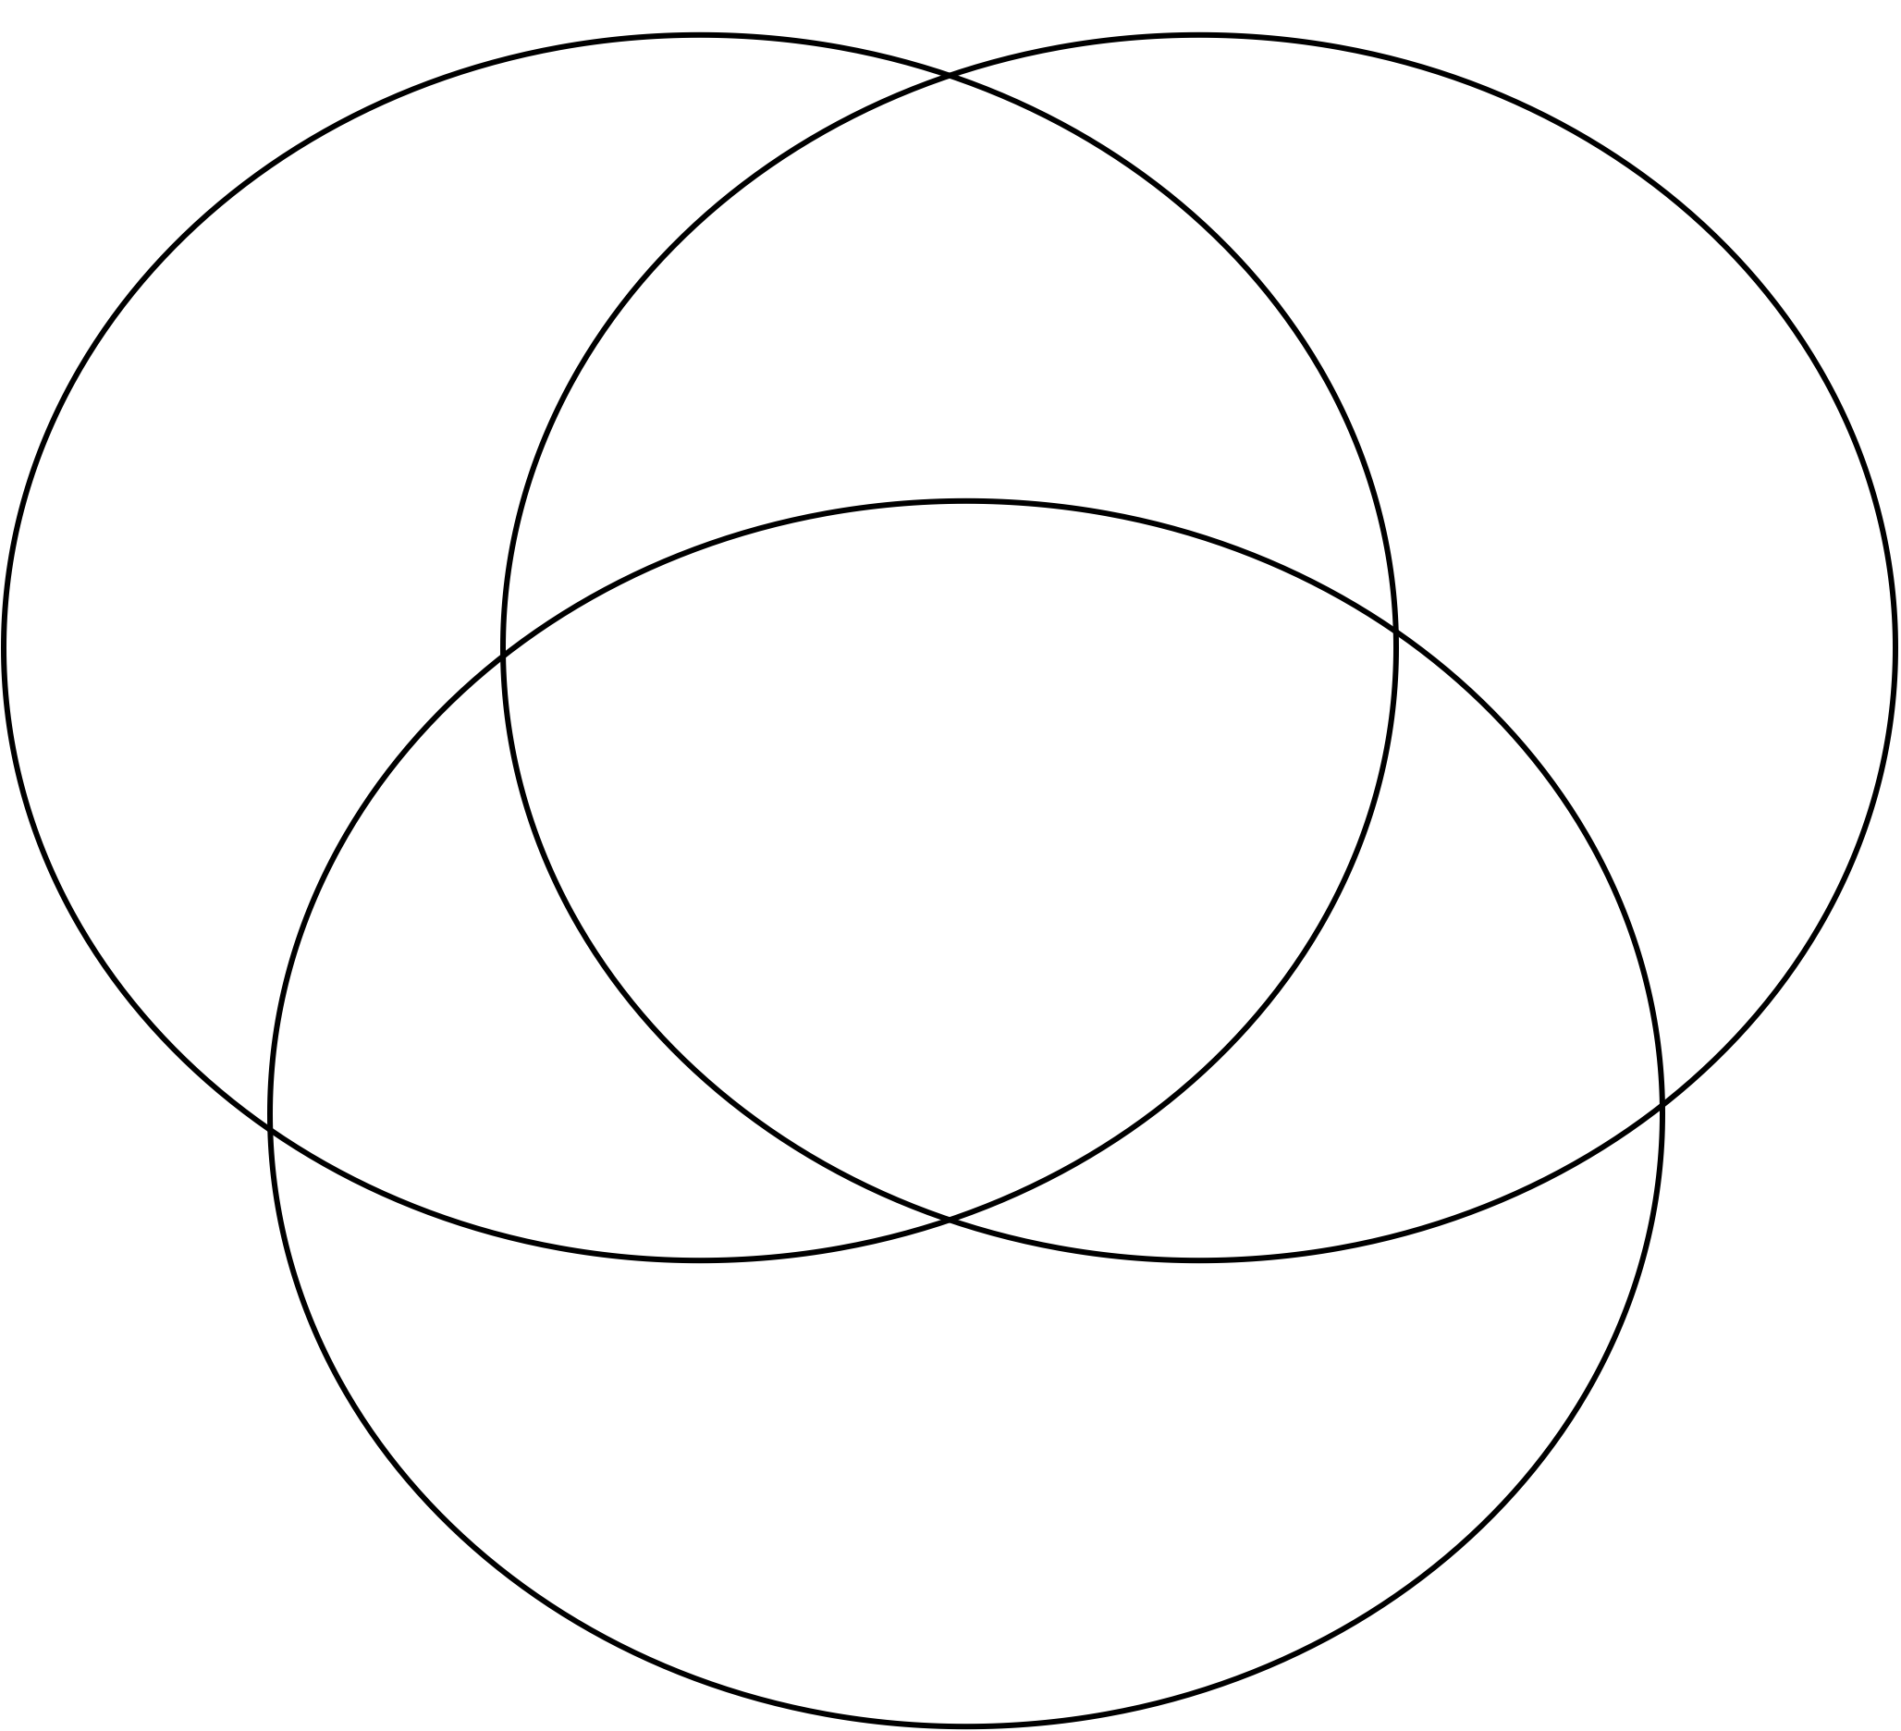
Activity 1: Important characteristics
What characteristics do you consider important for creativity, science education and early learning?
Science Education
Creativity
How should they be linked or related?
Early Years Education
The project CREATIVITY IN EARLY YEARS SCIENCE EDUCATION has received funding from the European Union Erasmus+ Programme (2014‐2017) under Grant Agreement no: 2014-1-EL01-KA201-001644.

Slide 6
Rationale and Aims
for science education
Economic imperatives
Scientific literacy for citizens
Technological developments
Implications for aims of science education
  Focus on nature of science
  Community
  Positive attitudes
  Inquiry Based Learning
Growing evidence of the influence of teacher attitudes to science
The project CREATIVITY IN EARLY YEARS SCIENCE EDUCATION has received funding from the European Union Erasmus+ Programme (2014‐2017) under Grant Agreement no: 2014-1-EL01-KA201-001644.
Notes:
Considerable debate in recent years about the importance and purposes science education, reflected in documentation at EU level and in discussions in science education community UK in recent years that has contributed to growing emphasis on the nature of science. Common themes include:
Economic imperatives- both supply of future scientists and technically skilled workforce, and to complete globally the need for individuals who have the skills and competencies to apply knowledge in innovative ways, concerns about lack of take up of science and declining attitudes to science across the primary school.
Growing emphasis on scientific literacy for citizens – importance of science and mathematics education not just for future jobs and the needs of the economy – but for all as an individual and as part of a community - to participate in democratic processes - to make decisions in the context of access to vast quantities of information and in using new technologies, need to develop skills and dispositions for 21st century when futures are uncertain and knowledge changing rapidly.
Technological developments – offer new opportunities not just for assessing learning but shaping learning processes – how to take advantage of these new opportunities (especially in relation to capturing sharing and discussing ideas), as well as considering their limitations
Changes in society’s perception of science have led to changing perceptions of how it should be taught in schools. This includes emphasis on children understanding the nature of science, social and cultural aspects, notion of science as a human construction building on evidence and involving argumentation within a community.
There is greater acknowledgement of the need to foster positive attitudes to science and involve children in debate around contemporary issues.
Science should not be presented to children as something divorced from their everyday lives, rather the importance of helping children draw personal meaning, promoting the role of inquiry and creativity in questioning and interpreting the world around them.

Slide 7
Growing emphasis
on scientific literacy
Scientific literacy was defined by the OECD as:
The capacity to use scientific knowledge, to identify questions and draw evidence-based conclusions in order to understand and make decisions about the natural world and make changes to it through human activity. (Harlen, 2001)
This trend is reflected internationally through the inclusion of the development of scientific inquiry skills and understanding of scientific ways of working within curriculum requirements for science education.
The project CREATIVITY IN EARLY YEARS SCIENCE EDUCATION has received funding from the European Union Erasmus+ Programme (2014‐2017) under Grant Agreement no: 2014-1-EL01-KA201-001644.
Notes:
.

Slide 8
Why should we teach science in the early years? (Eshach & Fried, 2005)
Children naturally enjoy observing and thinking about nature.
Exposing students to science develops positive attitudes towards science.
Early exposure to scientific phenomena leads to better understanding of the scientific concepts studied later in a formal way.
The use of scientifically informed language at an early age influences the eventual development of scientific concepts.
Children can understand scientific concepts and reason scientifically.
Science is an efficient means for developing scientific thinking.
The project CREATIVITY IN EARLY YEARS SCIENCE EDUCATION has received funding from the European Union Erasmus+ Programme (2014‐2017) under Grant Agreement no: 2014-1-EL01-KA201-001644.
Notes:
Eshach, H. & Fried, M.N. J Sci Educ Technol (2005) 14: 315. https://doi.org/10.1007/s10956-005-7198-9
Six assertions supporting the idea that even small children should be exposed to science are given. These are, in order: (1) Children naturally enjoy observing and thinking about nature. (2) Exposing students to science develops positive attitudes towards science. (3) Early exposure to scientific phenomena leads to better understanding of the scientific concepts studied later in a formal way. (4) The use of scientifically informed language at an early age influences the eventual development of scientific concepts. (5) Children can understand scientific concepts and reason scientifically. (6) Science is an efficient means for developing scientific thinking.

Slide 9
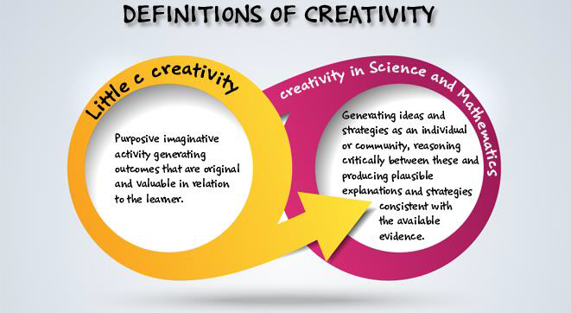
Definition of creativity adopted by the CEYS project
(from Creative Little Scientists, 2014)
The project CREATIVITY IN EARLY YEARS SCIENCE EDUCATION has received funding from the European Union Erasmus+ Programme (2014‐2017) under Grant Agreement no: 2014-1-EL01-KA201-001644.

Slide 10
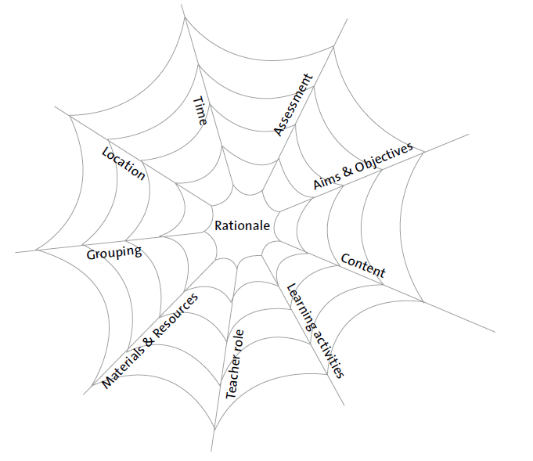
Curriculum Dimensions
The vulnerable spider web (van den Akker 2007 p 39)
Factors associated with creativity in early years science related to:
Aims, purposes, priorities
Teaching, learning & assessment
Contextual factors
The project CREATIVITY IN EARLY YEARS SCIENCE EDUCATION has received funding from the European Union Erasmus+ Programme (2014‐2017) under Grant Agreement no: 2014-1-EL01-KA201-001644.

Slide 11
Rationale, aims and objectives
Why are children learning?
Toward which goals are children learning?
Policy determined at different levels: national, local and school levels
Issues of coherence
Curriculum Content: What are children learning?
Learning activities: How are children learning?
Different opportunities for teacher decision making
Teacher role: How is the teacher facilitating learning?
Materials & resources: With what are children learning?
Grouping: with whom are children learning?
Location: Where are children learning?
Influence of timetables and assessment processes
Time: When are children learning?
Assessment: How to measure how far children’s learning has progressed?
The project CREATIVITY IN EARLY YEARS SCIENCE EDUCATION has received funding from the European Union Erasmus+ Programme (2014‐2017) under Grant Agreement no: 2014-1-EL01-KA201-001644.

Slide 12
Activity 2: Examing policy: Aims and Objectives
Consider the Aims and Objectives dimension of the vulnerable spider web. Refer back to the definitions you have been introduced to?
In groups of 3-4
How well are these reflected in the national document you have brought with you?
Report to the whole group
What are the similarities? Record them on your copy of the spider web.
What are the differences? What challenges have they presented for you as a teacher?
The project CREATIVITY IN EARLY YEARS SCIENCE EDUCATION has received funding from the European Union Erasmus+ Programme (2014‐2017) under Grant Agreement no: 2014-1-EL01-KA201-001644.
Notes:
20 mins

Slide 13
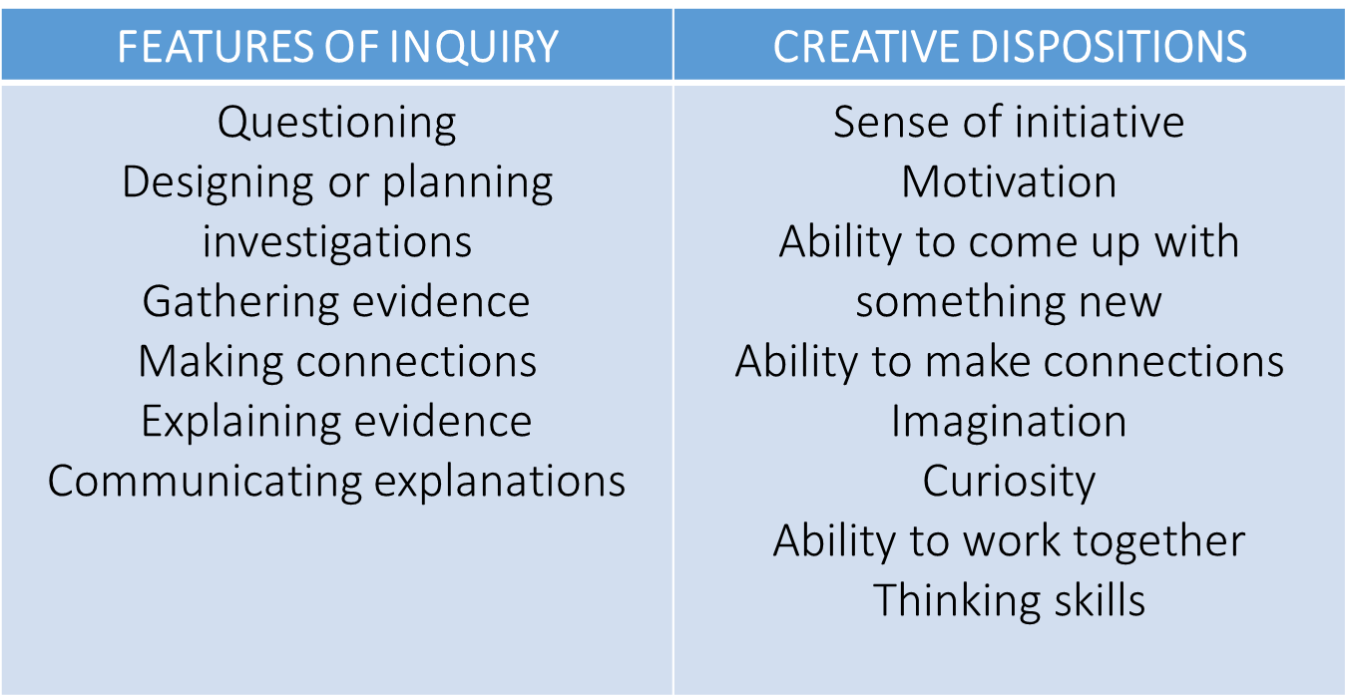
Features of inquiry and creative dispositions
The project CREATIVITY IN EARLY YEARS SCIENCE EDUCATION has received funding from the European Union Erasmus+ Programme (2014‐2017) under Grant Agreement no: 2014-1-EL01-KA201-001644.
Notes:
20 mins

Slide 14
Synergies between inquiry-based and creative approaches
SYNERGIES
Play and exploration
Motivation and affect
Dialogue and collaboration
Problem solving and agency
Questioning and curiosity
Reflection and reasoning
Teacher scaffolding and involvement
Assessment for learning
The project CREATIVITY IN EARLY YEARS SCIENCE EDUCATION has received funding from the European Union Erasmus+ Programme (2014‐2017) under Grant Agreement no: 2014-1-EL01-KA201-001644.
Notes:
20 mins

Slide 15
Creativity in European Countries’ Education Policy 1
Belgium (NC for private Catholic schools)
Out of 8 aims:
Thinking skills
Development of the senses
Development of creativity
Finland (The national core curriculum for Pre-primary education, 2014)
In the general objectives the development of creativity is highlighted, e.g. supervised and free play. Other working methods that are illustrative and promote the creativity of children are an essential part of pre-primary education, p.36.
Also children “are encouraged to ask questions and room is given to their reasoning and wondering”, p. 46.
The project CREATIVITY IN EARLY YEARS SCIENCE EDUCATION has received funding from the European Union Erasmus+ Programme (2014‐2017) under Grant Agreement no: 2014-1-EL01-KA201-001644.
Notes:
20 mins

Slide 16
Creativity in European Countries’ Education Policy 2
England (Statutory Framework for Early Years Foundation Stage, 2017)
Characteristics of effective teaching and learning:
  Play and explore
  Active learning
  Create and think critically, p.10
Northern Ireland
Eleven specific aims which include:
To enable children to apply what they learn to new contexts in order to respond creatively to the variety of challenges they encounter in life.
To enable children to develop their creative and imaginative capacities through artistic expression and response.
The project CREATIVITY IN EARLY YEARS SCIENCE EDUCATION has received funding from the European Union Erasmus+ Programme (2014‐2017) under Grant Agreement no: 2014-1-EL01-KA201-001644.
Notes:
20 mins

Slide 17
Activity 3: Examing policy: Learning, Teaching and Assessment
Look in more detail at your national policy guidelines about Learning, Teaching and Assessment of science in the early years.
In groups of 3-4
Highlight any existing links with inquiry and creativity.
Using a different colour marker, highlight any opportunities you think exist for inquiry and creativity.
Record them on your group’s spider web (focus on Learning Activities, Teacher Role, Assessment).
Report to the whole group
One thing that you found missing, surprised you, or made you worried
The project CREATIVITY IN EARLY YEARS SCIENCE EDUCATION has received funding from the European Union Erasmus+ Programme (2014‐2017) under Grant Agreement no: 2014-1-EL01-KA201-001644.
Notes:
20 mins

Slide 18
Activity 4: Opportunities in your school context
In different groups
Think about your own school environment, e.g. about the contextual factors (Materials and Resources, Location, Time, Grouping) of the spider web.
Individually identify which factors facilitate and which restrict inquiry and creativity in your school context and write them on post-its and put them on a poster paper.
Discuss with members of the group the areas that prove most challenging for you.
Use the materials you brought with you to show examples of good practice.
The project CREATIVITY IN EARLY YEARS SCIENCE EDUCATION has received funding from the European Union Erasmus+ Programme (2014‐2017) under Grant Agreement no: 2014-1-EL01-KA201-001644.
Notes:
20 mins

Slide 19
Introduction to classroom examples
Framework for the Curriculum Materials
Setting the scene – focus, rationale, background
Starting points
Developing the learning journey – activities and their rationale, examples of children’s responses, teacher reflections and implications for the next session.
Reflections – children’s progress, teacher role, classroom environment, next steps
Skeletons
Everyday materials
Electricity
The project CREATIVITY IN EARLY YEARS SCIENCE EDUCATION has received funding from the European Union Erasmus+ Programme (2014‐2017) under Grant Agreement no: 2014-1-EL01-KA201-001644.
Notes:
Now moving on
Share some examples from the classroom examples over time – that illustrate varied approaches to inquiry and creativity.
Also ways in which teacher worked around their national and/or school policy to overcome any restrictions, in order to promote inquiry and creativity in their early years teaching.
In the time frame can only give you time to gain a sense of what the materials might offer.
Looking at 3 different examples covering different age ranges:
Skeletons, children age 7-8
Everyday materials, children age 5-6
Electricity, children age 4-5

Slide 20
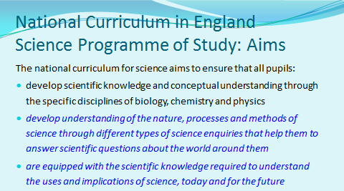
Everyday Materials
Children age 5-6
The project CREATIVITY IN EARLY YEARS SCIENCE EDUCATION has received funding from the European Union Erasmus+ Programme (2014‐2017) under Grant Agreement no: 2014-1-EL01-KA201-001644.

Slide 21
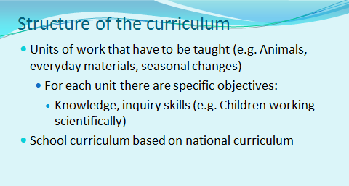
Everyday Materials
Children age 5-6
The project CREATIVITY IN EARLY YEARS SCIENCE EDUCATION has received funding from the European Union Erasmus+ Programme (2014‐2017) under Grant Agreement no: 2014-1-EL01-KA201-001644.

Slide 22
Everyday Materials
Children age 5-6
The project CREATIVITY IN EARLY YEARS SCIENCE EDUCATION has received funding from the European Union Erasmus+ Programme (2014‐2017) under Grant Agreement no: 2014-1-EL01-KA201-001644.

Slide 23
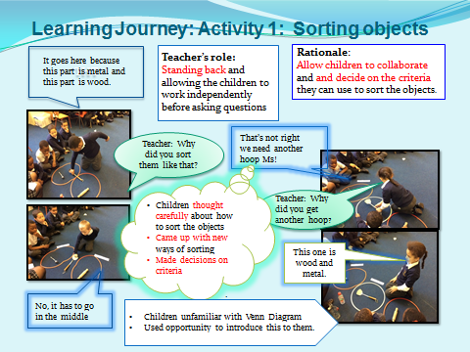
Everyday Materials
Children age 5-6
The project CREATIVITY IN EARLY YEARS SCIENCE EDUCATION has received funding from the European Union Erasmus+ Programme (2014‐2017) under Grant Agreement no: 2014-1-EL01-KA201-001644.
Notes:
Activity: To sort objects based on their own criteria. We recapped on the properties of various materials. I presented the children with some objects made from wood, metal and both, as well as two hoops. The children’s task was now to sort a range of objects using their own criteria.

Slide 24
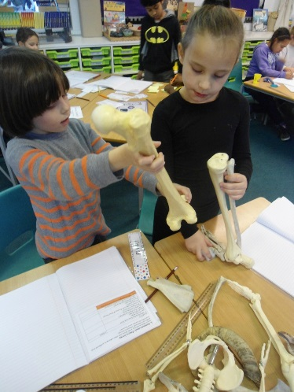
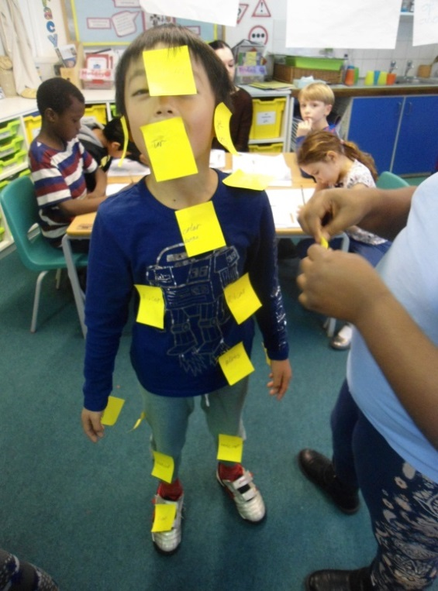
Skeletons
Children age 7-8
The project CREATIVITY IN EARLY YEARS SCIENCE EDUCATION has received funding from the European Union Erasmus+ Programme (2014‐2017) under Grant Agreement no: 2014-1-EL01-KA201-001644.

Slide 25
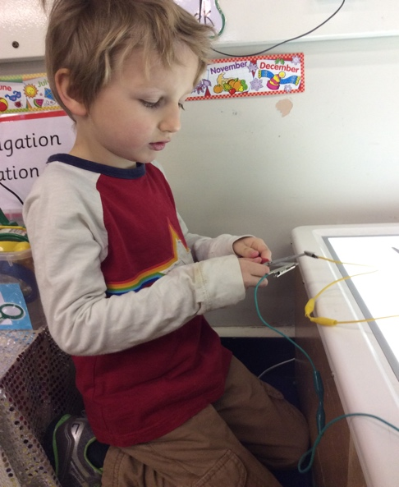
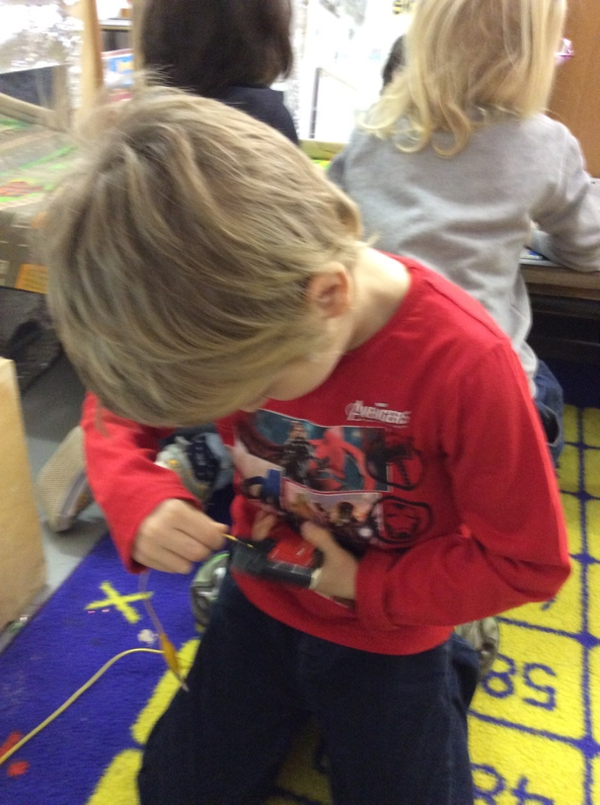
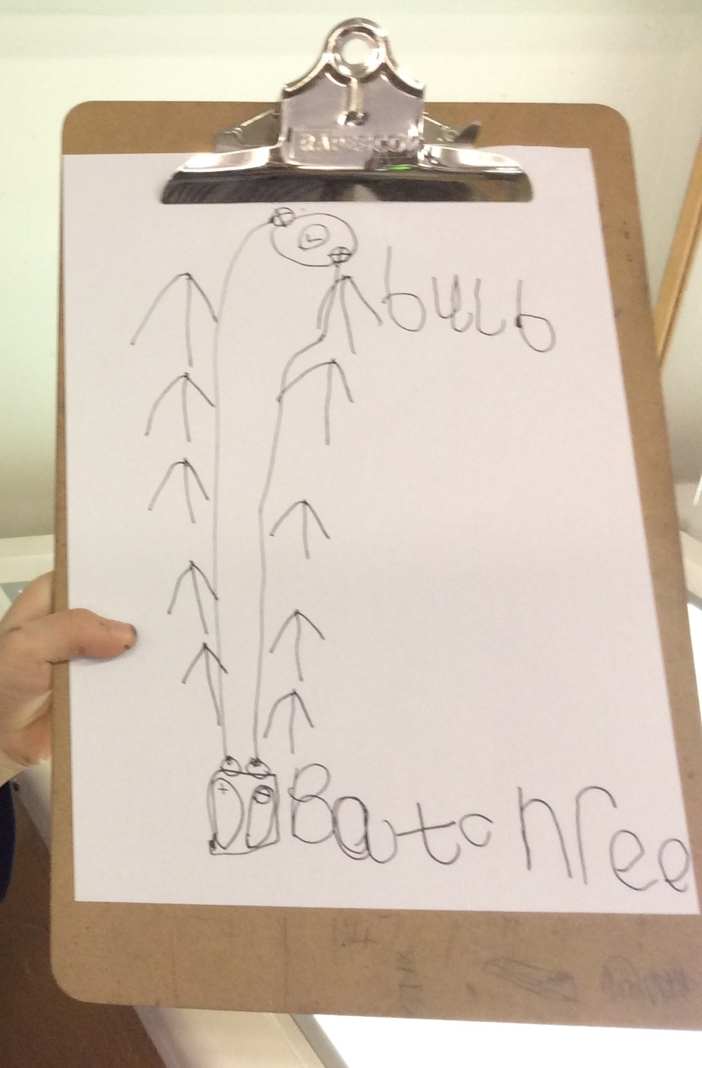
Electricity
Children age 4-5
The project CREATIVITY IN EARLY YEARS SCIENCE EDUCATION has received funding from the European Union Erasmus+ Programme (2014‐2017) under Grant Agreement no: 2014-1-EL01-KA201-001644.

Slide 26
Activity 5: Analysis of Classroom examples
In pairs discuss examples of Curriculum Materials.
1. Read through first to gain an overview of the learning journey.
2. Then consider the following questions:
What evidence do the materials provide of children’s inquiry skills and creative dispositions?
How did the teacher open up opportunities for inquiry and creativity within curriculum requirements?
What insights do you gain into the learning both of the children and the teacher?
What are the implications?
The project CREATIVITY IN EARLY YEARS SCIENCE EDUCATION has received funding from the European Union Erasmus+ Programme (2014‐2017) under Grant Agreement no: 2014-1-EL01-KA201-001644.

Slide 27
Activity 6:
Tackling restricting factors
In pairs
Look back at the factors you have identified as restricting inquiry and creativity in your science teaching, choose two and suggest solutions for them.
Back in groups
Prepare post cards with problem on one side and suggested solution on the other, after discussion with peers.
Share and discuss with a teacher of one other school.
The project CREATIVITY IN EARLY YEARS SCIENCE EDUCATION has received funding from the European Union Erasmus+ Programme (2014‐2017) under Grant Agreement no: 2014-1-EL01-KA201-001644.

Slide 28
Reflection and implications
How far have the module objectives been met?
In what ways did the different activities support your developing thinking?
Note 2 actions you will take building on module content.
The project CREATIVITY IN EARLY YEARS SCIENCE EDUCATION has received funding from the European Union Erasmus+ Programme (2014‐2017) under Grant Agreement no: 2014-1-EL01-KA201-001644.

Slide 29
Further information
Creative Little Scientists
(FP7 EU project 2011 – 2014)
Design principles and exemplar materials based on fieldwork www.creative-little-scientists.eu
Creativity in Early Years Science Education
(Erasmus+ EU project 2014 – 2017)
Curriculum Materials and Training Materials for teacher CPD to promote creative approaches to early years science www.ceys‐project.eu
The project CREATIVITY IN EARLY YEARS SCIENCE EDUCATION has received funding from the European Union Erasmus+ Programme (2014‐2017) under Grant Agreement no: 2014-1-EL01-KA201-001644.

Slide 30

THANK YOU!
The project CREATIVITY IN EARLY YEARS SCIENCE EDUCATION has received funding from the European Union Erasmus+ Programme (2014‐2017) under Grant Agreement no: 2014-1-EL01-KA201-001644.

Slide 31
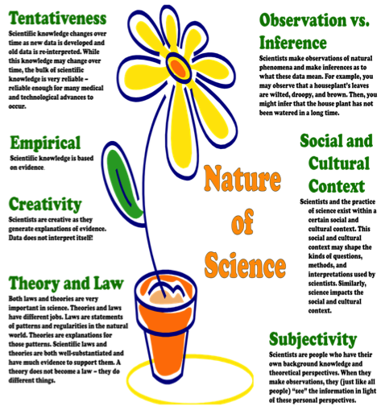
Assessment
Strategy
Formative
Self assessment
Peer assessment
Ongoing
Summative
Focus on product or process
CLS conceptual framework
Adopted by the CEYS project
Synergies
Play and exploration
Motivation and affect
Dialogue and collaboration
Problem solving and agency
Questioning and curiosity
Reflection and reasoning
Teacher scaffolding and involvement
Assessment for learning
Creative Dispositions
Sense of initiative
Motivation
Ability to come up with something new
Ability to make connections
Imagination
Curiosity
Ability to work together
Thinking skills
Learning activities/Features of inquiry
questioning
designing or planning investigations
gathering evidence
making connections
explaining evidence
communicating explanations
Notes:
This sets out key features of the CLS conceptual framework adopted by the CEYS project – it provides a useful reference point.
Facilitators will need to decide when best to use this dependent on audience.
It can be useful, particularly on a longer course for participants to have this as a handout for reference during a session.

Slide 32
Features of the Nature of Science
(Akerson et al, 2011, p64)
Notes:
Empirical – based on evidence
Tentative – changes in light of new data/ interpretations of data
Creative – involves imagination and creativity
Subjective – influenced by knowledge and perspectives
Social and cultural context – influences both practices of science and impact
Law (pattern/regularity) and Theory (explanation)

Slide 33

Acknowledgements
Creativity in Early Years Science EDUCATION (2014-2017) www.ceys-project.eu
© 2017 CREATIVITY IN EARLY YEARS SCIENCE EDUCATION Consortium
This work is licensed under the Creative Commons Attribution-NonCommercial-NoDerivatives 4.0 International License. To view a copy of this license, visit http://creativecommons.org/licenses/by-nc-nd/4.0/.

