Slide 1
Training Module 14
Planning for progression
Building on children’s ideas and questions

Slide 2
Introduction to the CEYS project
(use dependent on context)
European Erasmus+ project
Partners in Belgium, Greece, Romania, UK
Continuation of the Creative Little Scientists project http://www.creative-little-scientists.eu
Aims
  Development of a teacher development course and accompanying materials
  Promotion of the use of creative approaches in teaching science in preschool and early primary education (up to age of eight)
Notes:
The Creativity in Early Years Science project is a European Erasmus+ project with partner countries Greece, Romania, Belgium and the UK
As indicated – it aims to develop a European teacher professional development course and accompanying materials to promote the use of creative approaches in teaching science in preschool and early primary education (up to age of eight).
It is a continuation of the project Creative Little Scientists, an FP7 EU project, where curriculum design principles to foster inquiry and creativity in science education were designed.

Slide 3
Aims of the module
Introduce participants to characteristics of progression in early science learning
Consider the importance of children’s ideas and questions and the role of creativity in the development of concepts, scientific processes and attitudes in science
Share different strategies for eliciting and building on children’s ideas, questions and everyday experiences
Discuss approaches to planning responsive to children’s ideas, questions and experiences and promote progression through extended engagement in an area of study.
Examine the role of the teacher and the importance of the classroom environment in fostering creativity and positive attitudes in science.
Notes:
Characteristics of progression – how recognised?
Importance of children’s ideas/questions/creativity
Strategies for eliciting/building on children’s ideas
Responsive planning – extended engagement
Role teacher (shifting over time) – classroom environment

Slide 4
Links to Content Design Principles and Outcomes 1
1. Teacher education should provide content knowledge about science and mathematics, including interesting and current topics, to be used in activities linked with everyday life.
  1.1 Teachers should be able to pursue the social and affective objectives of children’s science and mathematics learning, in synergy with the corresponding cognitive ones
6. Teacher education should provide pedagogical content knowledge to stimulate inquiry and problem solving in science and mathematics education.
  6.3 Teachers should be able to recognise the key roles of children’s questioning and existing ideas (both implicit and explicit) of science and mathematics.
  6.4 Teachers should be able to use a variety of strategies for eliciting and building on children’s questions and ideas during inquiry processes (before, during and after explorations and investigations).
Notes:
These are linked to some of the overall aims of our materials.

Slide 5
Links to Content Design Principles and Outcomes 2
7. Teacher education should familiarise teachers with a range of formal and informal inquiry- and creativity-based learning, teaching and assessment approaches and strategies and their use in relation to authentic problems within the areas of science and mathematics.
  7.2 Teachers should be able to use a range of strategies both formal and informal for supporting children’s extended engagement with an area of study and progression in learning in science and mathematics.
10. Teacher education should enable teachers to recognize and build on children’s ideas, theories and interests for the teaching of science and mathematics.
  10.1 Teachers should be able to use a range of strategies for picking up on children’s ideas, theories and interests.
  10.2 Teachers should be able to build flexibility into planning to take advantage of unexpected events, children’s interests and questions.

Slide 6
Rationale
Importance of children’s ideas and questions
From their earliest years children seek to explore the world around them.
Questions play a central role in creative, inquiry-based approaches to learning.
Sustaining and building on children’s curiosity helps to foster positive attitudes to science and creative dispositions.
Notes:
Why is it important to build on children’s ideas and questions?
Important to recognise children’s developing ideas and questions from their earliest years
Questions central role in creative, inquiry–based learning
Furthermore engaging with children’s ideas and questions, major role in fostering positive attitudes to science and creative dispositions.
Vital for long term engagement with science.

Slide 7
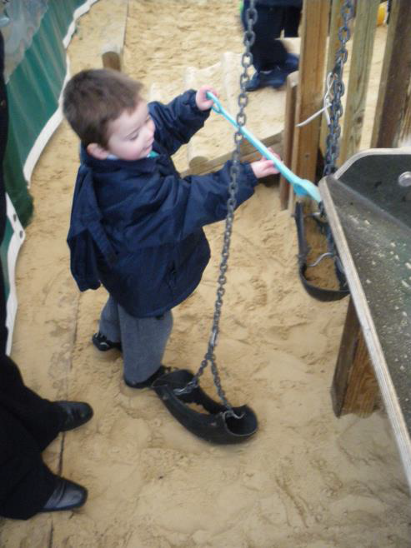
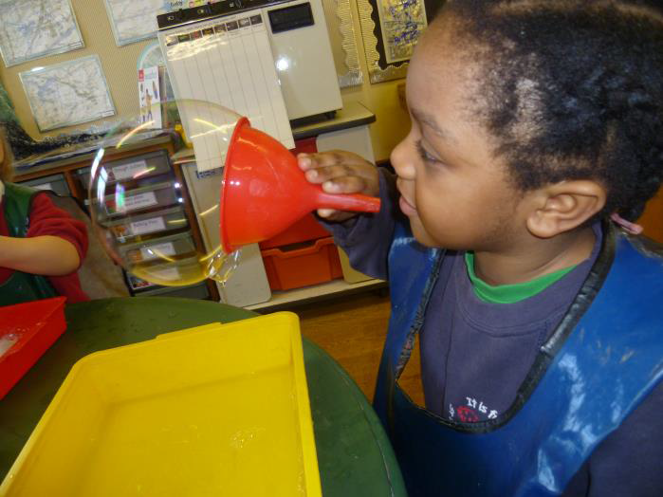
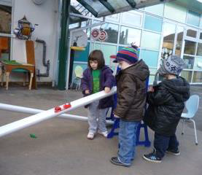
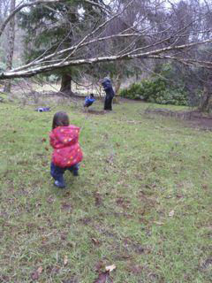
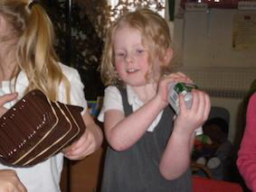
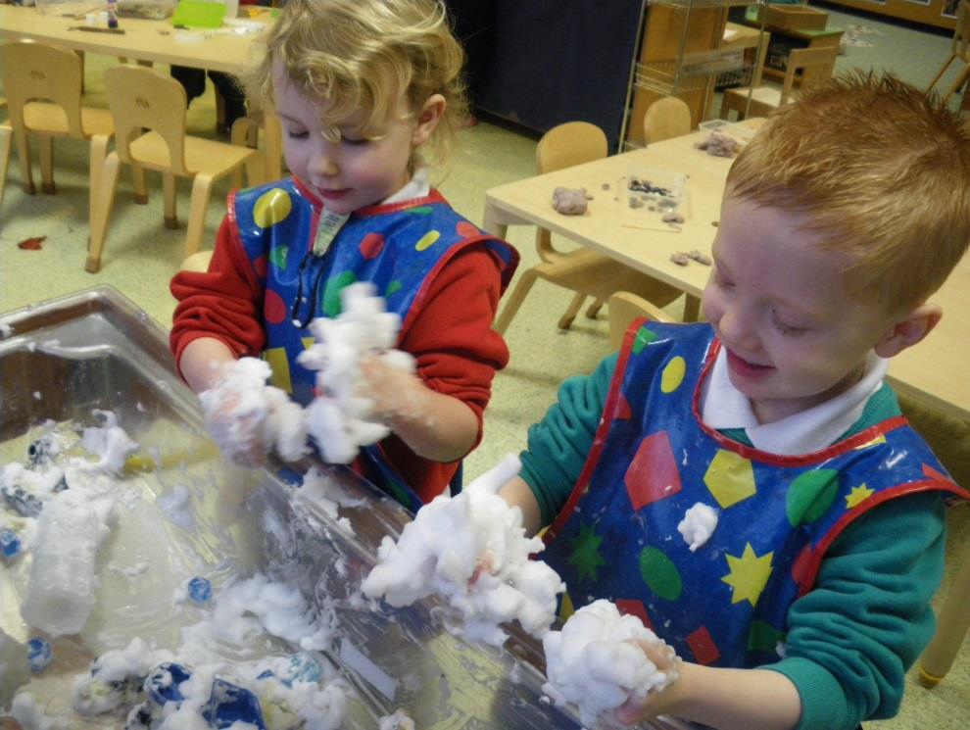
Questions and ideas are often implicit in children’s play and exploration
Notes:
There are many examples from our projects that illustrate this. Children’s questions and ideas are often implicit in their play and exploration as shown in these episodes from Creative Little Scientists – both indoors and out.
UKNI_Class_OutdoorSand_CreatInqPed.pdf The boy is filling a container with sand. The container is attached to a chain that goes over a pulley.
UKEN_Class_Bubbles_PractInvest.pdf
UKEN_Class_Cars_and_Ramps_IBSE.pdf
UKWA_Class_Makingmusicalinstrument_Resources.pdf
UKNI_Int_Foam_CreatInqLA.pdf
UKSC_Class_ScoutCamp_LEnvironm.pdf –in this picture the adult has helped make a swing out of rope attached to the branch. One child is sitting in the swing. The other (with the pink jacket) is pulling the swing with a rope to set it swinging.

Slide 8
Key issues for practitioners
How to identify and build on children’s ideas and questions
Ways to recognise and foster children’s inquiry skills and creative dispositions
Developing strategies for promoting and assessing progression in children’s, processes, attitudes and concepts in science
Fostering a classroom climate in which children are prepared to offer and evaluate alternative ideas and strategies and sustain engagement over time
Developing flexible approaches to curriculum planning, responsive to children’s ideas, questions and experiences
Notes:
But building on children’s ideas and questions has a number of challenges
Issues associated with assessment at the start
Teaching strategies
Classroom climate
Building in flexibility to respond to children’s ideas and questions.

Slide 9
Module outline
Introduction and rationale
Sharing examples from practice
Activities to elicit children’s ideas and questions
Examples from practice – evidence of progression
Role of the teacher, building on children’s ideas and questions
Implications for planning to support progression
Reflections on the module

Slide 10
Connecting IBSE and
Creative Approaches
(from Creative Little Scientists, 2012)
Features of inquiry
Creativity in learning
Questioning
Designing and planning investigations
Gathering evidence
Making connections
Explaining evidence
Communicating explanations
Sense of initiative
Motivation
Ability to come up with something new
Making connections
Imagination
Curiosity
Ability to work together
Thinking skills
Notes:
So first of all what are we looking for in promoting progression?
In the CEYS project strong focus on inquiry skills
And attitudes and dispositions associated with creativity

Slide 11
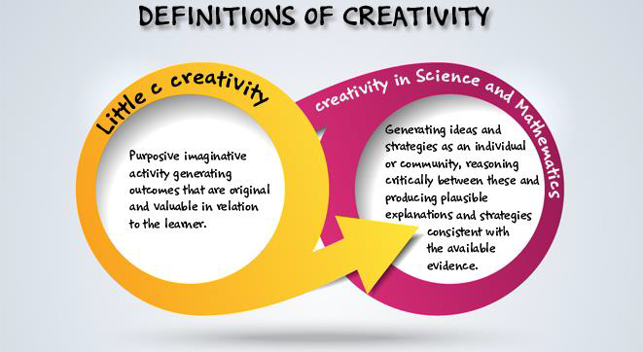
Definitions of creativity adopted by the CEYS project
(from Creative Little Scientists, 2014)
Notes:
Central features of scientific inquiry and the essential role of creativity
Fostering growing confidence and independence

Slide 12
Sharing examples from your school setting
Record 1 or 2 examples of ways in which you have built on children’s ideas, questions and experiences.
What were some of the challenges in doing this?
Think of a situation in which you noticed change or progression in children’s inquiry skills, science concepts or creative dispositions. What changes did you notice?
What do you think prompted the change?
As an individual - Write down 1/2 answers to these questions on separate post its and place on the sheet on the table.
As a group – See if you can sort these – Any common themes or differences in your approaches?
Notes:
Sharing experiences and expertise important dimension of the module.
Gaining sense of our different school contexts.
So first activity sets out to capture your ideas and strategies.
Two phases: Individual – as a group

Slide 13
Activities to elicit children’s ideas and questions
Work in 2/3s within your group
Explore the different activities provided in your tray.
Magnetic maze
Odd one out
Positive minus interesting
Concept cartoons
Drawing
Concept map
Issues to consider
What kinds of ideas and questions and might these materials foster?
How might you build on these?
What connections could you make to children’s everyday life experiences?
What other approaches might you use to elicit children’s ideas and questions?
Feedback 1 or 2 key issues raised by these activities
Notes:
These activities provide some further examples of stimuli for children’s ideas and questions– can be used across the primary school
You will have about 15/20 minutes to try some of these – take turns and share to explore potential.

Slide 14
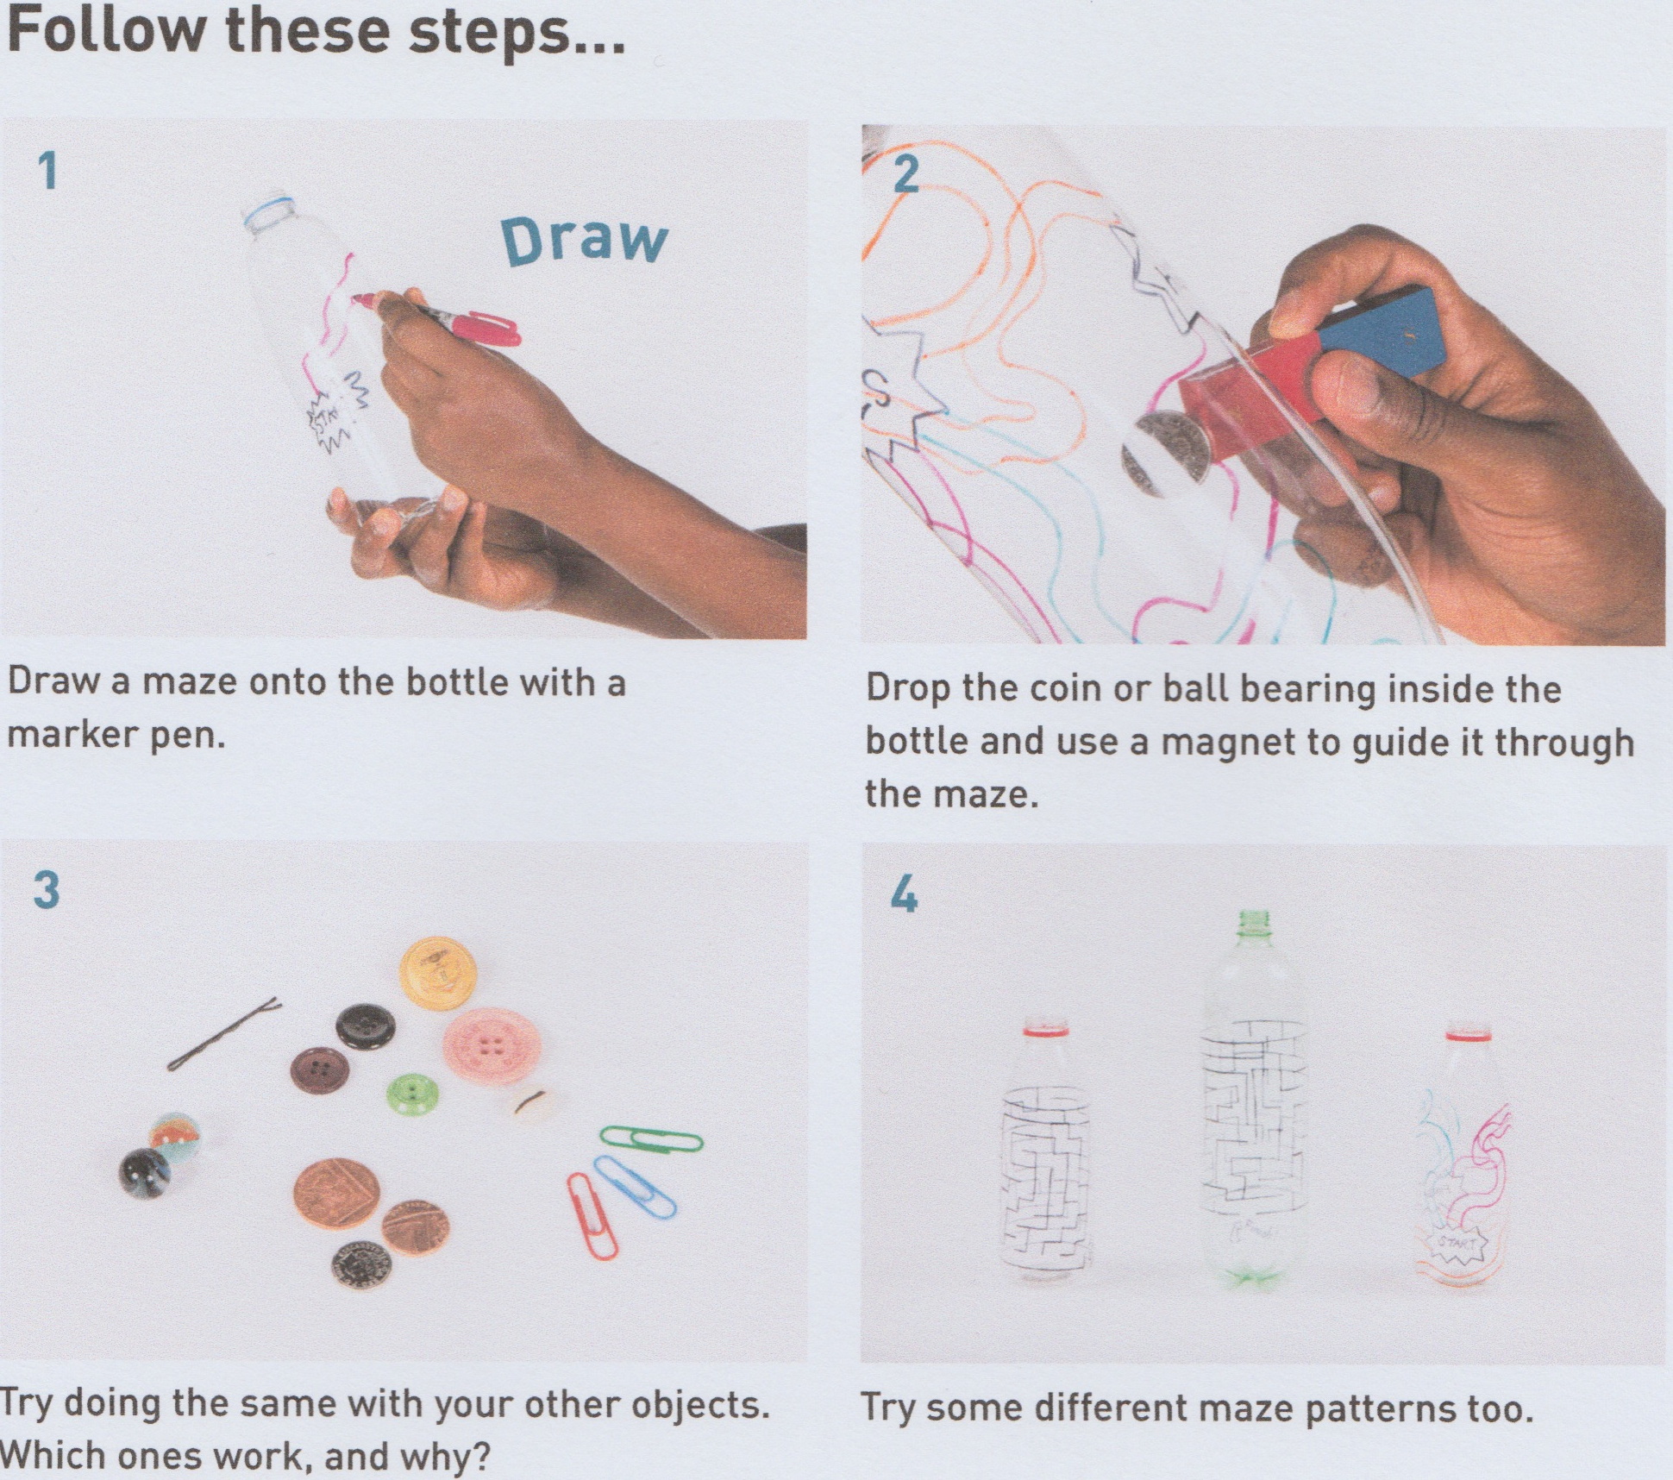
Magnetic Maze
http://www.sciencemuseum.org.uk/educators/classroom-resources/activities/magnetic-maze
Notes:
An activity from the Science Museum website.

Slide 15
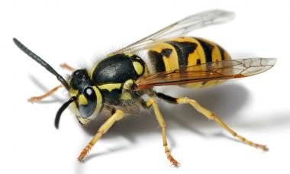
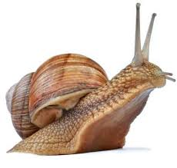
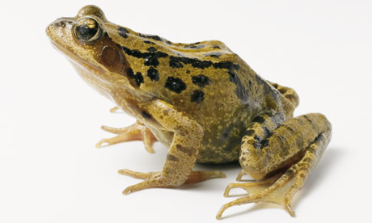
Which is the odd one out & why?
https://pstt.org.uk/resources/curriculum-materials/thinking-in-science
Notes:
See link to these materials on the slide.
Primary Science Teaching Trust has extensive website – wide range of activities in this case to promote thinking in science
No right answer
All possible
Reasoning critical
Supportive climate

Slide 16
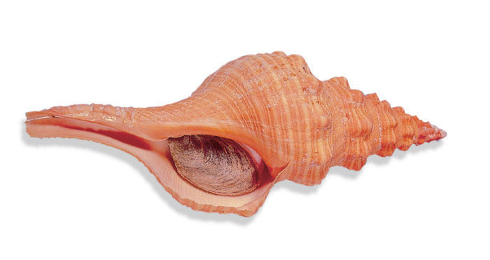

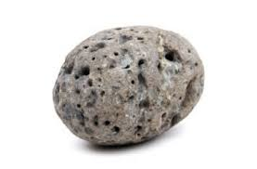
Which is the odd one out & why?
https://pstt.org.uk/resources/curriculum-materials/thinking-in-science

Slide 17
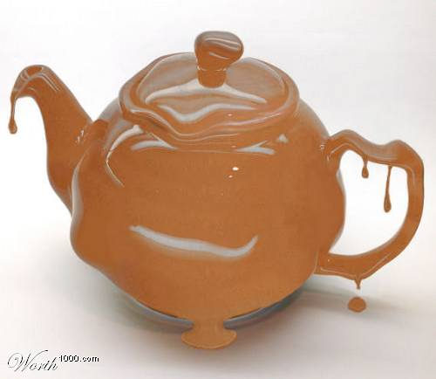
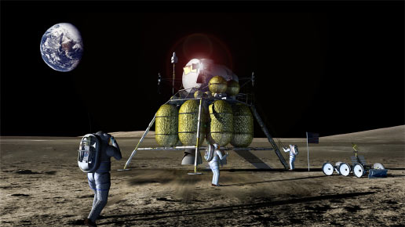
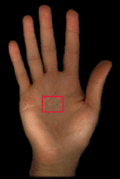
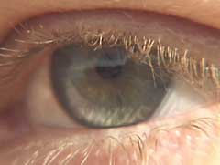

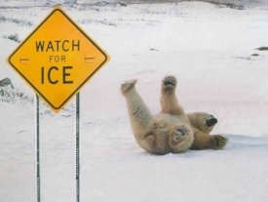
The chocolate teapot
Living on the Moon
An eye in the middle of your hand
Positive
Minus
Interesting?
A world without friction
A flexible skeleton
https://pstt.org.uk/resources/curriculum-materials/thinking-in-science
Notes:
Another approach

Slide 18
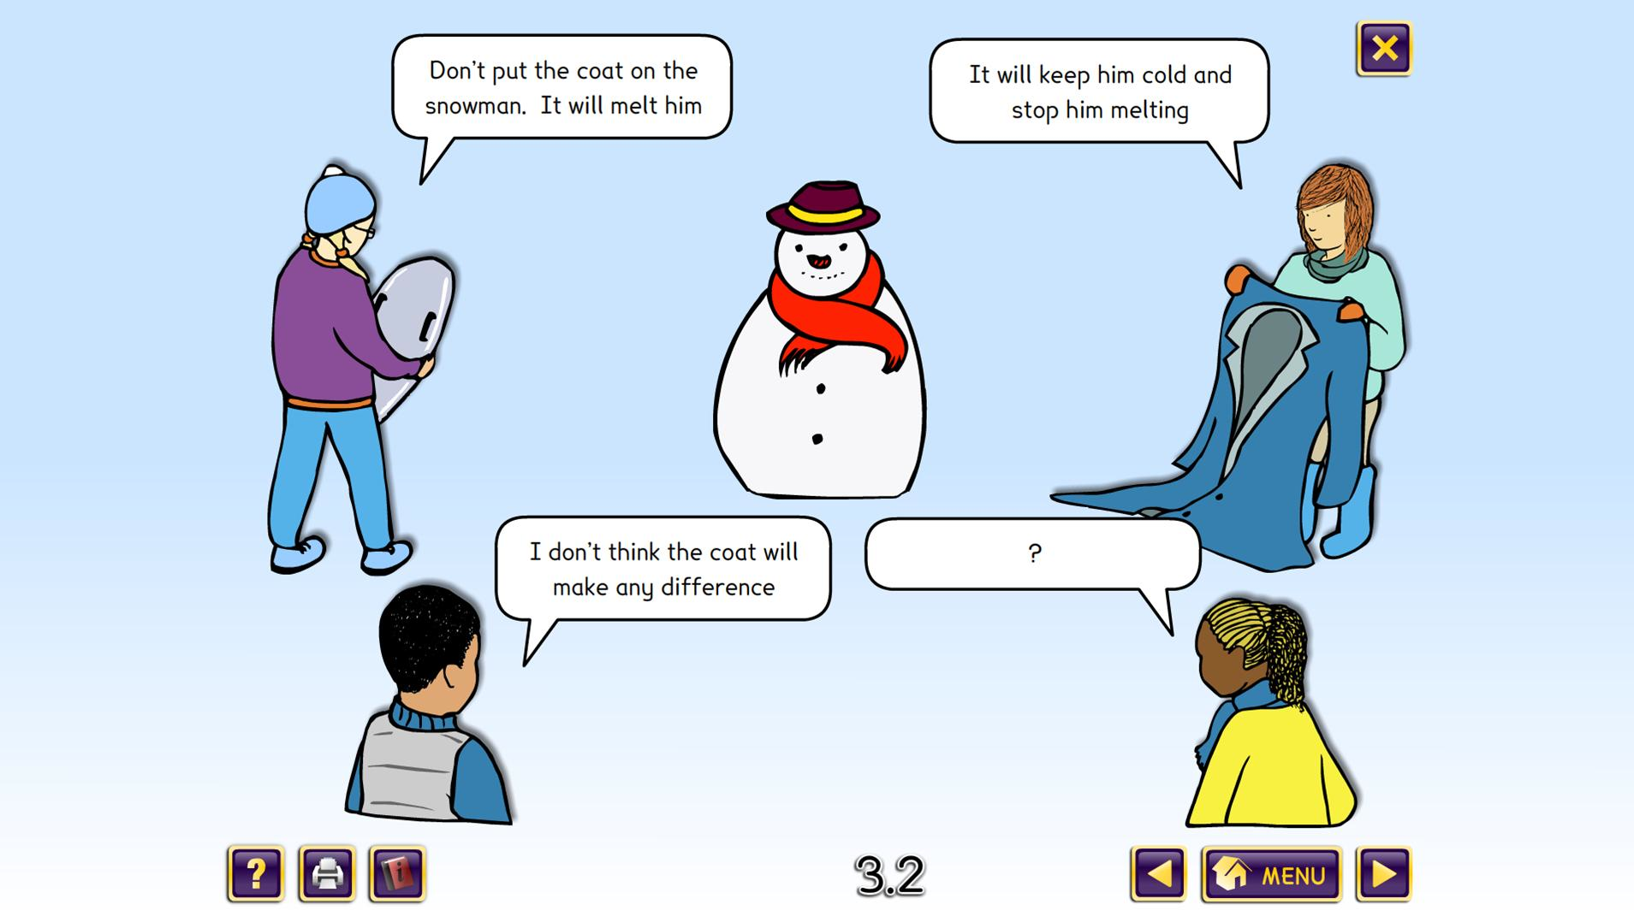
www.millgatehouse.co.uk/product/science-concept-cartoons-set-1
Notes:
Many of you will have experienced concept cartoons.
Now available in many languages.
Or you can make your own.
Introduced as some children find it more comfortable to talk about other children’s ideas – rather than their own.
Puppets also used for this reason.

Slide 19
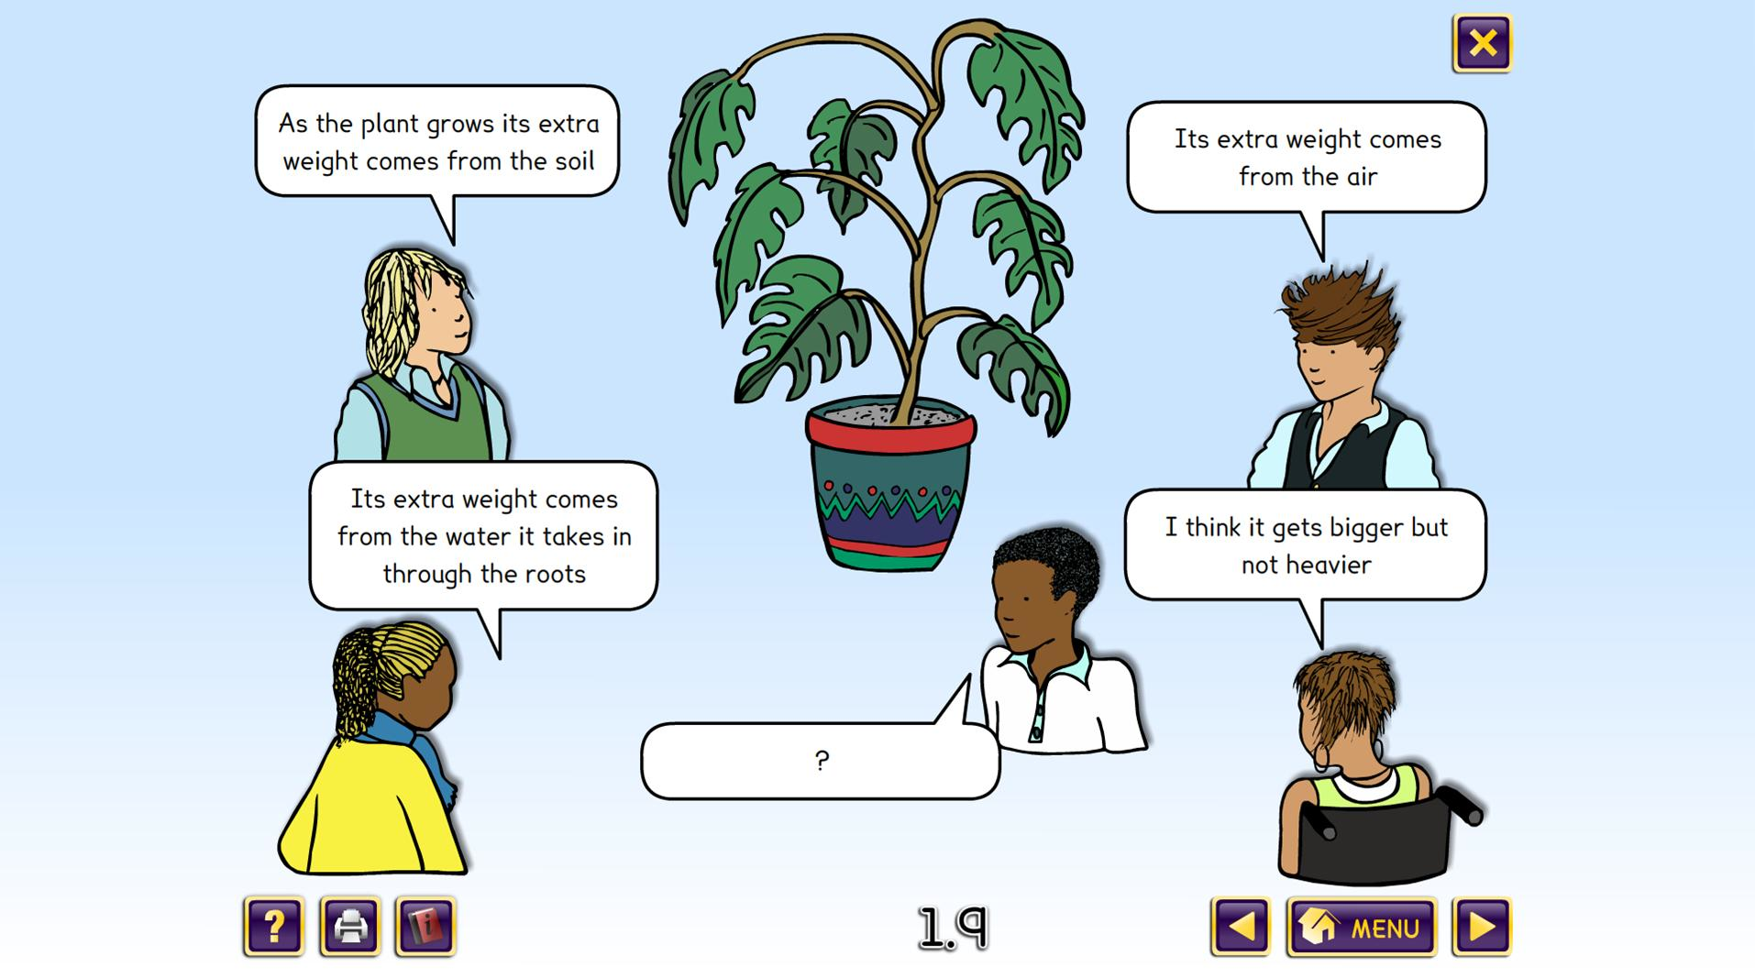
www.millgatehouse.co.uk/product/science-concept-cartoons-set-1

Slide 20
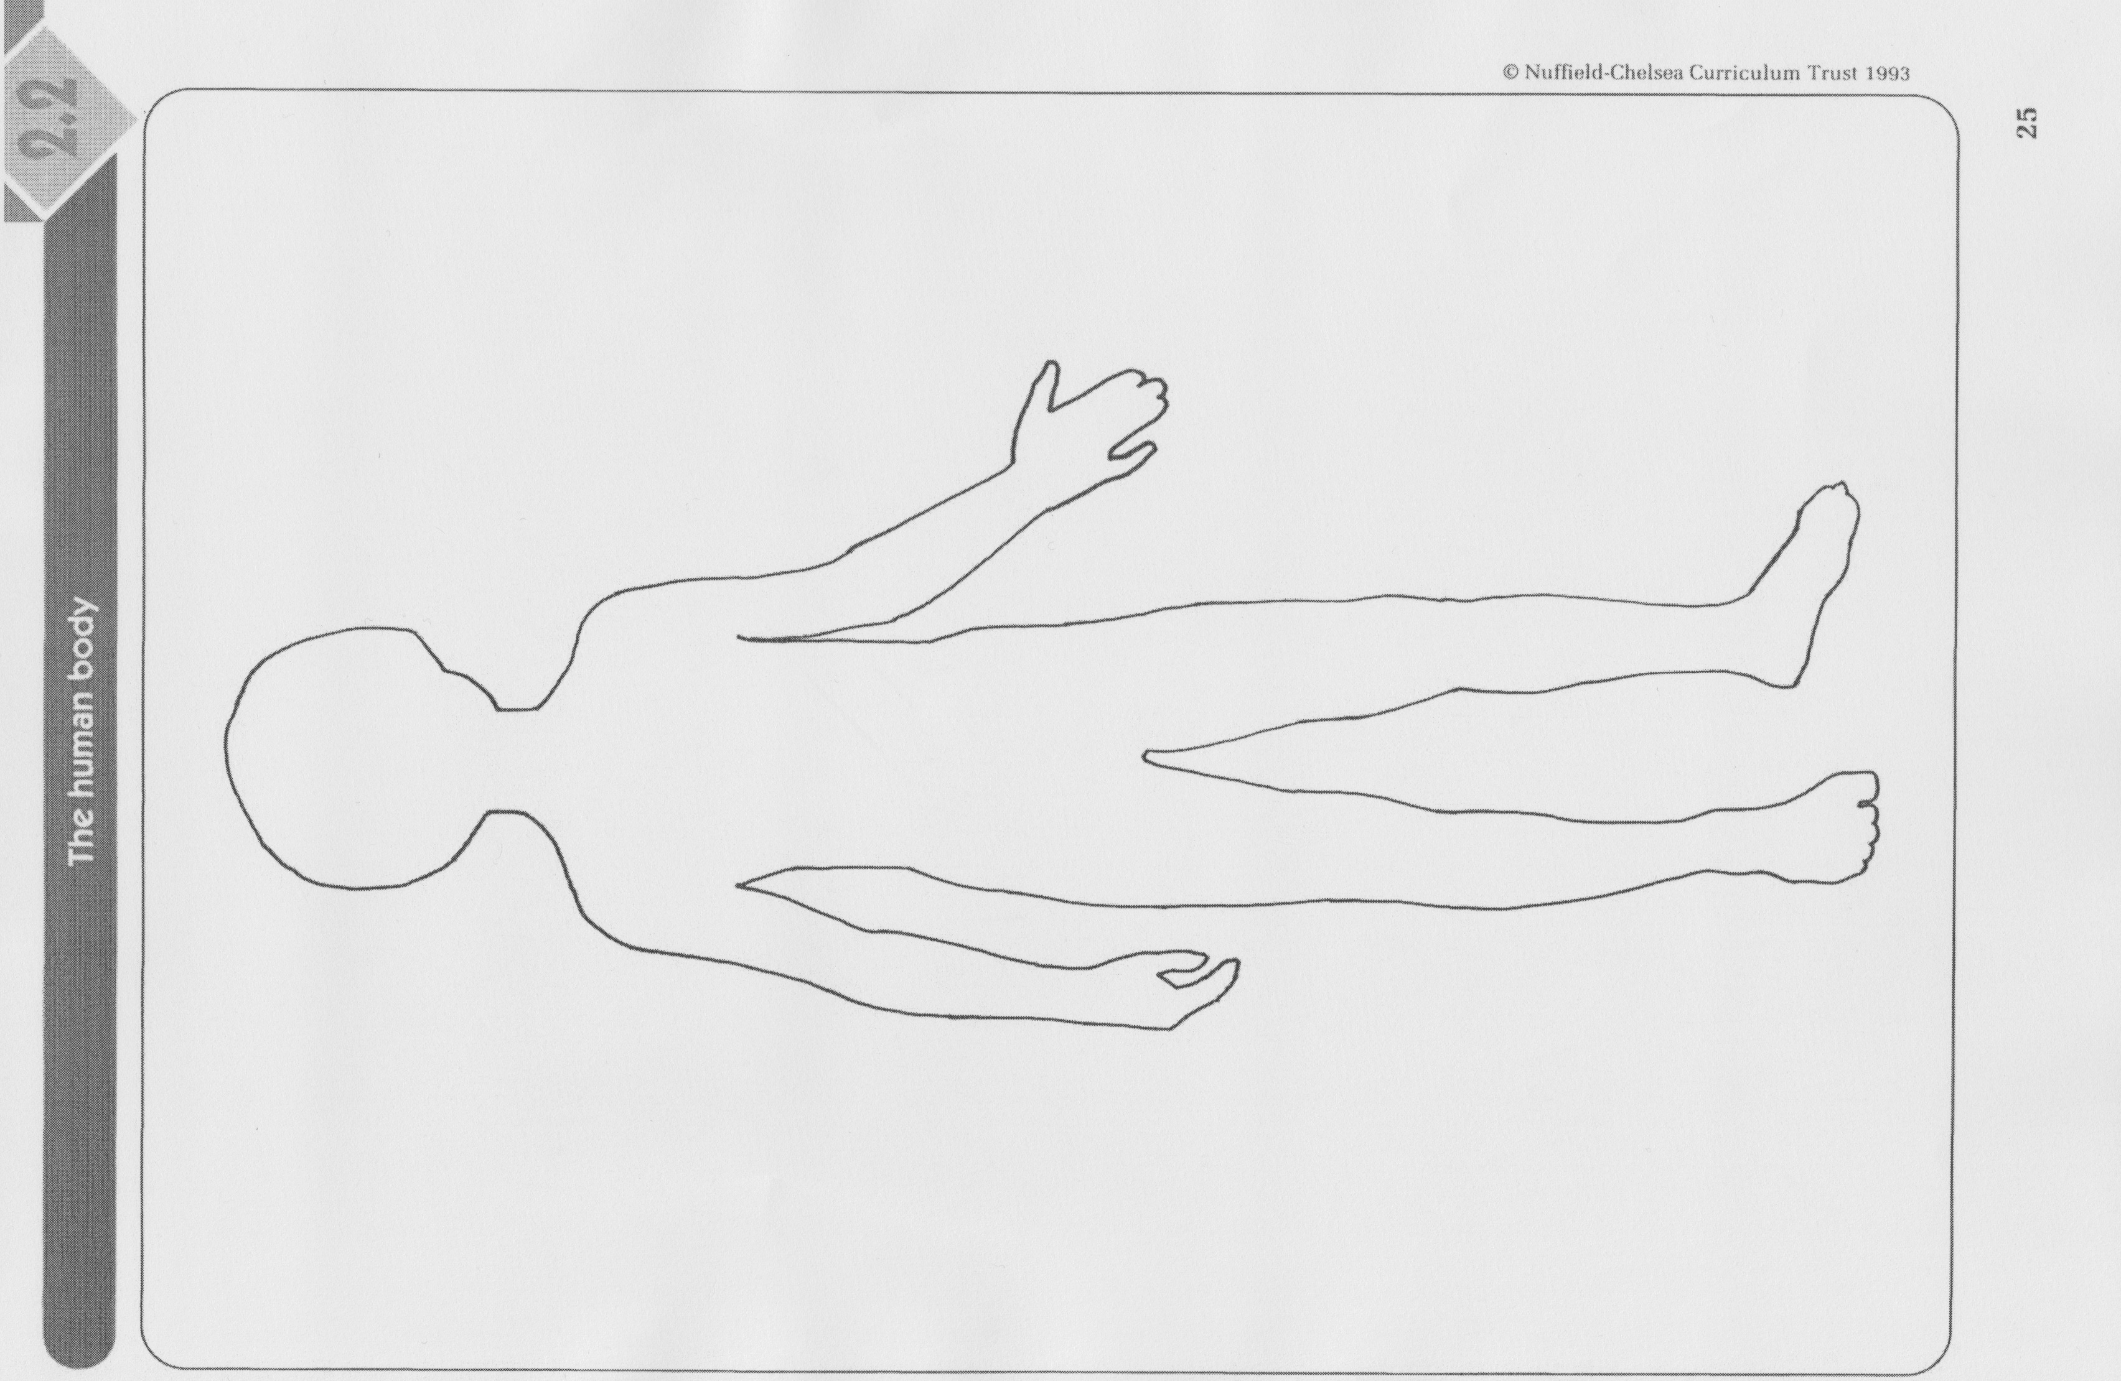
What happens to food inside your body?
https://www.stem.org.uk/resources/collection/3064/nuffield-primary-science-teachers’-guides-ages-5-7?page=2
Notes:
Approach used by the Primary SPACE project that carried out research into children’s ideas
Used in eliciting their ideas
Suggest you have a go in pairs and reflect on processes involved (not a test)
Think about potential for generating questions and revealing ideas

Slide 21
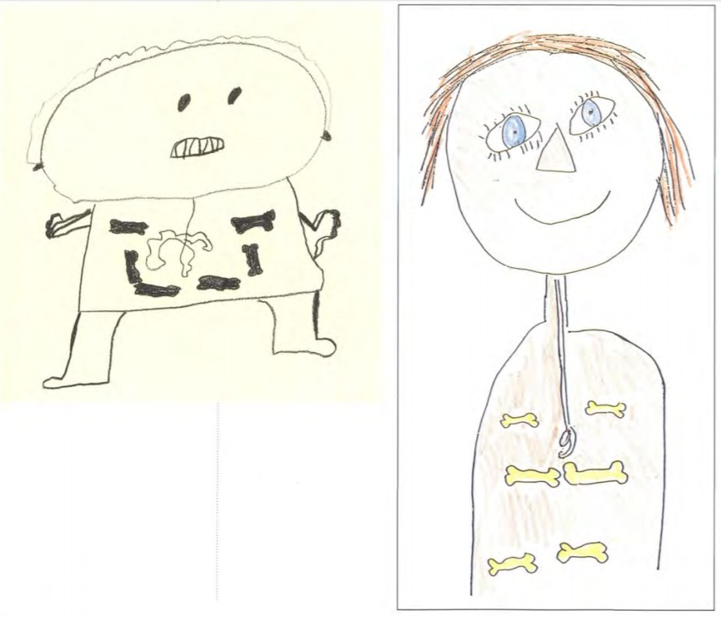
https://www.stem.org.uk/resources/elibrary/resource/27024/living-processes-teachers’-guide-ages-5-7

Slide 22
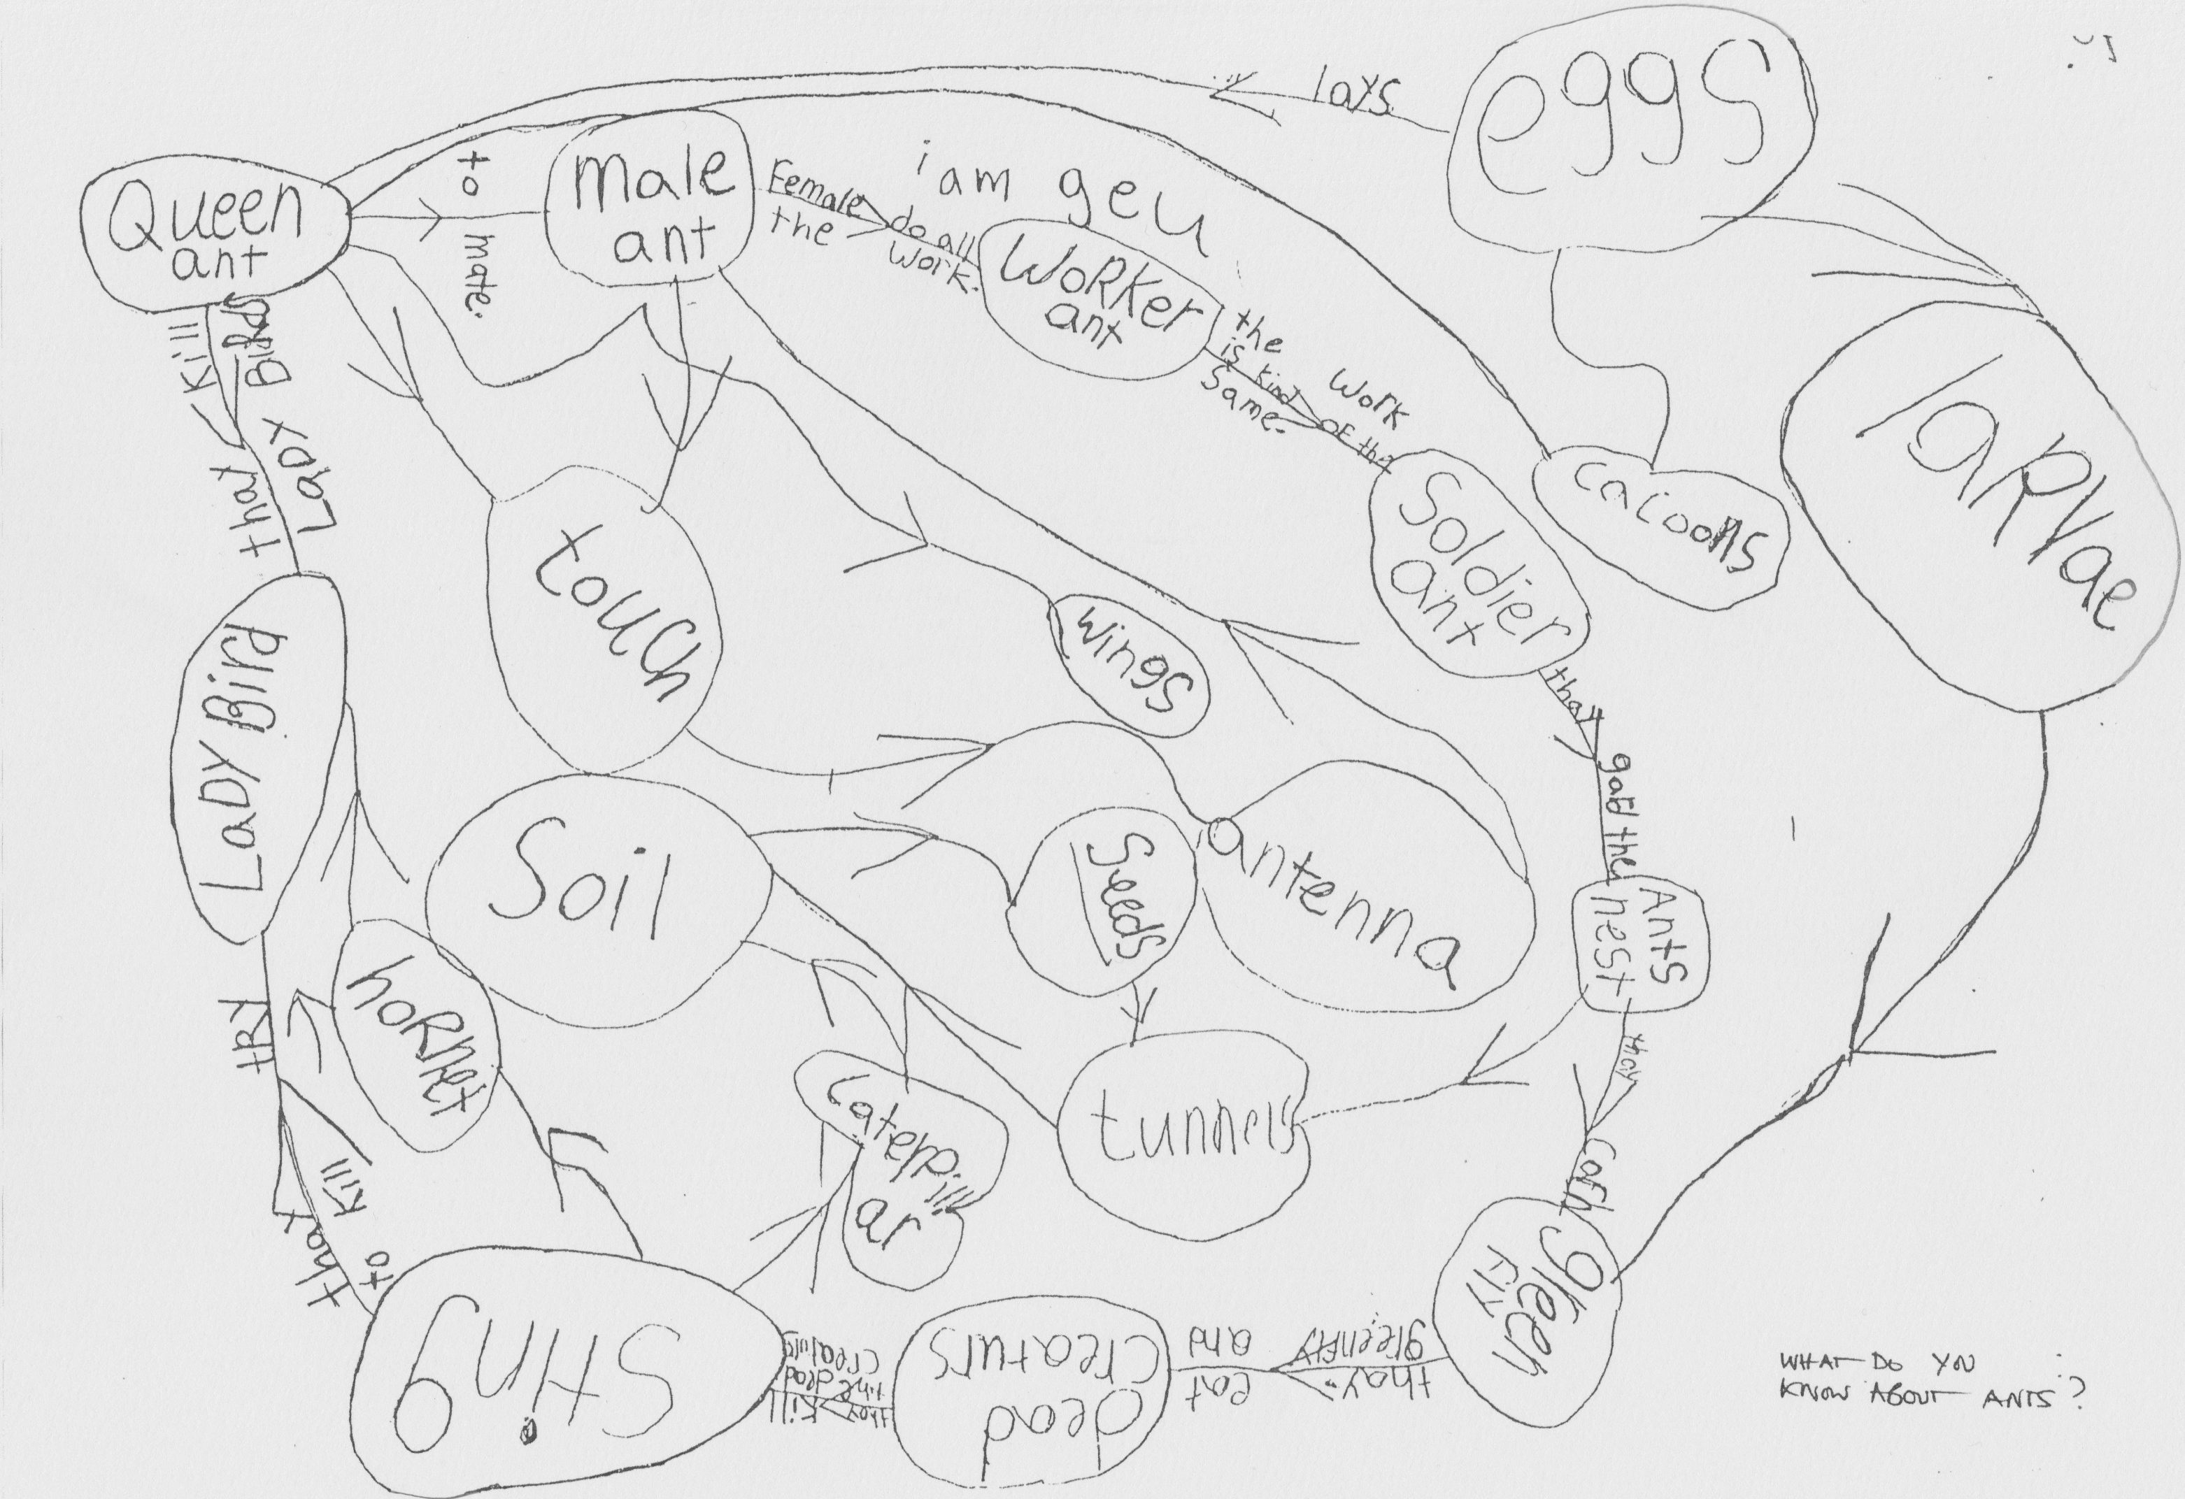
Child’s ongoing record of project on a project on ants
Notes:
Illustration potential of concept maps
From 6 year old child’s project on ants

Slide 23
Introduction to classroom examples
Framework for the Curriculum Materials
Setting the scene – focus, rationale, background
Starting points
Developing the learning journey – activities and their rationale, examples of children’s responses, teacher reflections and implications for the next session.
Reflections – children’s progress, teacher role, classroom environment, next steps
Water resistance
Living things and their habitats
Crime Scene investigation: Teeth
Notes:
Now moving on
Share some examples from the classroom of investigations over time – that illustrate varied approaches to inquiry and ways of recording.
Also ways in which teacher built on children’s responses over time and sought to foster children’s skills and understandings associated with inquiry.
Again in the time frame can only give you time to gain a sense of what the materials might offer.
Looking at 3 different examples cover a range of ages 5-6, 6-7 and 8-9
Waterproofing – emerging from damp patch on a child’s shoe
Living things – started within the curriculum requirements – central feature eliciting and building on children’s ideas and questions – and linking varied experiences in and outside school
Crime scene investigation teeth – whole school project setting up the crime scene – dressing up as scientists investigating the site – focus on teeth and again children taking increasing control – importance of links across the curriculum

Slide 24
Notes:
Focus on children’s learning – evidence of progression
Choose one to focus on that interests you – be prepared to share your responses with someone else in small groups

Slide 25
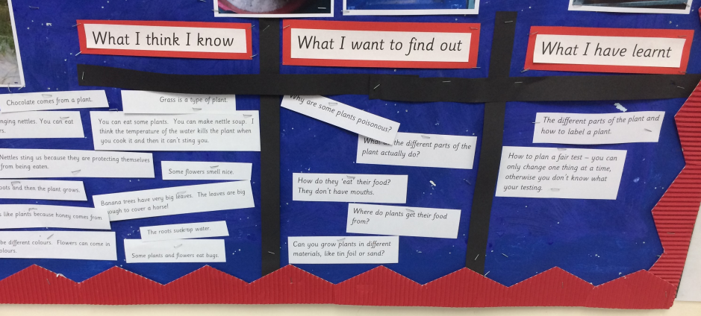
Developing the learning journey 3:
KWL – What we know, want to know, and have learnt grids
Activity: KWL grid - as a class we filled in a KWL grid with me scribing their ‘know’ and ‘want to find out’ ideas. These helped me plan the rest of the unit, along with the areas for development I had identified. We filled in the ‘learnt’ section after each lesson.
Rationale: This was an opportunity to observe children’ motivation and curiosity, their scientific skills in particular their questioning and recording their questions in writing.
.
When pushed to think scientifically, children came up with interesting questions such as ’why do we group animals by their skin type?’
Children were excited to find out more about animals, and why they behave/live the way they do. There were many questions about why certain species ‘prefer’ certain climates.
‘Why do we keep animals in zoos if that’s not where they're from?’
‘If we lived in a warmer place, maybe we could have a school pet tiger?’
‘Do animals have a brain in their head, or is it in their tummy?’
‘Why do people say we are like monkeys? We aren’t as hairy.’
‘Do fish drink water? ‘
I grouped questions into themes linked to the curriculum, developed a lesson sequence from these – building on children’s curiosity and motivation to answer questions.
Notes:
Move to the role of the teacher and the teacher’s learning journey

Slide 26
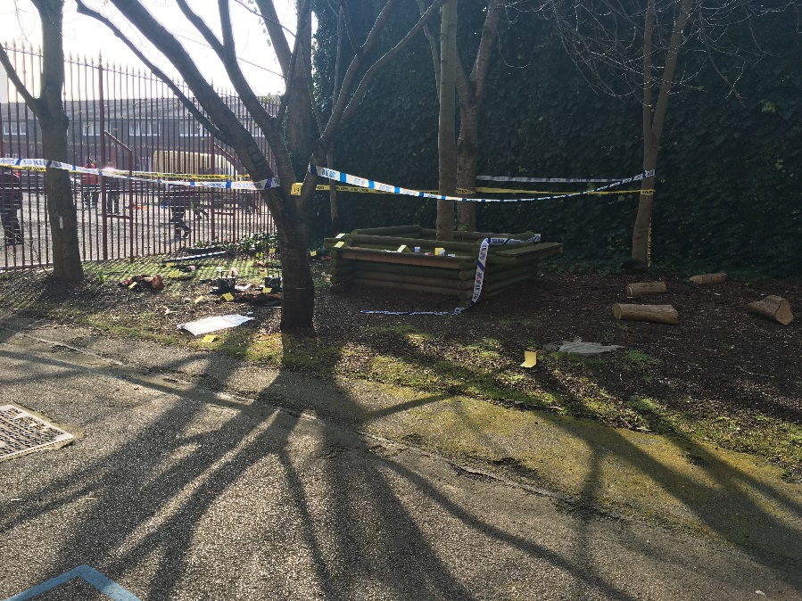
Developing the learning journey: Starting Point: Exploring the ‘crime scene’
Activity: Exploring the ‘crime scene’ Children came into school to find a ‘crime scene’ in an area of the playground.
Children were encouraged to explore the scene making observations and discussing possible ideas and explanations based on evidence.
Rationale:
Fostering curiosity and questioning
Making connections, speculating based on evidence.
Useful as an initial assessment to see what questions were developed and what links were naturally made by children.
Key Questions....
What can you see?
How does this help you?
What evidence can you find to support that?
If you can see that, what assumptions can you make?
Look there’s an eyeball. Yuck. Wow look at that footprint. It’s huge!
Teacher: Wow I wonder who could it belong to?
Children’s responses
They put their feet into the footprints .
Child: It’s big!
TA: Who could it belong to?
Children looked at their feet: It can’t be you miss, your feet are tiny. It must be an adult as they are bigger than me.
Children asked adults to place their feet in the footprint until they found one that matched the size.
CT: Have you looked at all the evidence?
The children continued to explore further.
Someone big
I’ve found a pointy tooth covered in green slime!
Some children need to be given choices to help them in answering questions and explaining thoughts.
Important role of confident peers/ adults to model questions and scientific language.
Role of adult questioning to focus children on evidence and explanation. Importance of children modelling/ listening to others and repeating if unsure.

Slide 27
Evidence of progression in children’s learning
In pairs discuss classroom examples.
1. Read through first to gain an overview of the learning journey.
2. Then consider the following questions:
What evidence do the materials provide of children’s inquiry skills and creative dispositions?
What ideas are they developing?
Can you identify examples of progression?
What do you think led to this?
What further questions would you like to ask?
Note down key points on the recording sheet provided.

Slide 28
Role of the teacher – building on children’s ideas and questions.
In what ways did the teacher build on children’s ideas and questions?
How were these identified?
Where would you go next?
How can you make links to children’s prior experiences and build connections across the curriculum?
What evidence is provided of the teacher’s learning journey?

Slide 29
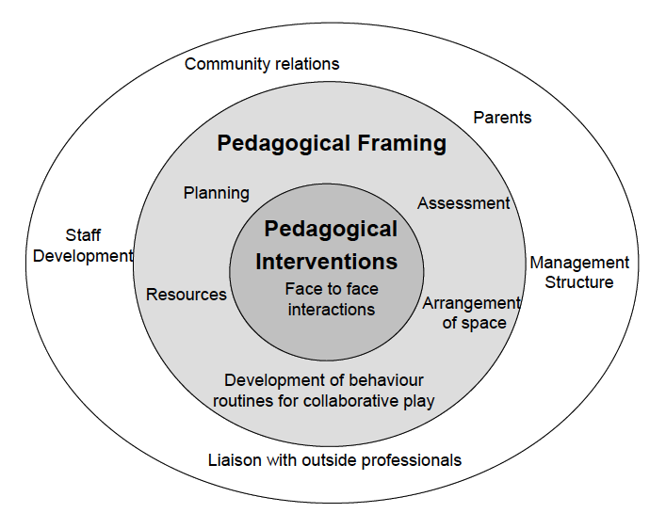
Pedagogical interventions in context
(Siraj Blatchford et al., 2002)

Slide 30
Synergies between inquiry-based and creative approaches
From the Conceptual Framework adopted by the CEYS Project (Creative Little Scientists, 2012)
Play and exploration
Motivation and affect
Dialogue and collaboration
Problem solving and agency
Questioning and curiosity
Reflection and reasoning
Teacher scaffolding and involvement
Assessment for learning
Notes:
The role of the teacher will be varied but these record synergies in particular – in relation to the areas the teachers wished to work on.

Slide 31
Pedagogical interventions in context
(Siraj Blatchford et al., 2002)

Slide 32
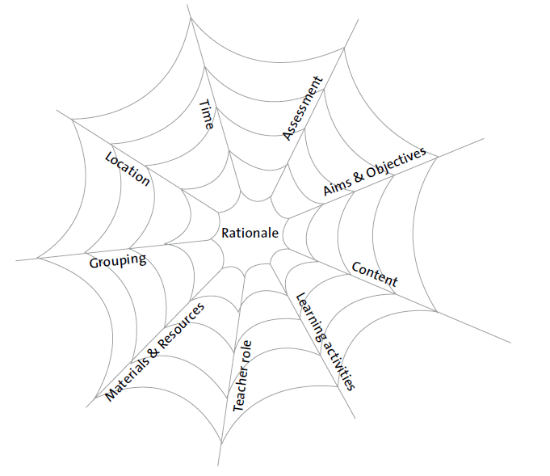
Implications for planning
As a group:
Review and record implications for planning in relation to the spider web dimensions
Curriculum Dimensions
The vulnerable spider web (van den Akker 2007 p 39)
Notes:
Make poster for display

Slide 33
Reflections on the module
In groups
Look back at your original posters – anything you might add? Note any additional comments or issues in another colour (pen/post it).
Identify 2 key messages and 2 issues raised

Slide 34
Individual reflection
In what ways will the different module activities assist you in designing lessons to support progression, building on children’s ideas and questions?
What impact do you expect this module will have on your future practice?
How far have the aims of the module been met?

Slide 35
Further information
Creative Little Scientists
(FP7 EU project 2011 – 2014)
Design principles and exemplar materials based on fieldwork www.creative-little-scientists.eu
Creativity in Early Years Science Education
(Erasmus+ EU project 2014 – 2017)
Curriculum Materials and Training Materials for teacher CPD to promote creative approaches to early years science www.ceys‐project.eu

Slide 36
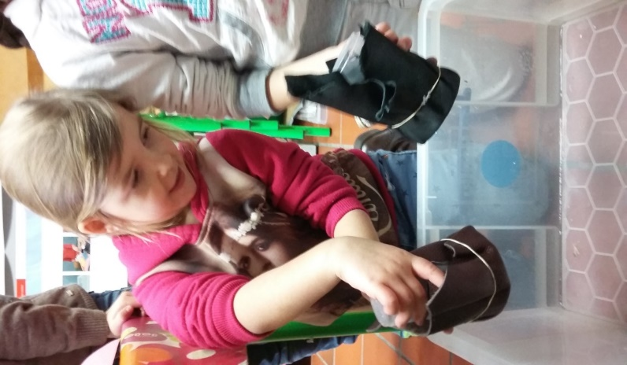
Thank you!

Slide 37

Acknowledgements
Creativity in Early Years Science EDUCATION (2014-2017) www.ceys-project.eu
© 2017 CREATIVITY IN EARLY YEARS SCIENCE EDUCATION Consortium
This work is licensed under the Creative Commons Attribution-NonCommercial-NoDerivatives 4.0 International License. To view a copy of this license, visit http://creativecommons.org/licenses/by-nc-nd/4.0/.

