Slide 1
Training Module 13
Using ICT to enhance creativity and inquiry in early years science

Slide 2
Introduction to the CEYS project
(use dependent on context)
European Erasmus+ project
Partners in Belgium, Greece, Romania, UK
Continuation of the Creative Little Scientists project http://www.creative-little-scientists.eu
Aims
  Development of a teacher development course and accompanying materials
  Promotion of the use of creative approaches in teaching science in preschool and early primary education (up to age of eight)
Notes:
The Creativity in Early Years Science project is a European Erasmus+ project with partner countries Greece, Romania, Belgium and the UK
As indicated – it aims to develop a European teacher professional development course and accompanying materials to promote the use of creative approaches in teaching science in preschool and early primary education (up to age of eight).
It is a continuation of the project Creative Little Scientists, an FP7 EU project, where curriculum design principles to foster inquiry and creativity in science education were designed.

Slide 3
Connecting inquiry and creativity in science
(From Creative Little Scientists, 2012)
Features of inquiry
Questioning
Designing or planning investigations
Gathering evidence
Making connections
Explaining evidence
Communicating explanations
Creative Dispositions
Sense of initiative
Motivation
Ability to come up with something new
Ability to make connections
Imagination
Curiosity
Ability to work together
Thinking skills

Slide 4
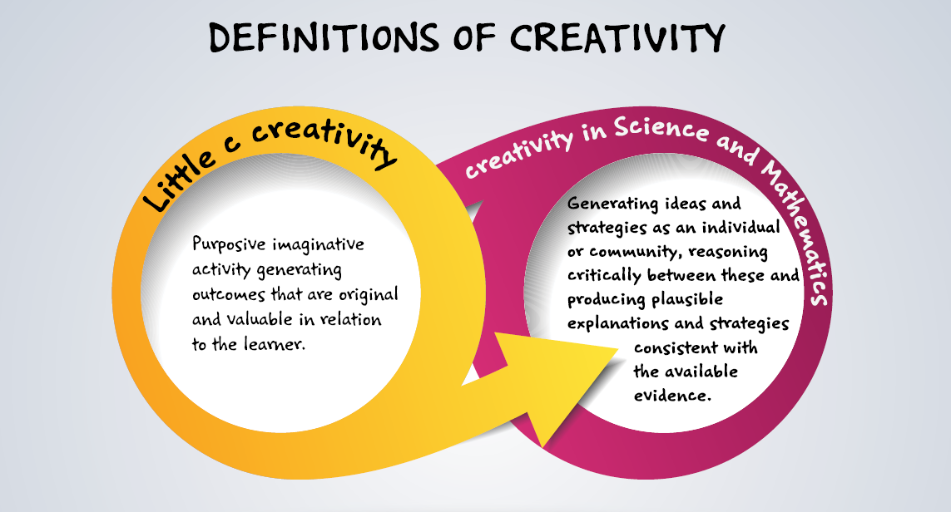
Conceptual Framework
Creative Little Scientists (2014)

Slide 5
What do you think this is and why?
What everyday object / thing do you think has been captured in these magnified images? Can you explain why you think this?
Please discuss the image you have been given in pairs and be ready to share your ideas with the whole group.
Reflection on the experience
What is your response to this activity?
What links can be made to creativity and inquiry?
Notes:
Draw out creative dispositions – wonder, curiosity, making connections etc and ways in which this encourages children to make observations, ask questions, make comparisons, suggest ideas etc.
And also access to an experience not available directly at first hand that can support investigations.
Items are:
A: Skin on arm
B: Masking tape
C: A fabric plaster
D: Instant coffee granules

Slide 6
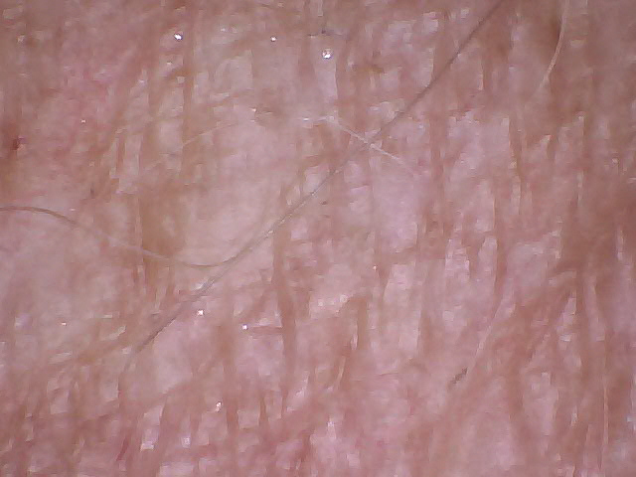
Image A

Slide 7
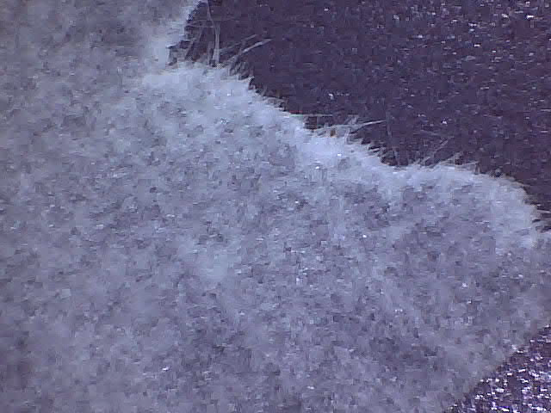
Image B

Slide 8
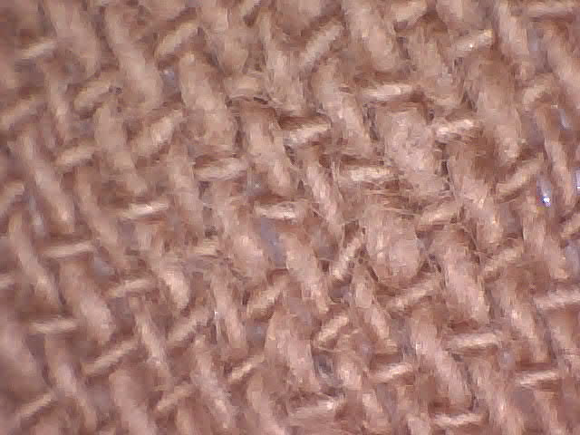
Image C

Slide 9
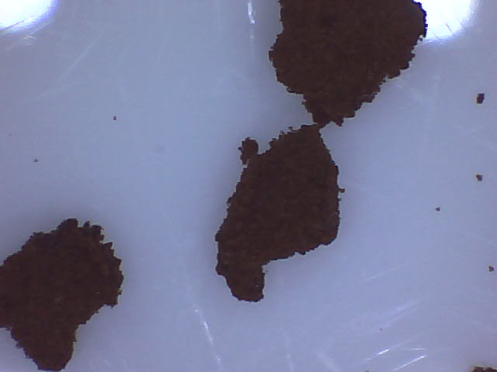
Image D

Slide 10
Rationale for the module
The majority of teachers argue technology has improved their teaching and that ICT can be used to enhance creativity.
Teachers who had received ICT training were more likely to select interactive and social computing applications as contemporary tools for creative pedagogy.
Whilst there is awareness of the significance of ICT across the curriculum, there is limited detailed reference to ICT either as a tool to support specific aspects of learning or the need to consider possible limitations of technology.
The potential of ICT to enable educational change towards a creative school environment is far from fully exploited, despite ICT being widely used in Initial Teacher Education to develop reflective practice.

Slide 11
Aims of the module
Introduce participants to the use of ICT in the context of inquiry-based and creative approaches to early years science education.
Assist pre-school and primary school teachers in understanding the ICT contribution and its benefits in enhancing inquiry.
Share with pre-school and primary school teachers’ strategies in implementing ICT-based lessons and experiments.
Increase teachers’ awareness on different approaches in involving children in ICT assisted investigations.

Slide 12
Links to Content Design Principles and Outcomes 1
9. Teacher education should enable teachers to make best use of and assess the various modes of expression and representation of science and mathematics learning to support inquiry and the development of creativity.
  9.3 Teachers should be able to select and use different approaches for and forms of recording children’s ideas and learning in science and mathematics at different stages of the learning process and for various purposes, including to support children’s reflection and reasoning processes

Slide 13
Links to Content Design Principles and Outcomes 2
17.Teacher education should address with teachers issues in ensuring rich provision, planning and use of resources (including digital resources) in and out of the classroom to support children’s inquiry and creativity.
  17.1 Teachers should be able to organise and use materials (including everyday materials), resources (including ICT and natural resources) and equipment (including digital equipment and simple laboratory instruments) in the classroom, school and wider environment, both indoors and out, to support independent inquiry and creativity.
  17.2 Teachers should be able to evaluate and select creativity enabling ICT resources for children to use in their inquiry.

Slide 14
Links to Content Design Principles and Outcomes 3
18. Teacher education should encourage and assess the development of teachers’ literacy, numeracy and digital literacy skills through science and mathematics.
  18.1 Teachers should develop their literacy, numeracy and digital literacy skills through science and mathematics.

Slide 15
Module outline
Aims and rationale for the module
Sharing experiences of using ICT to enhance science learning
Practical activities: using a range of ICT devices and applications to collect observations and measurements, model ideas/explanations, to control things
Reflection on classroom examples: ways in which ICT can enhance children’s inquiry and creativity
Role of the teacher – planning and intervention to ensure that ICT enhances children’s creative dispositions and scientific inquiry skills.
Implications for future planning
Reflections on module content and approaches

Slide 16
How have you used ICT to enhance learning in science?
As an individual - Write down suggestions on separate post its and place on the sheet on the table.
As a group – See if you can sort these into to key scientific activities
Accessing information
Making observations and data capture
Handling information
Modelling and visualizing ideas
Communicating ideas.
Feedback to the whole group:
Areas where you have lots of examples
Areas where you have few examples
Any challenges have you faced.
Working in groups of 4 or 5

Slide 17
What will happen if…
Whole group activity
Investigating making sounds using the datalogger and Data Harvest EasySense software
(See notes below the slide about the activity and alternative ICT resources)
Discussion
In what ways might this datalogging investigation
develop children’s creative dispositions and
enhance their scientific inquiry skills?
Notes:
This activity is intended to model the use of datalogging, analysis of data, generation of questions to investigate
Teacher displays data collected by a sound sensor as a block which changes size or as a colour changing wheel on a screen. Encourage children to make links between the sounds they make and how the display changes as they sing louder and louder. Encourage children to ask questions like ‘what will happen if we sing quietly or clap our hands?’, ‘what will happen as we move the music source further away from the sensor?’ Then try explore and investigate to find answers.
Below is a link to an online oscilloscope that could be used by particpants to explore what happens if they make sounds in different ways.
http://www.physics-chemistry-interactive-flash-animation.com/electricity_electromagnetism_interactive/oscilloscope_description_tutorial_sounds_frequency.htm

Slide 18
Connecting inquiry and creativity in science
(From Creative Little Scientists, 2012)
Features of inquiry
Questioning
Designing or planning investigations
Gathering evidence
Making connections
Explaining evidence
Communicating explanations
Creative Dispositions
Sense of initiative
Motivation
Ability to come up with something new
Ability to make connections
Imagination
Curiosity
Ability to work together
Thinking skills

Slide 19
Creativity in Early Years Science
Creative Little Scientists (2014)

Slide 20
Using ICT to promote inquiry and creativity in science
In groups of 3 or 4
Data loggers: measure temperature and light level to explore the classroom climate
USB microscope: look at a small insect, plant, crystals (sugar, salt,…) fabrics, skin, eyes teeth. in order to observe texture, patterns, design etc.
Sound sensor and datalogger : explore sounds in the local surroundings
Using a camera/ iPad to capture change over time to allow comparisons: Milk Magic http://www.sciencemuseum.org.uk/educators/classroom-resources/activities/kitchen_science)
Notes:
See the handout How can ICT enhance the science curriculum for further examples of possible activities that you can adapt depending on resources available.

Slide 21
Feedback
What
features of inquiry and
creative dispositions
were developed or enhanced by your use of ICT in the activity?
Were there any challenges?

Slide 22
Handout: How can ICT enhance the science curriculum?
Using information sources such as the internet or DVDs / CD ROMs
Using data capture equipment such as digital microscopes, visualizers, digital cameras, voice recorders and data logging sensors
Handling data using databases and spreadsheets
Visualising and investigating ideas with models, simulations and animations
Communicating ideas using word processors, publishing / presentation software, apps such as Explain Everything or Book Creator and animation software

Slide 23
Classroom Examples
The examples illustrate some uses of ICT in Science
In what ways did they enhance or foster inquiry and creativity?

Slide 24
Framework for the classroom examples
Setting the scene – focus, rationale, background
Starting points
Developing the learning journey – activities and their rationale, examples of children’s responses, teacher reflections and implications for the next session.
Reflections – children’s progress, teacher role, classroom environment, next steps

Slide 25
Life cycle of a frog: Using iPads to capture images of change over time (children age 4-5)

Slide 26
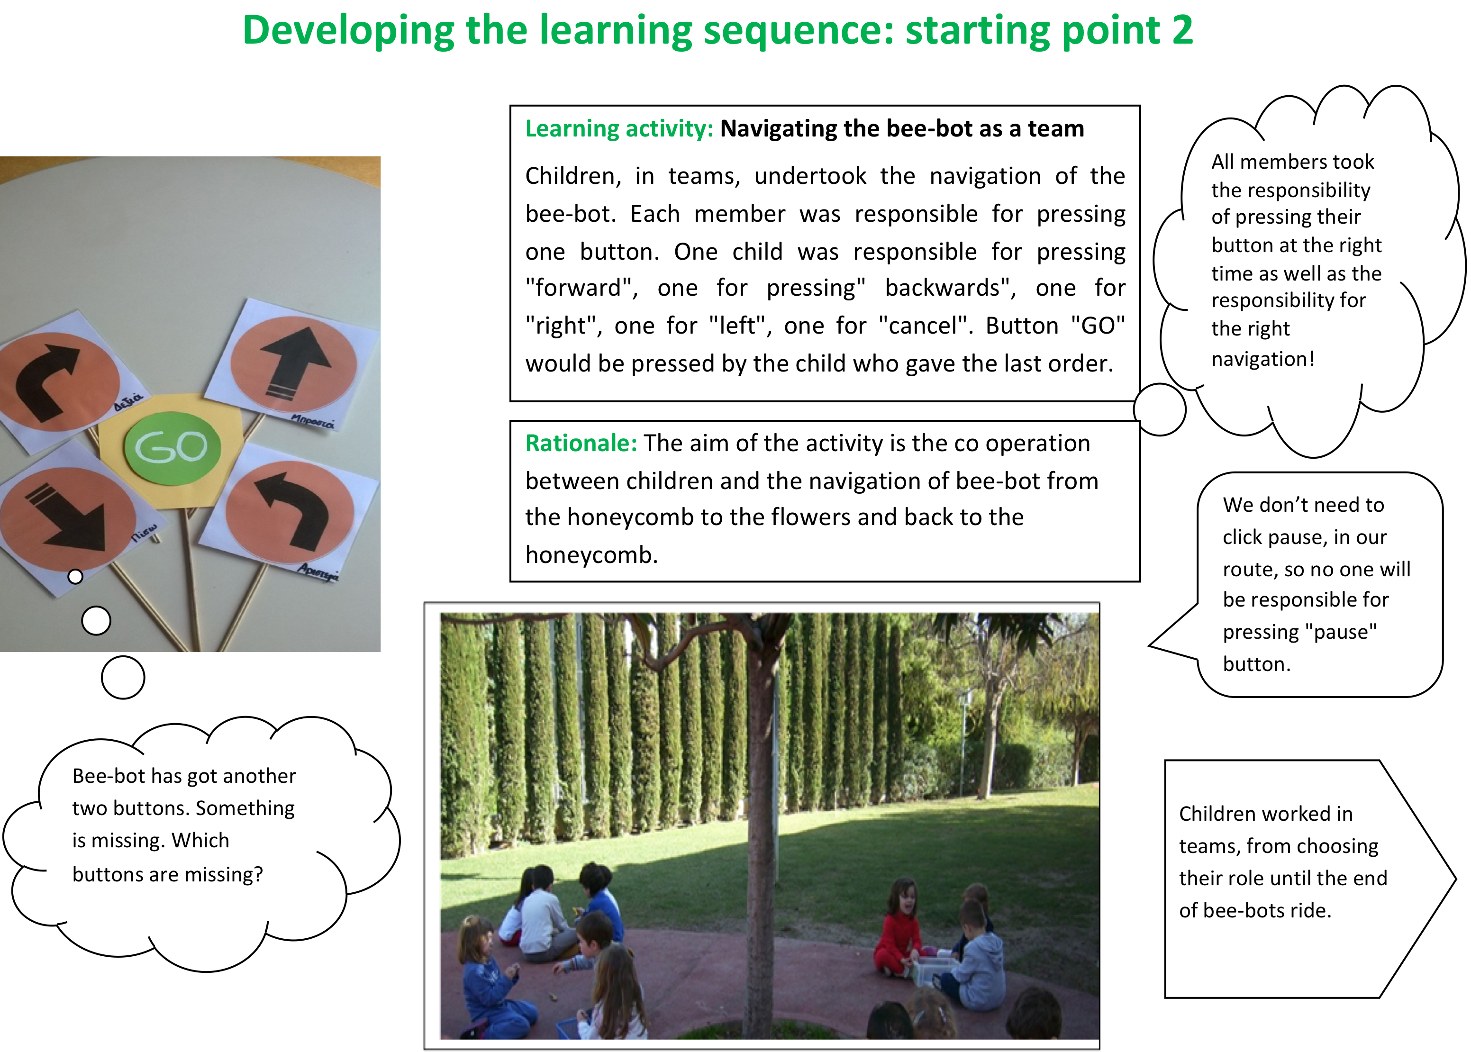
Bees and their colonies: Visualising ideas through simulation (children age 4-5)

Slide 27
Materials: Investigating ideas with simulations (children age 5-6)

Slide 28
Study of simple physical phenomena: handling data and communicating ideas
(children age 4-6 )

Slide 29
Reviewing the use of ICT in the Classroom Examples
Read through the classroom examples provided to gain an overview of the learning journey.
Then consider In what ways the use of ICT enhanced or fostered inquiry and creativity.

Slide 30
Role of the teacher
More Classroom Examples
Map symbols
Animal Fence
Playing with the microscope

Slide 31
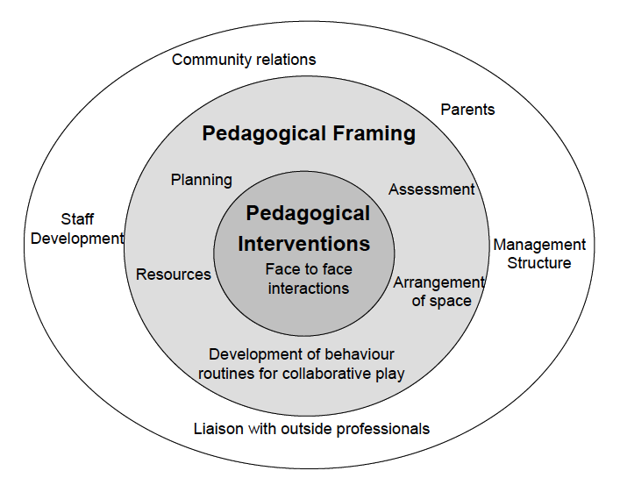
Role of the teacher
Linked to Pedagogical Model from Siraj-Blatchford et al. (2002)
Notes:
.

Slide 32
Synergies between Inquiry Based and Creative Approaches
Play and exploration
Motivation and affect
Dialogue and collaboration
Problem solving and agency
Questioning and curiosity
Reflection and reasoning
Teacher scaffolding and involvement
Assessment for learning

Slide 33
Classroom example task
Scan through the classroom example you have been given.
Please feed back to the group:
A brief summary of the ICT activity and the aspect(s) of scientific inquiry enhanced by the activity:
(accessing information, making observations and data capture, handling information, modelling and visualizing ideas or communicating ideas).
How the teacher planned / intervened to ensure that ICT enhanced the development of children’s creative dispositions and scientific inquiry skills.

Slide 34
Pedagogy related to the use of ICT should include:
ensuring that use is appropriate and ‘adds value’ to learning activities
building on teachers’ existing practice and on pupils’ prior conceptions
structuring activity while offering pupils some responsibility, choice and opportunities for active participation
prompting pupils to think about underlying concepts and relationships, creating time for discussion, reasoning, analysis and reflection
focusing research tasks and developing skills for finding and critically analyzing information
linking ICT use to ongoing teaching and learning activities
exploiting the potential of whole class interactive teaching and encouraging pupils to share ideas and findings.
Osborne and Hennessy (2003)
Notes:
Important issues to consider in planning for the use of ICT – relate to the nature of learning activities and the role of the teacher
Osborne, J. and Hennessy. S. Literature Review in Science Education and the Role of ICT: Promise, Problems and Future Directions. A NESTA Futurelab Research report – report 6. 2003..

Slide 35
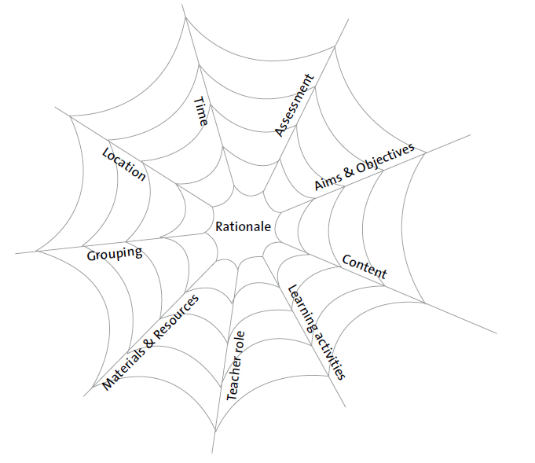
Curriculum Dimensions
The vulnerable spider web (van den Akker 2007 p 39)
Factors associated with creativity
in early years science related to
Aims, purposes, priorities
Teaching learning & assessment
Contextual factors
Notes:
In designing the use of ICT to foster inquiry and creativity useful to consider the inter-related dimensions associated with the ‘vulnerable spider web’.

Slide 36
Group task
In small groups, brainstorm how you might use ICT in a future activity linked to science that you will use back in school.
Annotate the spider diagram to show how your activity will develop children’s creativity and enhance their inquiry skills.
Present your ideas to the rest of the group as a poster and explain what aspect of scientific inquiry was enhanced and how.

Slide 37
Reflection on module content and approaches
What impact do you expect this module will have on your future activities?
Identify one or two actions you will take as a result of your experiences on the module.
How far have the aims of the module been met?
Any further questions?

Slide 38
Further information
Creative Little Scientists
(FP7 EU project 2011 – 2014)
Design principles and exemplar materials based on fieldwork www.creative-little-scientists.eu
Creativity in Early Years Science Education
(Erasmus+ EU project 2014 – 2017)
Curriculum Materials and Training Materials for teacher CPD to promote creative approaches to early years science www.ceys‐project.eu

Slide 39

THANK YOU!

Slide 40

Acknowledgements
Creativity in Early Years Science EDUCATION (2014-2017) www.ceys-project.eu
© 2017 CREATIVITY IN EARLY YEARS SCIENCE EDUCATION Consortium
This work is licensed under the Creative Commons Attribution-NonCommercial-NoDerivatives 4.0 International License. To view a copy of this license, visit http://creativecommons.org/licenses/by-nc-nd/4.0/.

