Slide 1
Training Module 12
Reflection and Reasoning

Slide 2
Introduction to the
CEYS project
(use dependent on context)
European Erasmus+ project
Partners in Belgium, Greece, Romania, UK
Continuation of the Creative Little Scientists project http://www.creative-little-scientists.eu
Aims
  Development of a teacher development course and accompanying materials
  Promotion of the use of creative approaches in teaching science in preschool and early primary education (up to age of eight)
Notes:
The Creativity in Early Years Science project is a European Erasmus+ project with partner countries Greece, Romania, Belgium and the UK
As indicated – it aims to develop a European teacher professional development course and accompanying materials to promote the use of creative approaches in teaching science in preschool and early primary education (up to age of eight).
It is a continuation of the project Creative Little Scientists, an FP7 EU project, where curriculum design principles to foster inquiry and creativity in science education were designed.

Slide 3
Aims of the module
Increase awareness of the role of reflection and consideration of alternative ideas in supporting children’s understanding of scientific ideas and procedures and development of creativity.
Introduce participants to different forms of questioning at appropriate points to encourage children’s reflection and explanation.
Share strategies for facilitating exchange of ideas within groups and across the class.

Slide 4
Links to Content Design Principles and Outcomes 1
3. Teacher education should advance teachers’ understandings about the nature of science and how scientists work, confronting stereotypical images of science and scientists.
  3.2 Teachers should be able to recognise young children’s capabilities to engage with processes associated with the evaluation as well as generation of ideas in science and mathematics, since these processes are also important for the development of learner creativity
  3.3 Teachers should be able to use foster the processes of imagination, reflection and consideration of alternative ideas in supporting children’s understanding of scientific ideas and procedures and development of creativity.

Slide 5
Links to Content Design Principles and Outcomes 2
11. Teacher education should enable teachers to use questioning effectively and encourage children’s questions in order to foster creativity and inquiry
  11.1 Teachers should be able to use different forms of questioning at appropriate points to scaffold creative learning outcomes in science and mathematics, and in particular to encourage children’s reflections and explanations, foster their independence and extend their inquiry.
15. Teacher education should promote teachers’ use of group work to support children’s inquiry processes and creative learning.
  15.6 Teachers should be able to use effective strategies for sharing ideas and discussions from different groups.

Slide 6
Module outline
Introduction: aims and rationale for the module
Opportunities for reflection and reasoning in science education: your experiences
Discussion activities: potential for simulating reflection and reasoning
Practical activities: fostering reasoning based on evidence
Examples from practice: opportunities for reflection within everyday classroom activities
Implications for teaching
Reflection on what has been gained from the workshop

Slide 7
Opportunities for reflection and reasoning in your own science education
IN PAIRS
Share your experiences of science learning in school.
Can you identify opportunities for reflection and reasoning?
What did you focus on – science ideas, inquiry processes, attitudes, other?
In what ways (if any) did this support your learning?
What stimulated you to reflect?
What hindered reflection?

Slide 8
Opportunities for reflection and reasoning in your own science education
AS A GROUP/ON YOUR TABLE
Share and discuss your ideas
Record on the sheet provided
Annotate to identify similarities and differences in your experiences
WHOLE GROUP
Share factors that stimulated/hindered reflection
What are the implications?

Slide 9
Reflection and reasoning in early years science education
Perspectives on science education highlight the importance of reflection and reasoning in science learning (Creative Little Scientists, 2012)
Children (2-3 years old) are able to make causal inferences about information they gain from the environment, demonstrating abilities to reason and reach conclusions, although not necessarily verbally (Gopnik, Sobel, Schulz, and Glymour, 2001).

Slide 10
Reflection and reasoning:
Challenges for teachers
How to stimulate and gain access to young children’s ideas and thinking
Strategies for supporting children’s reasoning
Ways to generate a supportive climate in which children feel confident to share/exchange ideas and make mistakes

Slide 11
Gaining access to children’s ideas
Providing activities to elicit and prompt children’s thinking
Observing the focus and direction of children’s play and exploration
Listening to children’s talk on their own or with peers
Encouraging children to record and represent their ideas in varied ways
Questioning to encourage children to express their ideas and thinking
Fostering discussion of alternative ideas and change in thinking

Slide 12
Discussion activities to prompt and elicit thinking
For example:
Exploring materials
Odd one out
Positive minus interesting
Concept cartoons
Developing concept maps
Sorting and classifying
Discussion of photographs of activities or children’s recording
See classroom examples later in the module

Slide 13
Examples of discussion activities
Set of activities for each table – work in groups of 2/3
What kinds of discussion might be prompted by these activities?
How might you promote discussion of alternative science ideas and explanations?
Can you identify ways in which you might use or adapt these approaches in your setting?
What other approaches might you use?
Feedback one or two issues raised by these activities

Slide 14
Mystery objects:
Exploring materials
Bag containing toys made of different materials.
Put your hand in the bag and feel the object without looking at it.
What does it feel like?
What do you think it is made of and why?
What do you think the object is and why?
Notes:
Select objects to provide a range of materials and properties for example toys:
Doll - fabric/plastic
Building block – plastic (lego), wood
Musical instrument – metal/wood
Vehicle – train/car – wood/metal/plastic
Teddy bear/animals – fabric/plastic/wood
Clothes – cotton, wool, polyester
Cup – glass/plastic/pottery
; cymbals - metal; teddy bear - fabric; crayons - wax; percussion instrument - wood; glass - glass or plastic; baby dolls - plastic and fabric; train - wood; clothes - cotton or polyester; toy car - metal; bin - metal; binoculars - plastic

Slide 15
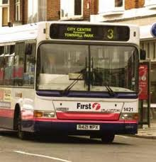
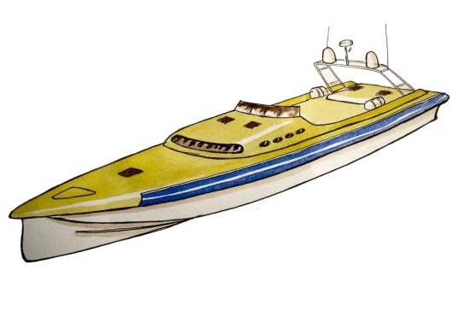

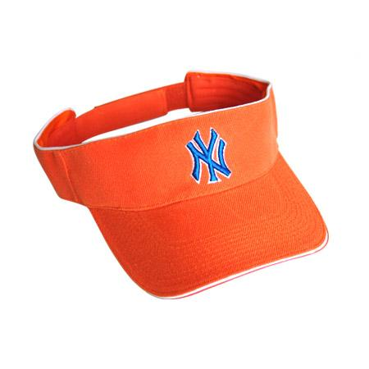

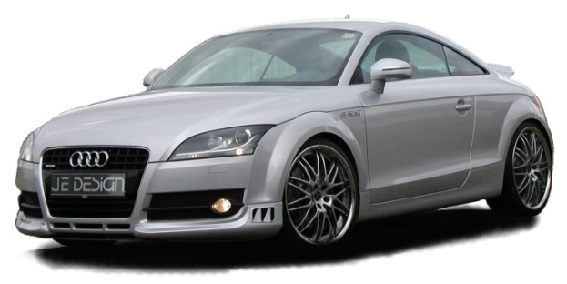
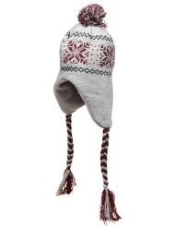
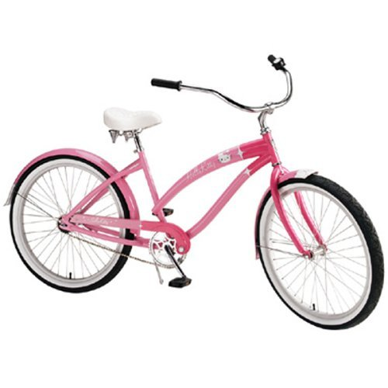
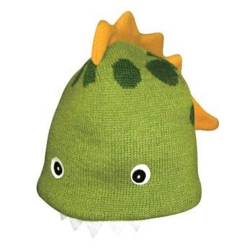
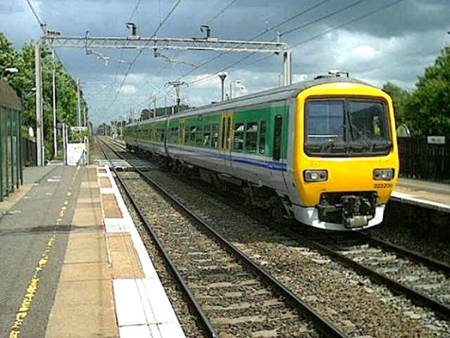
Odd One Out?
https://www.tes.com/teaching-resource/odd-one-out-thinking-game-6268484

Slide 16



Positive minus interesting
An umbrella made of glass
A house made of steel
Window panes made of wood
https://pstt.org.uk/application/files/6414/5753/5639/More_examples_of_PMI.pdf

Slide 17
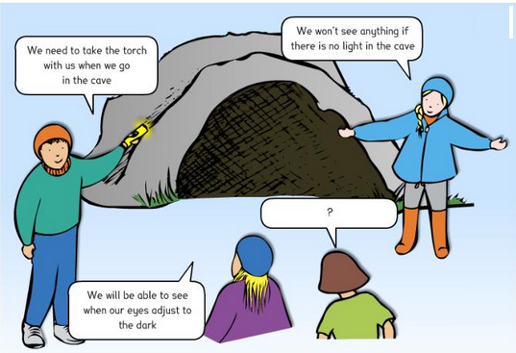
Concept cartoon
https://davinci2020.wordpress.com/2015/11/29/concept-cartoons/

Slide 18
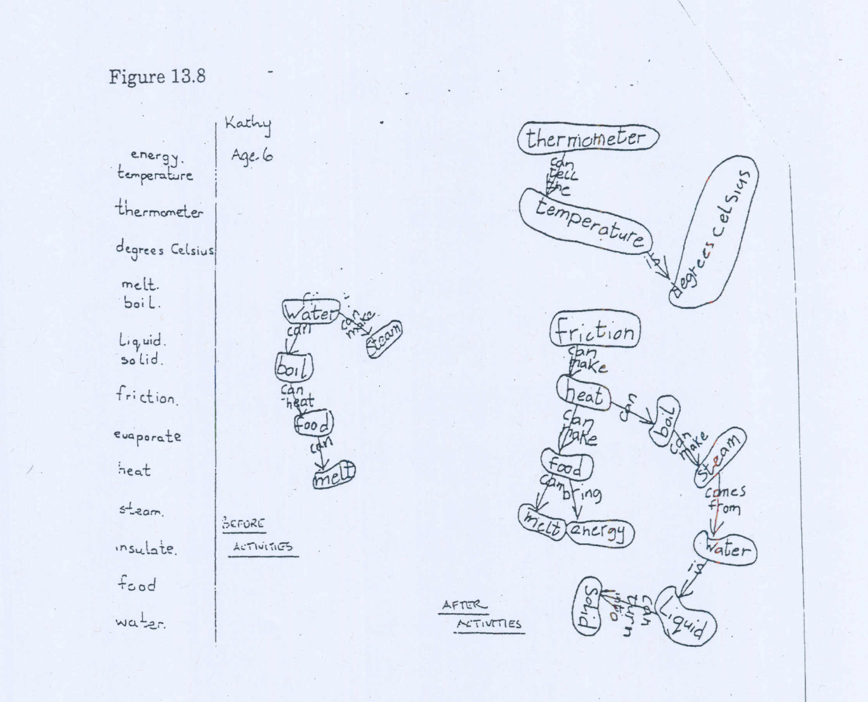
Concept map
From Harlen, W. et al (1990) Progress in Primary Science

Slide 19
Practical activities
Activity 1: Rolling Tubes
Predict which tube will travel faster/further on the ramp
Test (measure time and/or distance)
Does it make a difference if you change the height/surface?
What other factors do you notice make a difference?

Slide 20
Practical activities
Activity 2: Colour Spinners
Cut out a cardboard disc and divide it into seven equal segments.
Colour the segments the seven colours of the rainbow.
Make two holes in the centre of the card 1 cm apart and thread the string through them making a loop at each end.
Put a finger through the end of each loop and flip the disc over the string several times until the string is well twisted.
Pull your hands apart and let the string get loose – the disc will spin!
Repeat the steps with different colours.
What patterns do you notice?

Slide 21
Questioning to encourage and elicit thinking
Reflecting on evidence
What have you observed?
Have you noticed any patterns ?
How could you explain this? Are there any alternatives?
How have your ideas changed? Why?
How might your investigation be improved?
What further questions do you have?
In what ways were you acting like scientists?

Slide 22
Implications for teaching
Reflecting on inquiry processes
What did you discuss?
What raised/prompted discussion?
What evidence did you draw on?
How did you record your results? In what ways did this support your developing thinking?
What issues did the activities raise?
What questions could teachers ask to stimulate reasoning?

Slide 23
Introduction to classroom examples
Framework for the Curriculum Materials
Setting the scene – focus, rationale, background
Starting points
Developing the learning journey – activities and their rationale, examples of children’s responses, teacher reflections and implications for the next session.
Reflections – children’s progress, teacher role, classroom environment, next steps
Investigating Snails
Electricity
Floating Boats
Notes:
Now moving on.
Share some examples from the classroom of investigations over time – that illustrate varied approaches to inquiry and ways of recording.
Also ways in which teacher built on children’s responses over time and sought to foster children’s skills and understandings associated with inquiry.
Again in the time frame can only give you time to gain a sense of what the materials might offer.
Alternatively you can look at 3 shorter examples covering a range of ages 5-6, 6-7 and 8-9.
Waterproofing – emerging from damp patch on a child’s shoe
Living things – started within the curriculum requirements – central feature eliciting and building on children’s ideas and questions – and linking varied experiences in and outside school
Crime scene investigation teeth – whole school project setting up the crime scene – dressing up as scientists investigating the site – focus on teeth and again children taking increasing control – importance of links across the curriculum

Slide 24
Investigating
Snails
Children age 3-4
Learning activity 3: Making snail slime

Slide 25
Electricity
Child age 4

Slide 26
Floating Boats
Children age 5-6

Slide 27
Classroom examples:
Opportunities for reflection and reasoning
1. Read through first to gain an overview of the learning journey.
2. Then consider the following questions:
What evidence can you see of children’s reflection and reasoning? How does this change over time?
What aspects of the classroom environment prompt reflection?
Can you identify connections to creative dispositions ? How could opportunities for reflection and reasoning be extended?
How might you make links with the nature of science?

Slide 28
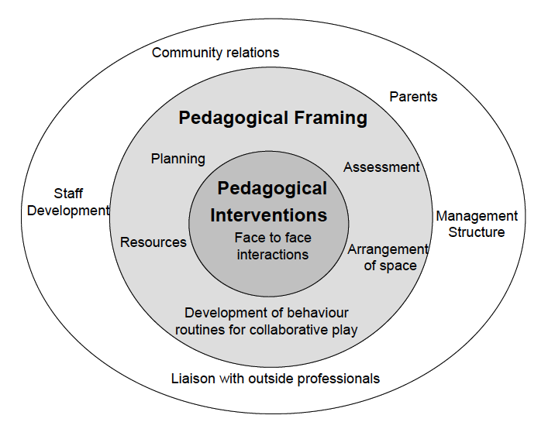
Implications for planning?
(linked to Pedagogical Model from Siraj-Blatchford et al, 2002)
Annotate the diagram to show implications

Slide 29
How to ensure productive exchange of ideas 1
The Fibonacci project (2012) offers a range of practical suggestions for fostering productive exchange of ideas including:
Making sure all children can see each other - seating for example in a circle or turning round to face each other.
Slowing down discussion to help children join in – for example asking children to wait for a few seconds, waiting for 5-10 seconds when there is silence can deepen a discussion or release new ideas.

Slide 30
How to ensure productive exchange of ideas 2
3. Explicit encouragement to children to talk to one another (rather than the teacher) – such as:
“Talk back to Louis, not to me”
“Amahl had a question for you”
“Marie, what did you think about what Sam said?”
“Allen, do you have anything to add to what Jeanne said?”

Slide 31
Supporting reflection and reasoning 1
4. Handling naïve conceptions when they are shared:
early on you may accept a naïve idea while at the same time highlighting results that raise questions about it;
later on you may guide the class to a more accurate conception based on evidence and reasoning.

Slide 32
Supporting reflection and reasoning 2
5. How to handle questions that cannot be answered by investigation or which the teacher may not be able to answer?
write them on the board, leaving none out, then sorting them into categories (for example - questions that might be investigated successfully through direct experience, questions that can be adapted for investigation, and questions that cannot be answered though first hand investigation (will need research from second hand sources).
Saying “I don’t know, but we can find out” models good (scientific) behaviour

Slide 33
Features of productive dialogue
Posing questions
Constructing shared interpretations and new knowledge
Articulating and justifying own points of view
Actively commenting and building on each other’s ideas
Agreeing and disagreeing politely
Changing our mind based on further evidence/input

Slide 34
Reflection on what has been gained from the module
Go back to your original posters
Is there anything you would add?
In what ways did the different activities support your developing thinking?
How far have the aims of the module been met?

Slide 35
Further information
Creative Little Scientists
(FP7 EU project 2011 – 2014)
Design principles and exemplar materials based on fieldwork www.creative-little-scientists.eu
Creativity in Early Years Science Education
(Erasmus+ EU project 2014 – 2017)
Curriculum Materials and Training Materials for teacher CPD to promote creative approaches to early years science www.ceys‐project.eu

Slide 36
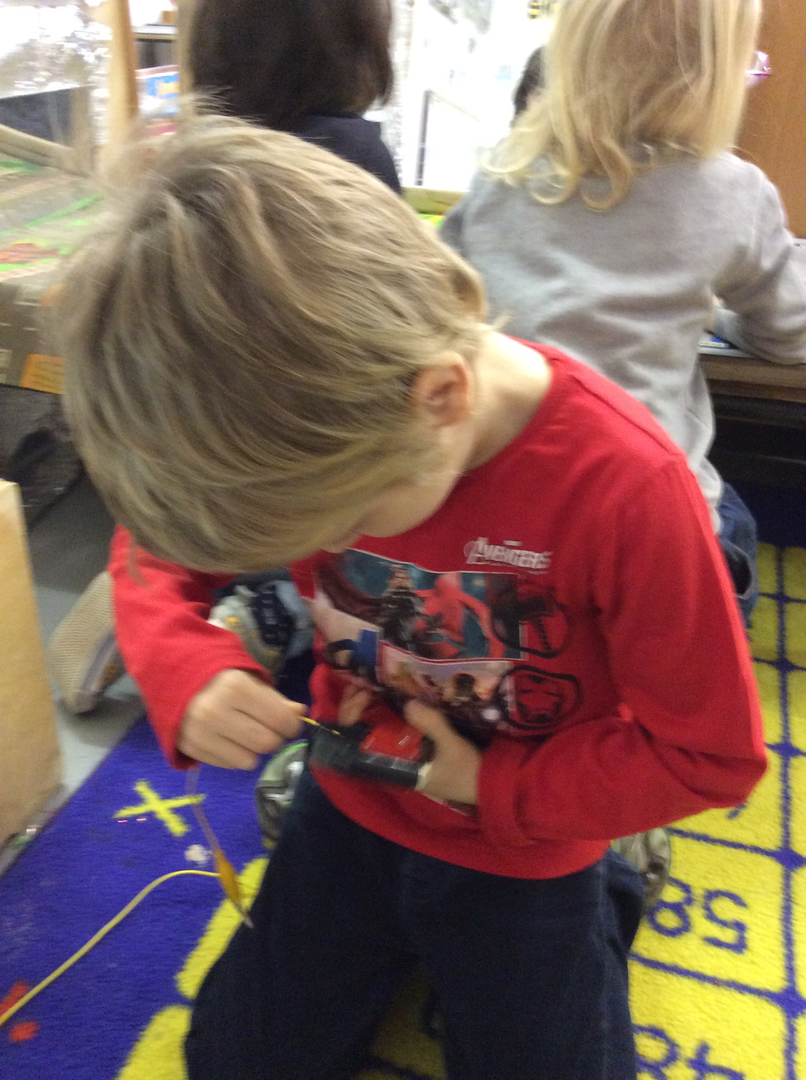
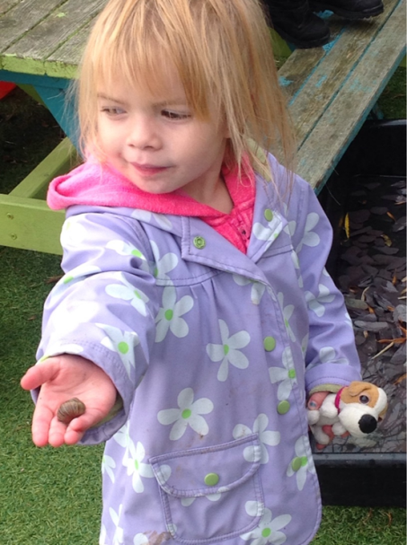
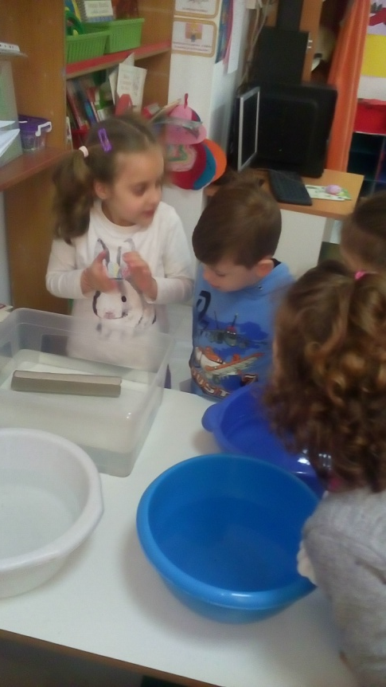
Thank you!

Slide 37

Acknowledgements
Creativity in Early Years Science EDUCATION (2014-2017) www.ceys-project.eu
© 2017 CREATIVITY IN EARLY YEARS SCIENCE EDUCATION Consortium
This work is licensed under the Creative Commons Attribution-NonCommercial-NoDerivatives 4.0 International License. To view a copy of this license, visit http://creativecommons.org/licenses/by-nc-nd/4.0/.

