Slide 1
Training Module 11
Linking learning inside and outside school

Slide 2
Module outline
Linking learning inside and outside school: Introduction, aims, rationale and background
Exploring outdoor opportunities
Focus: non-formal learning
Focus: informal learning
Focus: the role of the teacher
Planning opportunities for informal, formal and outdoor learning

Slide 3
Linking learning inside and outside school
Questions addressed
What is the importance of non-formal and informal learning?
How to use the environment (indoors and outdoors) in a flexible way?
How can the school ground and the outdoor classroom be enhanced in order to trigger science learning?
What strategies for informal, non-formal and outdoor learning in science do you and other participants use?
Notes:
Aims:
Introduce participants to the importance of formal, non-fomal and informal learning.
Introduce participants to a flexible use of the environment both indoors and out for science learning
Share strategies for informal learning in science within the school environment and other activities in school classrooms or outdoor play areas
Offer guidance on developing the school grounds and the outdoor classroom for use in science education
Engage participants in sharing ideas of how to use outdoor learning, informal and non-formal learning to enhance science learning.

Slide 4
Links to Content Design Principles
7. Teacher education should familiarise teachers with a range of formal and informal inquiry- and creativity-based learning, teaching and assessment approaches and strategies and their use in relation to authentic problems within the areas of science and mathematics.
14. Teacher education should equip teachers with knowledge and skills to use a range of formal, non-formal and informal learning environments, including the outdoor environment, both the school grounds and the wider environment beyond the school, in their teaching of science and mathematics.
17. Teacher education should address with teachers issues in ensuring rich provision, planning and use of resources (including digital resources) in and out of the classroom to support children’s inquiry and creativity.

Slide 5
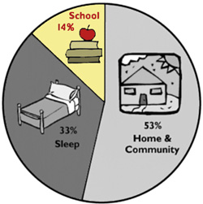

Linking learning inside and outside school
Why is this important?
Stongly motivating appoach to teaching and learning
Informal learning
“What makes informal learning attractive is its purely interest-driven, voluntary, self-directed, hands-on, and authentic nature.” (Asghar, 2012).

Slide 6
Linking learning inside and outside school
Why is this important?
Strongly motivating appoach to teaching and learning
Outdoor, nonformal & informal learning
A rich learning environment stimulates curiosity & triggers questions
Ownership and collaboration is enhanced
Builds on children’s interests
Fosters creative development
Driven by children’s interests
Authentic learning
Voluntary participation

Slide 7
Synergies between creative and inquiry based approaches to learning
(Creative Little Scientists, 2012)
Synergies
Play and exploration
Motivation and affect
Dialogue and collaboration
Problem solving and agency
Questioning and curiosity
Reflection and reasoning
Teacher scaffolding and involvement
Assessment for learning

Slide 8
Linking learning inside and outside school
Learning settings
Formal learning
Non-formal learning
Informal learning
Outdoor learning

Slide 9
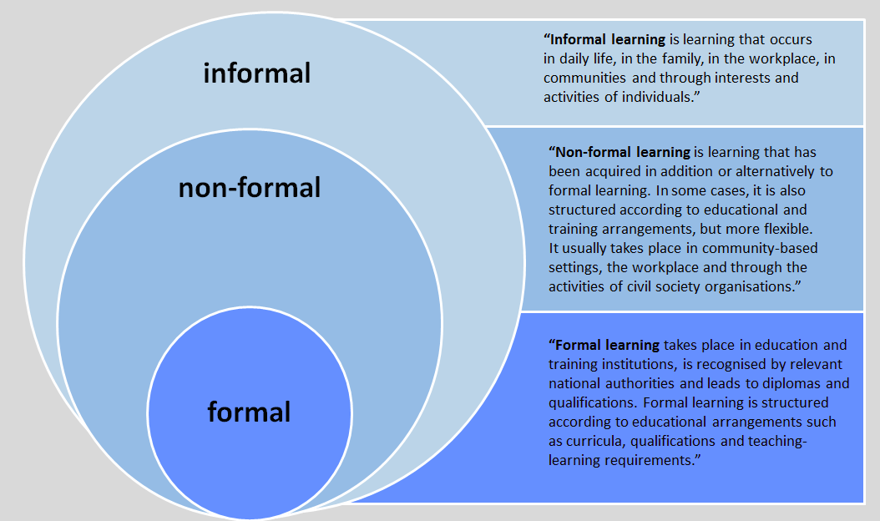
Linking learning inside and outside school
Learning settings
http://www.slideshare.net/LKOTZE/life-long-learning-and-planing-lesson-2

Slide 10
Linking learning inside and outside school
Learning settings (Eshach, 2007)
http://studypoints.blogspot.be/2015/02/describe-comparative-study-of-formal.html

Slide 11
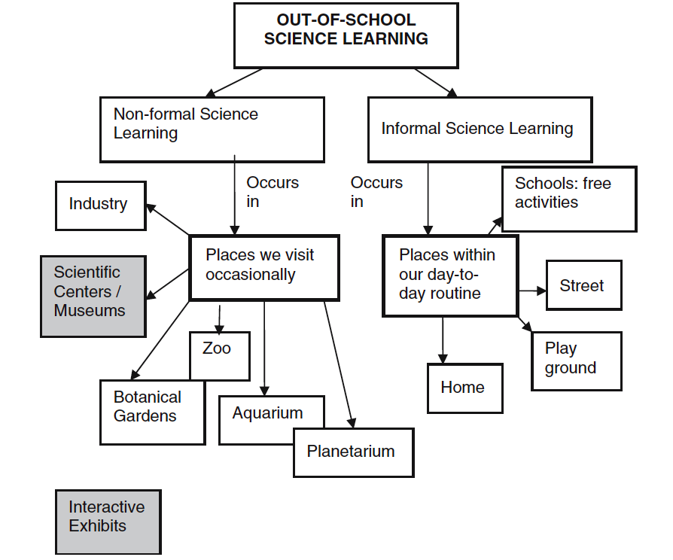
Linking learning inside and outside school
Learning settings (Eshach, 2007)

Slide 12
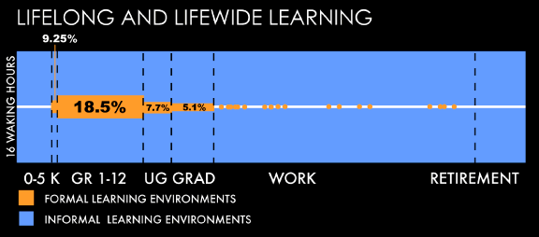
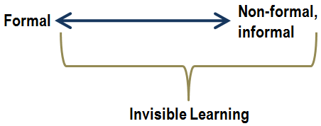
Linking learning
inside and outside school
Informal learning (Falk et al., 2012)

Slide 13

Linking learning inside and outside school
Expectations
As an individual
What do you hope to gain from the module?
Note down each question on a separate post it (one for each question)
As a group
See if you can sort these into groups – any common themes/differences?

Slide 14
Linking learning inside and outside school
Initial ideas
As an individual
Recording sheet: Out-of-school science learning
  Outdoor learning
  Non-formal learning
  Informal learning
Write down some examples you have organized.
Did you notice any science learning? How? What?

Slide 15
Linking learning inside and outside school
Outdoor & Informal learning
Work in groups of 4
Go outside to varied settings (3/4) in the immediate environment for example:
  School Playground, Garden, Parking Lot, Street, Park, Rooftop, Riverside, …
Explore the outdoor environment (use all your senses) and take pictures or bring things of situations/objects that could stimulate outdoor or informal science learning
Mail the pictures to (facilitator's e-mail comes here)

Slide 16
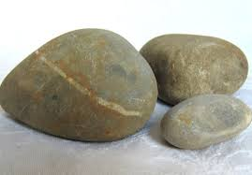
Linking learning inside and outside school
Outdoor & Informal learning
Share across the whole group
  Present your pictures/materials to the group
  What objects or situations could trigger science learning?

Slide 17
Linking learning inside and outside school
Outdoor & Informal learning
What aspects are important to trigger science learning
(to gain scientific insights or trigger questions)?
How could the school environment be improved to foster science learning?
Add ideas on A3 sheet

Slide 18

Linking learning inside and outside school
Non-formal learning
Explore the pictures of the non-formal learning contexts.

Slide 19
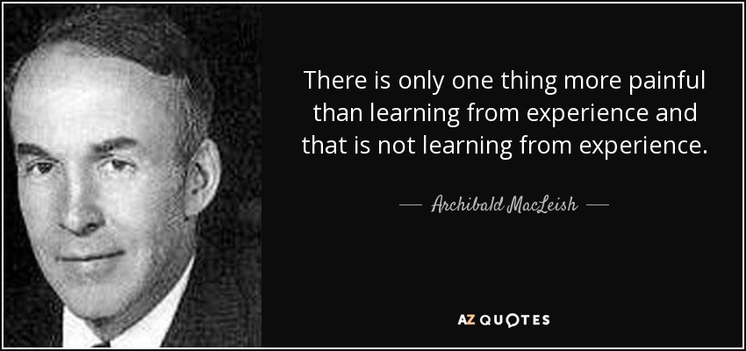
Linking learning inside and outside school
Non-formal learning

Slide 20
Linking learning inside and outside school
Non-formal learning
What do you think are important characteristics of a non-formal environment to stimulate creativity & science?
How would you prepare a field visit? (e.g. to a museum, field trip, zoo, …) What goals might you have?
What would your role be during the visit? What would you assess during the visit? How would you use this information?
How would you follow up a field visit? (e.g. to a museum, field trip, zoo, …)
Add ideas on A3 sheet

Slide 21
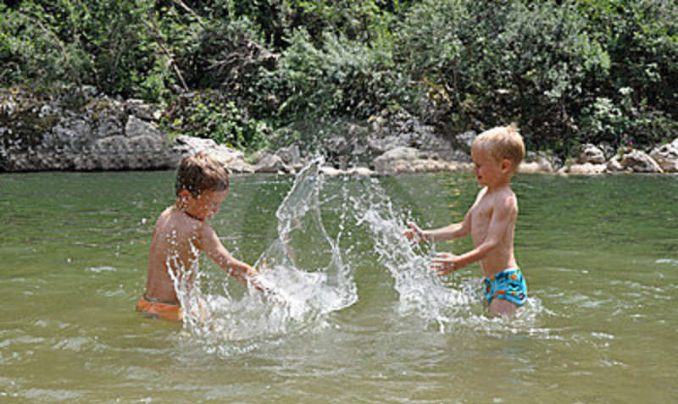
Linking learning inside and outside school
Informal learning
Explore the pictures of the informal learning contexts.

Slide 22
Linking learning inside and outside school
Informal learning
How could you as a teacher foster informal learning (in & outside the classroom)?
How could you build on (previous) informal learning in the classroom?
How could you enhance informal learning in the classroom?
Add ideas on A3 sheet

Slide 23
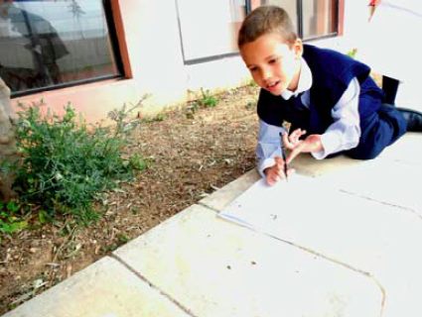
Linking learning inside and outside school
Role of the teacher
Discussion & reflection on classroom examples
Minibeasts

Slide 24
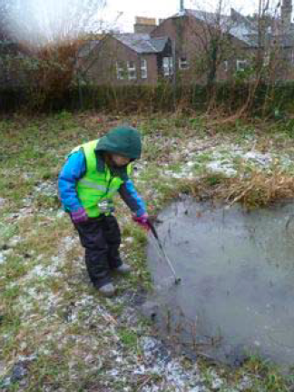
Linking learning inside and outside school
Role of the teacher
Discussion & reflection on classroom examples
Forest school

Slide 25
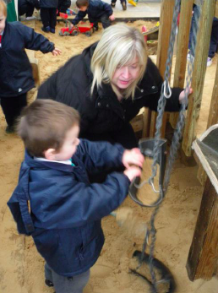
Linking learning inside and outside school
Role of the teacher
Discussion & reflection on classroom examples
Outdoor sand

Slide 26

Linking learning inside and outside school
Role of the teacher
Discussion & reflection on classroom examples
What is the role of the teacher in the episode?
How do they stimulate children to explore the outdoor environment?
How do they build on informal/non-formal learning?
How do they use the outdoor environment?
What would you do (differently)
in your practice?
Add ideas on A3 sheet

Slide 27

Linking learning inside and outside school
Planning opportunities for informal, formal and outdoor learning
Look at your ideas (see A3 sheets).
What approaches would you find useful in stimulating informal and non-formal learning?
What challenges do you see?
Note 2 or 3 actions you will take building on module content on the action plan.

Slide 28
Linking learning
inside and outside school
Reflection on what has been gained
How far have the questions at the start of the module been answered?
Do you still have questions that need addressing?

Slide 29
Further information
Creative Little Scientists
(FP7 EU project 2011 – 2014)
Design principles and exemplar materials based on fieldwork www.creative-little-scientists.eu
Creativity in Early Years Science Education
(Erasmus+ EU project 2014 – 2017)
Curriculum Materials and Training Materials for teacher CPD to promote creative approaches to early years science www.ceys‐project.eu

Slide 30

Linking learning
inside and outside school

Slide 31

Acknowledgements
Creativity in Early Years Science EDUCATION (2014-2017) www.ceys-project.eu
© 2017 CREATIVITY IN EARLY YEARS SCIENCE EDUCATION Consortium
This work is licensed under the Creative Commons Attribution-NonCommercial-NoDerivatives 4.0 International License. To view a copy of this license, visit http://creativecommons.org/licenses/by-nc-nd/4.0/.

