Slide 1
Training Module 10
Cross-curricular project work

Slide 2
Introduction to the CEYS project
(use dependent on context)
European Erasmus+ project
Partners in Belgium, Greece, Romania, UK
Continuation of the Creative Little Scientists project http://www.creative-little-scientists.eu
Aims
  Development of a teacher development course and accompanying materials
  Promotion of the use of creative approaches in teaching science in preschool and early primary education (up to age of eight)
Notes:
The Creativity in Early Years Science project is a European Erasmus+ project with partner countries Greece, Romania, Belgium and the UK
As indicated – it aims to develop a European teacher professional development course and accompanying materials to promote the use of creative approaches in teaching science in preschool and early primary education (up to age of eight).
It is a continuation of the project Creative Little Scientists, an FP7 EU project, where curriculum design principles to foster inquiry and creativity in science education were designed.

Slide 3
Connecting Inquiry Based Science Education and Creative Approaches
Inquiry-based Science Education
Creative Dispositions
Sense of initiative
Motivation
Ability to come up with something new
Making connections
Imagination
Curiosity
Ability to work together
Thinking skills
(for example Chappell et al 2008)
Questioning
Designing and planning investigations
Gathering evidence
Making connections
Explaining evidence
Communicating explanations
(for example Minner et al 2010)
From Creative Little Scientists, 2012
Notes:
A key challenge for the Creative Little Scientists project was to define what we mean by creativity in science and mathematics. We often use the term ‘creativity’ in rather general terms – and it appears also in policy documents – but what exactly does that mean.
Drawing on a wide range of sources and discussions with stakeholders from the early years and science education communities we developed the following definitions that are a central feature of the project.

Slide 4
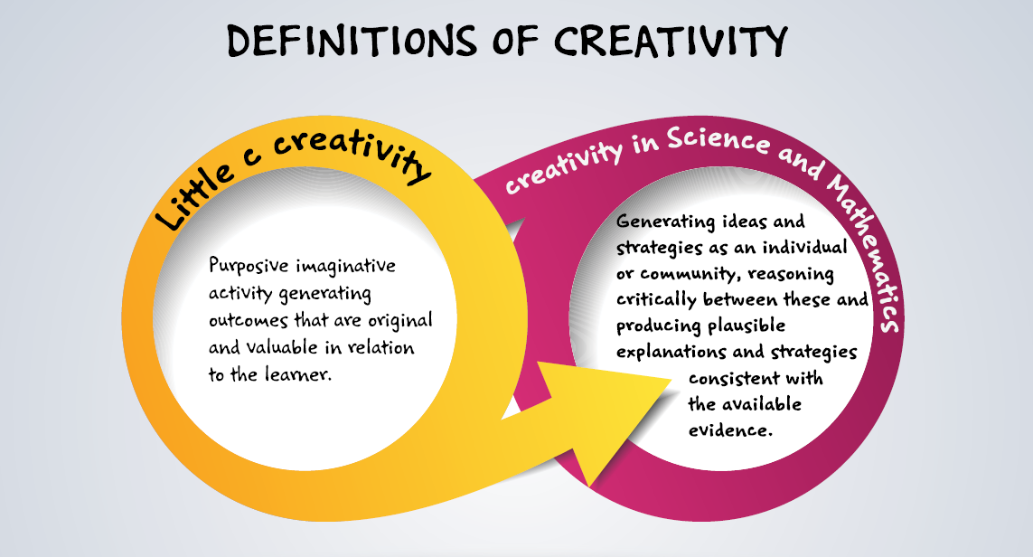
Conceptual Framework
(Creative Little Scientists, 2014)

Slide 5
Synergies between inquiry-based and creative approaches
(Creative Little Scientists, 2012)
Play and exploration
Motivation and affect
Dialogue and collaboration
Problem solving and agency
Questioning and curiosity
Reflection and reasoning
Teacher scaffolding and involvement
Assessment for learning

Slide 6
Initial expectations
Identify and share your expectations and any questions related to this module.
Record them on a sheet of paper for future evaluation

Slide 7
Aims of the module
Introduce participants to cross-curricular science teaching in the context of inquiry-based and creative approaches to early years science education.
Foster understanding of the goals and benefits of cross-curricular approaches
Increase participants’ awareness of different approaches to cross-curricular science teaching.
Share strategies for designing cross-curricular projects.

Slide 8
Links to Content Design Principles and Outcomes
16. Teacher education should provide teachers with knowledge of approaches to timetabling and organizing cross-curricular project work.
  16.1 Teacher should be able to use approaches to cross-thematic, cross-curricular and project work to promote creativity in science and mathematics.
  16.2 Teachers should be able to use a variety of approaches to timetabling, within the existing curriculum and policy expectations to allow space for cross-curricula project work and child-initiated exploration and inquiry.
  16.3 Teachers should be able to build connections across the curriculum of various kinds and with potential to contribute to children’s inquiry and creativity.

Slide 9
What is meant by cross-curricular teaching and learning?
Varied approaches and interpretations involving:
Linking social, emotional, practical and intellectual skills and dispositions
Making connections between curriculum subjects.
Drawing together knowledge and skills from a number of subjects within a thematic project or in solving real life problems.
Providing opportunities to revisit and apply of knowledge and skills from one subject in another.
Designing motivating, meaningful learning experiences for children linked to their everyday lives outside school.
Fostering creative thinking in making connections between subjects and cultures.

Slide 10
What are the goals of cross curricular teaching and learning?
Motivate and encourage children’s learning linked to their wider life experiences and interests.
Provide active and experiential learning for children.
Promote an integrated approach to children’s cognitive, personal and social development .
Draw on similarities in, and links between, individual subjects (in terms of subject content, teaching and learning processes) and make these links explicit.
Contribute towards a broad range of teaching and learning opportunities within individual subjects and across subjects - in interpreting specific external curriculum requirements.
Allow teachers opportunities to evaluate and reflect on their teaching and be imaginative and innovative in their curriculum planning.
Promote a shared vision amongst teachers through collaborations in curriculum design.

Slide 11
Benefits of cross curricular approaches to science education 1
Pupils are enabled to use similar skills in different subjects with the same context or problem. They are helped to see that events do not happen in isolation, thus showing the relevance of science ideas and skills in a wider context. Knowledge in the real world is not applied in bits and pieces but in an integrative fashion.
Kysilka, M. L. (1998). Understanding integrated curriculum. Curriculum journal,9(2), 197-209.
Pupils are more likely to develop creativity, critical thinking and problem solving abilities as they become more familiar with recognizing the complex demands of problems requiring knowledge and skills from more than one subject.
Fibonacci Project (2012, p6)

Slide 12
Benefits of cross curricular approaches to science education 2
Interdisciplinary studies, based on groupings of experiences and outcomes from within and across curriculum areas, can provide relevant, challenging and enjoyable learning experiences and stimulating contexts to meet the varied needs of children and young people.
(Scottish Government, 2008)
The prime motivators for learning should be shared, relevant and meaningful experiences. Shared experience is by definition inclusive: meaningful and relevant experience motivates participation, but such experiences need careful planning.
(Barnes, 2011,p.233)
When successful, pupils find learning easier because it is less disjointed and more relevant. Consequently the pupils are more motivated. As only one context is used, language demands are related as the same words recur. This is particularly important where there are many different languages spoken in the classroom.
(Fibonacci, 2012, p6)

Slide 13
Outline of the module
Introduction to cross curricular science teaching: definitions, goals, benefits.
Practical activity – opportunities for cross curricular connections within scientific inquiry.
Sharing your vision and classroom experiences in relation to cross curricular science teaching.
Discussion of classroom examples – opportunities for cross-curricular connections, links to goals of cross-curricular approaches, role of the teacher
Reflection on classroom examples - benefits of cross-curricular links, implications
Group brainstorming on the design of cross curricular science teaching projects. Discussion of implications for planning
Reflections on what has been gained from the module – both content and process, in relation to the aims of the module.

Slide 14
Practical activity
Science inquiry across the curriculum
Choice of practical activities:
Can you make a parachute so that a present be delivered safely?
Which materials would make the best ear muffs?
Which vegetables are suitable for dyeing fabrics?
What is the potential in each activity for:
Making links to everyday life experiences?
Fostering inquiry skills and creative dispositions?
Applying skills and knowledge from other subjects?
In what ways can the teacher foster connections?
Notes:
The activities above are just some suggestions to illustrate possible types of example.
Facilitators to add examples relevant to their context

Slide 15

Practical Activity 1
(Linking science and mathematics)
Can you make a parachute so your present is delivered quickly and safely?

Slide 16
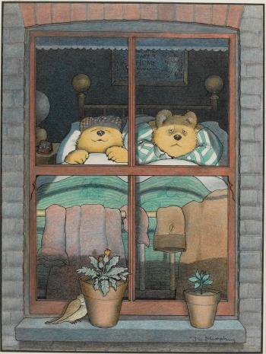
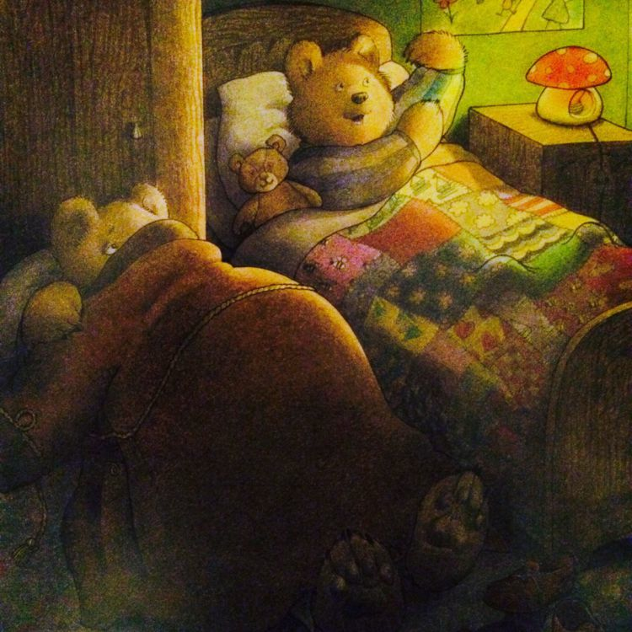
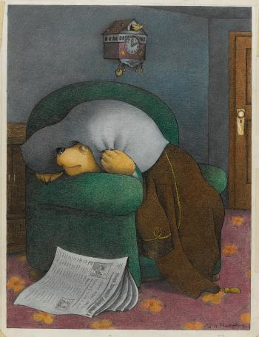
Practical Activity 2
(Link with literacy - starting with a story)
Which materials would make the best ear muffs?
Mr Bear could not sleep. He tried different places inside and outside the house BUT - Mrs Bear snored, Baby Bear was pretending to be an aeroplane, the cuckoo clock went tick tock. Can you help him?
Notes:
This is based on the storybook Peace at Last by Jill Murphy – published in 1980
You can watch the story Peace at Last on youtube at https://www.youtube.com/watch?v=9U9y35kWBvM
Children could send a letter or design to Mr Bear.

Slide 17
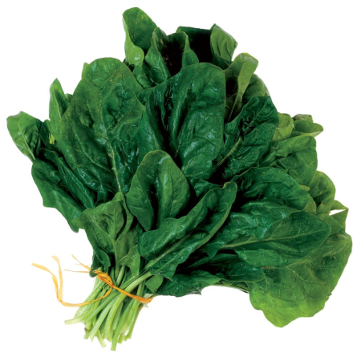


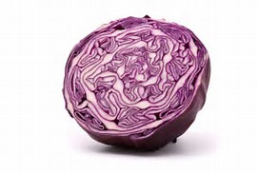
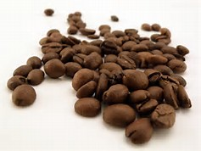
Practical activity 3
(Links with geography, history or art)
Which vegetables are suitable for dyeing fabrics?
Notes:
For example: Spinach, red cabbage, parsley, coffee, tea – include other examples as appropriate.

Slide 18
Importance of measurement in science
What do you need to measure?
How could you record results?
Collect some initial data
What patterns do you notice?
How might you explain them?
How could you test or develop your ideas further?
Notes:
It will be important to highlight the importance of measurement in science and consider how the form of representation supports the search for patterns in results.
It is helpful to encourage participants to consider a range of approaches to recording results including:
Sorting and ordering the practical examples
Visual representation – drawings, video recording, slomotion
As well as tables and charts.

Slide 19
Sharing experiences:
Opportunities and challenges in cross-curricular project work
As an individual record on separate post its
2/3 examples of cross-curricular teaching and learning from your own classroom
What kinds of links across the curriculum were involved?
What was the rationale/inspiration for the design of your example?
Did you receive any support or assistance in designing cross-curricular learning experiences – from whom?
What challenges did you face?
As a group of 4/5
Share and group your responses on a poster
Any common themes or differences?
What issues are raised?

Slide 20
Discussion of cross curricular teaching goals: analysis of classroom examples
Which goals of cross curricular science teaching are reflected in the following classroom examples?
In what ways do these cross-curricular approaches support children’s creativity and inquiry?
  Science and Literature: Float and sink
  Science and Physical Education: Soft play
  Science and Mathematics: Carpenter corner
As an individual - record answers on separate post its.
As a group - share and sort responses
Any common themes or differences?
Whole group - discuss key points, issues for planning

Slide 21
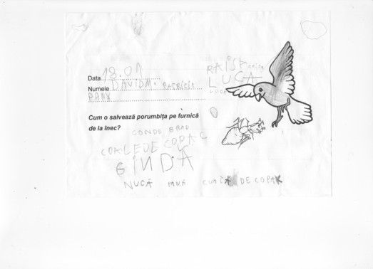
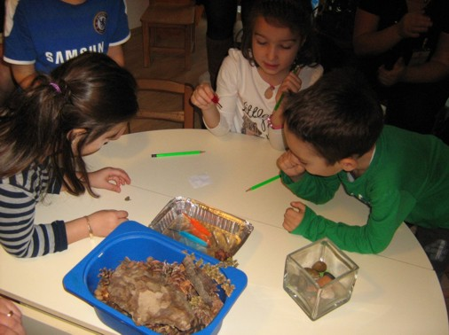
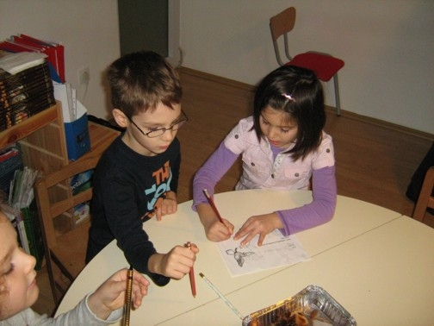
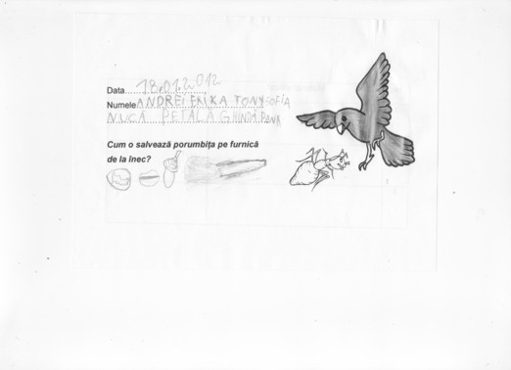
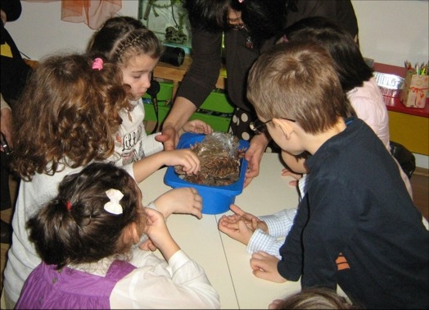
Float or Sink?
How can you rescue the little ant that fell in the river?
Notes:
Then one day, the little ant fell into a river. A dove flying by saw what happened and wanted to help the ant.
Later, Maria suggested that the children run an investigation to identify the best idea to solve the problem. The children were given small containers with water in order to verify what materials existing in the forest could be used as little ‘boats’ for the ant. A variety of materials were made available including nuts, feathers, wooden sticks, leaves, little stones, acorns, pieces of bark, fir cones, etc. Maria asked every group to come to the front table and to take the materials they thought were the most suitable for the task to save the ant, items they intended to test. Children had to predict which objects would float.

Slide 22
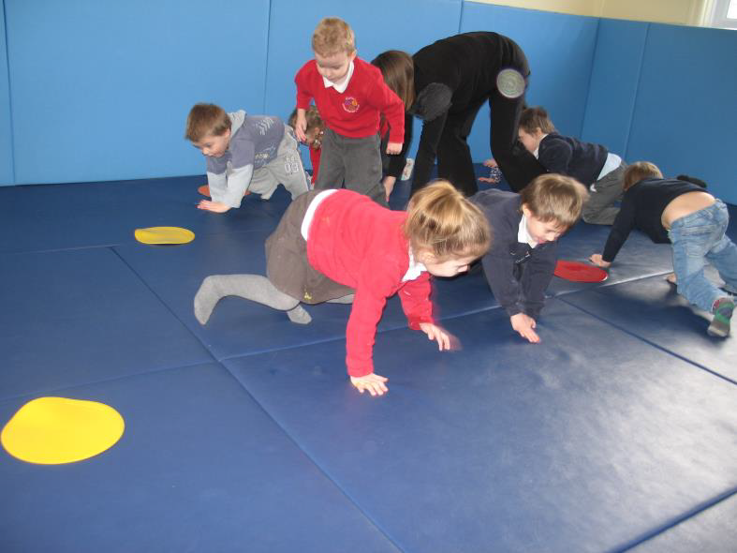
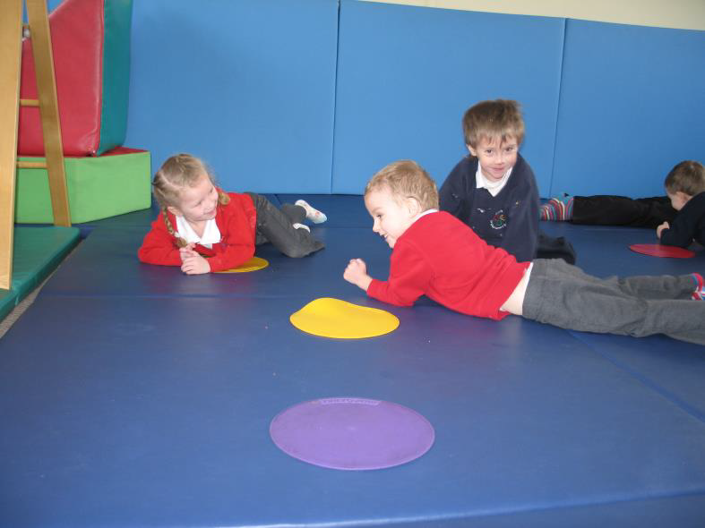
Soft Play
Stomping like an elephant
Slithering like a snake

Slide 23
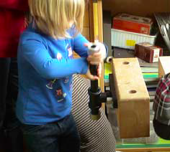
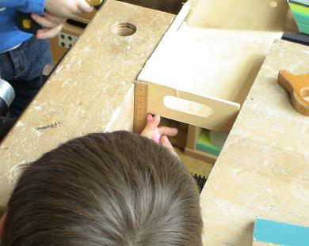
Carpenter Corner

Slide 24
Benefits of cross-curricular science teaching
Analysis of more classroom examples
What are the potential benefits of cross curricular science teaching reflected in the classroom examples?
What is the role of the teacher in fostering connections?
In what ways do these cross-curricular approaches support children’s creativity and inquiry?
What are the implications for planning?
Crime Scene investigation
Ema and her food preferences
The sounds around us

Slide 25
Framework for the Classroom Examples provided
Setting the scene – focus, rationale, background
Starting points
Developing the learning journey – activities and their rationale, examples of children’s responses, teacher reflections and implications for the next session.
Reflections – children’s progress, teacher role, classroom environment, next steps

Slide 26
Crime Scene Investigation

Slide 27
Ema and her food preferences

Slide 28
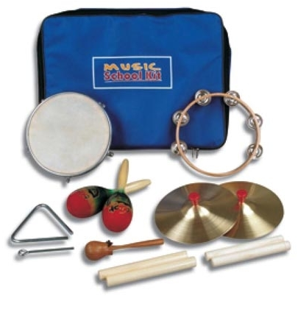
Sounds around us
Activity: A game with sounds coming from musical instruments
Children close their eyes and try to recognize what instrument produces the sound they hear.
Rationale : this activity aimed to trigger a conversation about the sounds.
All the pupils participated and they had fun.
Μπορείς να αναγνωρίσεις αυτό τον ήχο?
Games easily earn children’s engagement and interest.
The sounds heard in the game came only from the instruments found in the closet, so the next thought was to open sounds up to the world…!!!
Mrs S., look out for the volume this drum produces…

Slide 29
Analysis of classroom examples
1. In pairs read through the example.
2. Then consider the following questions:
  What are the potential benefits of cross curricular science teaching reflected in the classroom examples?
  What is the role of the teacher in fostering connections?
  In what ways do these cross-curricular approaches support children’s creativity and inquiry?
  What are the implications for planning?
3. Whole group - Exchange of ideas and implications for planning

Slide 30
Fostering creative dispositions in the context of cross-curricular teaching
(Creative Little Scientists, 2012)
Sense of initiative
Motivation
Ability to come up with something new
Ability to connect what they have learnt during lessons with topics in other subjects
Imagination
Curiosity
Ability to work together
Thinking skills
Reflections on evidence from the classroom examples

Slide 31
What are the roles of the teacher?
In groups of 4 review the roles of the teachers in the examples discussed.
How did the teachers promote cross-curricular connections
In what ways do you think they fostered children’s creativity and inquiry?
How was support provided for children’s decision making in each case?
Whole group summarise implications for planning
Notes:
Whole Group discussion
Share and record teacher approaches that fostered creativity
Consider connections to the Synergies between inquiry-based and creative approaches.
Highlight importance of classroom context – both pedagogical framing and pedagogical interactions.

Slide 32
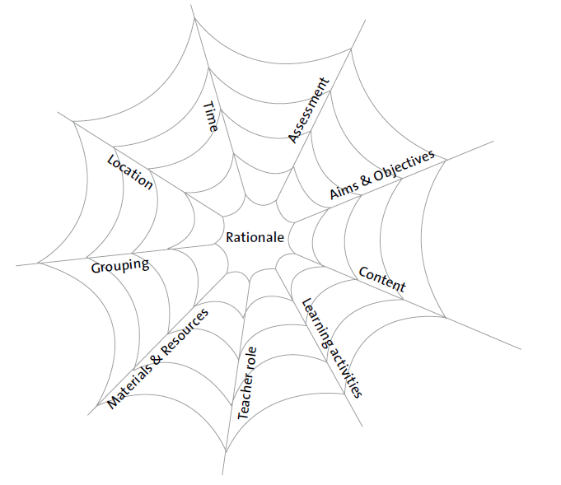
Implications for planning
Brainstorm in groups of 4
Design a cross curricular science project.
Make notes in relation to the ‘vulnerable spider web’
Build on a theme you already use in your classrooms or
Consider one of the following themes:
Toys, Celebrations, The Home.
Prepare a poster to share
Identify any questions/issues.
Curriculum Dimensions
The vulnerable spider web (van den Akker 2007 p 39)
Notes:
Facilitators to select themes appropriate to their local contexts.

Slide 33
Reflections
In groups 2/3s
Look back at your original ideas about cross-curricular science teaching. Anything you might add or change? Add in any additional comments or issues in another colour (pen/post it).
Note and record 2 actions you will take building on module content.
In what ways did the different activities support your developing thinking?
How far have the aims of the module been met?

Slide 34
Further information
Creative Little Scientists
(FP7 EU project 2011 – 2014)
Design principles and exemplar materials based on fieldwork www.creative-little-scientists.eu
Creativity in Early Years Science Education
(Erasmus+ EU project 2014 – 2017)
Curriculum Materials and Training Materials for teacher CPD to promote creative approaches to early years science www.ceys‐project.eu

Slide 35

THANK YOU!

Slide 36

ACKNOWLEDGEMENTS
CREATIVITY IN EARLY YEARS SCIENCE EDUCATION (2014-2017)
WWW.CEYS-PROJECT.EU
© 2017 CREATIVITY IN EARLY YEARS SCIENCE EDUCATION Consortium
This work is licensed under the Creative Commons Attribution-NonCommercial-NoDerivatives 4.0 International License. To view a copy of this license, visit http://creativecommons.org/licenses/by-nc-nd/4.0/.

