Slide 1
Training Module 1
Using questions of teachers and children

Slide 2
Introduction to the CEYS project
(use dependent on context)
European Erasmus+ project
Partners in Belgium, Greece, Romania, UK
Continuation of the Creative Little Scientists project http://www.creative-little-scientists.eu
Aims
  Development of a teacher development course and accompanying materials
  Promotion of the use of creative approaches in teaching science in preschool and early primary education (up to age of eight)
Notes:
The Creativity in Early Years Science project is a European Erasmus+ project with partner countries Greece, Romania, Belgium and the UK
As indicated – it aims to develop a European teacher professional development course and accompanying materials to promote the use of creative approaches in teaching science in preschool and early primary education (up to age of eight).
It is a continuation of the project Creative Little Scientists, an FP7 EU project, where curriculum design principles to foster inquiry and creativity in science education were designed.

Slide 3
Connecting Inquiry Based Science Education and Creative Approaches
Inquiry-based Science Education
Creative Dispositions
Sense of initiative
Motivation
Ability to come up with something new
Making connections
Imagination
Curiosity
Ability to work together
Thinking skills
(for example Chappell et al 2008)
Questioning
Designing and planning investigations
Gathering evidence
Making connections
Explaining evidence
Communicating explanations
(for example Minner et al 2010)
From Creative Little Scientists, 2012
Notes:
A key challenge for the Creative Little Scientists project was to define what we mean by creativity in science and mathematics. We often use the term ‘creativity’ in rather general terms – and it appears also in policy documents – but what exactly does that mean.
Drawing on a wide range of sources and discussions with stakeholders from the early years and science education communities we developed the following definitions that are a central feature of the project.

Slide 4
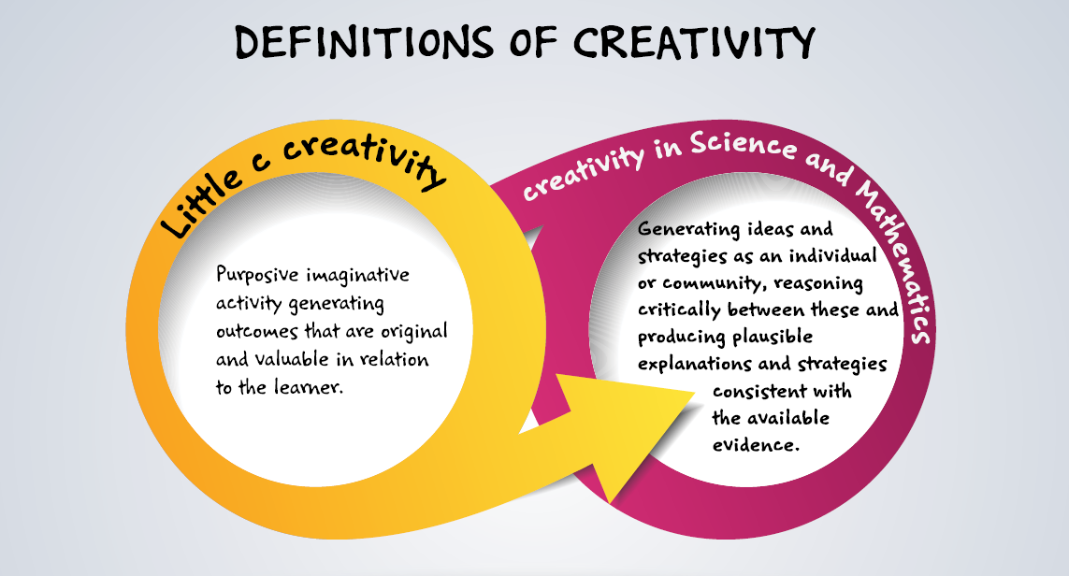
Conceptual Framework
Creative Little Scientists (2014)

Slide 5
Synergies between inquiry-based and creative approaches
From the Conceptual Framework adopted by the CEYS Project (Creative Little Scientists, 2012)
Play and exploration
Motivation and affect
Dialogue and collaboration
Problem solving and agency
Questioning and curiosity
Reflection and reasoning
Teacher scaffolding and involvement
Assessment for learning

Slide 6
Rationale for the module
Central role of questioning within both creative and inquiry-based approaches
Evidence of children’s curiosity and questioning from a very young age
Concern to sustain and build on this in education
Need for a supportive context to formulate ideas and questions
Importance of recognising and valuing children’s questions – both explicit and implicit in their actions, drawings, gestures
Challenges in working out how to build on their questions

Slide 7
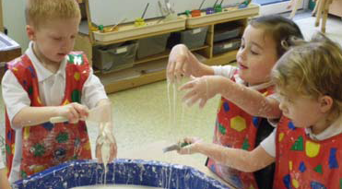
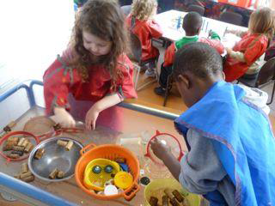
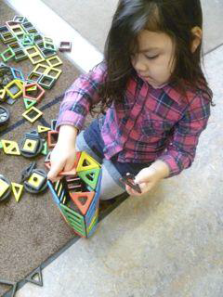
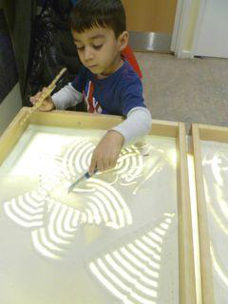
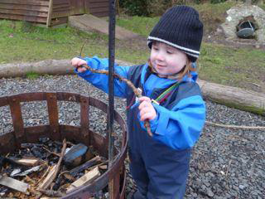
Building on children’s play and exploration of the world
around them
Notes:
Here are some examples of child’s play and exploration – illustrate children’s capacities for sustained engagement and interest in their environment
Children’s questions are often not made explicit but
Watching carefully the direction of their activities may suggest their interests and questions

Slide 8
Aims of the module
Introduce participants to the roles of questioning by both children and teachers in inquiry-based and creative approaches to early years science education.
Share strategies for stimulating, recognizing and building on children’s questions.
Increase awareness of different forms of questioning teachers can employ to scaffold children’s creativity and independence in generating and evaluating ideas.

Slide 9
Links to Content Design Principles and Outcomes 1
6. Teacher education should provide pedagogical content knowledge to stimulate inquiry and problem solving in science and mathematics education.
  6.3 Teachers should be able to recognise the key roles of children’s questioning and existing ideas (both implicit and explicit) of science and mathematics.
  6.4 Teachers should be able to use a variety of strategies for eliciting and building on children’s questions and ideas during inquiry processes (before, during and after explorations and investigations).
Notes:
Information for facilitators for sharing with participants as appropriate.

Slide 10
Links to Content Design Principles and Outcomes 2
10. Teacher education should enable teachers to recognize and build on children’s ideas, theories and interests for the teaching of science and mathematics.
  10.1 Teachers should be able to use a range of strategies for picking up on children’s ideas, interests and questions.
  10.2 Teachers should be able to build flexibility into planning to take advantage of unexpected events, children’s interests and questions.

Slide 11
Links to Content Design Principles and Outcomes 3
11. Teacher education should enable teachers to use questioning effectively and encourage children’s questions in order to foster creativity and inquiry.
  11.1 Teachers should be able to use different forms of questioning at appropriate points to scaffold creative learning outcomes in science and mathematics, and in particular to encourage children’s reflections and explanations, foster their independence and extend their inquiry.
  11.2 Teachers should value and be able to build on the potential of children’s own questions to foster their curiosity in science and mathematics, and support their generation and follow up, including those that are investigable.

Slide 12
Module outline
Sharing your experiences of stimulating and building on children’s ideas and questions
Discussion of classroom examples – stimulating, recognising and building on ideas
Analysis of teacher questioning – opportunities to elicit thinking and foster creativity and inquiry
Implications for planning – pedagogical framing and pedagogical interactions
Reflections on the workshop content/process – connections to previous sessions

Slide 13
Sharing experiences of stimulating and building on children’s ideas and questions
Work in 4 groups of 4/5
What approaches have you found useful in stimulating children’s ideas and questions?
What challenges have you faced?
As an individual - Write down answers to these questions on separate post-its and place on the sheet on the table.
As a group – See if you can sort these – Any common themes or differences?
Feedback to the whole group.

Slide 14
Discussion of classroom examples
Work in groups of 4/5
2 classroom examples each group – Focus on:
Evidence of children’s ideas and questions – both implicit and explicit. Does the age of the children matter?
How are ideas and questions triggered? Could you provide some more possibilities?
How are children and/or teachers building further on ideas, questions and theories?
Role of the teacher in the episode? What questions might you ask?
Note down key points on the sheet provided.
Notes:
Selected episodes BE Sandbox, GE Water Enquiry
Template UK EN Cars and Ramps 323-325, UK EN Sound 366-368

Slide 15
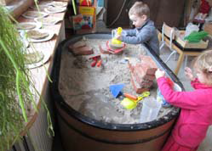
SandBox: Children age 3
Materials in the sand corner, including real bricks, tools
Notes:
This first example is from Belgium - materials in the sandbox – linked to a theme about stones.

Slide 16
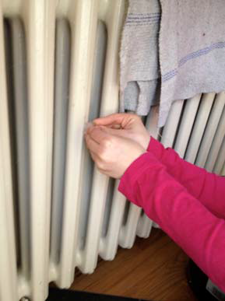
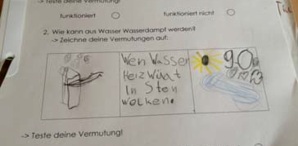
Water Inquiry: children age 6
Planning experiments to show that ice and steam both come from water
Notes:
This second example is from Germany – the children were asked to plan their own experiments to prove that ice and steam both come from water - they were able to use any equipment they liked – and were asked to record their ideas on a scientists sheet.

Slide 17
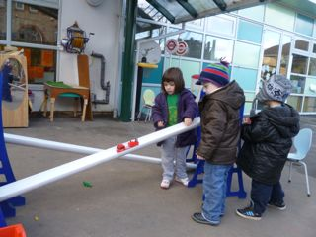
Cars and Ramps: Children age 3-4 set up outside
Notes:
This example took place in the outdoor area outside the classroom.
Two ramps were set up alongside each other- two lengths of white guttering with blue ladder-like supports at each end with rungs, so that the height of each end of the guttering and therefore the slope of the ramp could be varied.
Alongside there was a box containing a range of vehicles of various sizes.
The activity was left out all afternoon for children to come and go and there was plenty of space and time for children to follow their own ideas and interests

Slide 18
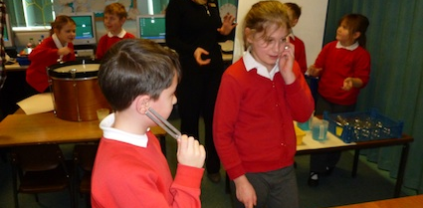
Sound: Children age 7-9
Exploring ways to make sounds
Notes:
The tables are set up with equipment for exploration: bass drum, snare drum and steel pan, each with a cup of rice; bottles and coloured water in a jug; trays, jugs, water and tuning forks; wind instruments; hollow tubes of different lengths; frog guiro; all tables have large paper and felt tip marker pens. The children had about 30 minutes to explore the resources on two tables and then had to find a way to represent on paper how sound is made.

Slide 19
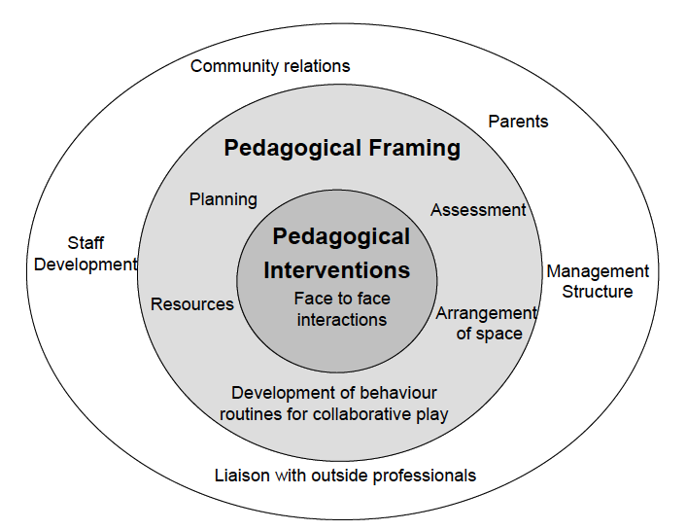
Sharing responses – implications for planning?
(linked to Pedagogical Model from Siraj-Blatchford) (2002))

Slide 20
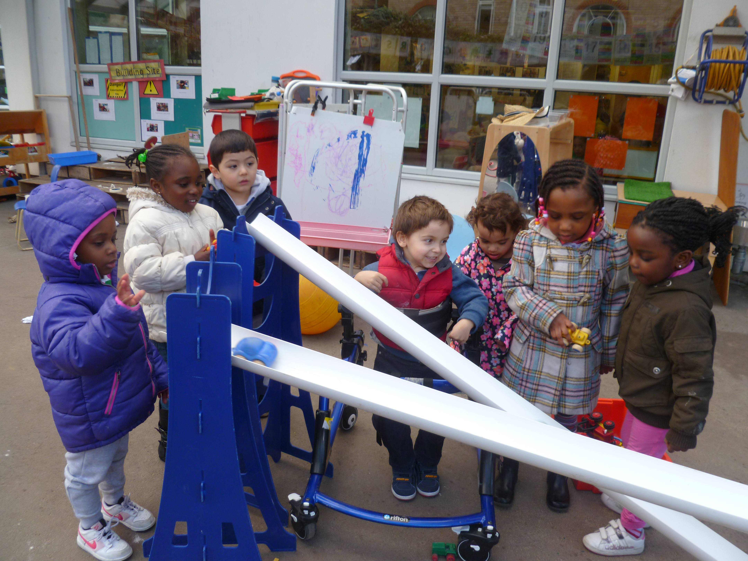
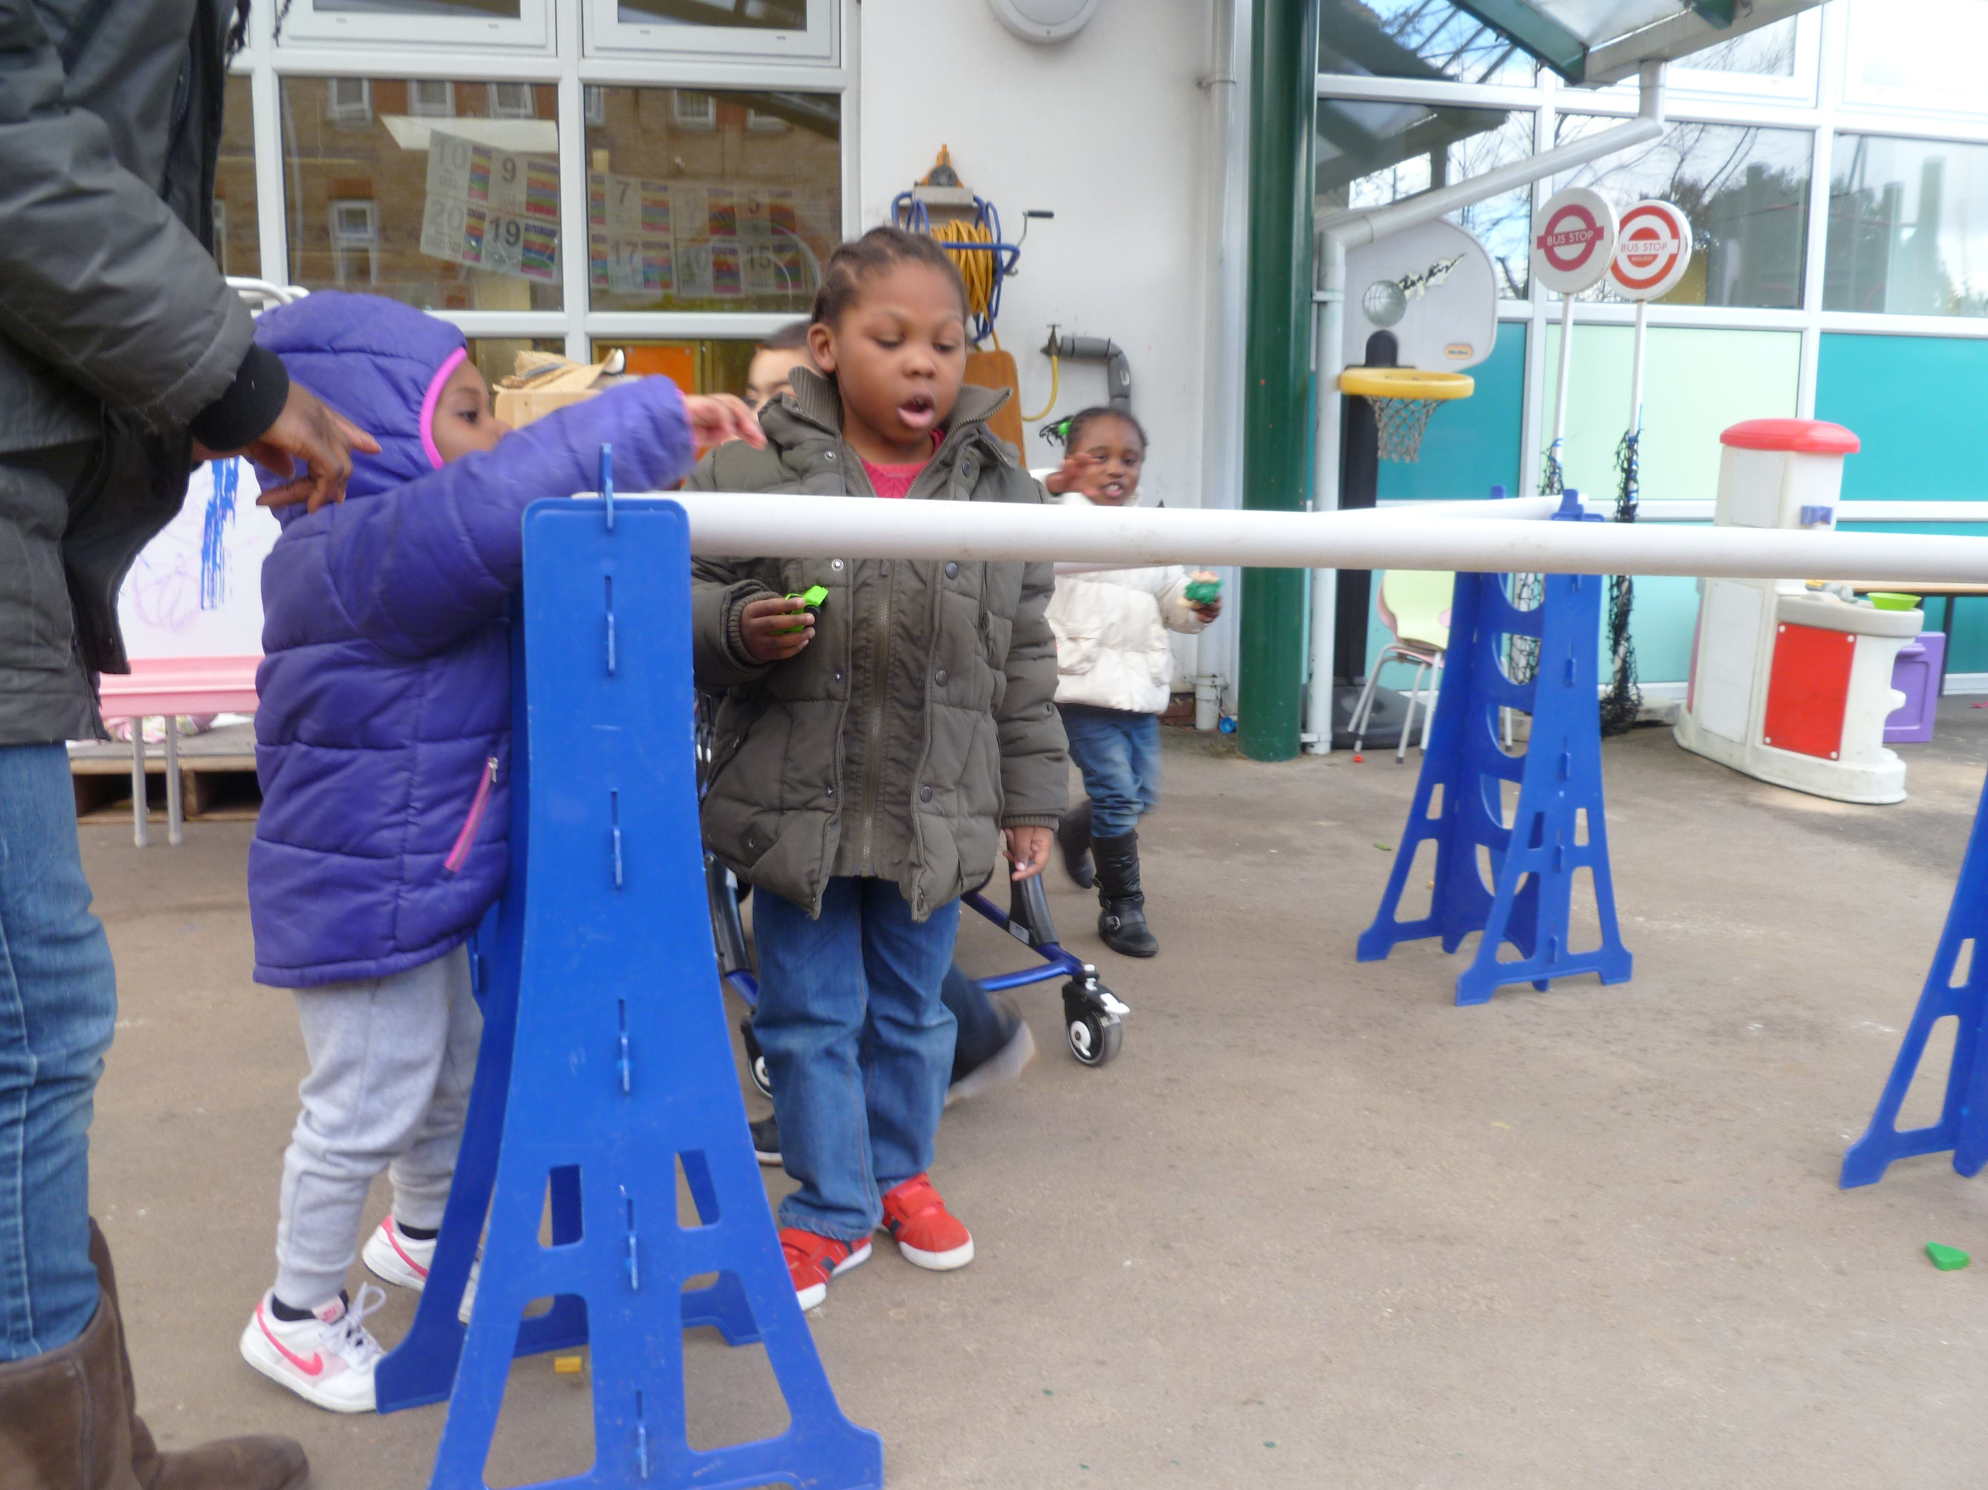
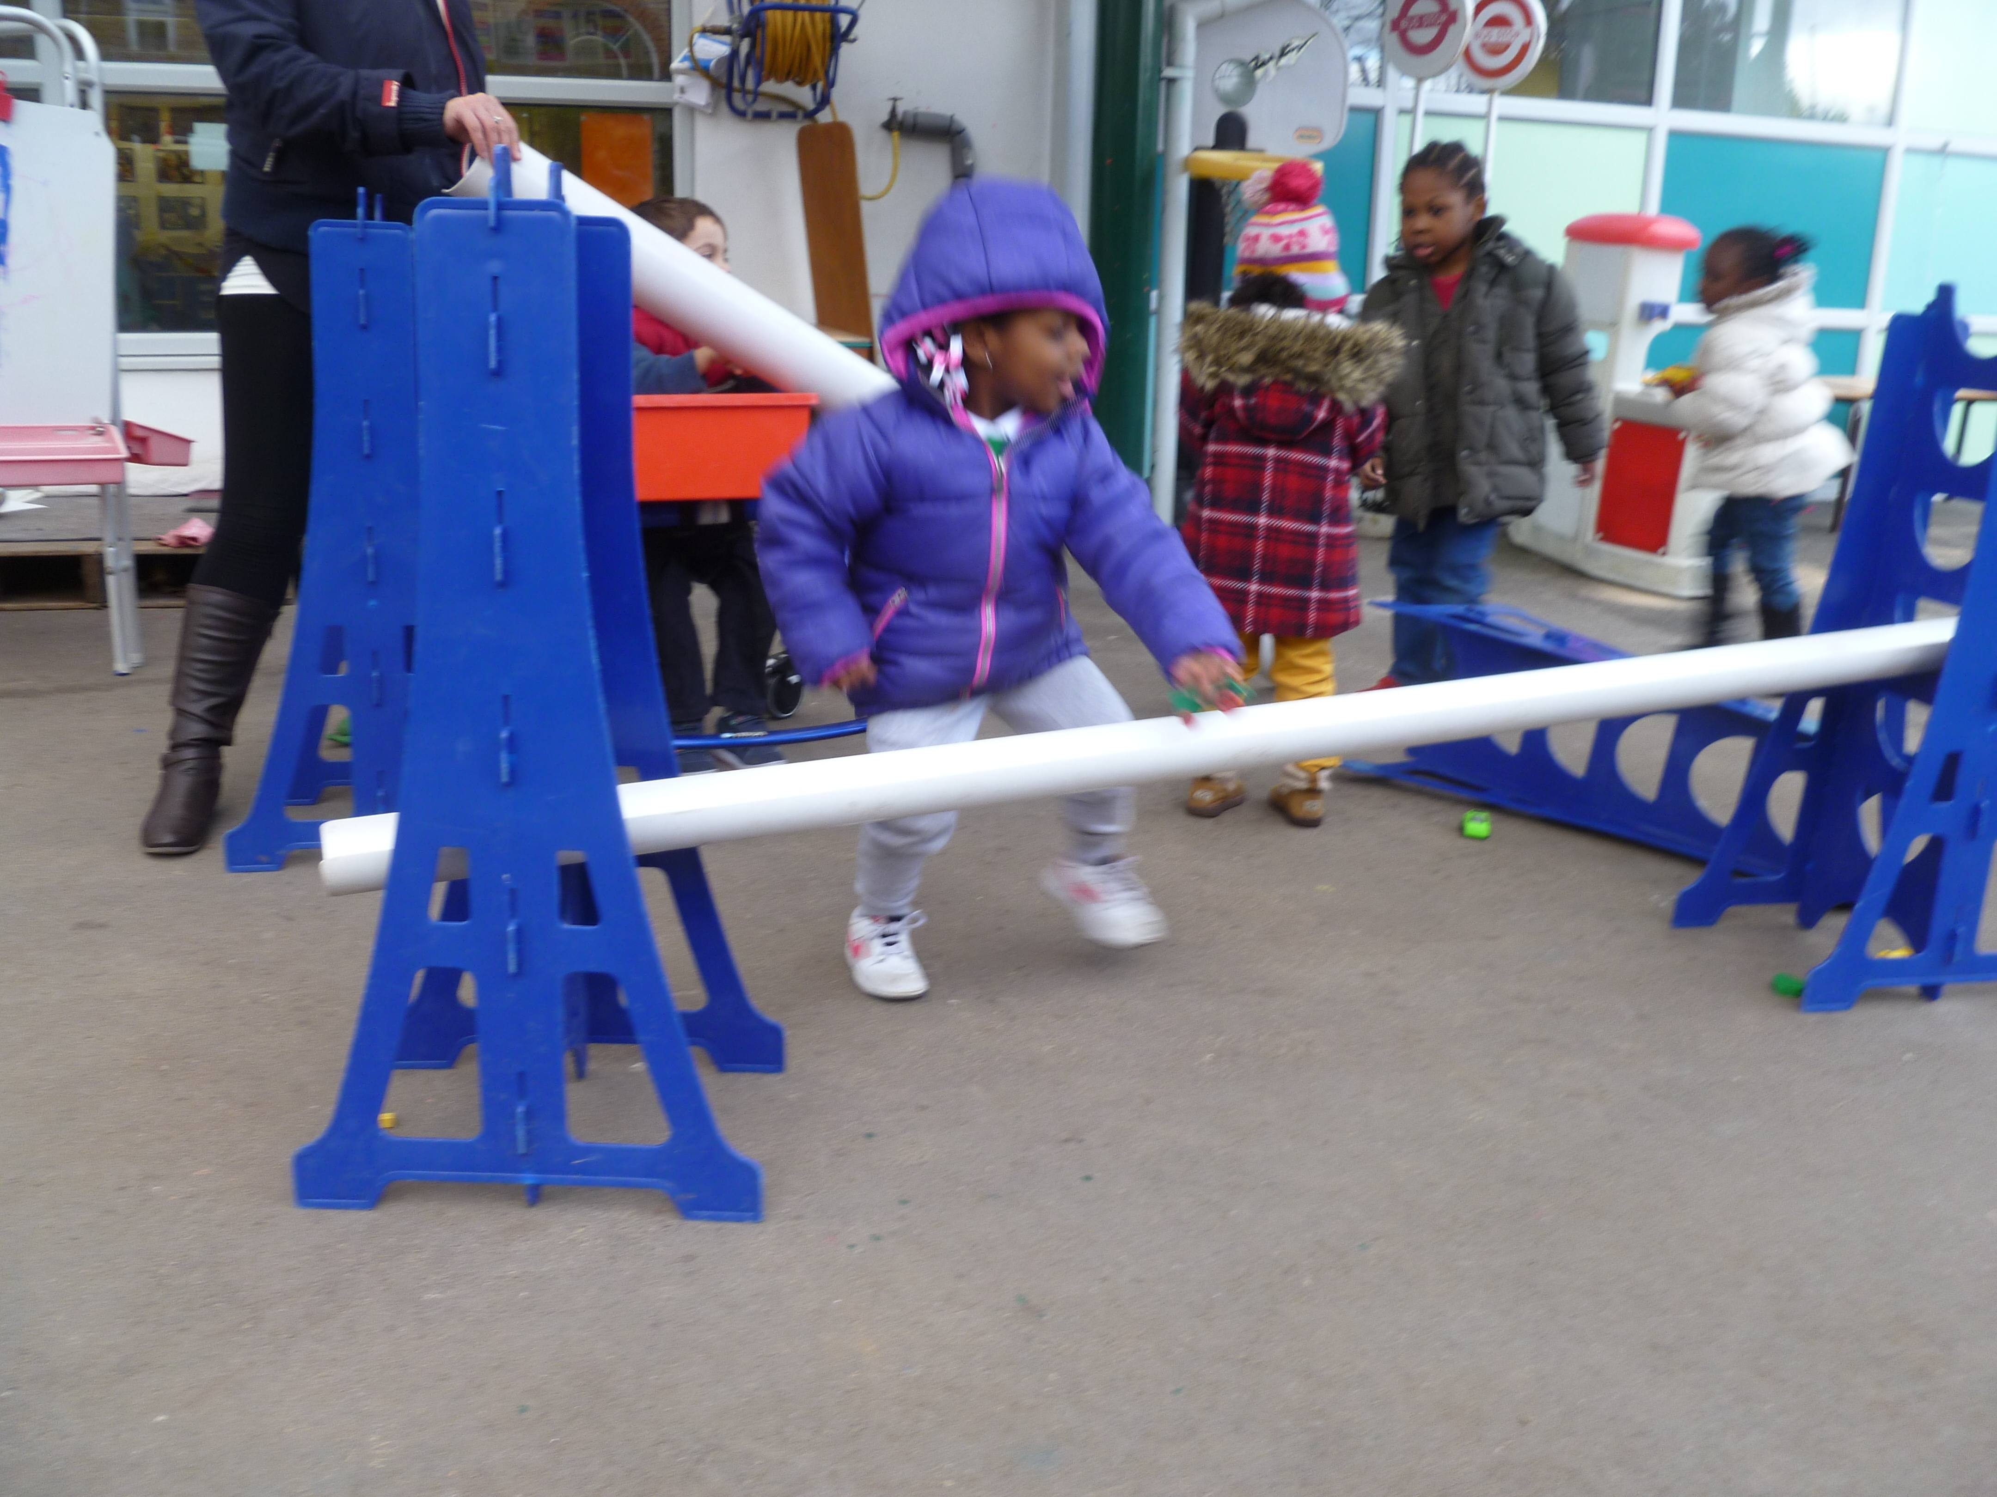
Inanna tries different slopes
Which one is going to come down first?
Inanna: This is very, very slow.
Deanna: How do you make it go fast?
Inanna: I tipped it up [demonstrating].
Deanna: That was fast!
Inanna: And when I push it [with a gesture to illustrate].
Inanna: I want mine to come first.
Deanna: What will you need to do?
Inanna: Push it.
Notes:
Approaches developed by the adult and children together taken on independently by the children in growing groups - making comparisons
Within this one child’s independent investigation – direction again indicated by photographs
Adult encouraging her to articulate ideas
Potential for creativity above.

Slide 21
How might such approaches foster creativity in learning?
Sense of initiative
Motivation
Ability to come up with something new
Ability to connect what they have learnt during lessons with topics in other subjects
Imagination
Curiosity
Ability to work together
Thinking skills
(Creative dispositions from the CLS Conceptual Framework)
Notes:
Can you offer any suggestions?
Take your recording sheet – annotate to indicate opportunities for fostering creativity in your example.
Brief feedback with whole group – opportunities within each episode – particular strengths/ aspects that need further encouragement
Display posters

Slide 22
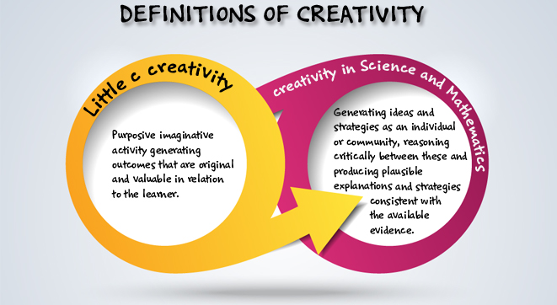
Creativity in early science and mathematics

Slide 23
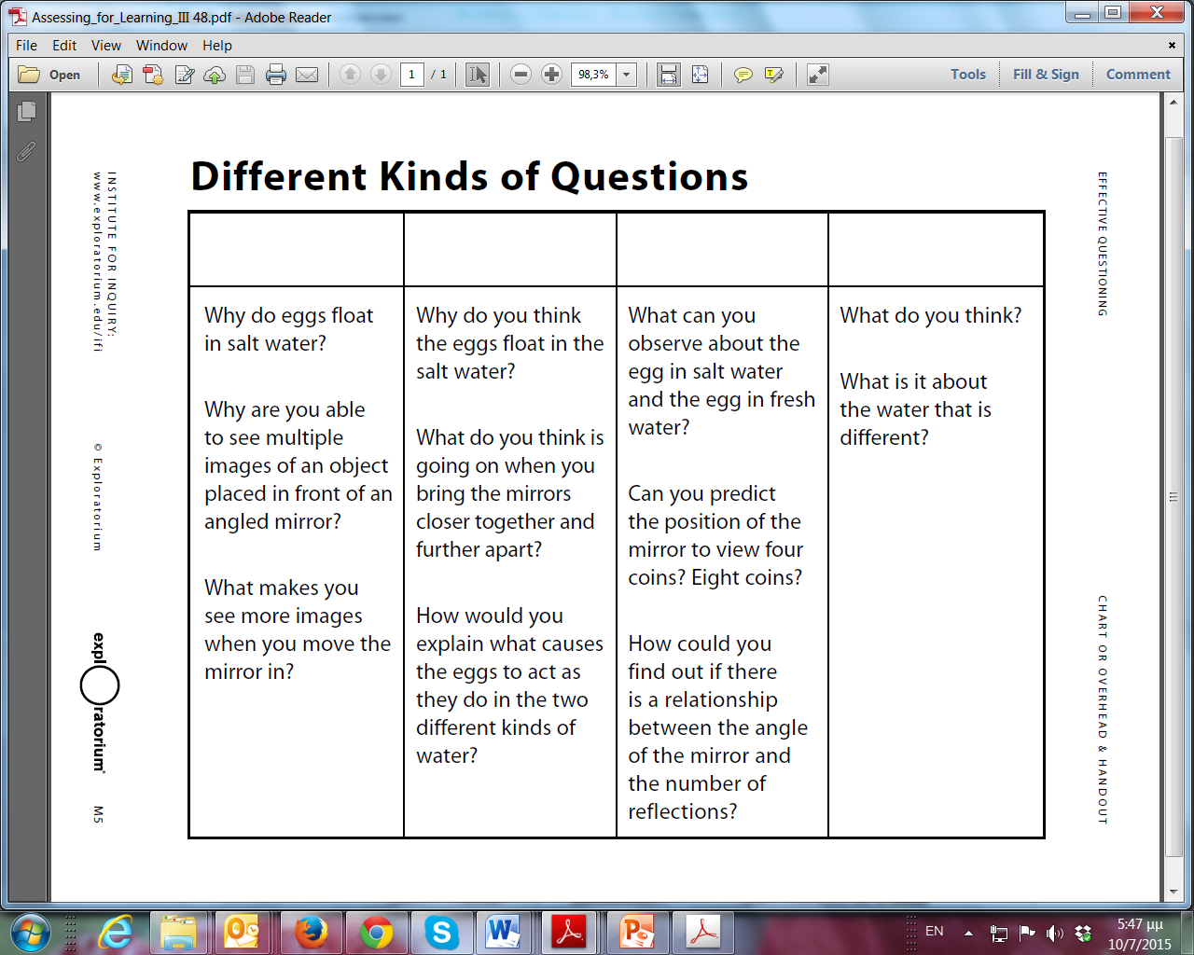
Teachers’ questions related to:
Floating eggs
Hinged mirrors
What do you think the questions in each column have in common?
Note: These materials were produced by the INSTITUTE FOR INQUIRY
www.exploratorium.edu/ifi
Assessing for learning III Effective questioning (M8)
Notes:
This material is drawn from the workshop Assessing for learning III Effective Questioning produced by the Institute of Inquiry www.exploratorium.edu/ifi to be used as appropriate.
1st column: > What do you think these questions have in common?
(They ask for a single right answer about a particular science subject or phenomenon.)
> What is being asked of the students here?
Once you’ve taken a few responses, explain:
> These kinds of questions ask for an answer about a particular science subject—in this case, angled mirrors or floating and sinking eggs. These are “Subject-Centered questions.” They ask for answers that can be right or wrong.
2nd column: > What do you think these questions have in common?
(They ask for students’ own ideas, and any response that describes their ideas is considered a “right” answer.)
> What is being asked of the students here?
Once you’ve taken a few responses, explain:
These kinds of questions ask for what students think about a particular science subject. They can be called “person-centered,” and have no “wrong” answers because they ask for students to explain what they think.
3rd column: > What do you think these questions have in common?
(They ask students to do something that requires them to use one of their process skills.)
What is being asked of the students? Are they being asked for an idea that explains why something they noticed is happening, or are they being asked something else?
Once you’ve taken a few responses, explain:
These kinds of questions don’t really ask for students’ ideas directly, but allow you to collect evidence of their skills and can be useful in helping students test their ideas.
4th column: “Other,” explaining that not all questions will fit neatly into the other three categories.
> Of all the kinds of questions teachers can ask, the Person-Centered ones are the most useful for finding out students’ ideas. They ask students to explain what they think, rather than asking for correct answers or asking students to use their process skills. Person-Centered questions invite students to voice their ideas in a way that does not put pressure on them to be “right.”

Slide 24
Sorting questions
Subject - specific | Person centred | Process skill oriented | Other

Slide 25
Analysis of teacher questioning
Eliciting thinking and fostering creativity and inquiry
What types of questions are asked by the practitioners (subject centered, process centred, person centred, other)?
What is the focus of teachers’ questions?
Do you note any change over time?
What insights are gained into children’s ideas, questions and strategies?
How might/does the teacher build on these?
Notes:
Episodes GR Ice Balloons, PT Sun Distance
Templates GE Building Blocks (113-115) and UK EN Beebot (309-314)

Slide 26
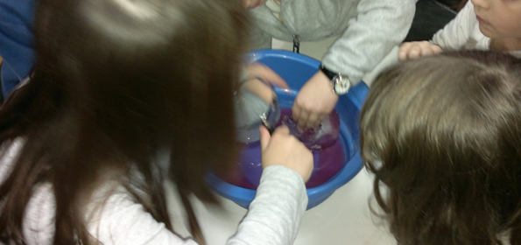
Ice Balloons: Children age 5-6
Exploring ice
Notes:
The episode was part of a series of lessons entitled “Winter”. It involved children in teams exploring the properties of ice using ice balloons and a variety of materials provided by the teacher (including syringes, paintbrushes, watercolours, dyes, bottle of vinegar and magnifying lenses) as well as other classroom materials selected by the children. The activity had been chosen by children on a previous day when they had brainstormed questions to explore.

Slide 27
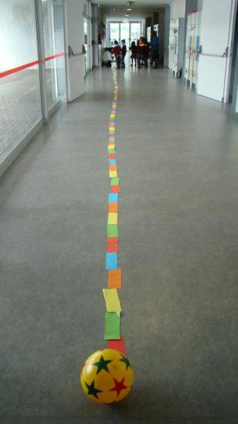
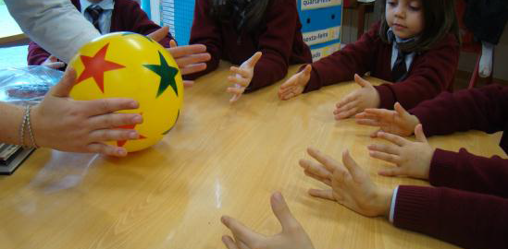
Sun distance: Children age 5
Notes:
First, in their classroom, they had a conversation with questions and hypotheses about the Sun’s size, the Earth’s size and the distance between them. Through dialogue between the teacher and the children, they gathered many facts about the Sun and its importance for life.
Then using a ball and a little piece of plasticine they began to explore the relative sizes and distances.

Slide 28
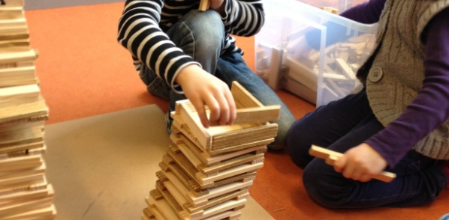
Building blocks: Children age 5
Building the Tower of Pisa
Notes:
Inspired by photographs of real buildings on the wall, the children decided to build the “Leaning Tower of Pisa” using wooden building blocks. The teacher stood back and let the children take the lead. She encouraged the children to express themselves clearly and she valued their ideas.

Slide 29
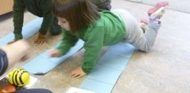
Beebot: Children age 3-4
Taking the Beebot to the Planets
Notes:
This session involved children working with programmable floor robots called Bee-Bots. They are used widely in nursery and primary schools for introducing control, directional language and programming to young children. They are attractive and simple to use with buttons to press to make the Bee-Bot go forwards and backwards and to turn left and right through 90 degrees.
The Bee-Bot has a memory that can store up to 40 steps.
Each child had a Bee-Bot. Dawn, the teacher, had prepared cardboard pathways for each Bee-Bot marked out with four steps, each to a different planet – for example Moon, Mars Venus, or Neptune. The session was planned to allow time for children to familiarise themselves with the functions of the different Bee-Bot buttons and then apply their knowledge to making their Bee-Bots go to their planet and back. Children were free to participate as they wished, provided space was available.

Slide 30
Create an Atmosphere for Sharing Ideas
Use sufficient “wait time” after asking a question.
Accept all ideas as equally worthy of consideration, whether scientifically correct or not.
Consider ideas collectively as “our” ideas; don’t identify them with individual students.
Set an example by being patient, sympathetic, encouraging, and fair.
Note: These materials were produced by the INSTITUTE FOR INQUIRY
www.exploratorium.edu/ifi
Assessing for learning III Effective questioning (M7)
Notes:
This material is drawn from the workshop Assessing for learning III Effective Questioning produced by the Institute of Inquiry www.exploratorium.edu/ifi to be used as appropriate.

Slide 31
Take-Home Messages
The way in which questions are expressed determines what happens as a result—whether they elicit a student’s understanding, lead to action and use of process skills, or are answered by recall of facts.
Questions that invite students to express their own ideas are open-ended and person centred.
Thoughtful questions require time for thoughtful answers.
Teacher reactions to student answers, and the general ethos of the classroom, can encourage students to openly express their ideas.
Note: These materials were produced by the INSTITUTE FOR INQUIRY
www.exploratorium.edu/ifi
Assessing for learning III Effective questioning (M8)
Notes:
This material is drawn from the workshop Assessing for learning III Effective Questioning produced by the Institute of Inquiry www.exploratorium.edu/ifi to be used as appropriate.

Slide 32
Implications
Planning questions you might ask
Take a recent science activity you have taught or observed, or one you are planning.
List the kinds of questions you might ask to
foster children’s inquiry and creativity
gain insights into children’s reasoning
Encourage children to reflect on their learning?

Slide 33
Reflections
Look back at your original post-its as a group – anything you might add? Add in any additional comments or issues in another colour (pen/post it).
In what ways did the different activities in this module help you to reflect on the role of questioning in your early years science classroom?
In what ways did they help you to reflect on ways of promoting creativity in early years science education?
How far have the aims of the module been met?

Slide 34
Further information
Creative Little Scientists
(FP7 EU project 2011 – 2014)
Design principles and exemplar materials based on fieldwork www.creative-little-scientists.eu
Creativity in Early Years Science Education
(Erasmus+ EU project 2014 – 2017)
Curriculum Materials and Training Materials for teacher CPD to promote creative approaches to early years science www.ceys‐project.eu

Slide 35

THANK YOU!

Slide 36

Acknowledgements
Creativity in Early Years Science EDUCATION (2014-2017) www.ceys-project.eu
© 2017 CREATIVITY IN EARLY YEARS SCIENCE EDUCATION Consortium
This work is licensed under the Creative Commons Attribution-NonCommercial-NoDerivatives 4.0 International License. To view a copy of this license, visit http://creativecommons.org/licenses/by-nc-nd/4.0/.

