Slide 1
Induction workshop Fostering creativity in early years science teaching Discovering the use of creative and inquiry-based approaches in early years science education

Slide 2
Welcome!
Foundation teacher: 
KS1 teacher: 
Science coordinator: 
Notes:
The (assistant) facilitator welcomes the participants. Their names are noted, the participants sign the attendance list, and they get a name sticker marked with a coloured dot:
Red: preschool teacher
Blue: early primary school teacher
Yellow: school staff member

Slide 3
Content of the Induction workshop
Welcoming and introduction to the CEYS project
Inquiry activity: open vs. guided structure
Meta-reflection
Didactical translation to classroom applications
Reflection on workshop approaches
Invitation to cooperate in the CEYS project

Slide 4
1. Introduction to the CEYS project
European Erasmus+ project
Greece, Romania, Belgium, UK
Aims: development of a teacher professional development course and accompanying materials
Promoting the use of creative approaches in teaching science in preschool and early primary education (up to age of eight)
Continuation of the Creative Little Scientists project

Slide 5
‘Creative Little Scientists’ definition of creativity in early years science and mathematics education

Slide 6
2. Inquiry activity: Winnie The Pooh in trouble
Winnie The Pooh is in the top of a tree, but suddenly his friend Tigger needs him. There is a large branch hanging down, that Winnie can use, but how can he come down safely, comfortably and as quickly as possible?
Can you make him something?

Slide 7
2. Inquiry activity: Winnie The Pooh in trouble
2 different approaches
20’: approach 1
Swap tables
20’: approach 2
→15’: presentation of the designs

Slide 8
2. Inquiry activity: Winnie The Pooh in trouble
Presentation of the designs
Variety of the designs?
What did you observe? Patterns?
Did you repeat tests? What happened then?
Other contributing or unanticipated factors?
How did you assess the process?
…

Slide 9
2. Inquiry activity: Winnie The Pooh in trouble
Scientific knowledge as background:
Friction
Steepness of the slope
Mass

Slide 10
3. Meta-reflection
10’
How did you feel during the activity?
In what way was your creativity stimulated (or not?)
What stimulated you to investigate?
Which ordering of approaches do you prefer and why (open→structured or structured→open)?
How did you assess the process? What can be the benefits of assessment?

Slide 11
3. Meta-reflection
8’
Main characteristics of the open-ended and structured inquiry activities?
Role of the teacher in the different approaches?

Slide 12
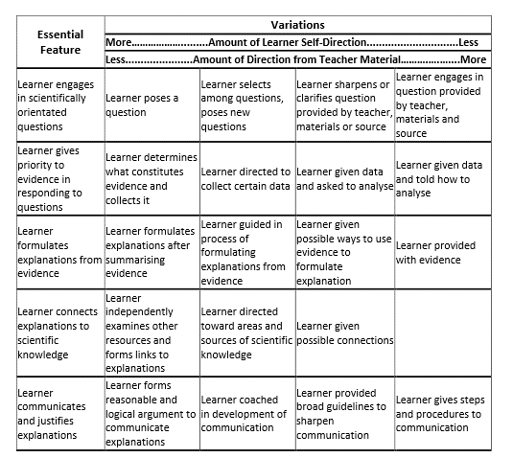
6’
Where would you place the two different apporaches?
Essential features of classroom inquiry and their variations (Barrow, L. H. 2010. Encouraging creativity with scientific inquiry. Creative Education,1(1),p3.

Slide 13
3. Meta-reflection
Plenary – 8’
Main characteristics of the open and structured approaches
Do the different types of inquiry have a different impact on the opportunities for developing creativity?

Slide 14
3. Meta-reflection
Synergies between inquiry based science education and creative approaches
Play and exploration
Motivation and affect
Dialogue and collaboration
Problem solving and agency
Questioning and curiosity
Reflection and reasoning
Teacher scaffolding and involvement
Assessment for learning

Slide 15
3. Meta-reflection
Nature of science?

Slide 16
4. Didactical translation to classroom applications
10’
Templates of creative little scientists: http://www.creative-little-scientists.eu/content/deliverables

Slide 17
4. Didactical translation to classroom applications
Approaches in the templates
Approaches in both inquiry activities
Notes:
Compare the approaches in the examples with the approaches in both inquiry activities

Slide 18
4. Didactical translation to classroom applications
Examples of science-related and other activities you have conducted in your classroom?
How can you foster creativity, agency and opportunities for children’s inquiry and decision making?

Slide 19
5. Reflection on workshop approaches
Did this process help you reflect on ways of promoting creativity in early years science education?
Fill-in form

Slide 20
6. Invitation to cooperate in the CEYS project
Interested?
Undertaking action research in your own classroom developing creativity in early years science
Commitment to the project 2015-2016 and its development activities
5 days of professional development
Testing and trialing the existing materials on creativity in early years science

Slide 21
6. Invitation to cooperate in the CEYS project
Opportunity to attend an EU-funded summer school (July 2016) and potentially in July 2015
Interested?
5 days professional development and support focused on creativity in early years science education
Opportunity to collaborate with the local CEYS project team and other lead teacher
Opportunity to participate in the development and validation of teacher education resources
Opportunity to partner with teachers from 25 international schools
Professional development and mentoring sessions from the CEYS team

